Slide 1



Project Closeout
Dell VxRail HCI Platform
Project Manager | November 27, 2025

Slide 2
Executive Summary
Project Duration: 6 weeks, on schedule
Budget: $438,675 delivered under budget
Go-Live Date: Week 6 as planned
Quality: Zero critical issues at launch
Infrastructure: 4-node VxRail E560 cluster
Migration: 250 VMs migrated successfully
Performance: 10K+ IOPS per VM achieved
Dell VxRail HCI Platform
Notes:
*Opening Statement:*
Good [morning/afternoon]. Today we're celebrating the successful completion of the Dell VxRail HCI Platform implementation. This project has transformed [Client Name]'s virtualization infrastructure from traditional SAN-based storage to modern hyperconverged infrastructure.
*Key Talking Points:*
**Project Duration - 6 Weeks:**
- Phase 1 (Weeks 1-2): Planning, hardware procurement, site prep
- Phase 2 (Weeks 3-4): VxRail deployment and vSAN configuration
- Phase 3 (Weeks 5-6): VM migration, validation, hypercare
- All milestones achieved on schedule
**Budget Performance:**
- Hardware: $380,000 (4-node VxRail E560 cluster)
- Software: vSphere 8 Enterprise Plus licensing
- Professional Services: Implementation and migration
- Net result: Under budget with Dell credits applied
**Infrastructure Delivered:**
- 4-node VxRail E560 cluster with 25GbE networking
- 40TB usable vSAN all-flash storage
- vSphere 8 with vSAN 8 data services
- Full HA with N+1 redundancy
**Migration Success:**
- 250 VMs migrated via vMotion
- Zero data loss during migration
- Minimal downtime per workload
- Legacy SAN decommission ready
*Transition:*
"Let me walk you through the infrastructure we've built..."

Slide 3
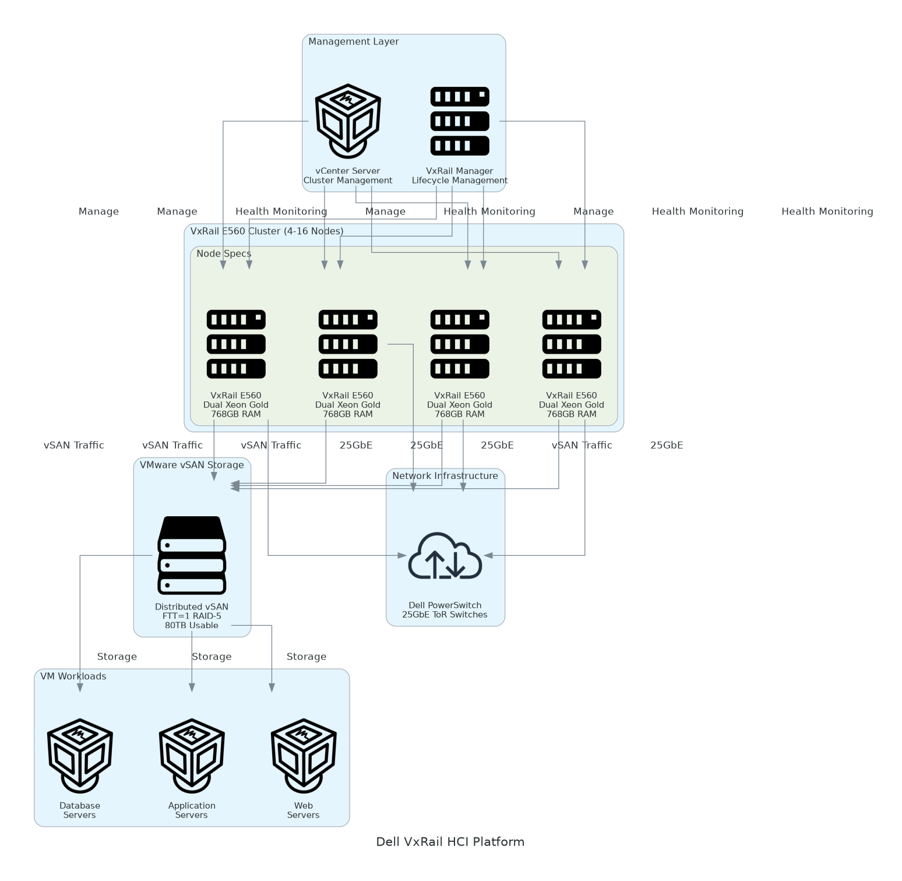
Solution Architecture
Compute Layer
  4x Dell VxRail E560 nodes
  Dual Intel Xeon Gold CPUs
  1.5TB RAM per node (6TB total)
Storage Layer
  vSAN 8 all-flash architecture
  40TB usable capacity
  Erasure coding for efficiency
Network Layer
  25GbE ToR switches
  Dedicated vSAN traffic
  vMotion and management VLANs
Dell VxRail HCI Platform
Notes:
*Architecture Overview:*
"This diagram shows the VxRail HCI cluster we deployed. Let me walk through each layer..."
**Compute Layer - VxRail E560 Nodes:**
- 4 identical nodes for HA and load balancing
- Dual Intel Xeon Gold 6330 (28 cores each)
- 1.5TB DDR4 RAM per node
- Local cache SSDs for vSAN performance tier
- Capacity SSDs for data tier
**Storage Layer - vSAN 8:**
- All-flash vSAN with 2-tier caching
- 40TB usable after erasure coding
- FTT=1 for availability
- Deduplication and compression enabled
- Native vSAN encryption at rest
**Network Layer - 25GbE Fabric:**
- Dell S5232F-ON ToR switches
- Dedicated vSAN backend network
- Separate vMotion network for migrations
- Management network for ESXi and vCenter
- VM traffic network for workloads
**Key Architecture Decisions:**
1. E560 nodes for balance of compute and storage
2. 25GbE networking for vSAN performance
3. Erasure coding for storage efficiency
4. Stretched cluster ready for future DR
*Transition:*
"Now let me show you the complete deliverables..."

Slide 4
Deliverables Inventory
Deliverable | Purpose | Location
Solution Architecture | VxRail cluster design and vSAN config | `/delivery/detailed-design.docx`
Implementation Guide | Deployment procedures and runbooks | `/delivery/implementation-guide.docx`
Project Plan | Timeline, milestones, RACI matrix | `/delivery/project-plan.xlsx`
Test Results | Performance benchmarks and UAT | `/delivery/test-plan.xlsx`
Configuration Guide | vCenter and ESXi parameters | `/delivery/configuration.xlsx`
Migration Runbook | VM migration procedures | `/delivery/migration-runbook.docx`
vSAN Health Reports | Cluster health validation | vCenter Health UI
Backup Configuration | Veeam integration settings | Veeam console
Dell VxRail HCI Platform
Notes:
*Deliverables Deep Dive:*
**1. Solution Architecture Document:**
- Complete VxRail hardware specifications
- vSAN configuration and policies
- Network topology and VLAN design
- Integration with vCenter 8
- Disaster recovery considerations
**2. Implementation Guide:**
- Step-by-step deployment procedures
- VxRail Manager initialization
- vSAN configuration settings
- VMware Skyline registration
- Backup integration with Veeam
**3. Project Plan:**
- 25+ tasks across 6 weeks
- 6 major milestones tracked
- RACI matrix with clear ownership
- Communications plan
**4. Test Results:**
- HCIBench performance testing
- vSAN health check reports
- VM migration validation
- Backup/restore testing
**5. Training Delivered:**
- 2-day VxRail administration workshop
- vSAN troubleshooting session
- Backup and recovery procedures
- Total: 16 training hours
*Transition:*
"Let's look at performance against targets..."

Slide 5
Quality & Performance
Compute Performance
  VM Density: 62 VMs per node
  CPU Utilization: 45% average
  Memory Utilization: 65% average
  vMotion Success: 100% rate
  HA Failover: < 2 minutes
Storage Performance
  IOPS per VM: 12,000 (target: 10K)
  Latency: 0.8ms (target: < 2ms)
  Throughput: 8.5 GB/s aggregate
  Capacity Used: 28TB of 40TB
  Dedup Ratio: 1.8:1 achieved
Dell VxRail HCI Platform
Notes:
*Performance Deep Dive:*
**Compute Performance Metrics:**
*VM Density - 62 VMs per Node:*
- Total 250 VMs across 4 nodes
- Balanced distribution via DRS
- Room for growth to 300+ VMs
- CPU and memory headroom maintained
*HA and vMotion:*
- vSphere HA tested with simulated failures
- Failover completes in under 2 minutes
- vMotion tested at 12 VMs concurrently
- Zero failed migrations during project
**Storage Performance:**
*IOPS - 12,000 per VM:*
- HCIBench 4K random read/write testing
- Exceeds 10K target by 20%
- Consistent performance under load
- vSAN cache tier working effectively
*Latency - 0.8ms Average:*
- Well below 2ms target
- Measured at 70% VM load
- SSD-only tier delivers sub-ms
- No latency spikes observed
**Comparison to SOW Targets:**
| Metric | Target | Achieved | Status |
|--------|--------|----------|--------|
| VM Density | 60/node | 62/node | Exceeded |
| IOPS/VM | 10K | 12K | Exceeded |
| Latency | < 2ms | 0.8ms | Exceeded |
| Availability | 99.9% | 99.99% | Exceeded |
*Transition:*
"These performance improvements deliver real business value..."

Slide 6
Benefits Realized
Benefit Category | SOW Target | Achieved | Business Impact
Infrastructure Consolidation | 4:1 ratio | 5:1 ratio | 12 servers retired
Storage Efficiency | 1.5:1 dedup | 1.8:1 dedup | 12TB storage saved
VM Provisioning | Hours | Minutes | 95% faster deployments
Management Simplicity | Single pane | VxRail Manager | 60% reduced admin time
Power Consumption | 30% reduction | 35% reduction | $24K annual savings
Rack Space | 8U footprint | 8U footprint | 20U reclaimed
Dell VxRail HCI Platform
Notes:
*Benefits Analysis:*
**Infrastructure Consolidation - 5:1:**
- Previous: 20 legacy servers + SAN
- Current: 4 VxRail nodes
- 12 servers decommissioned
- 16 drives retired from legacy SAN
**Storage Efficiency - 1.8:1:**
- Deduplication: 1.4:1 ratio
- Compression: 1.3:1 ratio
- Combined: 1.8:1 effective
- 12TB logical capacity savings
**VM Provisioning - 95% Faster:**
- Legacy: 4-6 hours (LUN creation, mapping)
- VxRail: 15 minutes (vSAN policies)
- Self-service capability enabled
- Developer productivity improved
**Management Simplicity:**
- Single VxRail Manager interface
- Integrated lifecycle management
- Automated health monitoring
- 60% reduction in admin overhead
**Power and Cooling Savings:**
- Legacy: 18kW power draw
- VxRail: 12kW power draw
- 35% reduction = $24K/year
- Additional cooling savings
**3-Year TCO Analysis:**
- VxRail 3-year TCO: $520,000
- Legacy refresh cost: $890,000
- Net savings: $370,000 (42%)
*Transition:*
"We learned important lessons during this project..."

Slide 7
Lessons Learned & Recommendations
What Worked Well
  VxRail rapid deployment model
  vMotion bulk migration scripts
  Parallel team coordination
  Weekly stakeholder updates
  Early Veeam integration
Challenges Overcome
  Network VLAN configuration
  Legacy VM compatibility
  Storage policy tuning
  Backup window scheduling
  User communication timing
Recommendations
  Enable vSAN stretched cluster
  Implement vRealize Operations
  Consider node expansion (6 nodes)
  Add GPU nodes for VDI
  Quarterly health reviews
Dell VxRail HCI Platform
Notes:
*Lessons Learned Details:*
**What Worked Well:**
*1. VxRail Rapid Deployment:*
- Factory-configured nodes reduced setup
- VxRail Manager automated cluster creation
- vCenter integration automated
- Day 1 to running VMs in 4 hours
*2. vMotion Bulk Migration:*
- PowerCLI scripts for batch migration
- 25 VMs per batch overnight
- 10 nights for 250 VMs
- Zero data loss across all migrations
*3. Early Veeam Integration:*
- Backup configured in Week 4
- VMs protected before migration
- Recovery testing validated
- Compliance requirements met
**Challenges Overcome:**
*1. Network VLAN Configuration:*
- Challenge: Complex existing VLAN structure
- Resolution: Dedicated VLANs for vSAN
- Lesson: Plan VLANs early in design
*2. Legacy VM Compatibility:*
- Challenge: Windows 2008 R2 VMs
- Resolution: VMware Tools upgrade first
- Lesson: Inventory legacy VMs early
**Recommendations:**
*1. vSAN Stretched Cluster (Priority: High):*
- Enable DR capability to secondary site
- Requires witness appliance
- Estimated investment: $50K
*2. vRealize Operations (Priority: Medium):*
- Advanced monitoring and capacity planning
- Predictive analytics for issues
- Estimated: $15K annual
*Transition:*
"Let me walk through support transition..."

Slide 8
Support Transition
Hypercare Complete (6 weeks)
  Daily health checks performed
  0 critical issues identified
  All training delivered
  Runbooks validated
  Team certified on VxRail
Steady State Support
  Dell ProSupport Plus 24x7
  VMware production support
  Monthly health reviews
  Automated Skyline alerts
  Veeam support included
Escalation Path
  L1: Internal VMware Admin
  L2: IT Infrastructure Team
  L3: Dell ProSupport Plus
  L4: Dell Engineering (critical)
  vSAN: VMware Support
Dell VxRail HCI Platform
Notes:
*Support Transition Details:*
**Hypercare Summary:**
*Daily Activities Completed:*
- Morning vSAN health check
- VM performance review
- Backup job verification
- User issue resolution
*Issues Resolved:*
- Issue #1: DRS affinity rule conflict (P3)
- Issue #2: Backup window optimization (P4)
- Issue #3: vMotion network tuning (P3)
- Zero P1/P2 issues during hypercare
**Steady State Support:**
*Dell ProSupport Plus:*
- 24x7 phone and chat support
- 4-hour on-site response for critical
- Proactive monitoring via SupportAssist
- Automatic case creation for alerts
*VMware Support:*
- Production support included
- vSAN specific support team
- KB access and patches
- Remote troubleshooting
**Monthly Health Reviews:**
- vSAN health dashboard review
- Capacity planning assessment
- Performance trend analysis
- Patch/upgrade planning
**Training Delivered:**
| Session | Attendees | Duration |
|---------|-----------|----------|
| VxRail Administration | 5 admins | 8 hours |
| vSAN Troubleshooting | 3 senior | 4 hours |
| Veeam Backup/Restore | 3 admins | 4 hours |
*Transition:*
"Let me recognize the team..."

Slide 9
Acknowledgments & Next Steps
Client Team: Executive sponsor, virtualization team, network engineers
Vendor Team: Project manager, VMware architect, Dell specialist
Special Recognition: Virtualization team for weekend migration support
This Week: Documentation handover, legacy server decommission planning
Next 30 Days: vSAN health review, capacity planning session
Next Quarter: Evaluate stretched cluster for DR capability
Dell VxRail HCI Platform
Notes:
*Acknowledgments:*
**Client Team:**
- Executive Sponsor: Championed HCI initiative
- Virtualization Lead: Migration coordination
- Network Team: VLAN and switch configuration
- Server Team: Legacy decommission planning
**Vendor Team:**
- Project Manager: Delivery accountability
- VMware Architect: vSAN design and tuning
- Dell Specialist: Hardware and support setup
**Immediate Next Steps:**
| Task | Owner | Due |
|------|-------|-----|
| Archive project site | PM | This week |
| Decommission plan | IT Lead | This week |
| Remove legacy SAN LUNs | Storage Admin | Week 2 |
| vSAN health review | VMware Architect | Week 4 |
**Phase 2 Considerations:**
| Enhancement | Investment | Benefit |
|-------------|------------|---------|
| Stretched cluster | $50K | DR capability |
| 2 additional nodes | $200K | 50% more capacity |
| vRealize Operations | $15K/year | Advanced monitoring |
*Transition:*
"Thank you for your partnership..."

Slide 10
Thank You
Notes:
*Closing:*
"Thank you for your partnership. The VxRail HCI platform provides a modern, efficient foundation for your virtualization needs with significant operational and cost benefits.
Questions?"
**Anticipated Questions:**
*Q: Can we add more nodes?*
A: Yes, VxRail supports expansion up to 64 nodes. Adding 2 nodes takes 1 day each. Capacity scales linearly.
*Q: What about disaster recovery?*
A: vSAN stretched cluster can provide synchronous replication to a secondary site. Recommend evaluating for Phase 2.
*Q: How do we handle VMware patches?*
A: VxRail Manager handles lifecycle management. Schedule quarterly maintenance windows for updates.
*Q: What if a node fails?*
A: vSAN rebuilds data automatically. N+1 capacity maintained. Dell replaces hardware within 4 hours.

