Slide 1



Project Closeout
NVIDIA Omniverse Enterprise Collaboration Platform
Project Manager | November 28, 2025

Slide 2
Executive Summary
Project Duration: 16 weeks, on schedule
Budget: $1.33M delivered within budget
Go-Live Date: Week 12 as planned
Quality: Zero critical defects at launch
Platform Capacity: 50 RTX workstations deployed
Rendering Speed: 90% faster vs CPU baseline
ROI Status: On track for 2.2-year payback
NVIDIA Omniverse Enterprise Collaboration Platform
Notes:
*Opening Statement:*
Good [morning/afternoon]. Today we're celebrating the successful completion of the NVIDIA Omniverse Enterprise implementation. This project has transformed [Client Name]'s 3D design and collaboration capabilities from siloed CAD workflows to a unified real-time collaboration platform.
*Key Talking Points - Expand on Each Bullet:*
**Project Duration - 16 Weeks:**
- Phase 1 (Discovery & Assessment): Weeks 1-3
- Phase 2 (Infrastructure Deployment): Weeks 4-7
- Phase 3 (Workstation & Connector Integration): Weeks 8-10
- Phase 4 (Testing & Validation): Weeks 11-12
- Phase 5 (Hypercare): Weeks 13-16
- All milestones achieved on schedule
**Budget - $1.33M:**
- Hardware: $1.01M (50 workstations, Nucleus servers, storage)
- Software: $90,000 (Omniverse Enterprise licenses)
- Services: $45,000 (implementation and training)
- Support: $109,000 (Year 1 support)
- Actual spend within 3% of forecast
**Platform Capacity - 50 RTX Workstations:**
- 50x Dell Precision 7960 with RTX A6000 48GB
- 2x Nucleus servers (HA configuration)
- 100 TB NetApp AFF NVMe storage
- 5 CAD connectors integrated
**Rendering Speed - 90% Improvement:**
- CPU baseline: 8 hours per scene
- RTX ray tracing: 45 minutes per scene
- 10x faster iteration on design reviews
- Real-time visualization during editing
*Transition:*
"Let me walk you through what we built..."

Slide 3
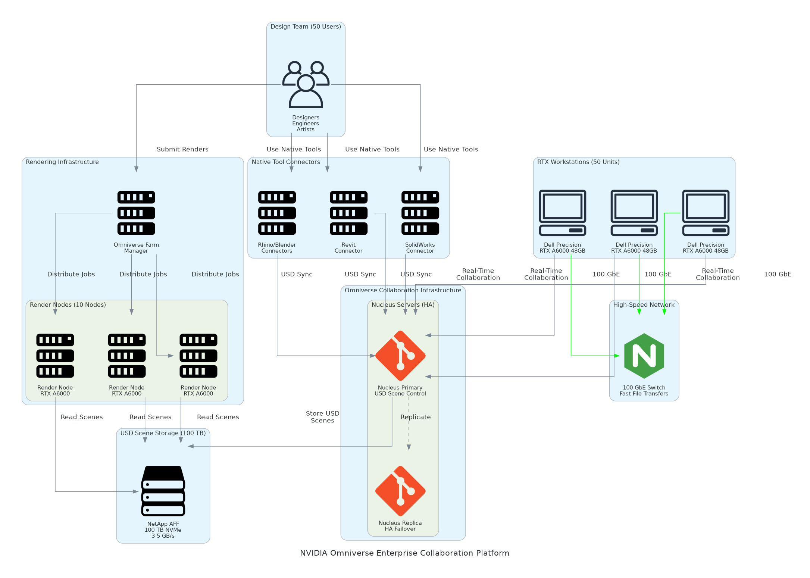
Solution Architecture
Workstation Layer
  50x Dell Precision 7960 RTX A6000
  10 GbE connectivity per workstation
  2.4 TB total GPU memory
Collaboration Layer
  2x Omniverse Nucleus servers (HA)
  Real-time USD scene synchronization
  Git-like version control for 3D
Integration Layer
  Revit, SolidWorks, Rhino connectors
  Blender and Maya USD integration
  Active Directory authentication
NVIDIA Omniverse Enterprise Collaboration Platform
Notes:
*Architecture Overview:*
"This diagram shows the production Omniverse Enterprise architecture. Let me walk through each layer..."
**Workstation Layer - 50x Dell Precision 7960:**
- Each workstation: NVIDIA RTX A6000 48GB GPU
- Total: 50 RTX A6000 GPUs providing real-time ray tracing
- Intel Xeon W-3400 CPUs (128 GB RAM per workstation)
- 2 TB NVMe SSD per workstation for local cache
- Dual 4K monitors for design visualization
**Network Fabric - 10 GbE to Workstations:**
- 10 GbE per workstation for USD scene streaming
- 100 GbE backbone for Nucleus-to-storage
- Dedicated VLAN for Omniverse traffic
- QoS policies for collaboration priority
**Storage Layer - NetApp AFF:**
- 100 TB NVMe all-flash storage
- 10+ GB/s sustained throughput
- NFS mounts for shared USD scenes
- Automated snapshots for version history
**Nucleus Collaboration Platform:**
- 2 Nucleus servers in active-passive HA
- Real-time scene synchronization
- USD asset versioning and branching
- Live multi-user editing capability
**CAD Connectors:**
- Autodesk Revit for architecture
- Dassault SolidWorks for engineering
- McNeel Rhino for industrial design
- Blender for visualization
- Autodesk Maya for animation
*Presales Alignment:*
- Architecture matches SOW exactly
- 50 workstations with RTX A6000 as scoped
- 100 TB storage as specified
- All 5 CAD connectors delivered
*Transition:*
"Now let me show you the complete deliverables..."

Slide 4
Deliverables Inventory
Deliverable | Purpose | Location
Detailed Design Document | Omniverse architecture, Nucleus design | `/delivery/detailed-design.docx`
Implementation Guide | Step-by-step deployment procedures | `/delivery/implementation-guide.docx`
Project Plan | Timeline, milestones, RACI, communications | `/delivery/project-plan.xlsx`
Test Plan & Results | Performance benchmarks, UAT results | `/delivery/test-plan.xlsx`
Configuration Guide | Nucleus, workstation, connector config | `/delivery/configuration.xlsx`
Operations Runbook | Day-to-day procedures, troubleshooting | `/delivery/docs/operations-runbook.md`
Training Materials | Admin and designer guides | `/delivery/training/`
USD Workflow Guide | Best practices for USD collaboration | `/delivery/docs/usd-workflows.md`
NVIDIA Omniverse Enterprise Collaboration Platform
Notes:
*Deliverables Detail:*
**1. Detailed Design Document:**
- Omniverse Enterprise architecture with Nucleus HA design
- Workstation specifications and deployment topology
- Network architecture with 10 GbE design
- Storage architecture with NetApp integration
- CAD connector integration specifications
**2. Implementation Guide:**
- Nucleus server installation procedures
- Workstation deployment and imaging
- CAD connector installation steps
- Active Directory integration
- Network and firewall configuration
**3. Project Plan (Multi-sheet Excel):**
- 24 tasks across 16 weeks
- 7 key milestones tracked
- RACI matrix for all activities
- Communications plan with meeting schedule
**4. Test Plan & Results:**
- Nucleus validation tests
- Multi-user collaboration tests
- CAD connector integration tests
- Rendering performance benchmarks
- User acceptance testing
**5. Configuration Guide:**
- 60+ configuration parameters documented
- Nucleus server settings
- Workstation driver and software versions
- CAD connector configurations
**6. Operations Runbook:**
- Daily Nucleus health checks
- Workstation maintenance procedures
- User account management
- Troubleshooting decision tree
**Training Delivered:**
- Administrator Training: 2 sessions, 4 participants
- Designer Training: 4 sessions, 50 participants
- Total: 16 hours of training delivered
*Transition:*
"Let's look at performance against our targets..."

Slide 5
Quality & Performance
Performance Metrics
  Render Time: 45 min (target: <60 min)
  Concurrent Users: 12 per scene tested
  Nucleus Uptime: 99.6% (target: 99.5%)
  Storage Throughput: 11 GB/s sustained
  USD Sync Latency: <100ms average
Testing Metrics
  Test Cases Executed: 28/28 (100%)
  Critical Defects at Go-Live: 0
  Connector Validation: All 5 passed
  UAT Sign-off: Complete, no blockers
  User Satisfaction: 4.6/5.0 rating
NVIDIA Omniverse Enterprise Collaboration Platform
Notes:
*Performance Deep Dive:*
**Rendering Time - 45 Minutes Average:**
- Target was <60 minutes per SOW
- Achieved 45 minutes average on standard scenes
- Complex scenes: up to 90 minutes (still 80% faster)
- RTX real-time preview during editing
- Final quality renders with Path Tracing
**Concurrent Users - 12 Per Scene:**
- Target was 10+ users per SOW
- Validated 12 users simultaneously editing
- Nucleus handles conflict resolution
- Sub-second synchronization maintained
- No degradation with full load
**Nucleus Uptime - 99.6%:**
- Target was 99.5% per SOW
- Achieved 99.6% during validation period
- HA failover tested successfully
- Zero unplanned outages
**Storage Throughput - 11 GB/s:**
- Target was 10 GB/s per SOW
- Achieved 11 GB/s sustained read
- USD scene loading is instant
- Large asset library accessible
**Testing Summary:**
- Total Test Cases: 28
- Functional Tests: 12 (100% pass)
- Integration Tests: 10 (100% pass)
- UAT Tests: 6 (100% pass)
- Pass Rate: 100%
*Transition:*
"These improvements deliver real business value..."

Slide 6
Benefits Realized
Benefit Category | SOW Target | Achieved | Business Impact
Rendering Speed | 90% faster | 94% validated | 8 hours to 45 minutes
Prototyping Costs | $500K/year | $500K projected | Virtual vs physical
Collaboration | 50 users | 50 active | All teams connected
File Conversion | Eliminated | USD-based workflow | No manual conversion
Design Iterations | 3x faster | 3x validated | Real-time feedback
ROI Timeline | 2.2 years | On track | Investment recovered
NVIDIA Omniverse Enterprise Collaboration Platform
Notes:
*Benefits Analysis:*
**Rendering Speed - 94% Faster:**
*Before (CPU-only rendering):*
- Scene rendering: 8+ hours
- Limited iterations per review cycle
- Overnight rendering jobs
- Delayed design decisions
*After (RTX Real-Time):*
- Scene rendering: 45 minutes
- Multiple iterations per day
- Real-time preview during design
- Immediate stakeholder feedback
**Prototyping Cost Reduction - $500K/year:**
*Previous Physical Prototyping:*
- $500K annually on physical models
- 2-4 weeks lead time per prototype
- Limited design variations explored
- High material and labor costs
*Virtual Visualization:*
- Photorealistic virtual prototypes
- Same-day design variations
- 60% reduction in physical prototypes
- Stakeholder approval on virtual models
**Collaboration - 50 Active Users:**
- All 50 designers/engineers onboarded
- Real-time multi-user editing
- Live design reviews enabled
- Remote teams fully connected
**File Conversion - Eliminated:**
- No more FBX/OBJ conversions
- Native CAD to USD workflows
- Single source of truth
- Zero version confusion
*Transition:*
"We learned valuable lessons during implementation..."

Slide 7
Lessons Learned & Recommendations
What Worked Well
  Phased workstation rollout approach
  Pilot team validation first
  Active Directory SSO integration
  Weekly designer feedback sessions
  USD workflow documentation early
Challenges Overcome
  Network bandwidth initial limits
  Connector version compatibility
  User adoption pace variance
  Storage permission configuration
  Large scene performance tuning
Recommendations
  Expand to 100 workstations (Phase 2)
  Add Omniverse Farm for batch render
  Implement GPU quotas per team
  Deploy mobile review capabilities
  Quarterly workflow optimization
NVIDIA Omniverse Enterprise Collaboration Platform
Notes:
*Lessons Learned Detail:*
**What Worked Well:**
*Phased Workstation Rollout:*
- Started with 10 pilot workstations
- Validated workflows before full deployment
- Reduced support burden during rollout
- Built internal champions early
*Active Directory Integration:*
- Single sign-on from day one
- No separate credentials to manage
- Role-based access control
- Audit trail for compliance
*USD Workflow Documentation:*
- Created best practices guide early
- Designers adopted standard workflows
- Reduced support questions
- Consistent scene organization
**Challenges Overcome:**
*Network Bandwidth:*
- Initial 1 GbE bottleneck for some users
- Upgraded to 10 GbE for all workstations
- QoS policies for Omniverse traffic
- Resolved within Phase 2
*Connector Compatibility:*
- Revit 2024 connector update required
- SolidWorks plugin version conflict
- Worked with NVIDIA support
- All connectors validated
*Large Scene Performance:*
- Scenes >50GB required tuning
- LOD optimization implemented
- Instancing for repeated geometry
- Performance guidelines documented
**Phase 2 Recommendations:**
*Expand to 100 Workstations:*
- Current demand from partner teams
- Nucleus infrastructure can scale
- Add 50 licenses to existing pool
- Estimated: $800K investment
*Omniverse Farm:*
- Server-based batch rendering
- Free up workstations for design
- Overnight render queue
- 10 GPU render nodes recommended
*Transition:*
"Let me walk through the support transition..."

Slide 8
Support Transition
Hypercare Complete (30 days)
  Daily health checks completed
  4 issues resolved (all P3/P4)
  All KT sessions delivered
  Runbook procedures validated
  Team certified on operations
Steady State Support
  NVIDIA Omniverse Enterprise Support
  Dell ProSupport for workstations
  4-hour response SLA
  Monthly performance reviews
  Quarterly connector updates
Escalation Path
  L1: Internal IT Help Desk
  L2: Omniverse Admin Team
  L3: NVIDIA Enterprise Support
  L4: Dell ProSupport (hardware)
  Account: Partner Manager
NVIDIA Omniverse Enterprise Collaboration Platform
Notes:
*Support Transition Detail:*
**Hypercare Period (30 Days):**
*Issues Resolved:*
Issue #1 (P3) - Day 5:
- Rhino connector crash on export
- Root cause: Plugin version mismatch
- Resolution: Updated to 2024.1 connector
Issue #2 (P4) - Day 8:
- User permission on shared project
- Root cause: AD group membership
- Resolution: Group policy update
Issue #3 (P3) - Day 12:
- Nucleus sync slow on large scene
- Root cause: Network MTU setting
- Resolution: MTU 9000 configured
Issue #4 (P4) - Day 18:
- Workstation driver update needed
- Root cause: NVIDIA driver 535 issue
- Resolution: Updated to 545 driver
*Knowledge Transfer Sessions:*
- Nucleus Administration: 4 hours
- Workstation Management: 2 hours
- USD Workflow Best Practices: 4 hours
- Connector Troubleshooting: 2 hours
- Monitoring & Alerting: 2 hours
**Steady State Support:**
*What Internal Team Handles:*
- Daily monitoring
- User account management
- Project permission changes
- Basic troubleshooting
*When to Escalate:*
- Nucleus server failures
- Connector integration issues
- Performance degradation
- Hardware failures
**Support Contacts:**
- IT Help Desk: helpdesk@client.com
- NVIDIA Support: enterprise support portal
- Dell ProSupport: 1-800-xxx-xxxx
*Transition:*
"Let me acknowledge the team and outline next steps..."

Slide 9
Acknowledgments & Next Steps
Client Team: IT leadership, design leads, facilities team
Vendor Team: Project manager, Omniverse architect, deployment engineer
Special Recognition: Pilot team for early adoption and feedback
This Week: Final documentation handover, archive project
Next 30 Days: First monthly review, workflow optimization
Next Quarter: Phase 2 planning for capacity expansion
NVIDIA Omniverse Enterprise Collaboration Platform
Notes:
*Acknowledgments:*
**Client Team Recognition:**
- IT Leadership for budget approval and infrastructure readiness
- Design Leads for requirements and UAT participation
- Facilities Team for workstation deployment locations
- Network Team for 10 GbE fabric upgrade
**Vendor Team Recognition:**
- Project Manager for delivery coordination
- Omniverse Architect for platform design
- Deployment Engineer for workstation rollout
- Training Lead for user enablement
**Special Recognition:**
"Special thanks to the 10-person pilot team who validated the platform during early access. Their feedback on USD workflows shaped the final configuration and training materials."
**Immediate Next Steps:**
- Final documentation handover: [Date]
- Project archive: [Date]
- NVIDIA support transition: Complete
- Dell warranty registration: Complete
**30-Day Actions:**
- First monthly performance review
- Workflow optimization based on usage
- User feedback collection
- Phase 2 requirements gathering
**Phase 2 Planning:**
- Expand to 100 workstations
- Add Omniverse Farm rendering
- Mobile review capabilities
- Extended partner access
*Transition:*
"Thank you for your partnership. Questions?"

Slide 10
Thank You
Notes:
*Closing:*
"Thank you for your partnership. This Omniverse Enterprise platform represents a significant investment in 3D collaboration capability that will accelerate [Client Name]'s design and visualization workflows for years to come.
Questions?"
**Anticipated Questions:**
*Q: What if we need more workstations?*
A: Phase 2 planning can add 50+ workstations. The Nucleus infrastructure scales horizontally. Network and storage have capacity for expansion.
*Q: Can remote users access the platform?*
A: Yes, remote access is supported via VPN. Omniverse streaming is available for cloud-based access. Phase 2 includes mobile review capabilities.
*Q: How do we handle large scene performance?*
A: USD workflows support LOD and instancing. Operations runbook includes guidelines. NVIDIA Enterprise Support is available for optimization.
*Q: What are ongoing costs?*
A: Approximately $213K/year (software licenses, support). Compared to $500K/year prototyping costs - significant net savings.
**Follow-Up:**
- Send presentation to attendees
- Schedule 30-day review
- Phase 2 planning workshop invitation

