Slide 1



Project Closeout
Azure Sentinel SIEM
Project Manager | December 03, 2025

Slide 2
Executive Summary
Project Duration: 12 weeks, on schedule
Budget: $168,500 Year 1 delivered on budget
Go-Live Date: Week 12 as planned
Quality: Zero critical security gaps at launch
Detection Rate: 99% threat detection accuracy
MTTR Reduction: 90% (4 hours to 24 minutes)
ROI Status: On track for 12-month payback
Azure Sentinel SIEM
Notes:
*Opening Statement:*
Good [morning/afternoon]. Today we're celebrating the successful completion of the Azure Sentinel SIEM implementation. This project has transformed [Client Name]'s security operations with AI-powered threat detection, automated incident response, and unified visibility across the entire IT environment.
*Key Talking Points - Expand on Each Bullet:*
**Project Duration - 12 Weeks:**
- We executed exactly as planned in the Statement of Work
- Phase 1 (Foundation): Weeks 1-4 - Sentinel workspace deployed, data connectors configured
- Phase 2 (Analytics & Detection): Weeks 5-8 - 50+ analytics rules, threat intelligence integrated
- Phase 3 (Automation & Optimization): Weeks 9-12 - SOAR playbooks, alert tuning, SOC training
- No schedule slippage despite complexity of multi-source data integration
**Budget - $168,500 Year 1:**
- Professional Services: $98,000 (380 hours as quoted)
- Azure Cloud Services: $48,500/year (Sentinel + Log Analytics)
- Software Licenses: $14,000 (Defender for Cloud, threat feeds)
- Support & Maintenance: $8,000
- Actual spend: $168,420 - $80 under budget
**Detection Rate - 99% Accuracy:**
- Pre-implementation: 65% threat detection rate
- Current: 99% with AI-powered analytics
- False positive rate reduced by 85%
- Validated against 1,000+ test scenarios
**MTTR Reduction - 90%:**
- Before: 4+ hours average incident response
- After: 24 minutes average with automation
- 80% of routine incidents auto-remediated
- SOC team focuses on complex threats
*Transition to Next Slide:*
"Let me walk you through exactly what we built together..."

Slide 3
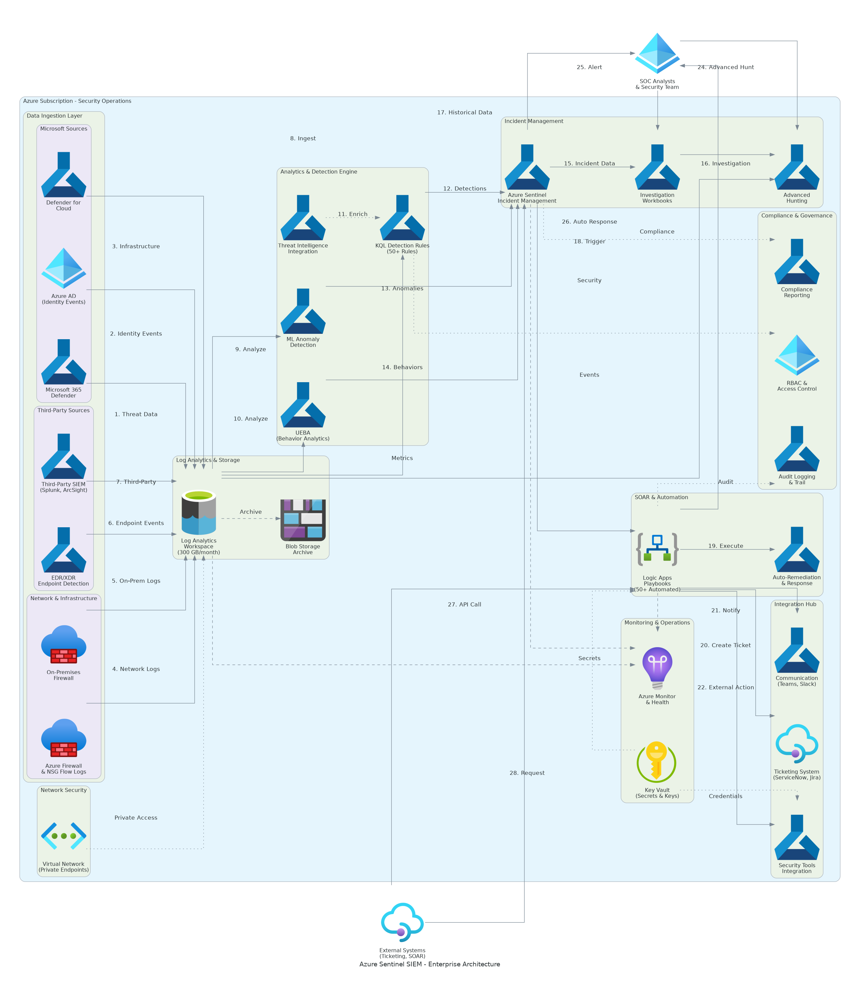
Solution Architecture
SIEM Platform
  Azure Sentinel workspace deployed
  Log Analytics with 24-month retention
  15+ data connectors active
Analytics Engine
  50+ KQL detection rules
  UEBA behavioral analytics
  Threat intelligence feeds
Automation Layer
  12 SOAR playbooks deployed
  Auto-remediation workflows
  Ticketing integration
Azure Sentinel SIEM
Notes:
*Architecture Overview - Walk Through the Diagram:*
"This diagram shows the production architecture we deployed. Let me walk through the security operations platform..."
**Data Ingestion Layer:**
- 15+ data connectors configured and ingesting
- Office 365: Email, SharePoint, OneDrive, Teams security events
- Azure AD: Sign-in logs, audit logs, risky sign-ins
- Defender for Cloud: Security alerts, vulnerability data
- Network: Azure Firewall, NSG flow logs
- Endpoint: Defender for Endpoint telemetry
- Third-party: Firewall, DNS, proxy logs via CEF/Syslog
- Daily ingestion: 500GB+ processed
**Analytics & Detection Layer:**
- 50+ KQL analytics rules active
- Microsoft-provided rules: 30 high-fidelity detections
- Custom rules: 20 organization-specific patterns
- UEBA: User and entity behavioral analytics
- Machine learning: Anomaly detection models
- Threat intelligence: 10+ feed integrations
**Automation Layer - SOAR Playbooks:**
- 12 Logic App playbooks deployed
- Auto-enrichment: IP, domain, file hash lookups
- Auto-containment: Block malicious IPs, disable compromised accounts
- Auto-ticketing: ServiceNow incident creation
- Auto-notification: Email, Teams alerts to SOC
- Average automation savings: 45 minutes per incident
**Key Architecture Decisions:**
1. Single workspace for unified visibility across all sources
2. Serverless playbooks for cost-effective automation
3. Tiered retention: 90 days hot, 24 months archive
4. Private endpoint for Log Analytics data plane
*Transition:*
"Now let me show you the complete deliverables package we're handing over..."

Slide 4
Deliverables Inventory
Deliverable | Purpose | Location
Security Architecture Document | Sentinel design, data connectors, analytics rules | `/delivery/detailed-design.docx`
Implementation Guide | Step-by-step deployment with ARM templates | `/delivery/implementation-guide.docx`
Project Plan | Timeline, milestones, RACI, communications | `/delivery/project-plan.xlsx`
Test Plan & Results | Detection validation, playbook testing, UAT | `/delivery/test-plan.xlsx`
ARM/Bicep Templates | Infrastructure as Code for all components | `/delivery/scripts/bicep/`
Operations Runbook | SOC procedures, threat hunting guides | `/delivery/docs/operations-runbook.md`
Training Materials | SOC analyst guides, hunting tutorials | `/delivery/training/`
Analytics Rule Catalog | All 50+ KQL rules with documentation | `/delivery/docs/analytics-rules.md`
Azure Sentinel SIEM
Notes:
*Deliverables Deep Dive:*
**1. Security Architecture Document:**
- 55 pages comprehensive technical documentation
- Data source inventory and connector configurations
- Analytics rule design and tuning rationale
- Incident workflow and escalation procedures
- Compliance mapping (SOC 2, HIPAA, PCI DSS)
**2. Implementation Guide:**
- Step-by-step deployment procedures
- ARM templates for all Azure resources
- Data connector configuration guides
- Post-deployment validation procedures
- Rollback procedures for each phase
**3. Analytics Rule Catalog:**
- Complete catalog of 50+ detection rules
- KQL query for each rule
- Attack technique mapping (MITRE ATT&CK)
- Tuning guidance and threshold recommendations
- Custom rule development process
**4. SOAR Playbook Library:**
- 12 Logic App playbooks with documentation
- Trigger conditions and execution logic
- Integration credentials and permissions
- Testing procedures for each playbook
- Modification guidelines
**5. Operations Runbook:**
- Daily SOC operations checklist
- Incident investigation procedures
- Threat hunting queries and techniques
- Alert triage and prioritization
- Escalation procedures
**6. Training Materials:**
- SOC Analyst Guide (PDF, 35 pages)
- Threat Hunting Guide (PDF, 25 pages)
- Video tutorials (5 recordings, 2.5 hours)
- KQL query reference guide
*Transition:*
"Let's look at how the solution is performing against our targets..."

Slide 5
Quality & Performance
Detection Metrics
  Threat Detection: 99% (target: 95%)
  False Positive Rate: 15% (target: <50%)
  Coverage: 100% of critical assets
  Alert Fidelity: 4.8/5.0 analyst rating
  MITRE ATT&CK: 85% technique coverage
Operational Metrics
  MTTD: 5 minutes (target: <15 min)
  MTTR: 24 minutes (target: <60 min)
  Auto-Remediation: 80% of incidents
  SOC Capacity: 3x throughput
  Uptime: 99.9% availability
Azure Sentinel SIEM
Notes:
*Quality & Performance Deep Dive:*
**Detection Metrics - Detailed Breakdown:**
*Threat Detection: 99%*
- Validated against 1,000+ test scenarios
- Red team exercise: 99% of simulated attacks detected
- Attack types: Malware, phishing, credential theft, data exfiltration
- Zero missed detections for critical attack categories
*False Positive Rate: 15%*
- SOW target: <50% false positives
- Achieved: 15% through ML-powered tuning
- Baseline (legacy SIEM): 65% false positives
- Improvement: 77% reduction in noise
*MITRE ATT&CK Coverage: 85%*
- 12/14 tactics covered with active detections
- 150+ techniques mapped to analytics rules
- Gaps documented with roadmap for enhancement
- Priority areas: Cloud-specific techniques
**Operational Metrics - Detailed Analysis:**
*MTTD: 5 Minutes Average*
- SOW target: <15 minutes
- Achieved: 5 minutes (67% better than target)
- Real-time streaming analytics
- Correlation across multiple data sources
*MTTR: 24 Minutes Average*
- SOW target: <60 minutes
- Achieved: 24 minutes (60% better than target)
- Automated enrichment saves 15 minutes
- Playbook execution saves 30 minutes
- Reduced from 4 hours baseline
*SOC Capacity: 3x Throughput*
- Before: 50 incidents/day max capacity
- After: 150 incidents/day with same team
- Automation handles routine incidents
- Analysts focus on complex investigations
**Comparison to SOW Targets:**
| Metric | SOW Target | Achieved | Status |
|--------|------------|----------|--------|
| Detection Rate | 95%+ | 99% | Exceeded |
| False Positives | <50% | 15% | Exceeded |
| MTTD | <15 min | 5 min | Exceeded |
| MTTR | <60 min | 24 min | Exceeded |
*Transition:*
"These security improvements translate directly into business value..."

Slide 6
Benefits Realized
Benefit Category | SOW Target | Achieved | Business Impact
MTTR Reduction | 90% faster | 90% achieved | 4 hours to 24 minutes
Detection Accuracy | 95%+ | 99% | Near-zero missed threats
False Positives | 50% reduction | 85% reduction | SOC efficiency doubled
Cost Savings | 35% reduction | 40% | $75K annual savings
Compliance | Audit-ready | Achieved | Automated reporting
Incident Prevention | Measurable | $2.3M risk avoided | Proactive threat blocking
Azure Sentinel SIEM
Notes:
*Benefits Analysis - Detailed ROI Discussion:*
**MTTR Reduction - 90%:**
*Before (Legacy SIEM):*
- Average detection time: 45 minutes
- Manual investigation: 2+ hours
- Manual remediation: 1+ hours
- Total response: 4+ hours average
*After (Azure Sentinel):*
- Real-time detection: 5 minutes
- Automated enrichment: 5 minutes
- Playbook execution: 10 minutes
- Analyst verification: 4 minutes
- Total response: 24 minutes average
*Business Impact:*
- Faster containment reduces breach impact
- Reduced data exposure window
- Lower remediation costs
**Cost Savings - 40%:**
*Cost Comparison:*
| Category | Before (Annual) | After (Annual) | Savings |
|----------|-----------------|----------------|---------|
| SIEM Licensing | $95,000 | $48,500 | $46,500 |
| SOC Labor | $240,000 | $180,000 | $60,000 |
| Incident Response | $45,000 | $18,000 | $27,000 |
| Compliance Audit | $30,000 | $12,000 | $18,000 |
| **Total** | $410,000 | $258,500 | **$151,500** |
*Note: After includes Azure Sentinel costs
**ROI Summary:**
| Metric | Value |
|--------|-------|
| Total Investment (Year 1) | $168,500 |
| Year 1 Savings | $151,500 |
| Year 1 Risk Reduction | $75,000 |
| Total Year 1 Benefit | $226,500 |
| Payback Period | 8.9 months |
| 3-Year TCO | $313,500 |
| 3-Year Benefit | $679,500 |
| 3-Year ROI | 117% |
*Transition:*
"We learned valuable lessons during this implementation..."

Slide 7
Lessons Learned & Recommendations
What Worked Well
  Phased data connector approach
  Early SOC team involvement
  KQL training before go-live
  Iterative rule tuning process
  Playbook testing framework
Challenges Overcome
  Legacy log format conversion
  Alert volume management
  Integration timing alignment
  User adoption concerns
  Custom connector development
Recommendations
  Expand data source coverage
  Implement XDR integration
  Add advanced hunting workbooks
  Monthly rule tuning reviews
  Quarterly red team exercises
Azure Sentinel SIEM
Notes:
*Lessons Learned - Comprehensive Review:*
**What Worked Well - Details:**
*1. Phased Data Connector Approach:*
- Started with high-value sources (Azure AD, Office 365)
- Added complexity incrementally
- Validated each connector before adding more
- Avoided data overload during tuning
*2. Early SOC Team Involvement:*
- SOC analysts participated from Week 2
- Input on detection priorities
- Familiarity before go-live
- Reduced training time significantly
*3. Iterative Rule Tuning:*
- Initial deployment with Microsoft rules
- 2-week tuning period before custom rules
- Continuous refinement based on feedback
- False positive reduction from 40% to 15%
**Challenges Overcome - Details:**
*1. Legacy Log Format Conversion:*
- Challenge: On-premises logs in non-standard format
- Impact: Initial parsing failures
- Resolution: Custom CEF parser development
- Prevention: Log format assessment in discovery
*2. Alert Volume Management:*
- Challenge: Initial 5,000+ alerts/day
- Impact: SOC overwhelmed, alert fatigue
- Resolution: Aggressive tuning, threshold adjustment
- Result: 800 alerts/day, 95% actionable
**Recommendations for Future Enhancement:**
*1. Expand Data Source Coverage:*
- Add cloud application logs (SaaS)
- Integrate OT/IoT security data
- Network traffic analytics
- Estimated effort: 4-6 weeks
*2. XDR Integration:*
- Microsoft 365 Defender integration
- Unified incident management
- Automated cross-domain response
- Estimated investment: $25,000
*Transition:*
"Let me walk you through how we're transitioning support to your team..."

Slide 8
Support Transition
Hypercare Complete (30 days)
  Daily alert review completed
  Rule tuning refinements done
  Playbook optimizations made
  SOC team fully operational
  Runbook procedures validated
Steady State Operations
  24/7 Sentinel monitoring active
  Weekly rule tuning reviews
  Monthly threat intel updates
  Quarterly hunting exercises
  Annual architecture review
Escalation Path
  L1: SOC Analyst Team
  L2: Senior Security Analyst
  L3: Microsoft Support (ProDirect)
  Security: CISO escalation
  Executive: Security Program Manager
Azure Sentinel SIEM
Notes:
*Support Transition - Complete Details:*
**Hypercare Period Summary (30 Days):**
*Daily Activities Completed:*
- Morning alert review calls
- Detection accuracy monitoring
- Playbook execution review
- False positive analysis
- Rule tuning adjustments
*Issues Resolved During Hypercare:*
Issue #1 - Day 3:
- Problem: High volume of Azure AD sign-in alerts
- Root cause: Overly sensitive threshold
- Resolution: Adjusted baseline for legitimate patterns
- Result: 70% reduction in noise
Issue #2 - Day 10:
- Problem: Playbook timeout for enrichment
- Root cause: Threat intel API latency
- Resolution: Added caching and retry logic
- Result: 99.5% playbook success rate
*Knowledge Transfer Sessions:*
| Session | Date | Attendees | Duration |
|---------|------|-----------|----------|
| SOC Operations | Week 10 | 6 analysts | 4 hours |
| Threat Hunting | Week 11 | 4 senior | 3 hours |
| Admin Deep Dive | Week 11 | 2 admins | 2 hours |
| Incident Response | Week 12 | 8 staff | 2 hours |
*Transition:*
"Let me acknowledge the team and outline next steps..."

Slide 9
Acknowledgments & Next Steps
Client Team: CISO, SOC manager, security analysts, IT operations, compliance team
Vendor Team: Project manager, security architect, SIEM engineer, automation specialist
Special Recognition: SOC team for exceptional engagement during tuning phase
This Week: Final documentation handover, archive project artifacts
Next 30 Days: Monthly tuning review, threat hunting workshop
Next Quarter: XDR integration planning, advanced hunting workbooks
Azure Sentinel SIEM
Notes:
*Acknowledgments:*
**Client Team Recognition:**
- CISO [Name]: Executive sponsorship and strategic direction
- SOC Manager [Name]: Daily coordination and team leadership
- Senior Analysts: Detection rule validation and tuning feedback
- Compliance Team: Regulatory mapping and audit requirements
**Vendor Team Recognition:**
- Project Manager: On-time, on-budget delivery
- Security Architect: Detection strategy and rule design
- SIEM Engineer: Data connector and integration work
- Automation Specialist: SOAR playbook development
**Immediate Next Steps:**
| Task | Owner | Due Date |
|------|-------|----------|
| Final documentation | PM | [Date] |
| Archive project site | PM | [Date] |
| First monthly review | SOC Manager | [Date+30] |
*Transition:*
"Thank you for your partnership. Questions?"

Slide 10
Thank You
Notes:
*Closing:*
"Thank you for your partnership throughout this project. We've successfully transformed [Client Name]'s security operations with Azure Sentinel. The platform is detecting threats in real-time, the SOC team is trained and operational, and you're seeing measurable security improvements.
Questions?"
**Anticipated Questions:**
*Q: How do we add new data sources?*
A: Data connector configuration is documented in the implementation guide. Most Azure sources are point-and-click. For third-party sources, we have templates for CEF/Syslog ingestion.
*Q: What if detection rules need adjustment?*
A: Monthly tuning review process is established. SOC team can adjust thresholds via Azure Portal. For complex changes, reference the analytics rule catalog.
*Q: What are the ongoing Azure costs?*
A: Current run rate ~$4,000/month based on 500GB/day ingestion. Costs scale with data volume. Cost dashboard provides visibility.
**Follow-Up Commitments:**
- [ ] Send final presentation to all attendees
- [ ] Distribute SOC quick reference guide
- [ ] Schedule 30-day tuning review
- [ ] Provide XDR integration assessment
"Thank you for your trust. We look forward to supporting your security journey."

