Slide 1



Solution Briefing
Google Workspace
['Presenter Name'] | November 22, 2025

Slide 2
Business Opportunity
Opportunity
  Eliminate on-premises email infrastructure reducing IT costs by 40%
  Enable seamless remote collaboration with real-time document editing and unlimited storage
  Support mobile workforce with access from any device without VPN complexity
Success Criteria
  95%+ user adoption within 90 days of deployment measured by active usage metrics
  40% reduction in IT infrastructure and support costs compared to Exchange and file servers
  ROI realization within 24 months through reduced hardware, licensing, and support expenses
Google Workspace

Slide 3
Engagement Scope
Parameter | Scope |  | Parameter | Scope
User Count | 500 licensed users |  | Deployment Approach | Phased by department (5 waves)
Workspace Edition | Business Plus |  | Training Approach | Virtual + self-service
Email Migration | 500 mailboxes (2.5 TB) |  | Coexistence Period | 4 weeks with Exchange
File Migration | File servers to Drive (3 TB) |  | Directory Sync | GCDS for automated provisioning
Identity Integration | SAML SSO with Azure AD |  | Distribution Lists | 150 groups
DLP Policies | Sensitive content detection |  | Mobile Management | Advanced mobile device management
Retention Policy | 7-year retention (Vault)
Google Workspace

Slide 4
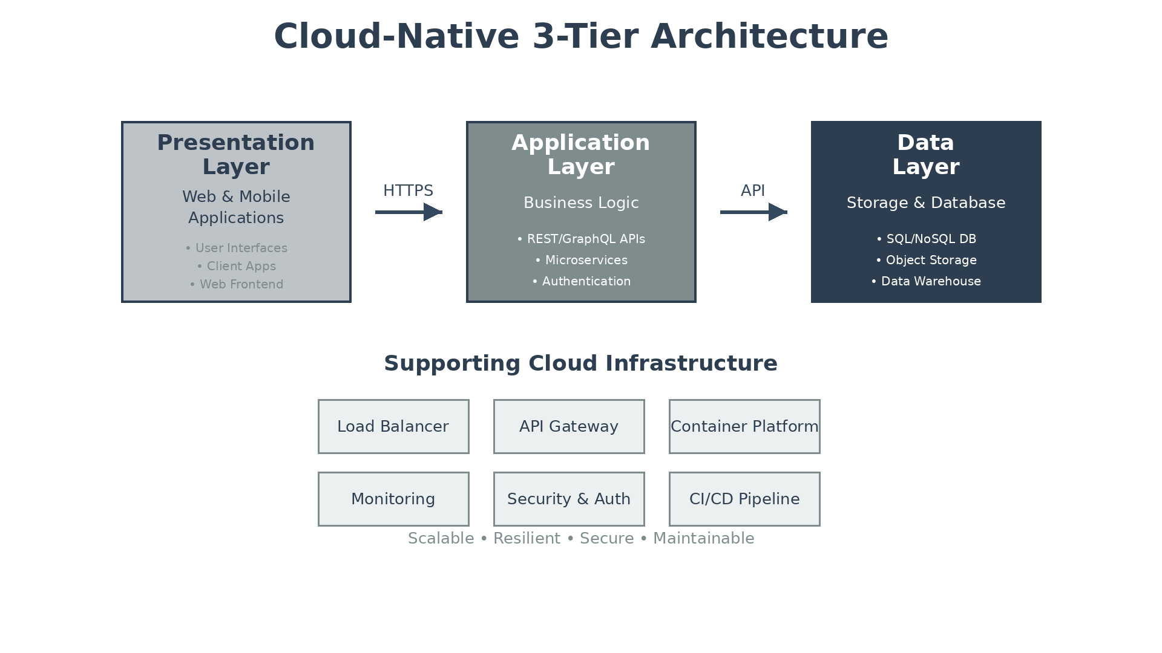
Solution Overview
Core Workspace Applications
  Gmail with 30 GB storage and Drive with 5 TB per user
  Google Docs, Sheets, Slides for real-time document collaboration
  Google Meet video conferencing for 500 participants with recording
Security and Identity
  Data Loss Prevention (DLP) and Google Vault for 7-year retention
  SAML SSO with Azure AD and automated user provisioning
  Advanced mobile device management with 2-Step Verification enforcement
Google Workspace

Slide 5
Implementation Approach
Phase 1: Planning & Pilot (Weeks 1-3)
  Conduct migration planning workshops and assess current environment
  Configure Google Admin console, SSO, and security policies
  Pilot with 25 IT and early adopter users to validate workflows
Phase 2: Department Phased Migration (Weeks 4-10)
  Migrate 500 mailboxes from Exchange to Gmail in 5 waves of 100 users
  Transfer 3 TB of file server data to Google Drive with permissions preservation
  Migrate 150 distribution lists to Google Groups with automated provisioning
Phase 3: Training & Adoption (Weeks 8-12)
  Deliver administrator training on Google Admin console and GAM scripting
  Conduct 10 virtual end-user training sessions covering Gmail, Drive, Docs, Meet
  Provide 2 weeks of go-live hypercare support with dedicated help desk
Google Workspace

Slide 6
Timeline & Milestones
Phase No | Phase Description | Timeline | Key Deliverables
Phase 1 | Planning & Pilot | Weeks 1-3 | Admin console configured, SSO active, 25-user pilot validated
Phase 2 | Phased Migration | Weeks 4-10 | 500 mailboxes migrated, 3 TB files transferred, Groups configured
Phase 3 | Training & Adoption | Weeks 8-12 | Admin training completed, 10 user sessions delivered, 95%+ adoption
Google Workspace

Slide 7
Success Stories
Client Success: Professional Services Firm
  Client: Management consulting firm with 450 employees across 6 locations
  Challenge: Aging Exchange 2013 servers requiring $180K hardware refresh. Limited remote collaboration forcing consultants to VPN for file access. 85% of workforce now remote post-pandemic requiring modern mobile-first tools.
  Solution: Deployed Google Workspace Business Plus with SAML SSO and DLP policies for 450 users.
  Results: $170K annual savings eliminating Exchange servers. 10x improvement in collaboration. 95% adoption within 60 days. Full ROI in 18 months.
  Testimonial: "Google Workspace transformed how our consultants collaborate. Real-time document editing eliminated version control nightmares, and Meet replaced expensive video conferencing subscriptions. Our IT team went from managing servers to enabling business value." — Jennifer Rodriguez, CTO
Google Workspace

Slide 8
Our Partnership Advantage
What We Bring
  10+ years delivering Google Workspace migrations for mid-market and enterprise
  60+ successful migrations totaling 50,000+ users across industries
  Google Cloud Partner with Workspace Specialization certification
  Certified Google Workspace Deployment Specialists on staff
Value to You
  Pre-built migration playbooks reduce deployment time by 35%
  Automated migration tools for Exchange, file servers, and Active Directory
  Proven training curriculum with 95%+ user satisfaction scores
  Direct Google support escalation through our partner channels
Google Workspace

Slide 9
Investment Summary
Cost Category | Year 1 List | Year 1 Credits | Year 1 Net | Year 2 | Year 3 | 3-Year Total
Professional Services | $38,400 | ($3,000) | $35,400 | $0 | $0 | $35,400
Software Licenses | $115,200 | ($10,000) | $105,200 | $115,200 | $115,200 | $335,600
TOTAL | $153,600 | ($13,000) | $140,600 | $115,200 | $115,200 | $371,000
Google Workspace

Slide 10
Next Steps
Decision: Executive approval for Google Workspace migration by [specific date]
Kickoff: Target migration start within 30 days of approval
Team Formation: Identify IT lead, department champions, and 25 pilot users from IT and early adopters
Week 1-2: Contract finalization and Google Workspace account setup, SSO configuration workshop
Week 3: Pilot deployment with 25 users, migration tool validation, first training session delivered
Google Workspace

Slide 11
Thank You

