Slide 1



Solution Briefing
Azure Document Intelligence
['Presenter Name'] | November 22, 2025

Slide 2
Business Opportunity
Opportunity
  Eliminate manual data entry and reduce document processing time by 80% with AI-powered extraction
  Achieve 95%+ accuracy using pre-built and custom models trained on your document types
  Scale document processing automatically to handle peak volumes without additional staffing
Success Criteria
  85% reduction in manual data entry with measurable FTE savings within 6 months
  95%+ extraction accuracy validated against business-critical document types
  Full integration with existing LOB systems (ERP, CRM, SharePoint) operational by Month 4
Azure Document Intelligence

Slide 3
Engagement Scope
Parameter | Scope |  | Parameter | Scope
Document Types | 3 document types (invoices receipts forms) |  | Availability Requirements | Standard (99.5%)
AI/ML Complexity | Azure Document Intelligence pre-built |  | Infrastructure Complexity | Serverless (Functions Blob Doc Intel)
External System Integrations | 2 REST APIs (CRM ERP) |  | Security Requirements | RBAC encryption at rest/transit
Data Sources | Blob Storage and SharePoint |  | Compliance Frameworks | SOC2
Total Users | 75 users |  | Accuracy Requirements | 95%+ extraction accuracy
User Roles | 3 roles (submitter reviewer admin) |  | Processing Speed | Batch processing
Document Processing Volume | 2000 docs/month |  | Deployment Environments | 2 environments (dev prod)
Data Storage Requirements | 250 GB |  | Deployment Regions | Single Azure region (East US)
Azure Document Intelligence

Slide 4
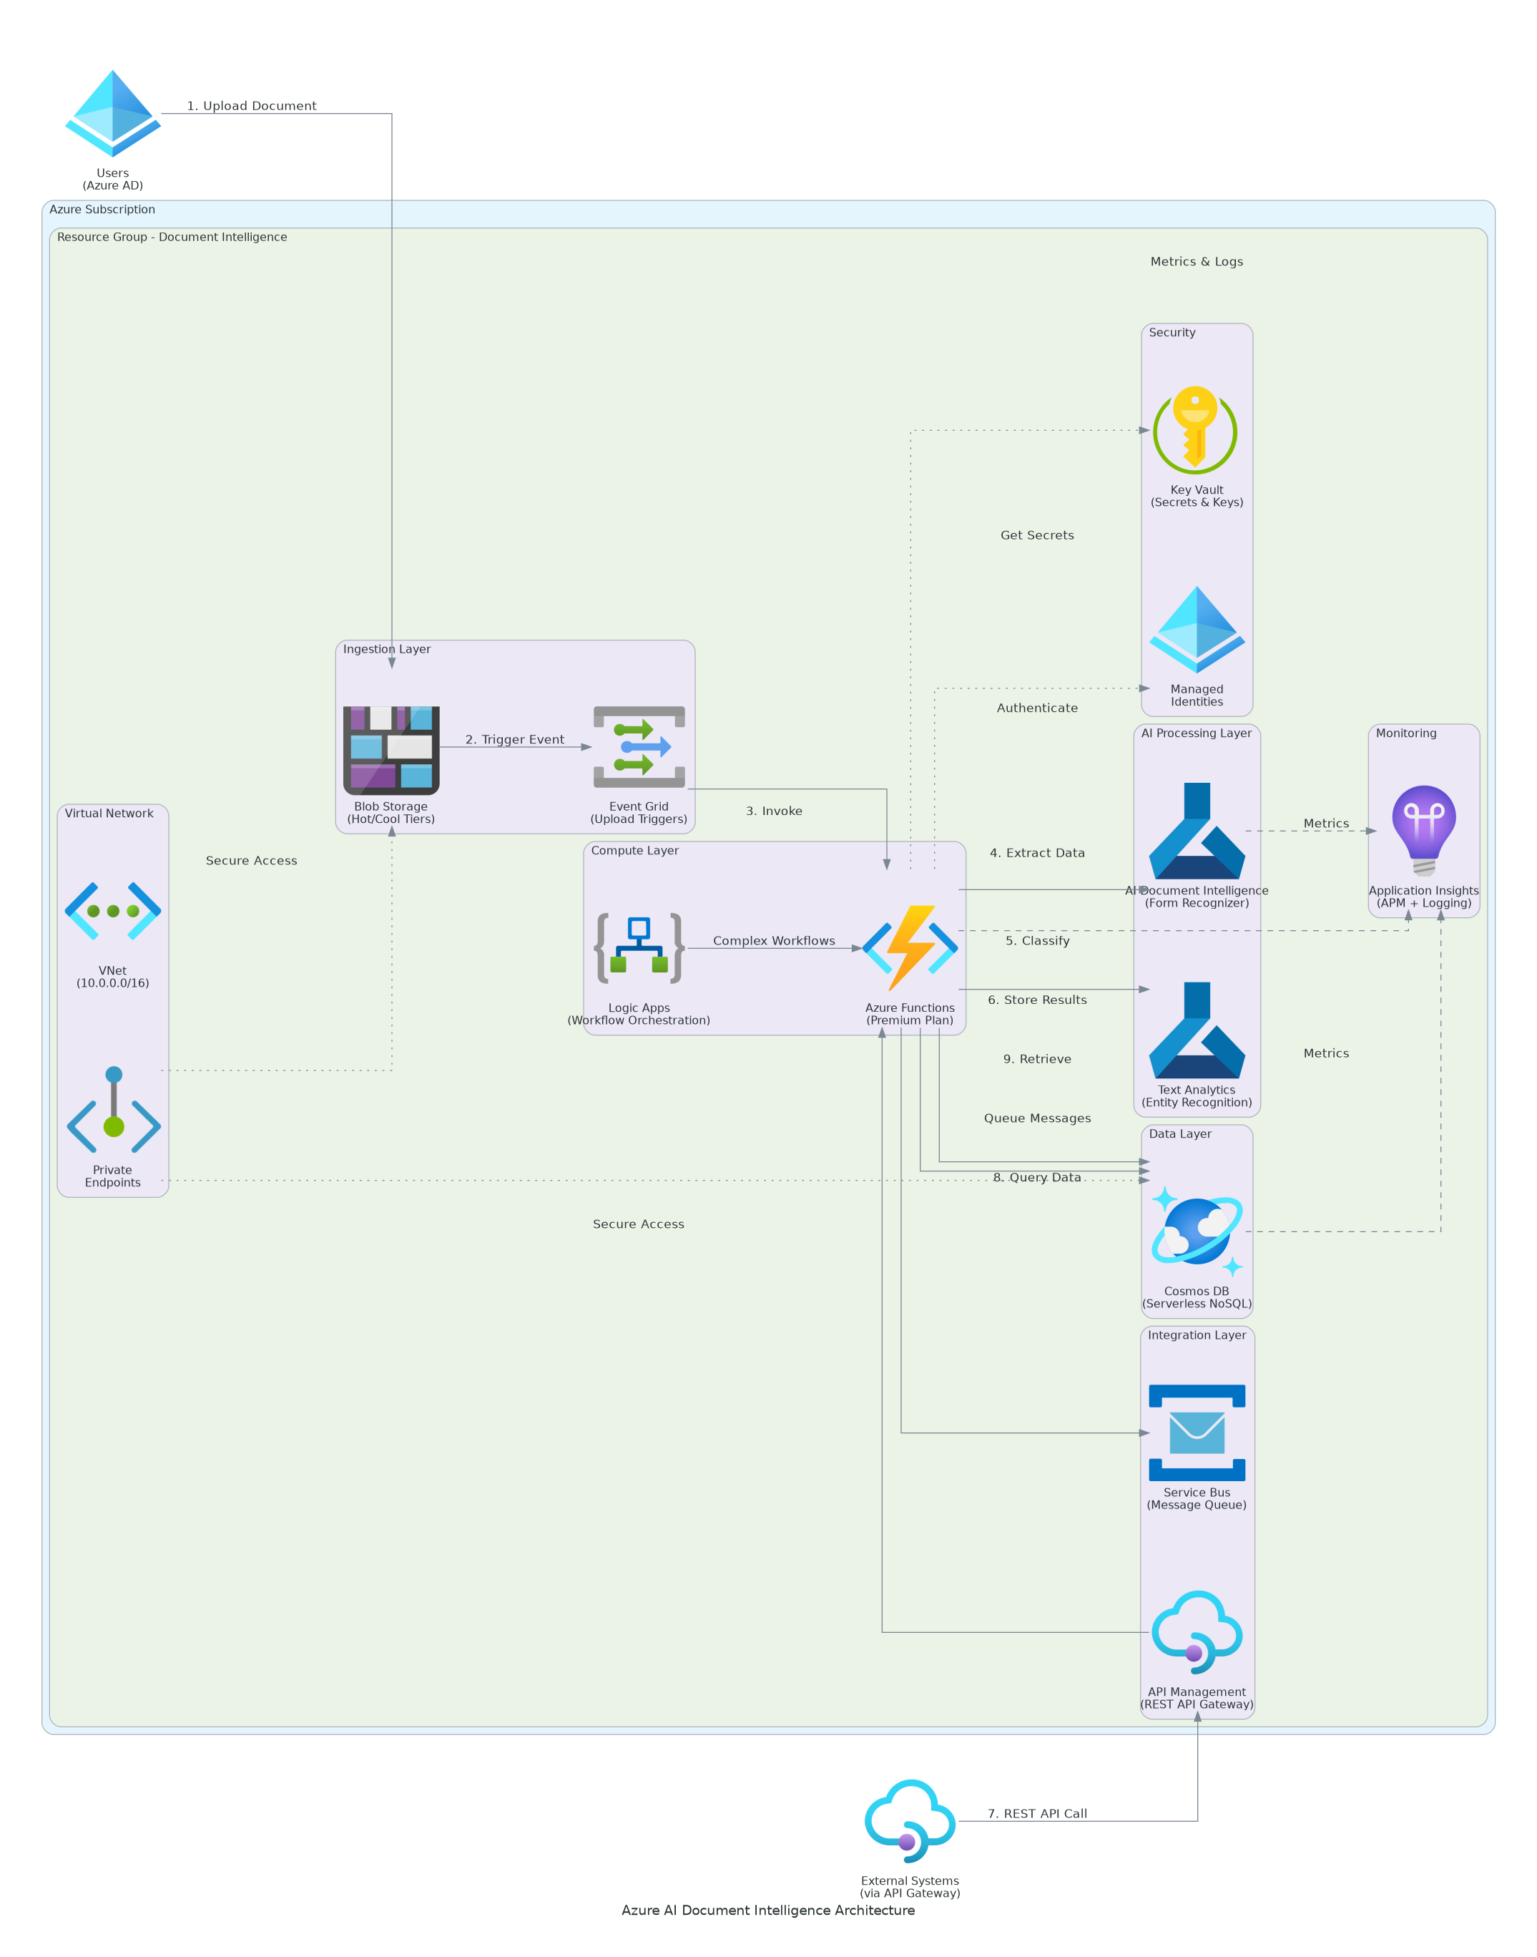
Solution Overview
AI/ML Services
  Azure Document Intelligence for OCR, layout analysis, and structured data extraction
  Pre-built models for invoices, receipts, contracts, and identity documents
  Custom models trained on your specific document types and business rules
Platform Architecture
  Azure Functions for serverless document processing workflows
  Cosmos DB for scalable metadata storage and extraction results
  Azure Blob Storage for secure document ingestion and archival
Azure Document Intelligence

Slide 5
Implementation Approach
Phase 1: Foundation & Model Training (Months 1-2)
  Deploy Azure Document Intelligence resource and configure security
  Analyze document samples and select appropriate pre-built models
  Train custom models for organization-specific document types
Phase 2: Pipeline Development (Months 3-4)
  Build serverless processing pipeline with Azure Functions
  Implement confidence scoring and human review workflows
  Integrate with downstream systems via Logic Apps and APIs
Phase 3: Optimization & Scale (Months 5-6)
  Fine-tune models based on production accuracy metrics
  Implement advanced validation rules and exception handling
  Complete knowledge transfer and operations handover
Azure Document Intelligence

Slide 6
Timeline & Milestones
Phase No | Phase Description | Timeline | Key Deliverables
Phase 1 | Foundation & Model Training | Months 1-2 | Azure environment configured, Document Intelligence models trained, Initial accuracy validated at 90%+
Phase 2 | Pipeline Development | Months 3-4 | Processing pipeline operational, LOB system integrations complete, Human review workflows functional
Phase 3 | Optimization & Scale | Months 5-6 | Model accuracy optimized to 95%+, Full production deployment, Operations team trained and certified
Azure Document Intelligence

Slide 7
Success Stories
Client Success: Regional Healthcare Provider
  Client: Mid-size healthcare network processing 50K+ documents monthly
  Challenge: 8 FTEs manual data entry, 72-hour backlog, 15% error rate causing compliance issues
  Solution: Document Intelligence with custom models for forms, claims, records
  Results: 85% manual reduction, 72hrs→4hrs processing, 97% accuracy, $420K savings
  Testimonial: "Document Intelligence transformed our patient onboarding. What took 3 days now happens in hours with better accuracy." — Sarah Mitchell, VP Operations, Regional Healthcare
Azure Document Intelligence

Slide 8
Our Partnership Advantage
What We Bring
  Microsoft Solutions Partner with AI and Data specialization
  50+ Azure Document Intelligence deployments across healthcare, finance, and insurance
  Certified Azure AI Engineers with custom model training expertise
  Pre-built accelerators for common document types and integrations
Value to You
  Proven deployment methodology reduces risk and accelerates time-to-value
  Pre-trained model templates for invoices, contracts, and forms
  Best practices from 50+ similar implementations
  Comprehensive knowledge transfer ensures team self-sufficiency
Azure Document Intelligence

Slide 9
Investment Summary
Cost Category | Year 1 List | Year 1 Credits | Year 1 Net | Year 2 | Year 3 | 3-Year Total
Professional Services | $82,250 | ($10,000) | $72,250 | $0 | $0 | $72,250
Cloud Infrastructure | $18,528 | ($3,690) | $14,838 | $18,528 | $18,528 | $51,894
Software Licenses | $2,904 | $0 | $2,904 | $2,904 | $2,904 | $8,712
Support & Maintenance | $2,676 | $0 | $2,676 | $2,676 | $2,676 | $8,028
TOTAL | $106,358 | ($13,690) | $92,668 | $24,108 | $24,108 | $140,884
Azure Document Intelligence

Slide 10
Next Steps
Decision: SOW approval and contract execution by [Target Date]
Kickoff: Project initiation scheduled for [Start Date] with team formation
Document Samples: Provide 50+ samples per document type for model training accuracy
Week 1-2: Azure environment setup, security configuration, and model selection workshop
Week 3-4: Model training with sample documents and first automated extractions validated
Azure Document Intelligence

Slide 11
Thank You

