Slide 1
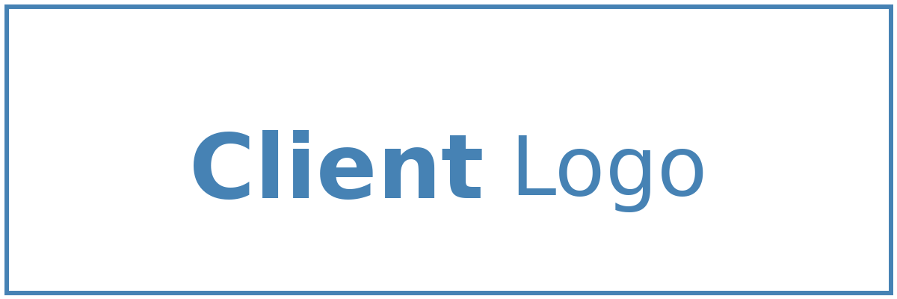
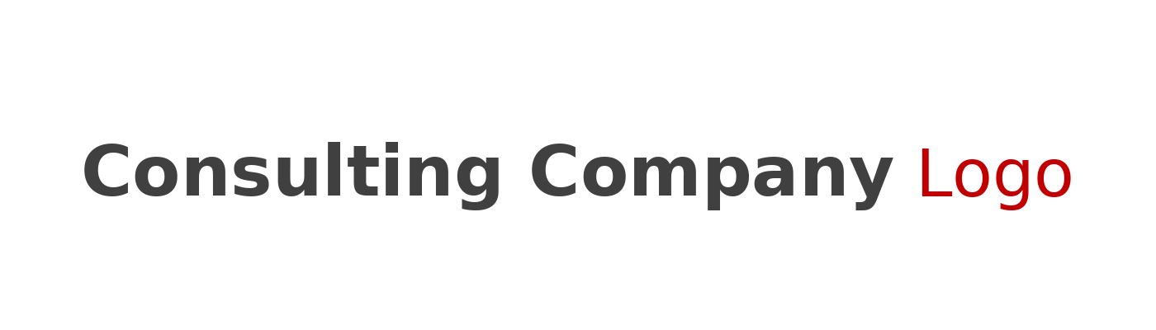

Solution Briefing
Azure Enterprise Landing Zone
Alison Smith | November 22, 2025

Slide 2
Business Opportunity
Opportunity
  Build a secure foundation for multi-subscription Azure deployments with consistent governance
  Reduce cloud management overhead by 40-50% through automated policy enforcement
  Enable rapid subscription provisioning while maintaining security and compliance standards
Success Criteria
  Deploy management group hierarchy with automated policy inheritance within 8 weeks
  Achieve 100% policy compliance across all subscriptions with real-time monitoring
  Reduce subscription provisioning time from weeks to hours with standardized templates
Azure Enterprise Landing Zone

Slide 3
Engagement Scope
Parameter | Scope |  | Parameter | Scope
Management Groups | 3-tier hierarchy |  | Availability Requirements | Standard (99.9%)
Subscriptions | 5-10 subscriptions |  | Infrastructure Complexity | Hub-spoke network topology
Hybrid Connectivity | ExpressRoute circuit |  | Security Requirements | Azure Defender Standard
Identity Federation | Azure AD Connect sync |  | Compliance Frameworks | SOC2 ISO27001
Total Users | 500 Azure users |  | Cost Management | Azure Cost Management
User Roles | 10 custom RBAC roles |  | Governance Automation | Policy-driven governance
Workloads to Onboard | 20-30 applications |  | Deployment Environments | Landing zones for dev staging prod
Policy Assignments | 50 policy assignments |  | Target Azure Regions | 2 regions (East US West US)
Azure Enterprise Landing Zone

Slide 4
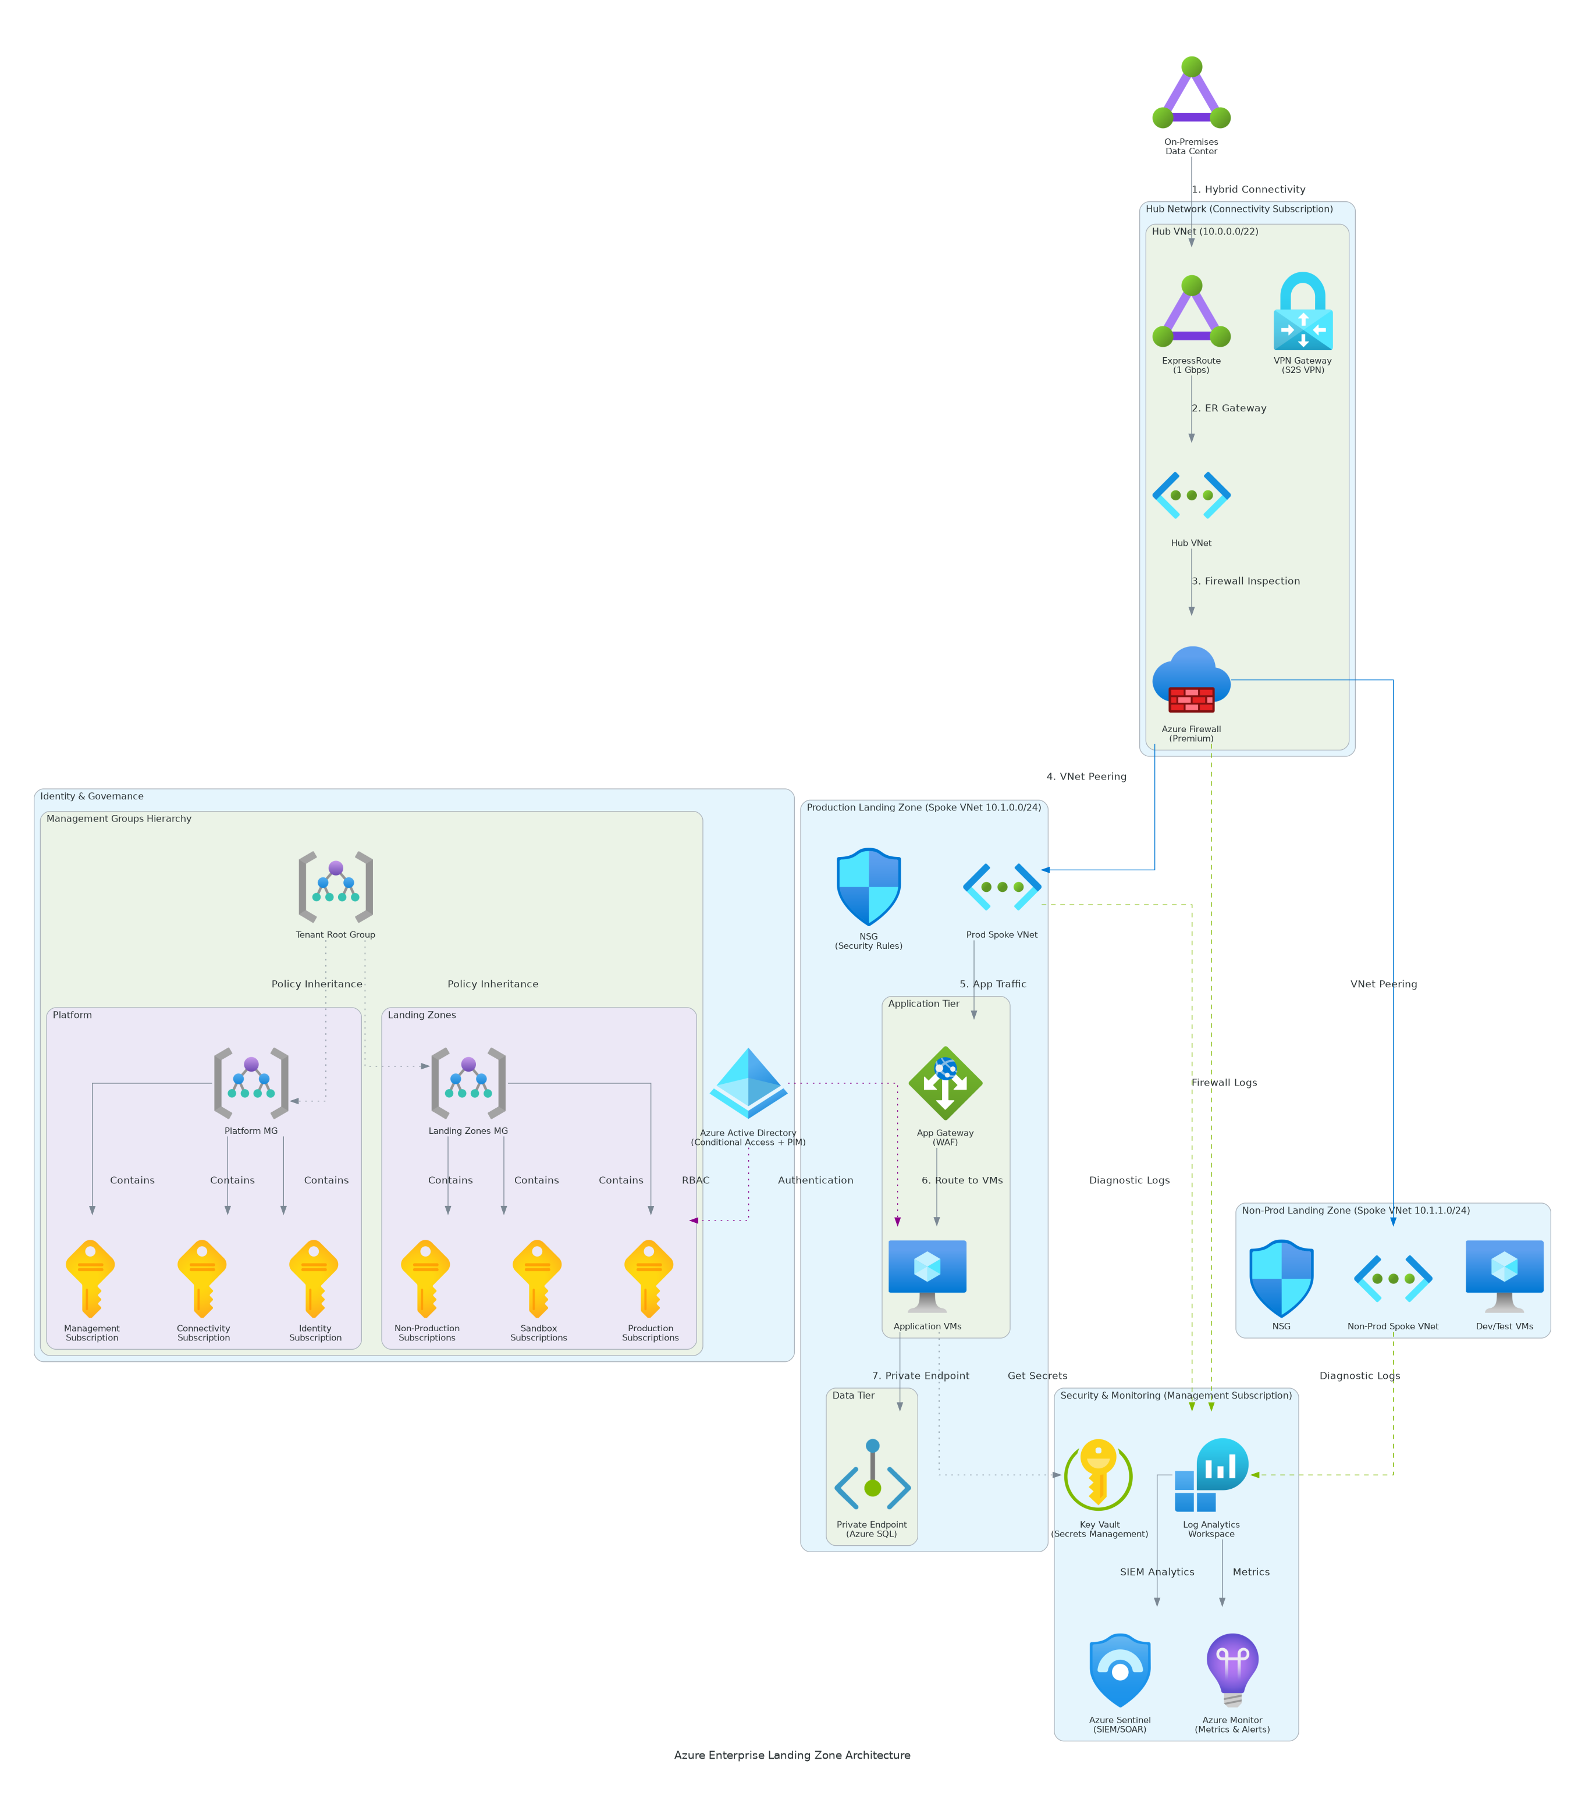
Solution Overview
Key Components
  Management Groups: Hierarchical organization of subscriptions with inherited policies and access controls
  Azure Policy: Automated compliance enforcement, resource guardrails, and configuration standards
  Hub-Spoke Network: Centralized connectivity with Azure Virtual WAN or hub virtual network design
Technology Stack
  Platform: Microsoft Azure with Management Groups and Policy framework
  Governance: Azure Policy, Blueprints, Resource Graph, RBAC
  Networking: Virtual WAN, Azure Firewall, ExpressRoute/VPN
Azure Enterprise Landing Zone

Slide 5
Implementation Approach
Phase 1: Assessment & Design (Weeks 1-3)
  Current Azure environment inventory and gap analysis
  Management group hierarchy design and naming conventions
  Policy framework definition and compliance requirements mapping
Phase 2: Foundation Deployment (Weeks 4-6)
  Management group structure implementation
  Core Azure Policy assignments (tagging, allowed regions, resource types)
  Hub network deployment with Azure Firewall and connectivity services
Phase 3: Governance & Optimization (Weeks 7-10)
  Azure Blueprints creation for subscription vending
  Azure Cost Management configuration and budget alerts
  Documentation, training, and operational handover
Azure Enterprise Landing Zone

Slide 6
Timeline & Milestones
Phase No | Phase Description | Timeline | Key Deliverables
Phase 1 | Assessment & Design | Weeks 1-3 | Current state analysis complete, Management group design approved, Policy framework documented
Phase 2 | Foundation Deployment | Weeks 4-6 | Management groups live, Core policies enforcing, Hub network operational
Phase 3 | Governance & Optimization | Weeks 7-10 | Blueprints ready, Cost management active, Knowledge transfer complete
Azure Enterprise Landing Zone

Slide 7
Success Stories
Client Success: Global Financial Services Firm
  Client: Fortune 500 financial institution with 500+ Azure subscriptions
  Challenge: Inconsistent governance, compliance failures, 35% cloud overspend, 3-week provisioning delays
  Solution: Landing zone with policies, hub-spoke network, automated subscription vending
  Results: 100% compliance in 90 days, 42% cost reduction ($2.1M savings), 4-hour provisioning
  Testimonial: "Landing zone transformed our governance from firefighting to proactive control. Teams self-service environments within trusted guardrails." — Sarah Mitchell, Cloud Director, Global Financial Services
Azure Enterprise Landing Zone

Slide 8
Our Partnership Advantage
What We Bring
  Microsoft Gold Partner with Azure Expert MSP designation
  100+ Azure Landing Zone implementations across enterprise clients
  Certified Azure Solutions Architects with governance specialization
  Pre-built policy libraries and landing zone accelerators
Value to You
  Proven landing zone frameworks reduce implementation risk by 70%
  Custom policy templates aligned with your compliance requirements
  Azure Cost Management expertise to optimize cloud spend
  Comprehensive skills transfer for internal team self-sufficiency
Azure Enterprise Landing Zone

Slide 9
Investment Summary
Cost Category | Year 1 List | Year 1 Credits | Year 1 Net | Year 2 | Year 3 | 3-Year Total
Professional Services | $134,000 | ($15,000) | $119,000 | $0 | $0 | $119,000
Cloud Infrastructure | $56,620 | $0 | $56,620 | $56,620 | $56,620 | $169,860
Software Licenses | $30,600 | $0 | $30,600 | $30,600 | $30,600 | $91,800
Support & Maintenance | $24,800 | $0 | $24,800 | $24,800 | $24,800 | $74,400
TOTAL | $246,020 | ($15,000) | $231,020 | $112,020 | $112,020 | $455,060
Azure Enterprise Landing Zone

Slide 10
Next Steps
Decision: SOW approval and contract execution by [Target Date]
Kickoff: Project initiation scheduled for [Start Date] with team formation
Team Setup: Identify Azure admin, security lead, and finance stakeholders upfront
Week 1-2: Contract finalization, Azure access provisioning, and discovery workshops
Week 3-4: Management group design workshop and foundation deployment begins
Azure Enterprise Landing Zone

Slide 11
Thank You

