Slide 1
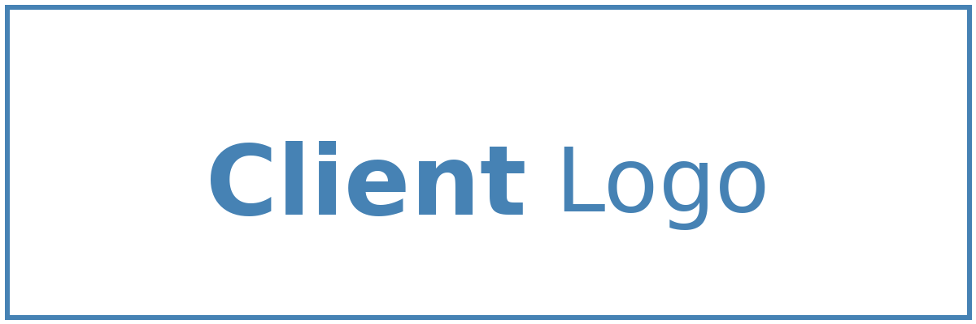


Solution Briefing
Azure DevOps Enterprise Platform
Alison Smith | November 22, 2025

Slide 2
Business Opportunity
Opportunity
  Reduce time-to-market with automated build and release pipelines that eliminate manual deployment bottlenecks
  Improve team productivity through centralized code management and streamlined collaboration workflows
  Increase software quality and reliability with consistent testing and deployment practices across all projects
Success Criteria
  Achieve 70% reduction in deployment time within 6 months with fully automated pipelines
  Standardize development practices across all teams with 100% adoption of unified tooling
  Establish foundation for continuous delivery enabling multiple production releases per day
Azure DevOps Enterprise Platform

Slide 3
Engagement Scope
Parameter | Scope |  | Parameter | Scope
Projects/Repositories | 10-20 repositories |  | Availability Requirements | Standard (99.5%)
CI/CD Pipelines | 25-50 pipelines |  | Infrastructure Complexity | Azure DevOps + self-hosted agents
External Integrations | GitHub SonarQube Artifactory |  | Security Requirements | Service connections branch policies
Deployment Targets | Azure Kubernetes Service VMs |  | Compliance Frameworks | SOC2
Total Users | 50 developers |  | Build Performance | Standard build times
User Roles | 4 roles (dev lead ops admin) |  | Deployment Frequency | Daily deployments
Build Artifacts | 100 GB storage |  | Deployment Environments | 3 environments (dev staging prod)
Pipeline Runs | 500 runs/month |  | Deployment Regions | Single Azure region
Azure DevOps Enterprise Platform

Slide 4
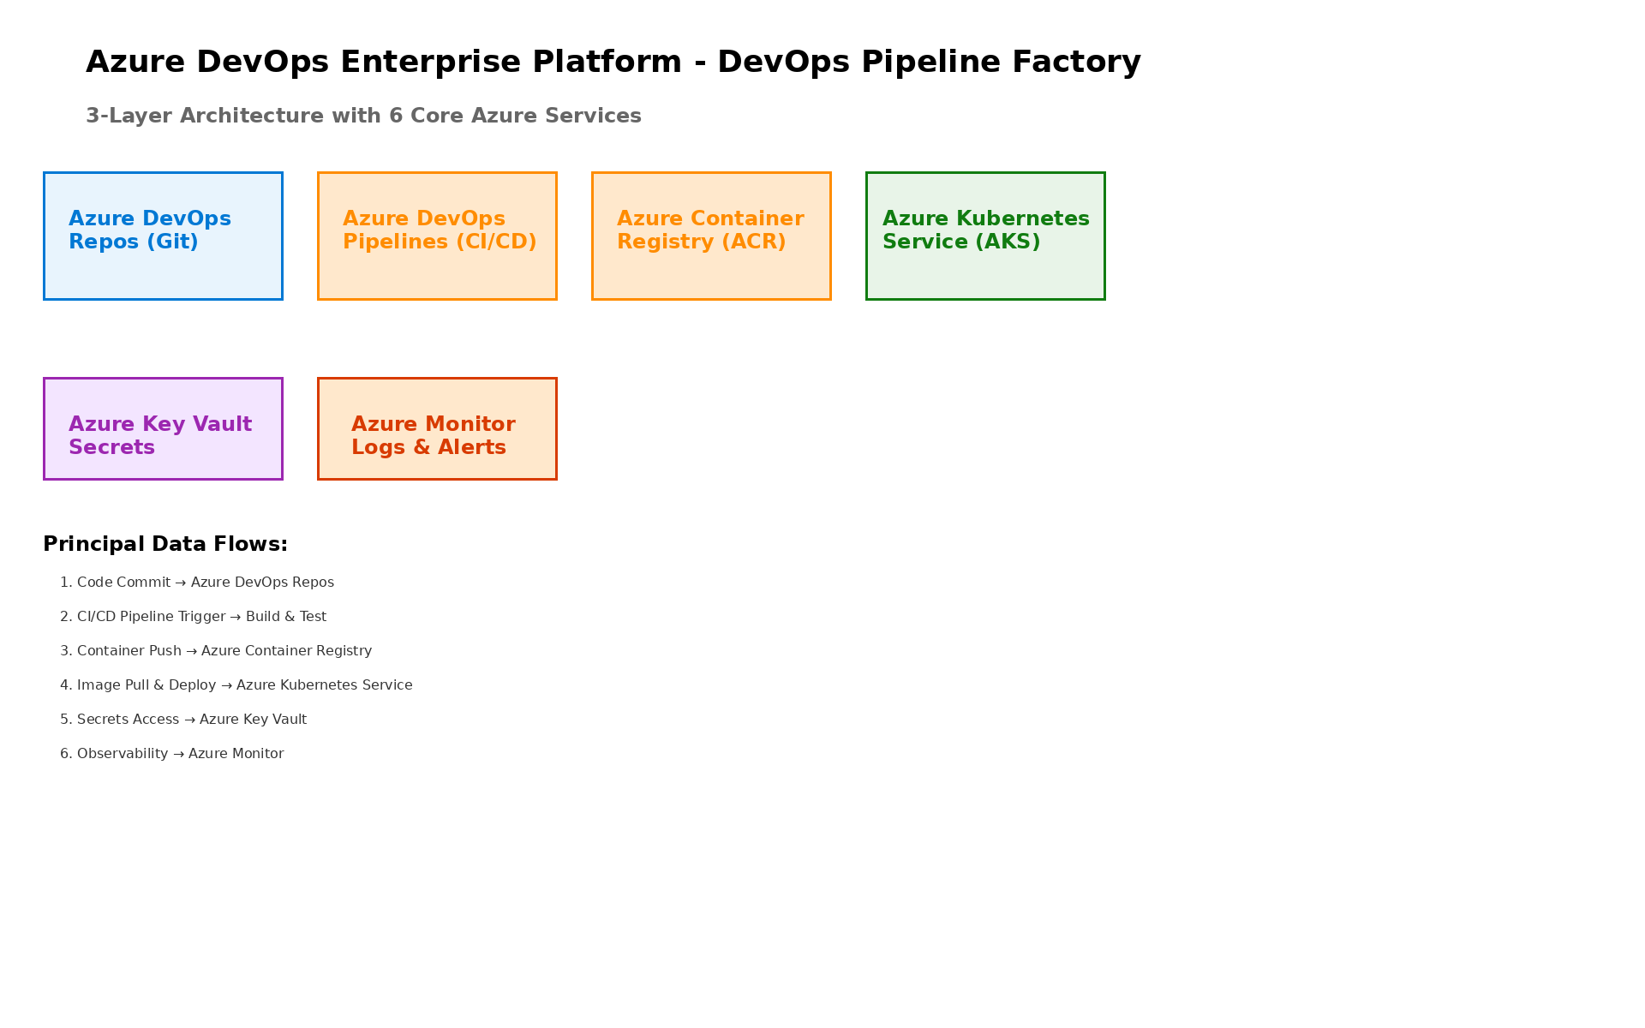
Solution Overview
Key Components
  Azure DevOps Services: Central hub for project management, code repositories, and pipeline orchestration
  Azure Pipelines: Automated build, test, and deployment workflows with multi-stage release management
  Azure Repos & Artifacts: Version control for source code with centralized package management
Technology Stack
  Platform: Azure DevOps Services with Git-based Azure Repos
  Build & Release: YAML-based Azure Pipelines with multi-stage workflows
  Package Management: Azure Artifacts feeds for dependencies
Azure DevOps Enterprise Platform

Slide 5
Implementation Approach
Phase 1: Assessment & Planning (Months 1-2)
  Current development workflow analysis and tool inventory assessment
  Pipeline strategy design and branching standards definition
  Azure DevOps organization structure and security configuration
Phase 2: Core Platform Setup (Months 3-4)
  Azure Repos migration with Git history preservation
  Azure Pipelines templates for build and release automation
  Azure Artifacts feeds and package management setup
Phase 3: Optimization & Adoption (Months 5-6)
  Team onboarding and pipeline standardization across projects
  Advanced workflows including multi-stage deployments and approvals
  Performance monitoring and continuous improvement processes
Azure DevOps Enterprise Platform

Slide 6
Timeline & Milestones
Phase No | Phase Description | Timeline | Key Deliverables
Phase 1 | Assessment & Planning | Months 1-2 | DevOps maturity assessment complete, Pipeline strategy documented, Security and governance policies defined
Phase 2 | Core Platform Setup | Months 3-4 | Azure Repos configured with migrated code, Build pipelines operational, Artifact feeds publishing packages
Phase 3 | Optimization & Adoption | Months 5-6 | Release pipelines automated, All teams onboarded, Monitoring and dashboards active
Azure DevOps Enterprise Platform

Slide 7
Success Stories
Client Success: Enterprise Software Company
  Client: Software company with 200+ developers across 8 product teams
  Challenge: Manual deployment processes taking 4+ hours per release, inconsistent build environments causing 30% of releases to fail, and inability to track code changes across projects
  Solution: Deployed Azure DevOps platform with standardized YAML pipelines, automated testing integration, and centralized artifact management
  Results: 85% reduction in deployment time (4 hours to 35 minutes), 95% pipeline success rate, release frequency increased from monthly to weekly, full audit trail for compliance requirements
  Testimonial: "Azure DevOps transformed how our teams deliver software. We went from dreading release days to confidently deploying multiple times per week. Our developers focus on building features instead of fighting deployments." — Sarah Martinez, VP Engineering, Enterprise Software Corp
Azure DevOps Enterprise Platform

Slide 8
Our Partnership Advantage
What We Bring
  Microsoft Gold Partner with Azure DevOps specialization
  100+ successful DevOps platform implementations
  Certified Azure DevOps Engineers and Solutions Architects
  Pre-built pipeline templates and migration accelerators
Value to You
  Proven migration methodology reduces disruption to development teams
  Reusable pipeline templates accelerate onboarding by 50%
  Comprehensive training program ensures team self-sufficiency
  Best practices from 100+ enterprise DevOps transformations
Azure DevOps Enterprise Platform

Slide 9
Investment Summary
Cost Category | Year 1 List | Year 1 Credits | Year 1 Net | Year 2 | Year 3 | 3-Year Total
Professional Services | $100,000 | ($8,000) | $92,000 | $0 | $0 | $92,000
Cloud Infrastructure | $6,200 | $0 | $6,200 | $6,200 | $6,200 | $18,600
Support & Maintenance | $1,524 | $0 | $1,524 | $1,524 | $1,524 | $4,572
TOTAL | $107,724 | ($8,000) | $99,724 | $7,724 | $7,724 | $115,172
Azure DevOps Enterprise Platform

Slide 10
Next Steps
Decision: Confirm DevOps platform investment by [Target Date]
Kickoff: Project start scheduled for [Start Date] with platform owner and pilot team
Team Formation: Identify platform owner, pilot team lead, and security approver
Week 1-2: Contract finalization, Azure DevOps organization setup, and stakeholder interviews
Week 3-4: Pipeline strategy workshop and pilot project selection with first automated pipeline running
Azure DevOps Enterprise Platform

Slide 11
Thank You

