Slide 1


Slide 2
Organizational Profile
Formally Established - 2016
Workspace - Pulchowk, Lalitpur
Team of 4 Computer Engineers from IOE, Pulchowk Campus
Working with multiple INGOs and local partner organizations
TEDx events in Nepal

Slide 3
What We Do - Areas of Expertise
Web App Development
Desktop and Mobile App Development
Project Management
Database Design and Administration
Graphic Design and Animation

Slide 4
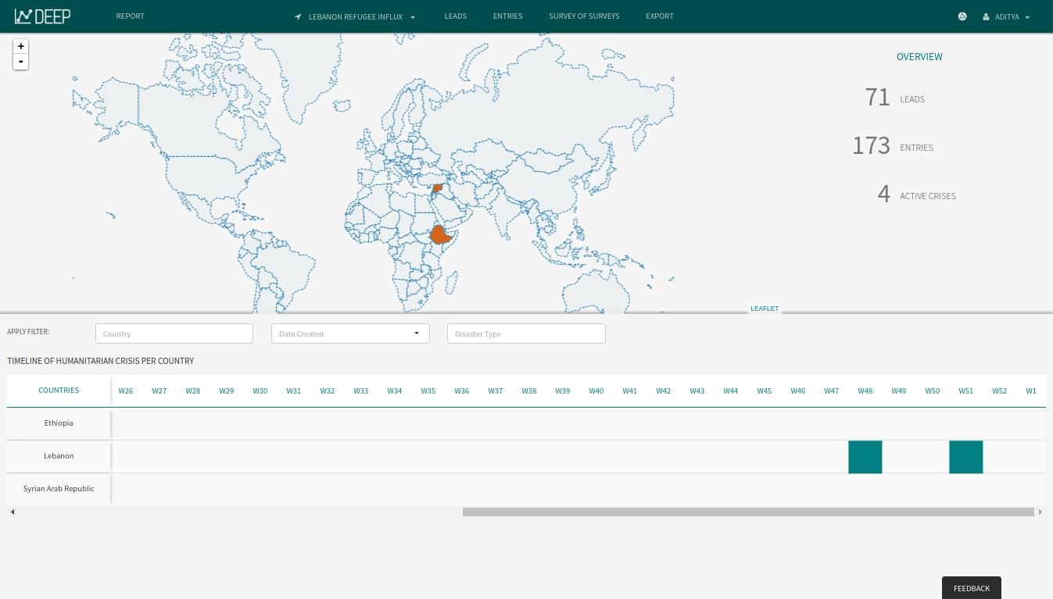
Web App Development - DEEP

Slide 5
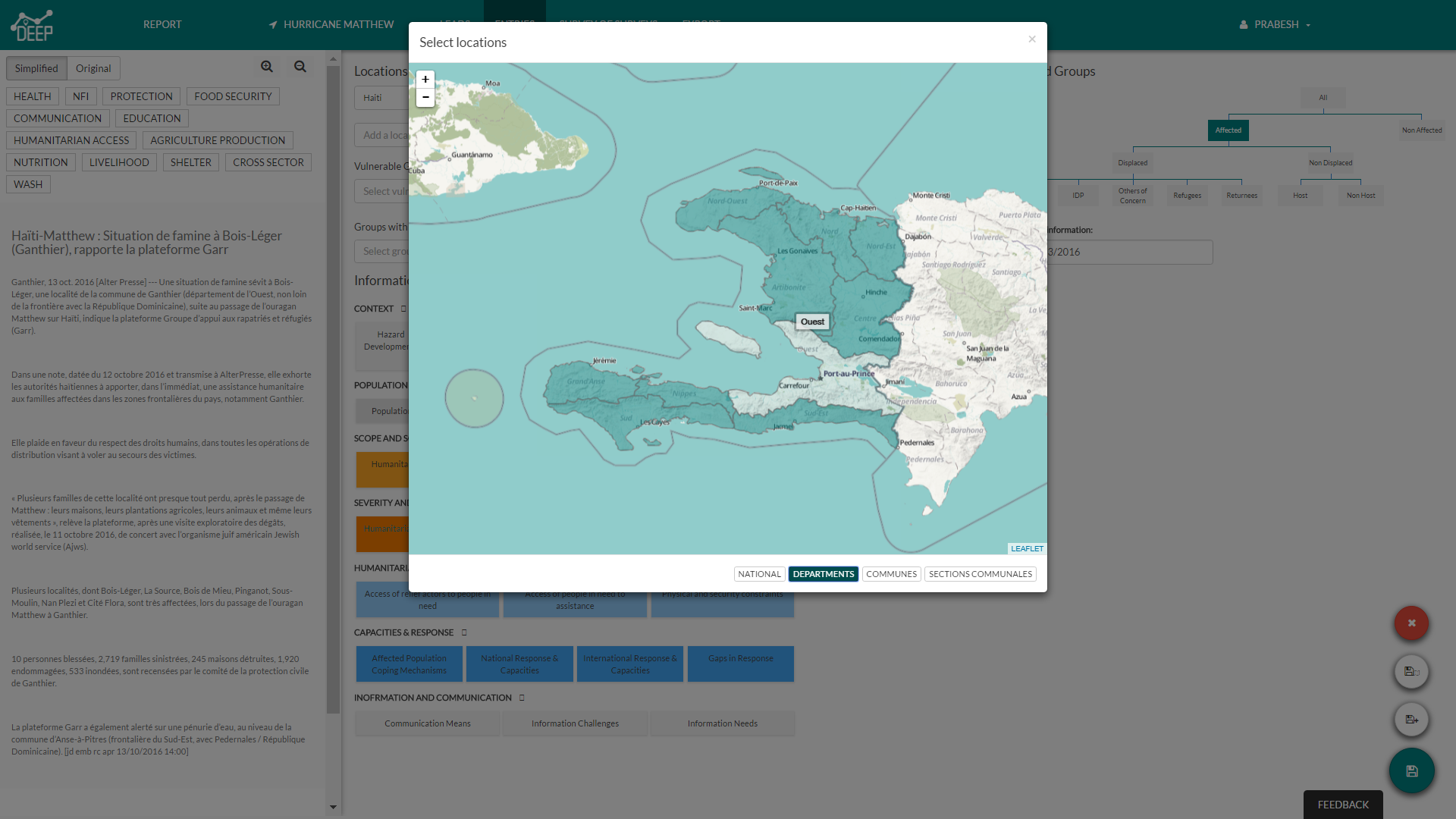
Web App Development - DEEP

Slide 6
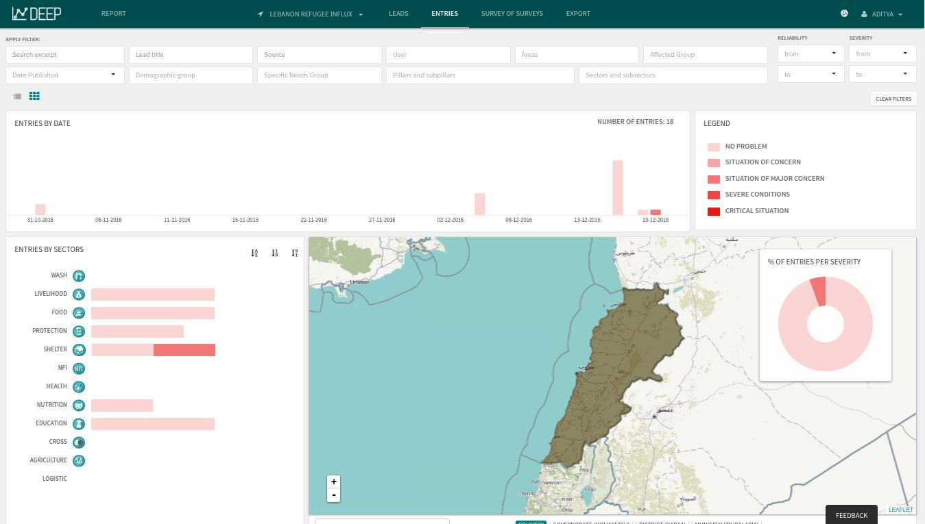
Web App Development - DEEP

Slide 7
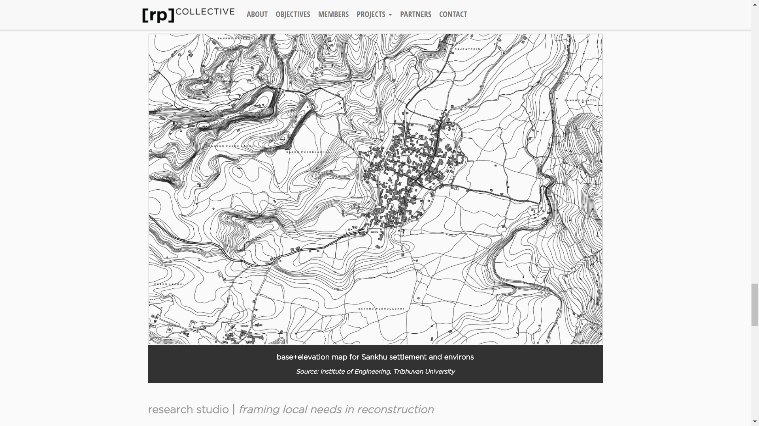
Web App Development - rp[collective]

Slide 8
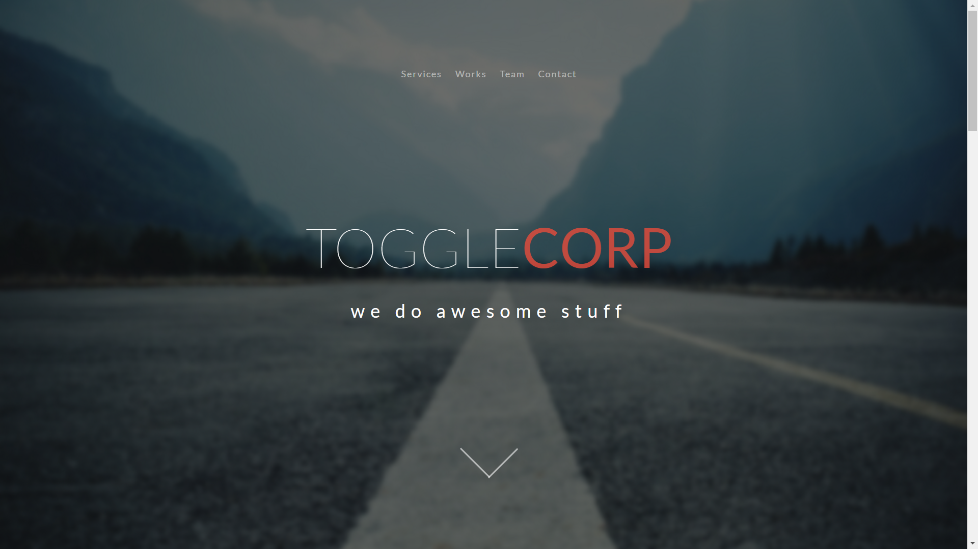
Togglecorp

Slide 9
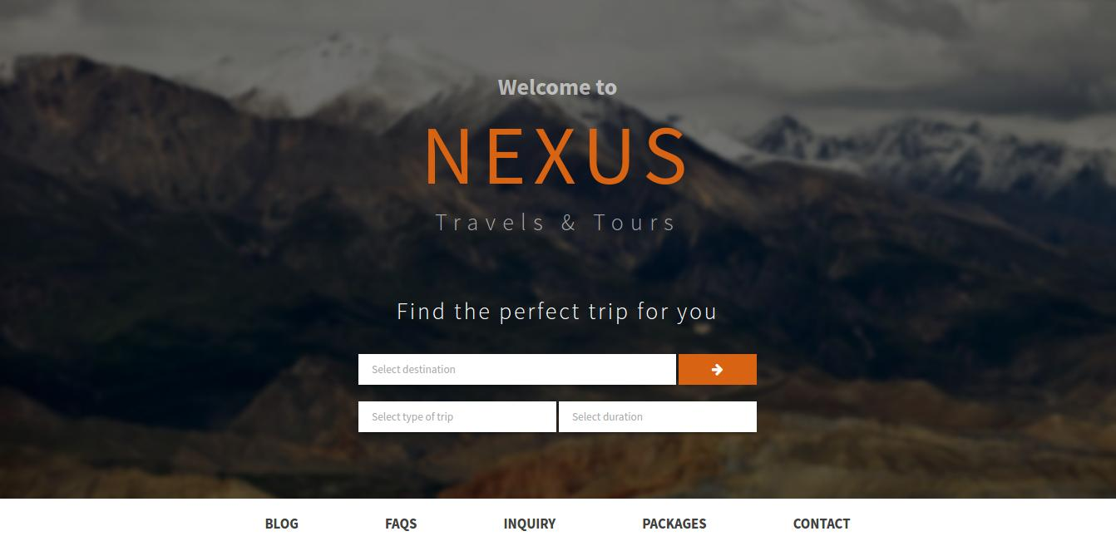
Nexus

Slide 10
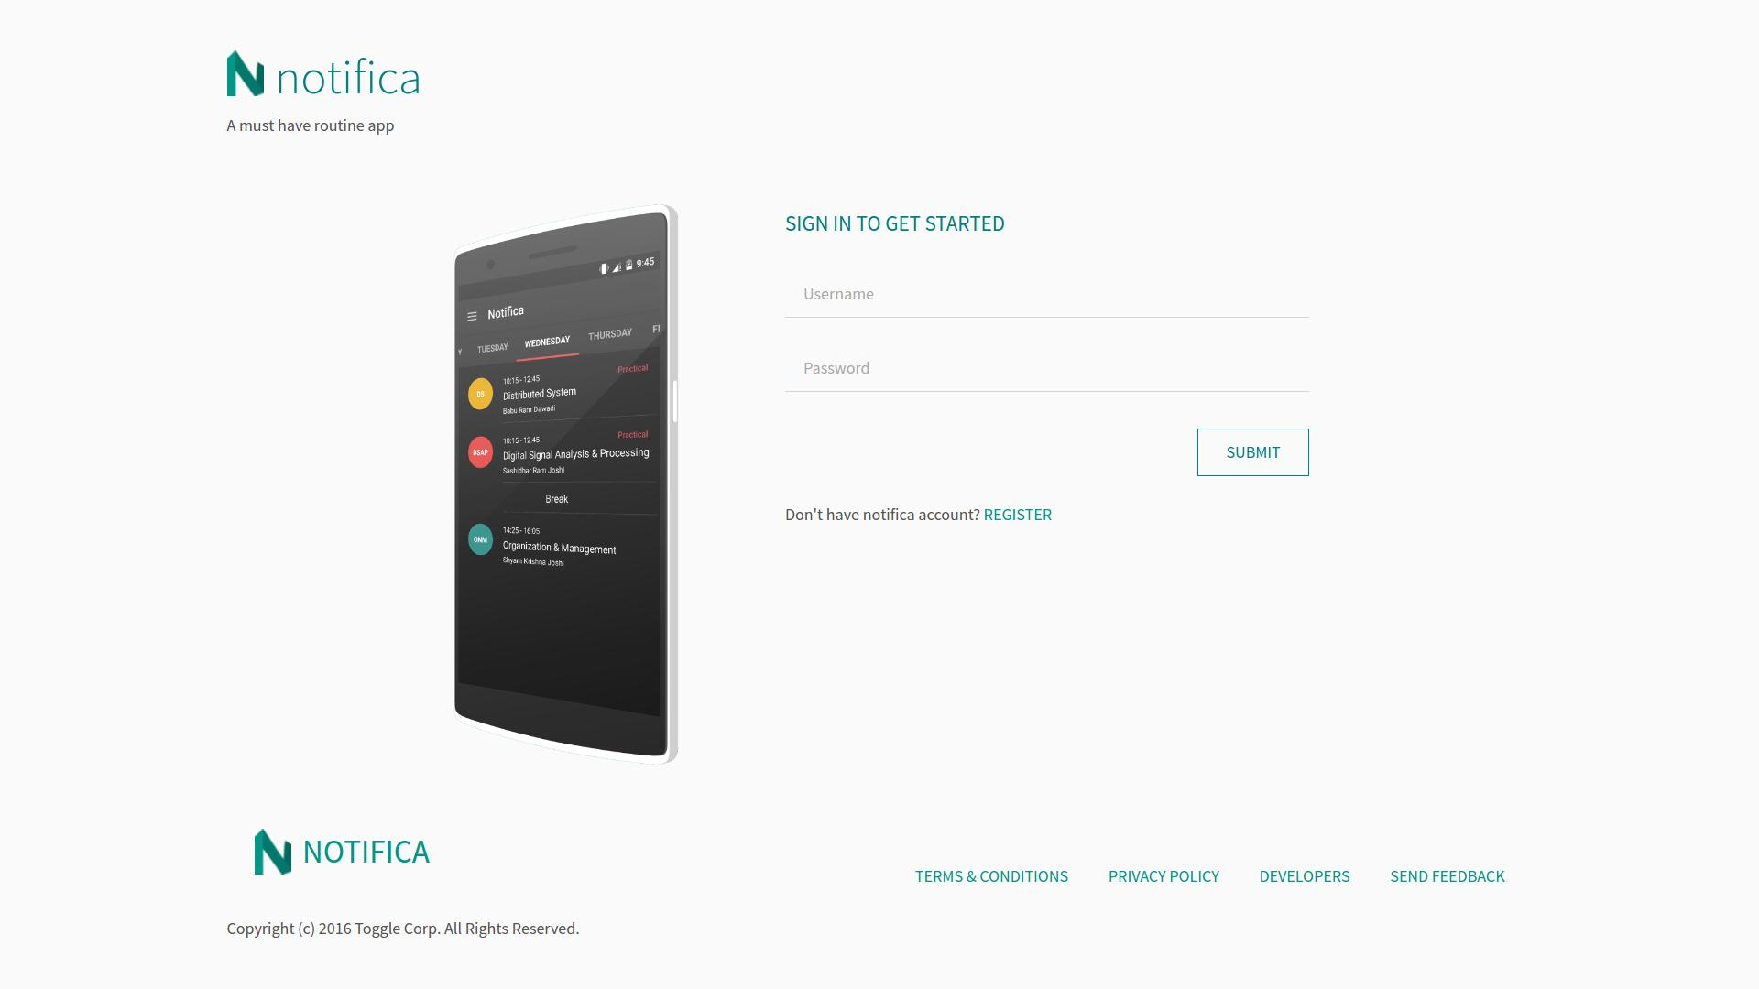
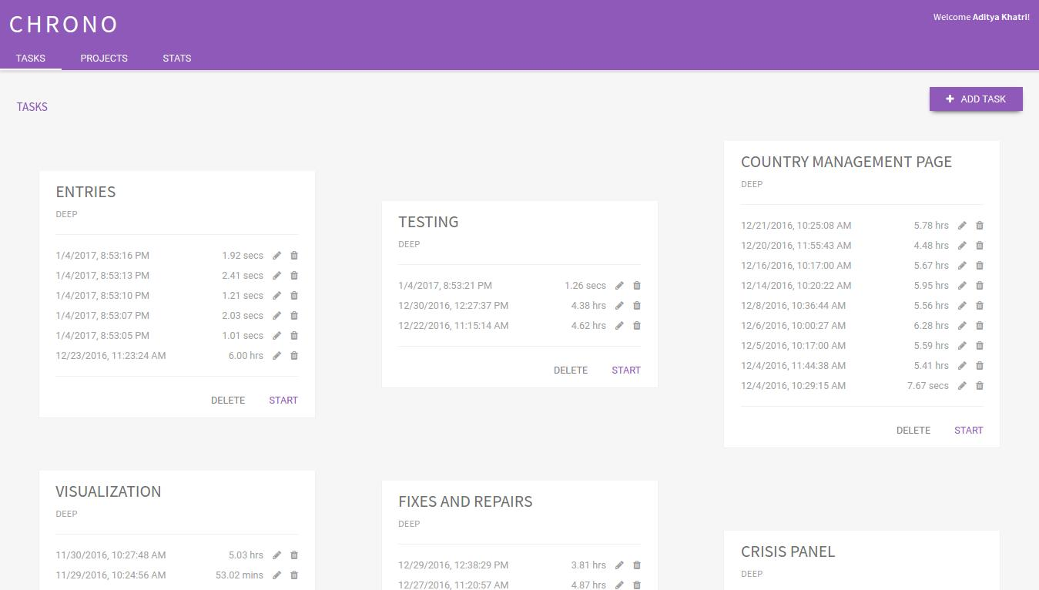
Notifica
Chrono

Slide 11
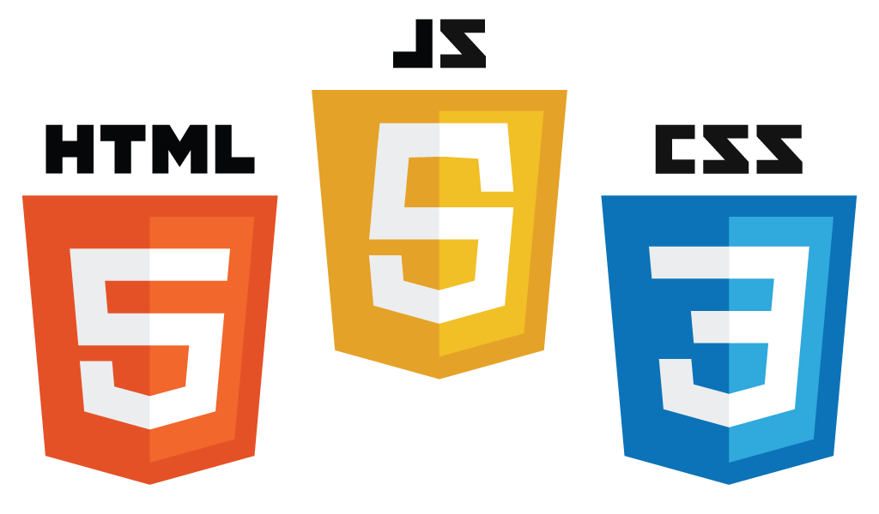

Website Design Plan - NLab
Interactive and dynamic web sites
HTML5 and CSS
Javascript and JQuery library
Other JS libraries as required

Slide 12


Website Design Plan - NLab
Leaflet JS
Leading JS interactive map library: layers, geojson, labels, pop-ups, customizations
Google Charts
The Google Chart API is a tool that lets people easily create a chart from some data and embed it in a web page.

Slide 13



How we work?
ITERATE
IDEATE
BUILD
DELIVER

Slide 14
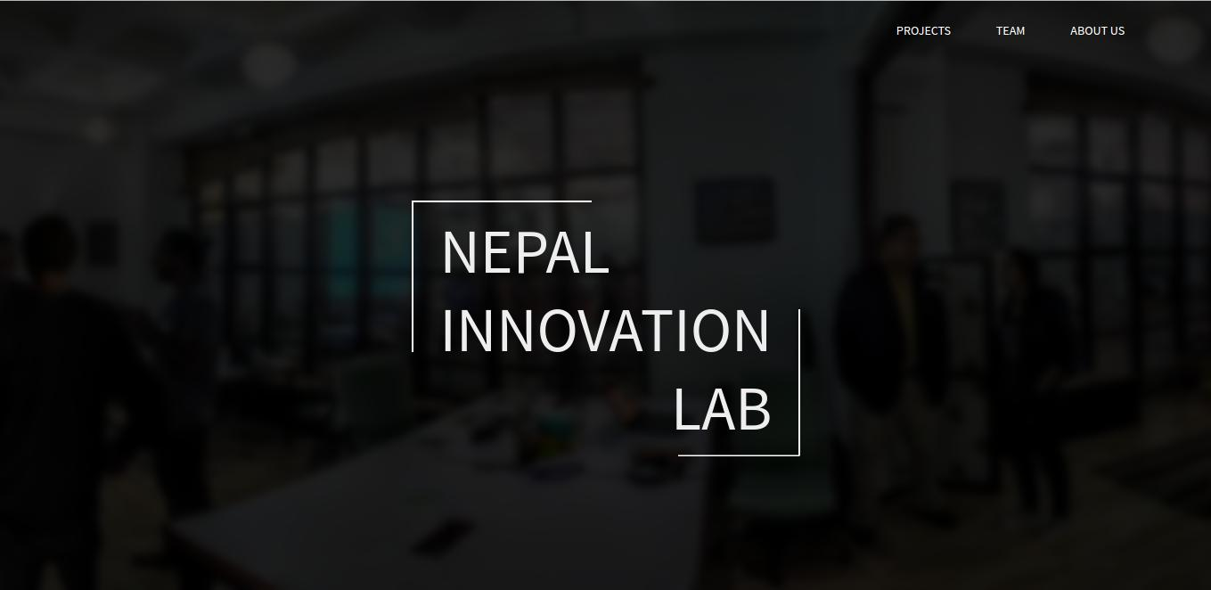
Mockup

Slide 15
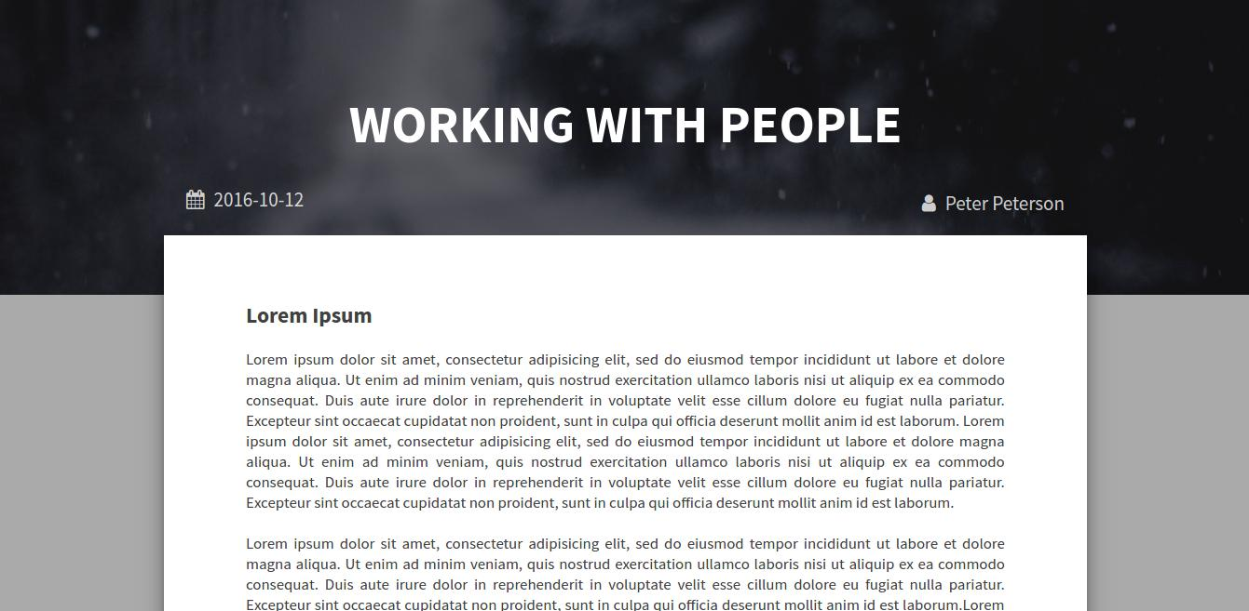
Mockup

Slide 16
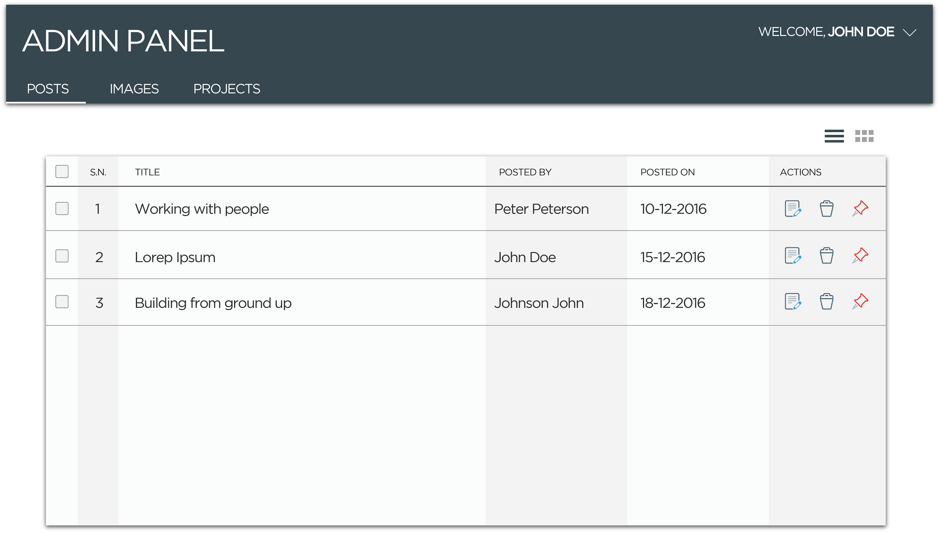
Mockup

Slide 17
Why ToggleCorp?
Creative and Enthusiastic Developers
Accessible 9am - 5pm. All week (Except Saturdays)
Quality focused Customer Satisfaction
Discourage CMS Packages - Engineer from the root - Structured Code
Light and tailored according to the customer’s needs
Simple yet Powerful Admin panel - Easy UI/UX

Slide 18
Deliverable
Quality assured, thoroughly tested full phased product
Free Support and Maintenance for a year
Site Overhaul - Minimum Charge acc. Time deployed
Responsive and Accessible for tech support within the working hour

Slide 19
Future Possibilities
Further customizations for innovation mapping
Any new ideas on the way . . .

Slide 20
Looking forward to...
Working with the lab team
Suggestions and comments
Learning and improving

Slide 21
THANK YOU

