Slide 1


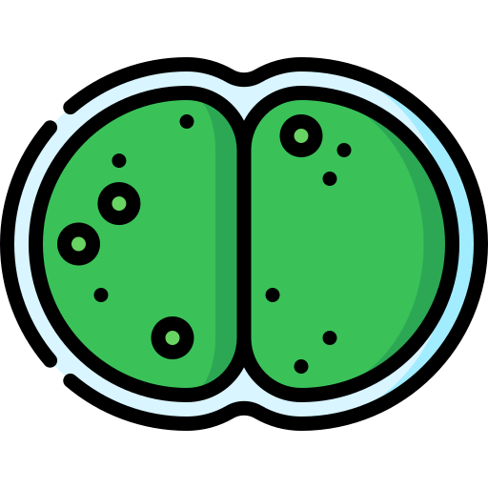
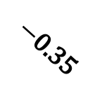
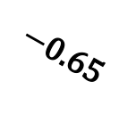
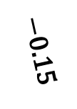


Water Temperature
Zooplankton Biomass
+0.45
$−$0.35
+0.40
$−$0.55
+0.70
$−$0.15
+0.50
$−$0.65
Algal Biomass
$−$0.20
Nutrient Concentration
Dissolved Oxygen
Notes:
This full DAG combines all three structures simultaneously.
Key rule: in the fork and chain, conditioning CLOSES a path. In the collider, conditioning OPENS a path.
Fork: Temperature → Nutrients and Temperature → Algae — temperature is a common cause (confounder) for the Nutrients → Algae relationship.
Chain: Nutrients → Algae → Dissolved Oxygen — algae mediates the Nutrients → DO pathway.
Collider: Temperature → Algae ← Nutrients (and Zooplankton) — Algae is a collider on the path between its multiple causes.
Real ecological systems have all three structures simultaneously. This is why we need DAGs: to reason about which paths are open, which are blocked, and what adjustment strategy is valid for a given question.
Teaser for Part II: how do we systematically read off the correct adjustment set from a DAG? — the backdoor criterion and d-separation.

