Slide 1
The impact on Air Pollution BBQs, Traffic, Seasons?
presented by:
Team L’aqua
Andrea Angeli Emin Oguz Inci Ali Kadar
Datathon KU Leuven 20/02/2020
https://github.com/eoguzinci/KUL_Datathon_Laqua

Slide 2
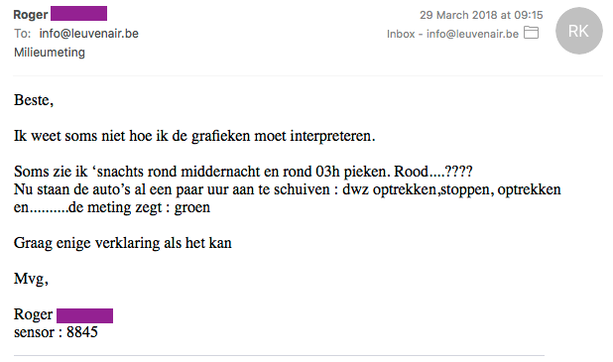
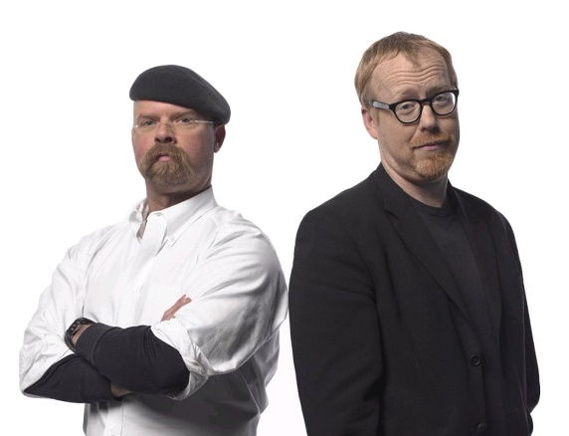

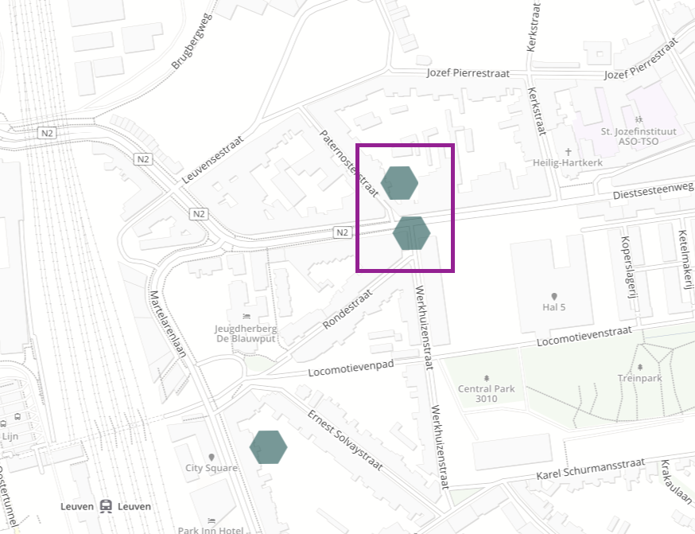
Local effects
Traffic
Fires, BBQ
IS IT SO?

Slide 3
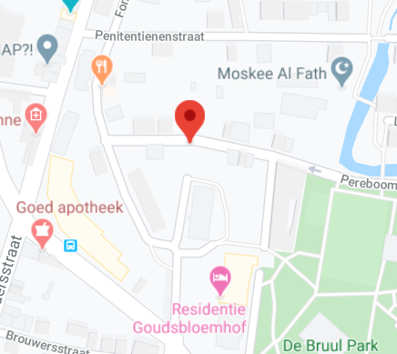
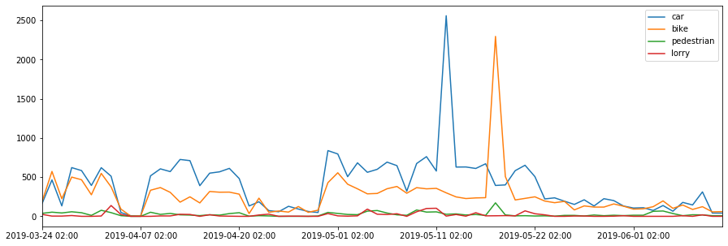
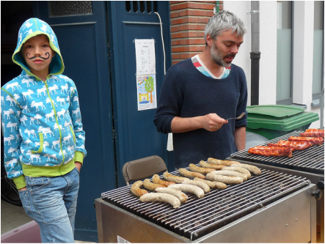
An example
11 may 2019
18 may 2019
Pereboomstraat: 50.884406, 4.693768
Reliable traffic data in Leuven: 5 cameras
Buurtfeest at Pereboomstraat on 18 may 2019
http://www.pereboom.be/buurtfeest-2019.html

Slide 4
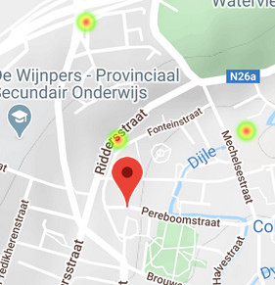
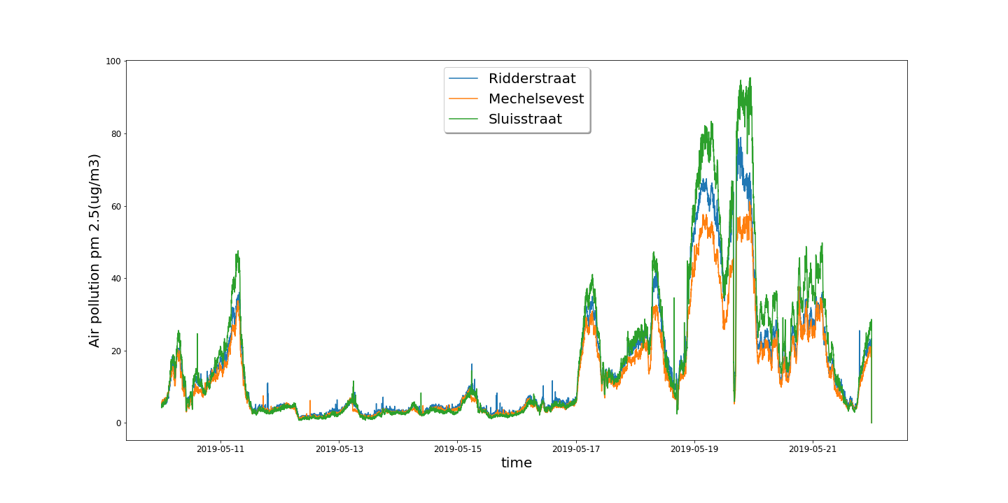
Air pollution

Slide 5
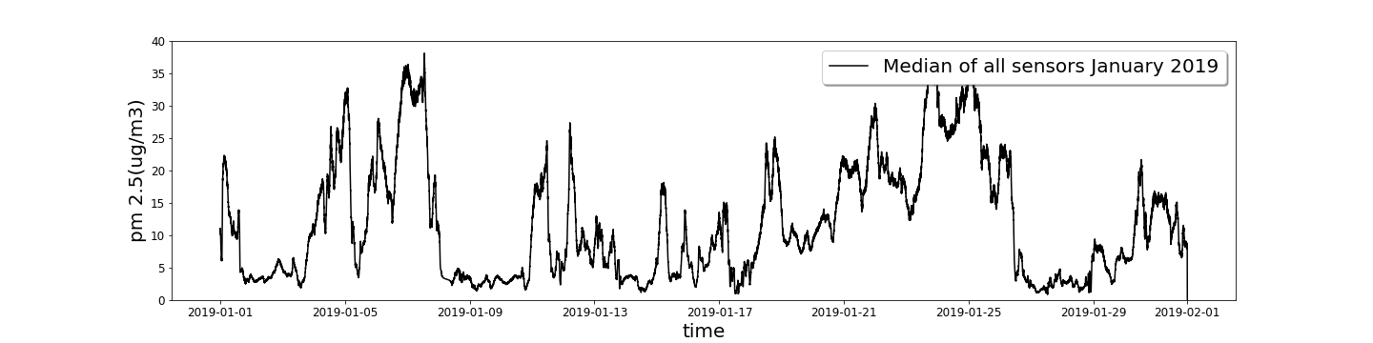
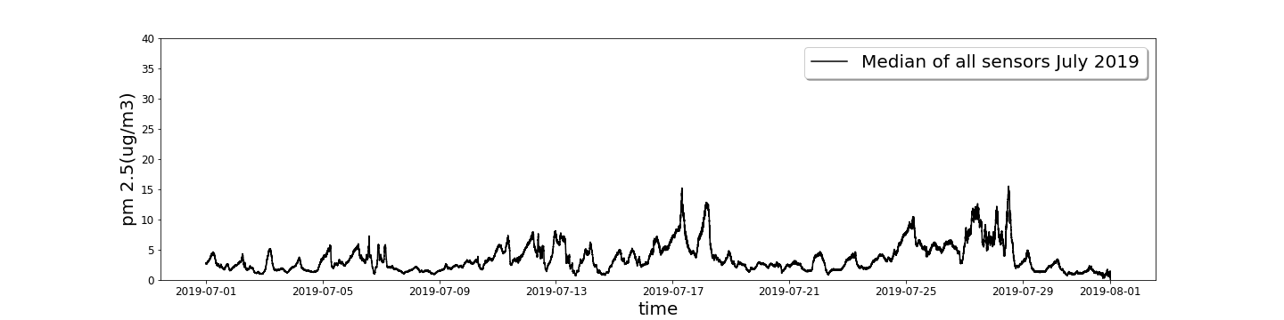
Air pollution by seasons
No Students!
No Heating!

Slide 6
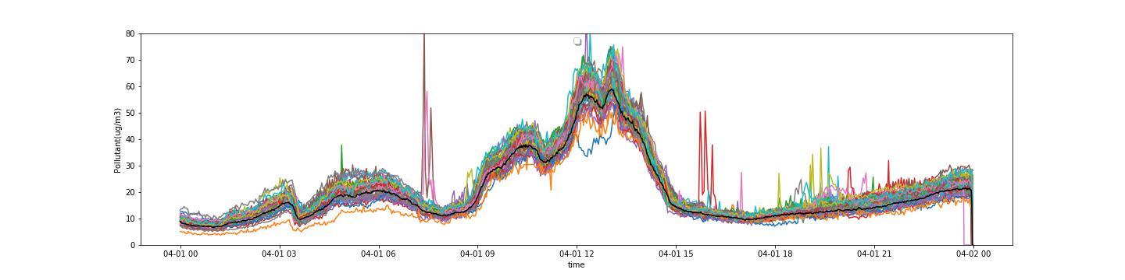
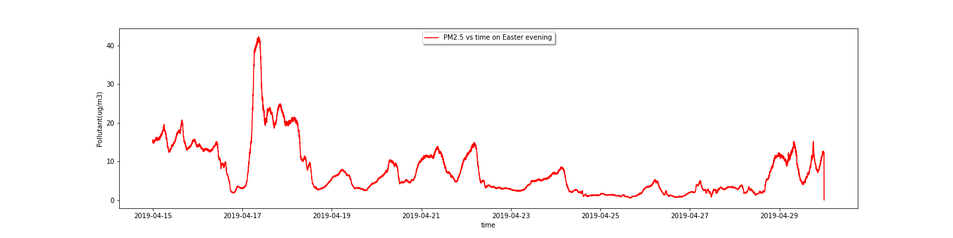
Easter bonfires (?)
Easter 2018
Easter 2019

Slide 7
Thank you for your attention
Question?

