Slide 1
E-Commerce Business Analytics
Revenue
GBP 10,247,219
Orders
19,773
Customers
4,334
Countries
38
Executive findings and recommendations Online Retail | Dec 2010 - Dec 2011

Slide 2
What mattered most
Revenue reached GBP 10,247,219 from 19,773 orders, with an average order value of GBP 518.
Peak trading month was 2011-11 at GBP 1,452,116, and September to November formed the strongest seasonal run-up into year-end.
The business is highly concentrated in the UK (85.1% of revenue), but the Netherlands, EIRE, Germany, and France form a credible international expansion shortlist.
Repeat customers account for 65.3% of identified customers, while the December 2010 cohort retained 50.2% of customers by month 11.
Returns and cancellations reduced value by GBP 893,980, or about 8.7% of clean revenue.
The highest-value promotional window is late morning through mid-afternoon, especially Thursdays at 12:00 and Tuesdays/Thursdays overall.

Slide 3
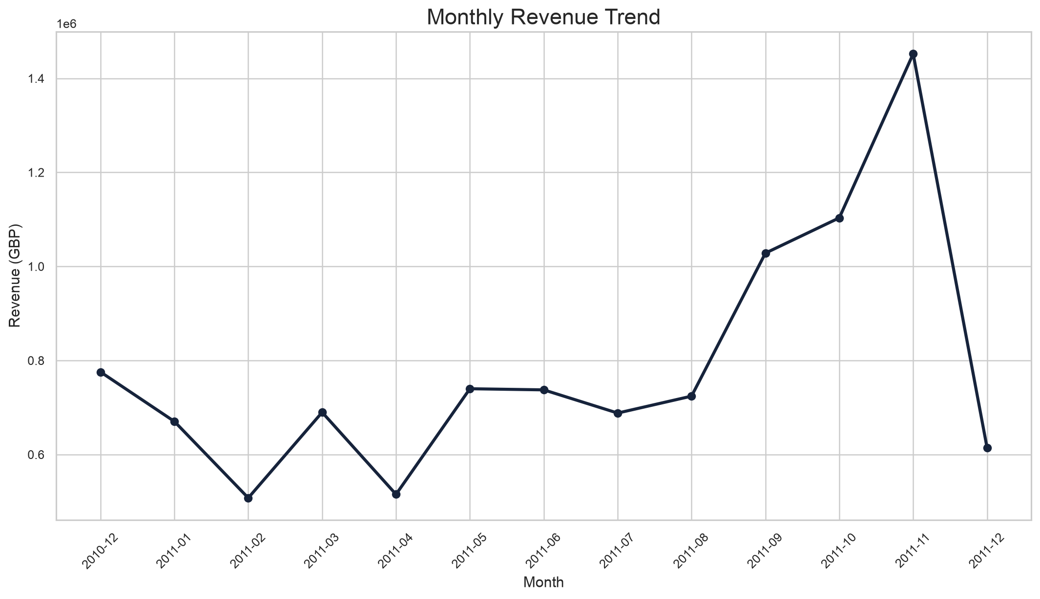
Sales overview
Revenue expanded sharply in the final quarter.
Peak month: 2011-11 at GBP 1,452,116.
September to November created the strongest revenue run-rate.
Average order value reached GBP 518, confirming wholesale-sized baskets.

Slide 4
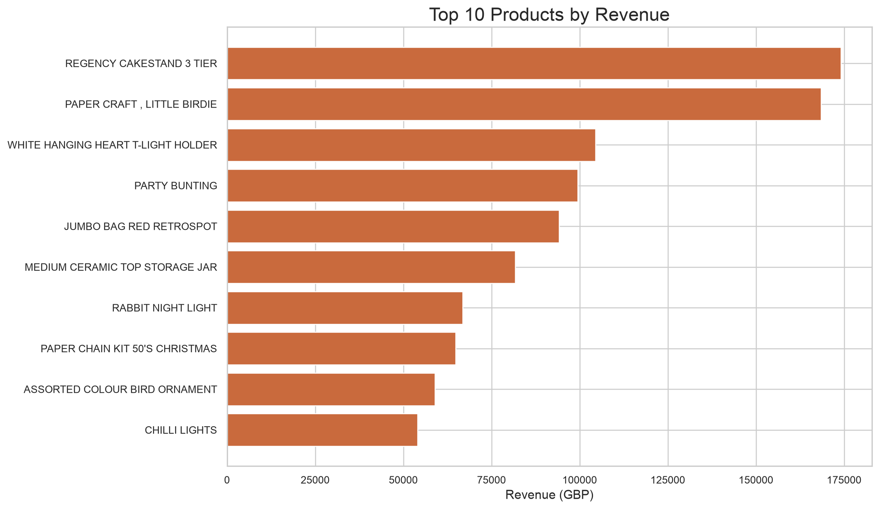
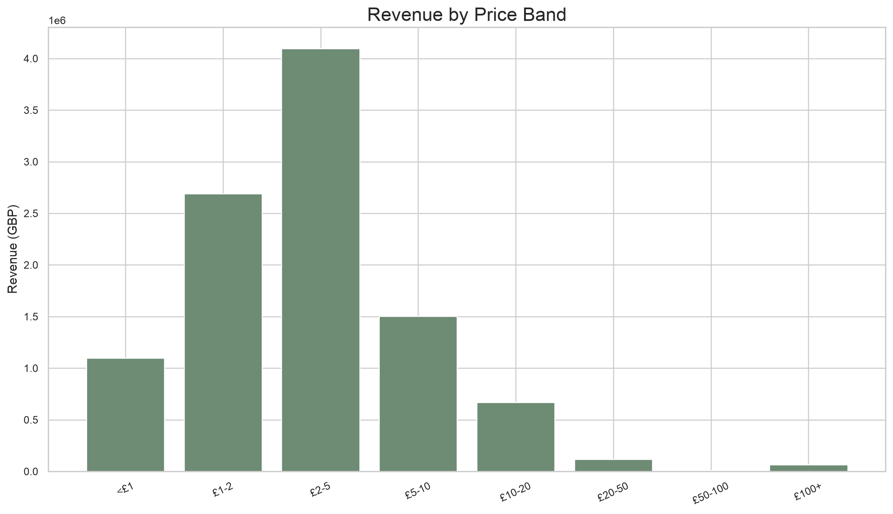
Products and pricing
A small set of hero SKUs carries outsized value.

Slide 5
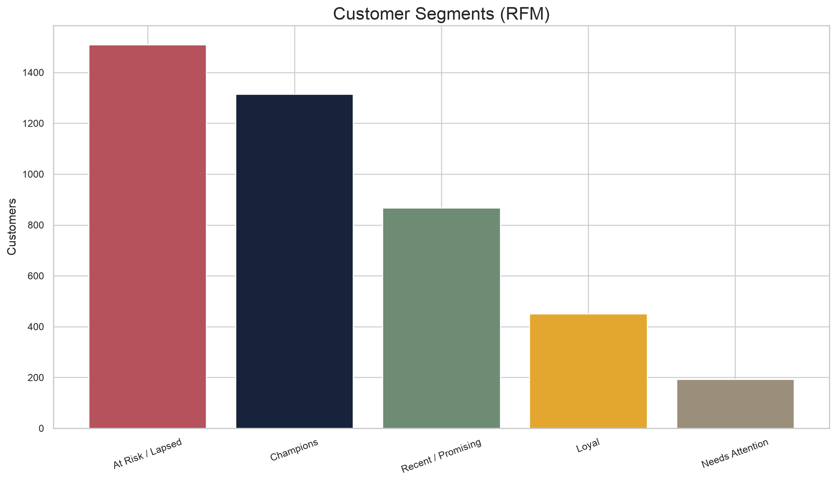
Customer behavior
Repeat business is meaningful, but lapse risk is large.
Repeat customers represent 65.3% of identified customers.
Champions and Loyal customers justify VIP retention motions.
At Risk / Lapsed is the largest segment and the biggest recovery opportunity.

Slide 6
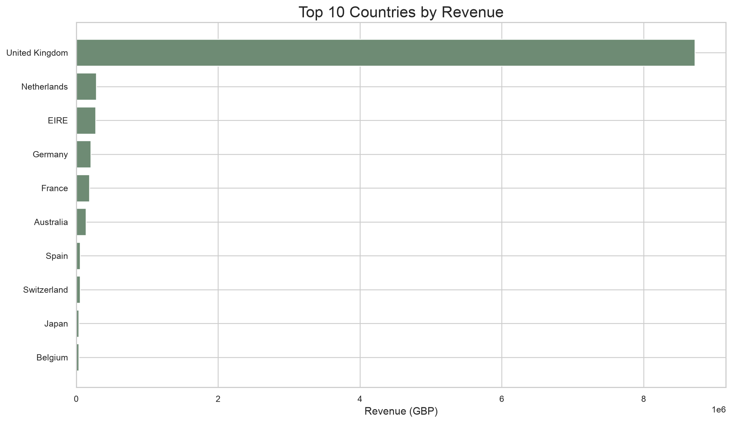
Geographic concentration
The UK dominates, but several export markets already prove demand.
UK share of revenue: 85.1%.
Netherlands, EIRE, Germany, and France are the best initial expansion markets.
International growth can be selective rather than broad and expensive.

Slide 7
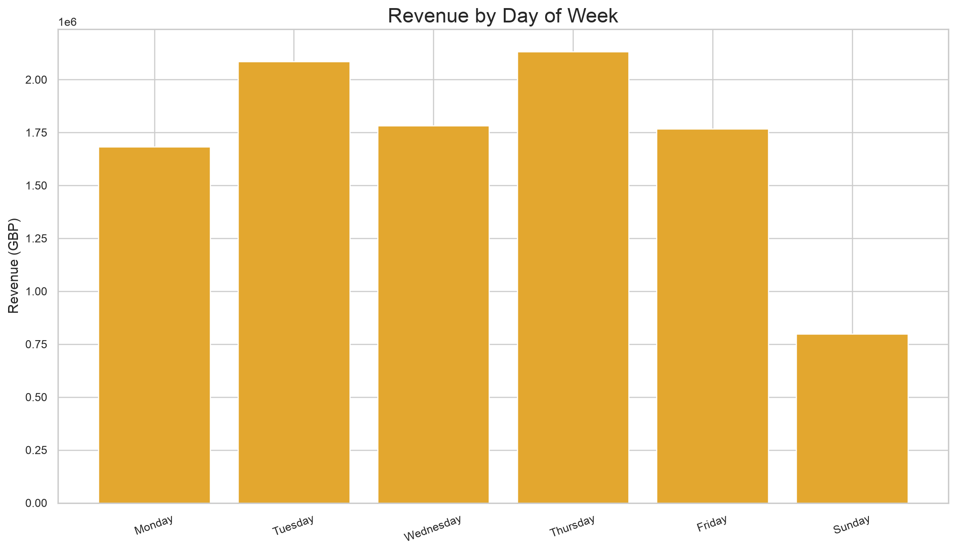
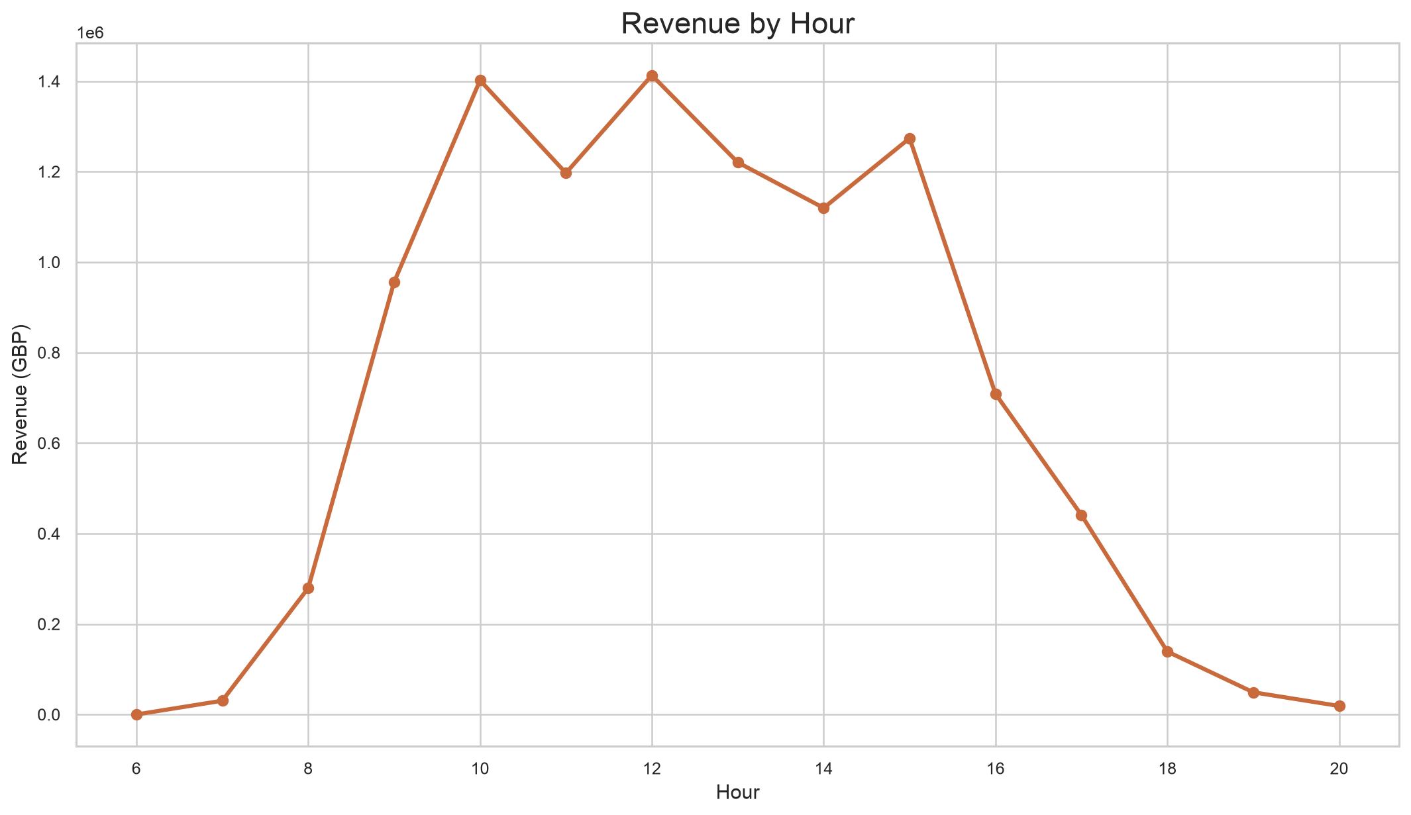
When to promote
High-value trading clusters around midweek business hours.

Slide 8
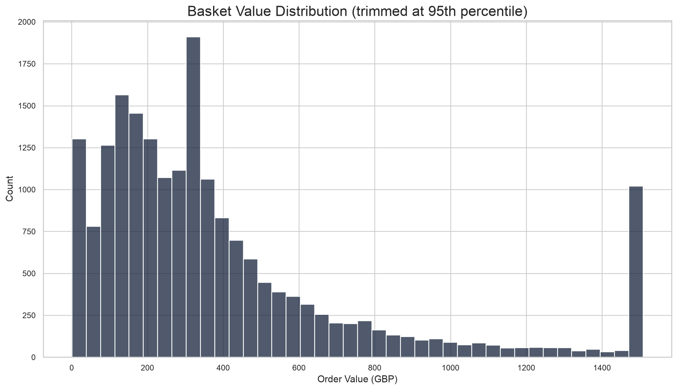
Basket economics
Order values are healthy but skewed by a long right tail.
Average basket value: GBP 518.
Median basket value: GBP 302.
Average distinct items per order: 26.2.

Slide 9
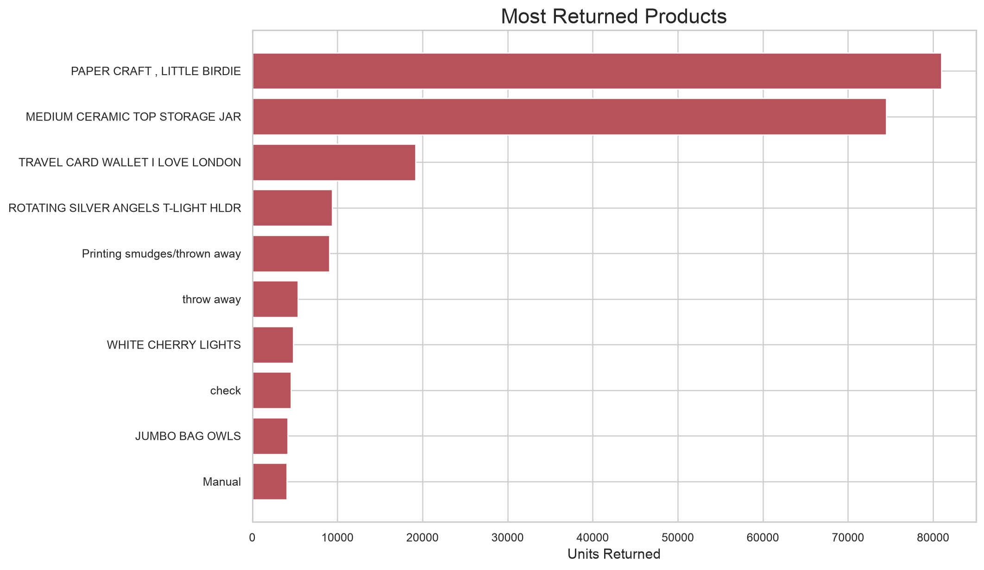
Returns and operational leakage
Returns are manageable overall but concentrated in a handful of codes.
Returns impact: GBP 893,980.
Return-line rate vs total lines: 2.0%.
Manual and operational adjustment codes should be separated from real merchandise return root causes.

Slide 10
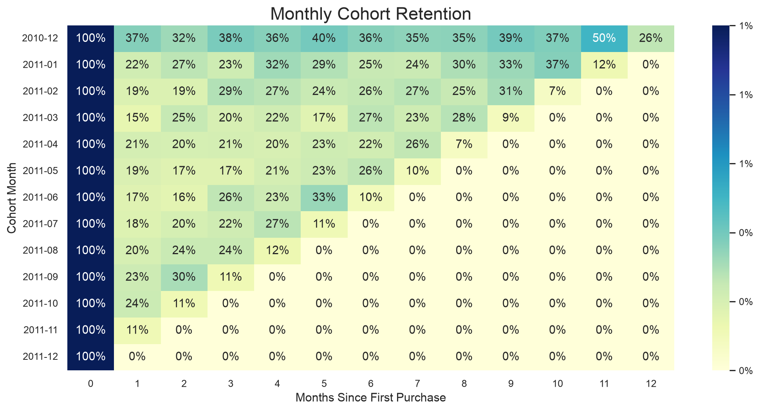
Retention and customer lifetime
Early repeat behavior determines long-run customer value.

Slide 11
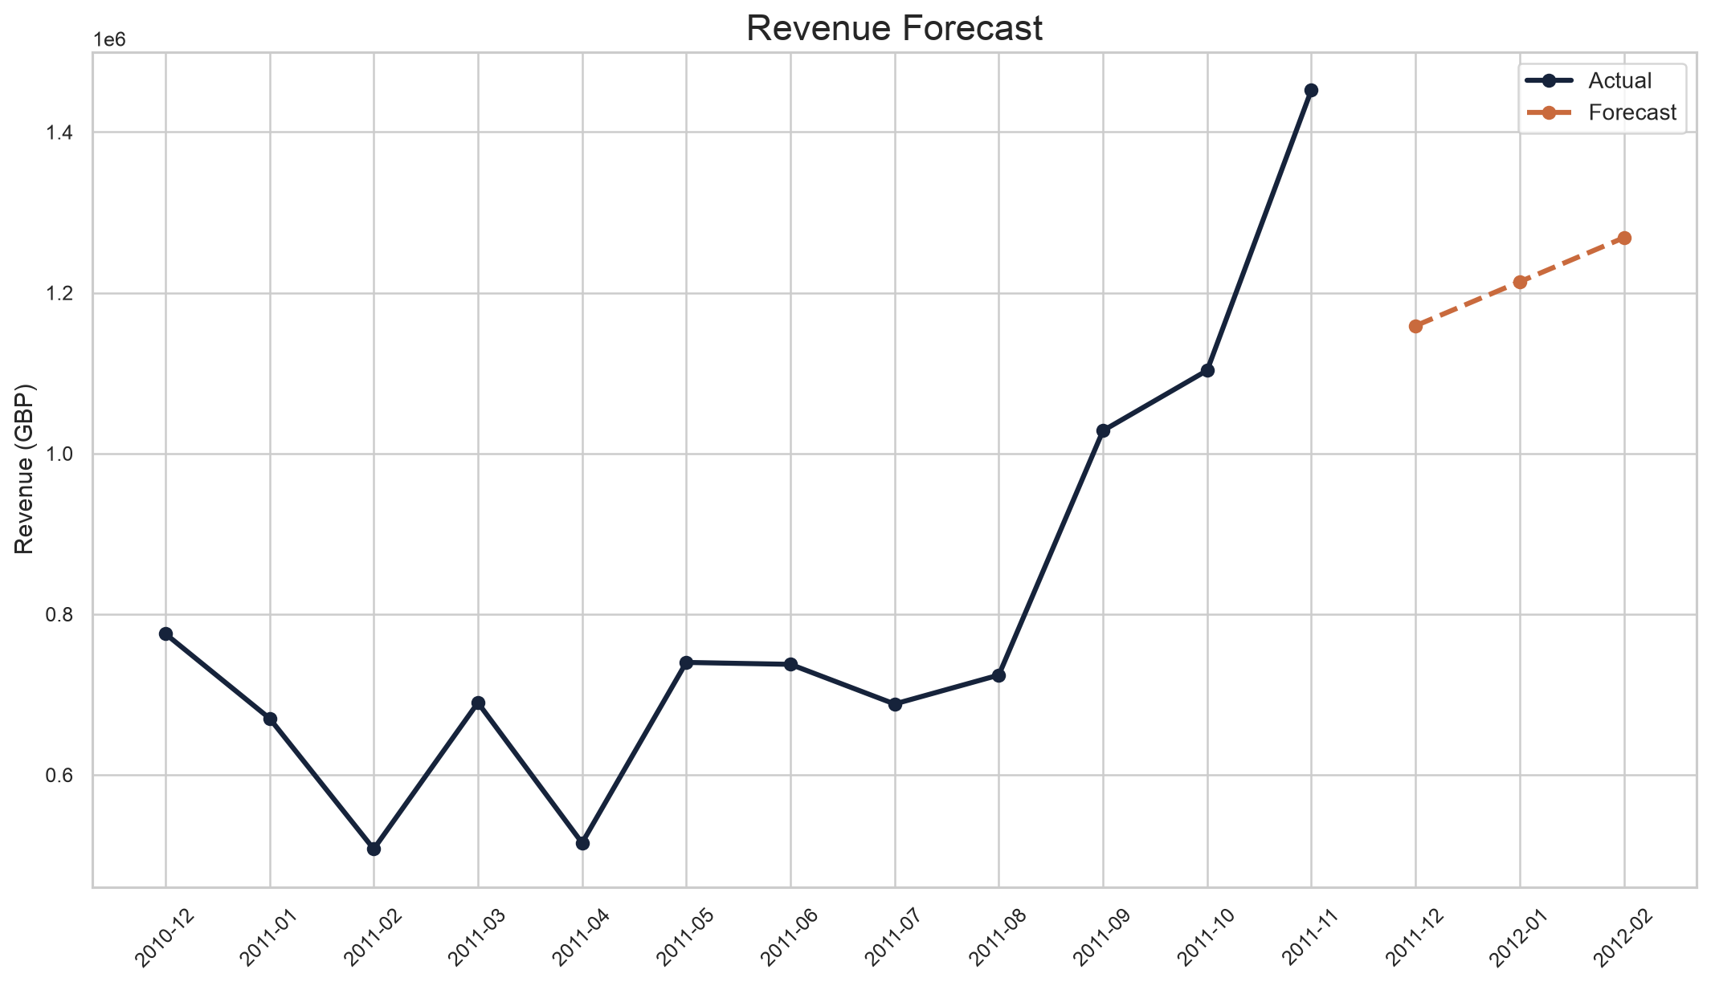
Forecast
Baseline trend points to continued growth into early 2012.
Forecast 2012-01: GBP 1,213,637.
Forecast 2012-02: GBP 1,268,425.
Treat as a baseline trend, then refine with promotion and seasonality assumptions.

Slide 12
Recommended actions
What the business should do next
Defend and scale top giftable SKUs such as REGENCY CAKESTAND 3 TIER, PARTY BUNTING, and JUMBO BAG RED RETROSPOT with priority inventory and featured placement.
Target high-value repeat buyers with replenishment and seasonal launch campaigns 30-45 days after purchase to lift cohort retention.
Concentrate promotional sends on Tuesday through Thursday and schedule merchandising pushes between 10:00 and 15:00 when conversion value is strongest.
Audit the unusually large return lines and manual adjustment codes separately so operational noise does not hide true merchandise returns.
Prioritize expansion tests in the Netherlands, EIRE, Germany, and France before broader international rollout because they already contribute meaningful revenue at low customer counts.

