Slide 1
Monte Carlo methods
Archie dowds, Bobby bazin, Tom Watson, Joshua Hescot, Eoin Mag Ualghairg

Slide 2
Introduction to monte carlo methods

Slide 3

What are monte carlo methods
Named after the Monte Carlo casino in Monaco, Monte Carlo simulation is a type of stochastic simulation.
These methods use randomness to create mathematical models.
Casino de Monte-Carlo, Monaco (Britannica, 2025)
Monte Carlo methods are often used when problems have inherent randomness, like in financial markets, climate modelling, and population growth.

Slide 4

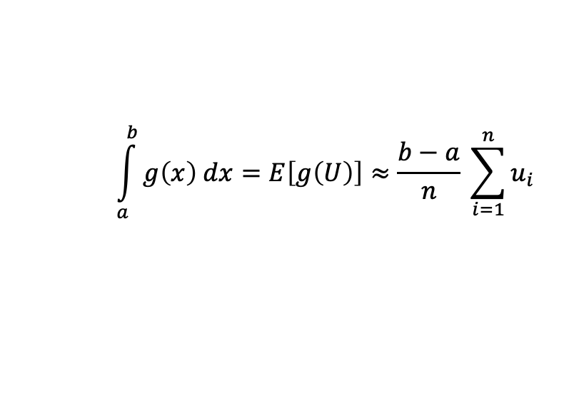
Monte carlo integration
Monte Carlo integration is a method for approximating definite integrals using random variables. It is commonly applied in Monte Carlo Simulation and is widely used in fields such as physics, computer graphics, and biology to solve deterministic problems through randomness (Cragg, J.G., 2018).
Here is an example using uniform distributions.
For a function g(x) that might be difficult to integrate using traditional methods,
$$\int_{a}^{b}{g\left(x\right) dx=E\left[g\left(U\right)\right]≈\frac{b−a}{n} \sum_{i=1}^{n}{u_{i}}}$$
where each
is a sample of a Uniform[a, b] random variable.
$$u_{i}$$
Different distributions can be used for Monte Carlo integration depending on the situation. Using different distributions can yield more accurate results with less samples.

Slide 5

Solving problems with monte carlo methods

Slide 6
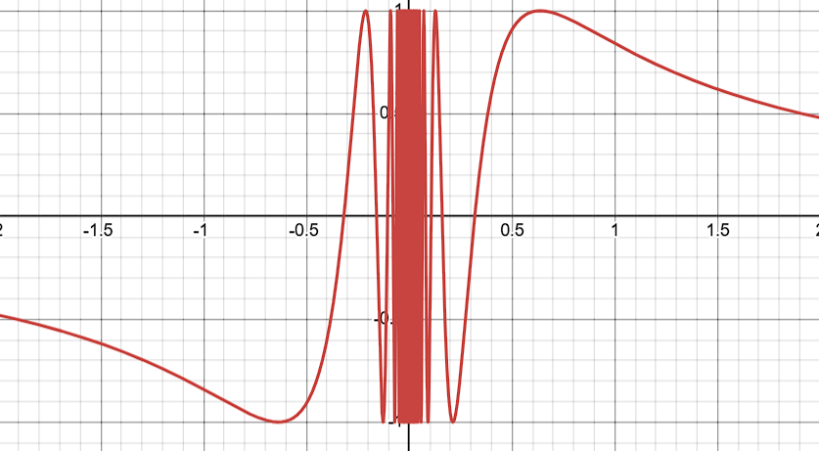
Evaluating an integral using monte carlo integration
In the tutorial sheet, question 5 helps to showcase the use of monte carlo integration.
a) For this question, we are looking at the function y = sin(1/x).
Using desmos, we can plot this, as follows:

Slide 7
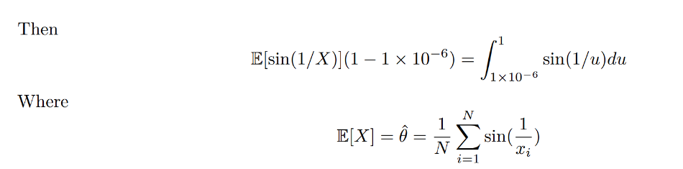

Evaluating an integral using monte carlo integration
b) We are then asked to use Monte Carlo integration to estimate the integral of sin(1/x) between 0 and 1. Since this function is undefined at x=0, we can use a lower bound very close to zero and still get a good estimate.
So now, we can find an estimate for the integral by finding the estimate to E[sin(1/X)].

Slide 8
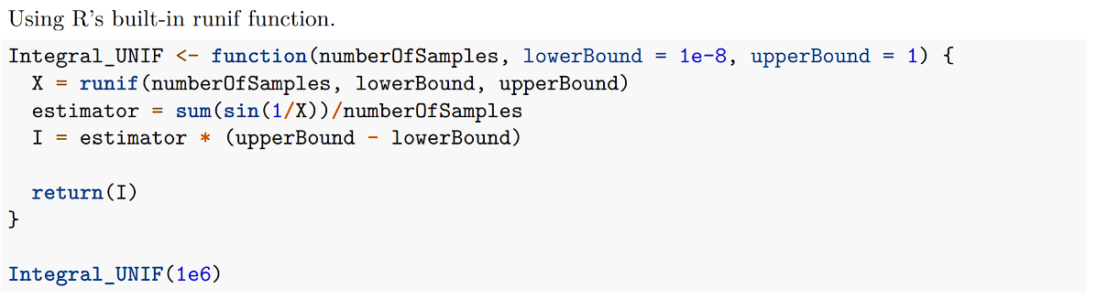
Evaluating an integral using monte carlo integration
Using the following algorithm on R, we compute the value to be approximately 0.5039177.
The approximate value is 0.5040670619 according to Wolfram Alpha, meaning that our approximation is correct to 3 significant figures. If we had used a larger sample, we would get an even better approximation.

Slide 9
Evaluating an integral using monte carlo integration
We investigated using different methods of sampling from a uniform distribution.
Uses the formula X_{n+1} = aX_{n} + d (mod m)
For a full period:
d and m must be coprime
a-1 is divisible by all prime factors of m
If 4 divides m then a-1 must also be divisible by 4
(Hull-Dobell theorem, 1962)
Generally, we pick a = 1664525, d = 1013904223 and m = 2³²
X₀ is the seed for the congruential generator.
Keeping X₀ the same gives reproducible samples.
Changing X₀ changes the values given by the congruential generator.

Slide 10
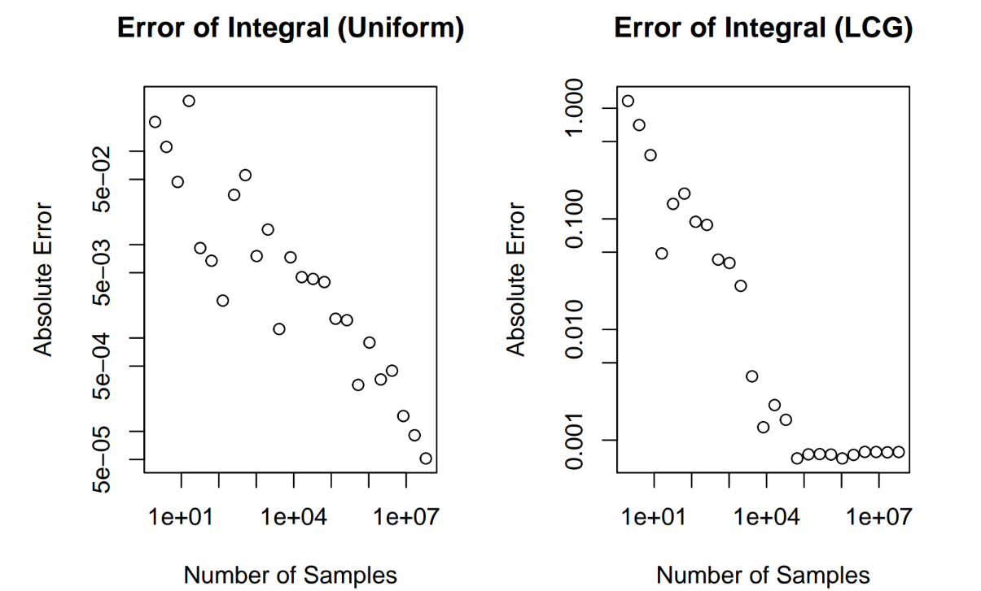
Evaluating an integral using monte carlo integration
Uniform is more accurate across all sample ranges as the LCG plateaus in accuracy past 1x10⁵

Slide 11
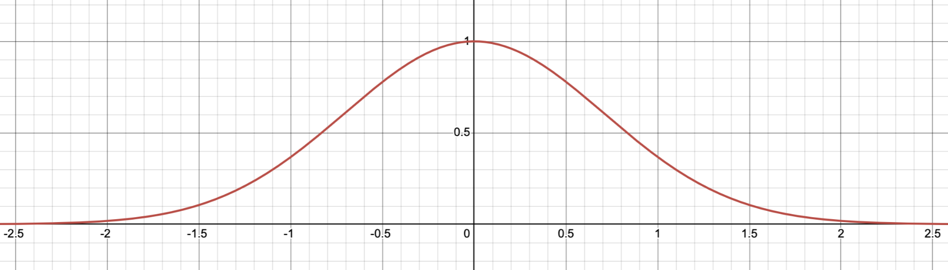

Normal distribution’s CDF using Monte carlo integration
The normal distribution is ubiquitous in statistics and modelling. The PDF of a normal random variable is a scaled gaussian. Unfortunately, gaussians do not have elementary anti-derivative. This makes calculating the CDF of a normal distribution more difficult.
Graph of the gaussian $e^{−x^{2}}$

Slide 12
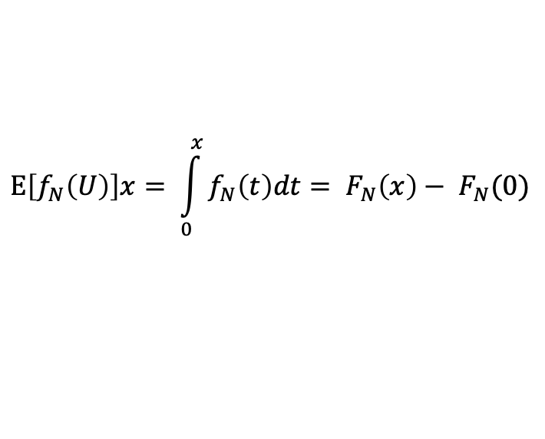
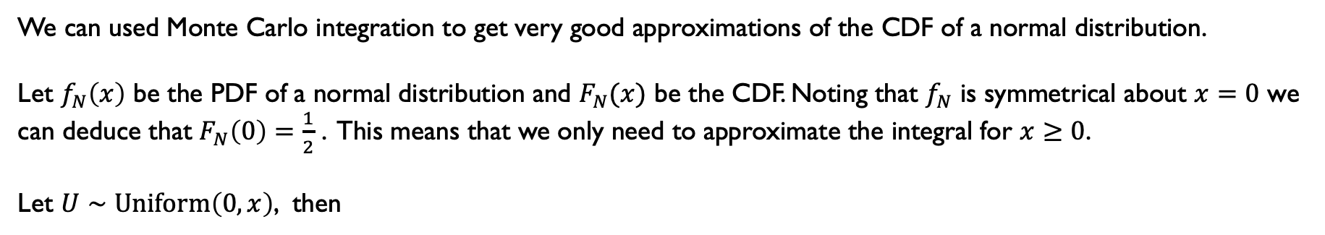
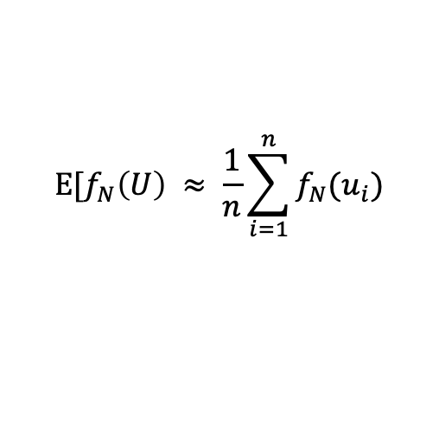
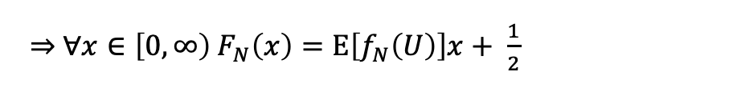
Normal distribution’s CDF using Monte carlo integration
We can used Monte Carlo integration to get very good approximations of the CDF of a normal distribution.
Let $f_{N}\left(x\right)$ be the PDF of a normal distribution and $F_{N}(x)$ be the CDF. Noting that $f_{N}$ is symmetrical about $x=0$ we can deduce that $F_{N}\left(0\right)=\frac{1}{2}$ . This means that we only need to approximate the integral for $x≥0$.
Let $U∼\text{Uniform}\left(0, x\right)$, then
$$\text{E}\left[f_{N}\left(U\right)\right]x= \int_{0}^{x}{f_{N}\left(t\right)dt}= F_{N}\left(x\right)− F_{N}(0)$$
$\underset{⇒}{ } ∀x∈\left[0, ∞\right) F_{N}\left(x\right)=\text{E}\left[f_{N}\left(U\right)\right]x+ \frac{1}{2}$
By taking many samples of $\text{Uniform}\text{(}0, x\text{)}$ and calculating
$$\text{E}\text{[}f_{N}\left(U\right) ≈ \frac{1}{n}\sum_{i=1}^{n}{f_{N}(u_{i})}$$
where $n$ is the number of samples taken and $u_{i}$ is the $i^{\text{th}}$ sample of the uniform distribution.
It is possible to get very accurate approximations for the CDF of a normal distribution.

Slide 13
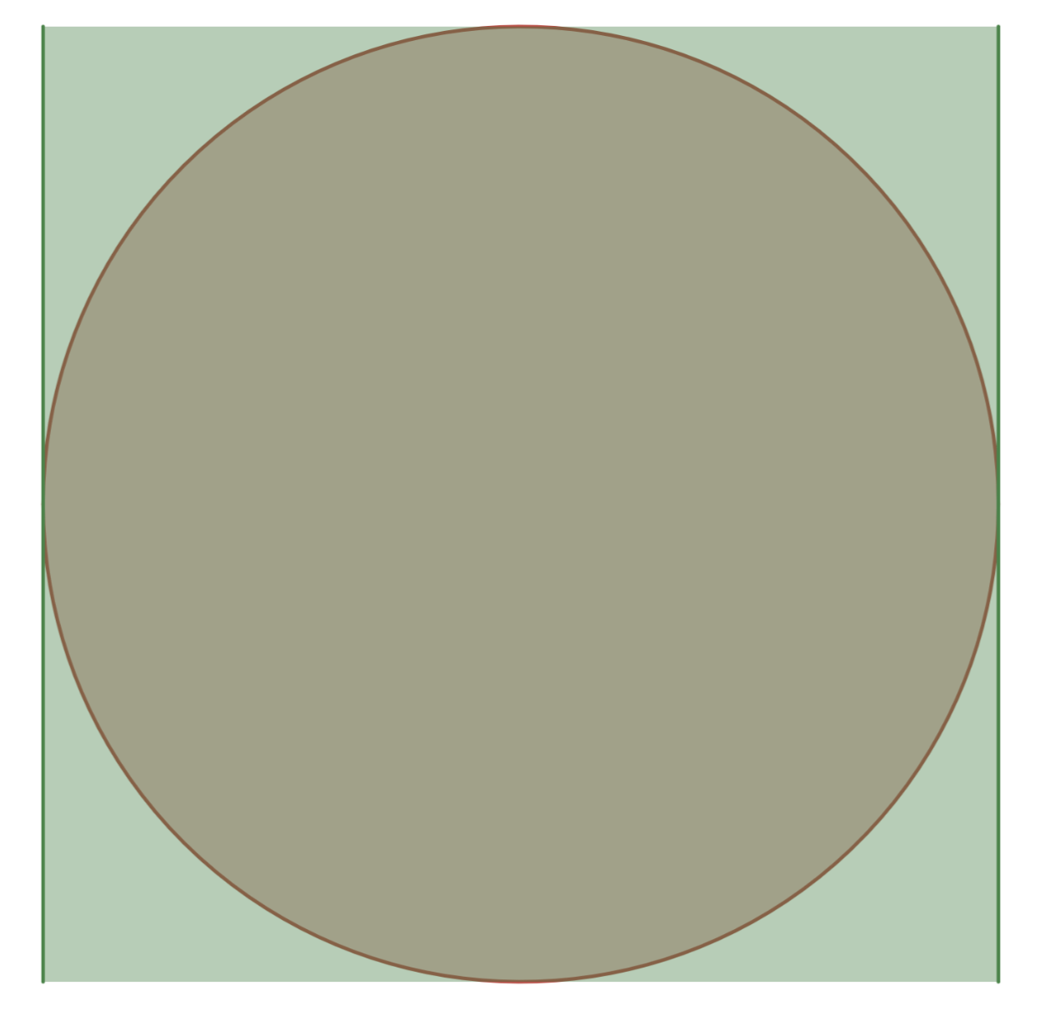
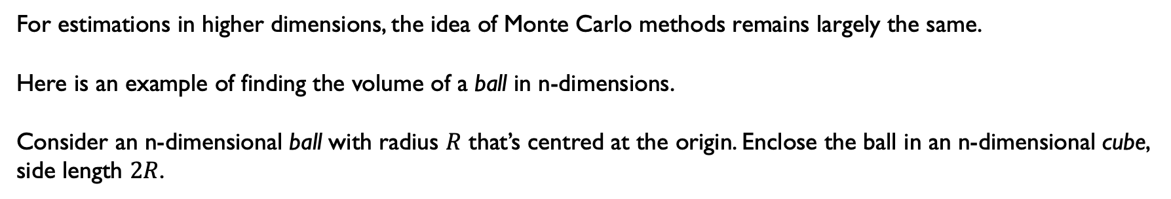
Monte Carlo Methods in n-dimensions
For estimations in higher dimensions, the idea of Monte Carlo methods remains largely the same.
Here is an example of finding the volume of a ball in n-dimensions.
Consider an n-dimensional ball with radius $R$ that’s centred at the origin. Enclose the ball in an n-dimensional cube, side length $2R$.
Note: cube and ball are italicised as notion of a ball in dimensions higher than 3 is very difficult to grasp.
Here n = 2

Slide 14
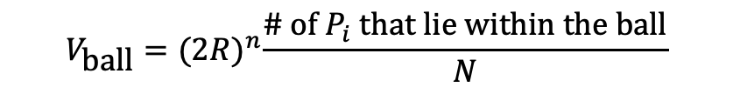
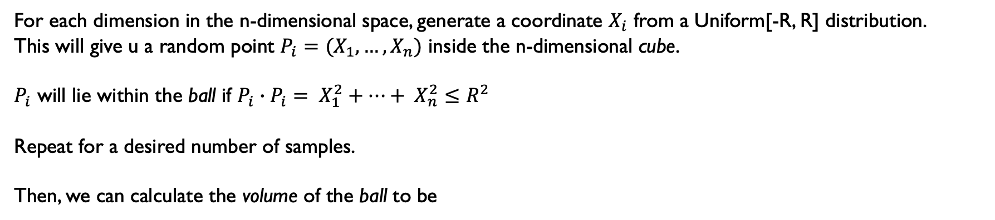

Monte Carlo Methods in n-dimensions
For each dimension in the n-dimensional space, generate a coordinate $X_{i}$ from a Uniform[-R, R] distribution.
This will give u a random point $P_{i}=(X_{1},…,X_{n})$ inside the n-dimensional cube.
$P_{i}$ will lie within the ball if $P_{i}∙P_{i}= X_{1}^{2}+…+ X_{n}^{2}≤R^{2}$
Repeat for a desired number of samples.
Then, we can calculate the volume of the ball to be
$$V_{\text{ball}}={(2R)}^{n}\frac{\text{\# }\text{of} P_{i} \text{that} \text{lie} \text{within} \text{the} \text{ball}}{N}$$
where $N$ is the number of samples taken.
This gives an idea of how Monte Carlo methods can be generalised to higher dimensions.

Slide 15

Applications in the real world

Slide 16
3d graphics

Slide 17
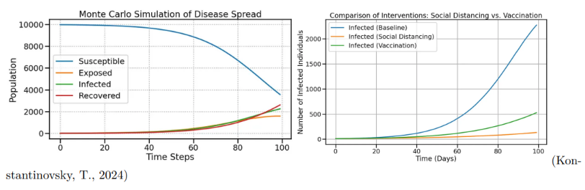
Disease outbreaks
Monte Carlo simulations can model disease transmission and recovery rates
Crucial for estimating uncertainty, lengths and peak of infection
Tests for interventions such as social distancing and vaccinations

Slide 18
References
Casino de Monte-Carlo (no date) Encyclopædia Britannica. Available at: https://www.britannica.com/topic/Casino-de-Monte-Carlo (Accessed: 20 April 2025).
Cragg, J.G. (2018). Monte Carlo Methods. The New Palgrave Dictionary of Economics, pp.9128–9130.
doi:https://doi.org/10.1057/978-1-349-95189-5_733.(Accessed: April 2025).

