Slide 1
Monte Carlo methods
Archie dowds, Bobby bazin, Tom Watson, Joshua Hescot, Eoin Mag Ualghairg

Slide 2

Introduction to monte Carlo Methods

Slide 3
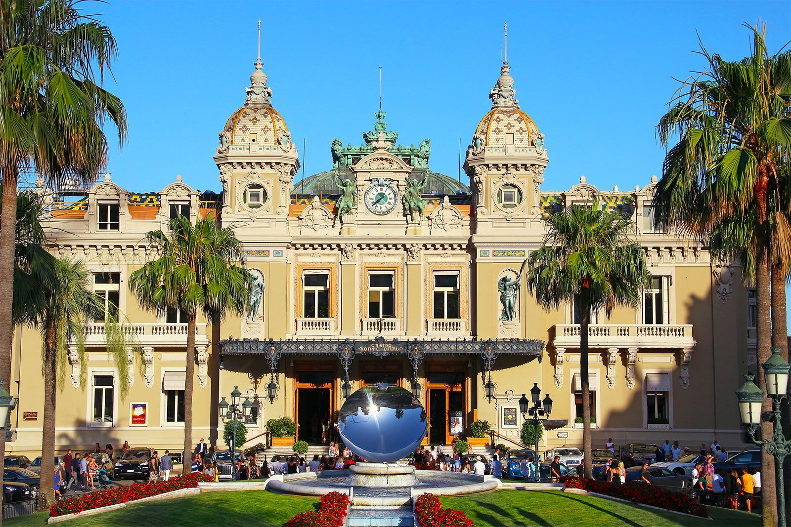
What are monte carlo methods
Named after the Monte Carlo casino in Monaco, Monte Carlo simulation is a type of stochastic simulation.
These methods use randomness to create mathematical models.
Casino de Monte-Carlo, Monaco (Britannica, 2025)
Monte Carlo methods are often used when problems have inherent randomness, like in financial markets, climate modelling, and population growth.

Slide 4

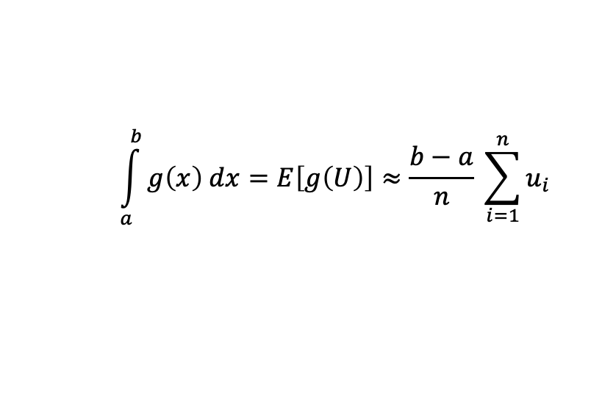
Monte carlo integration
Monte Carlo integration is a method for approximating definite integrals using random variables. It is commonly applied in Monte Carlo Simulation and is widely used in fields such as physics, computer graphics, and biology to solve deterministic problems through randomness (Cragg, J.G., 2018).
Here is an example using uniform distributions.
For a function g(x),
$$\int_{a}^{b}{g\left(x\right) dx=E\left[g\left(U\right)\right]≈\frac{b−a}{n} \sum_{i=1}^{n}{u_{i}}}$$
where each
is a sample of a Uniform[a, b] random variable.
$$u_{i}$$
Different distributions can be used for Monte Carlo integration depending on the situation. Using different distributions can yield more accurate results with less samples.

Slide 5

Solving problems with monte carlo methods

Slide 6
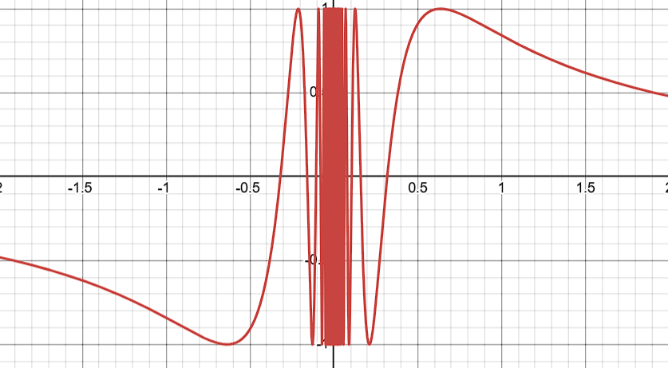
Evaluating an integral using monte carlo integration
In the tutorial sheet, question 5 helps to showcase the use of monte carlo integration.
a) For this question, we are looking at the function y = sin(1/x).
Using desmos, we can plot this, as follows:

Slide 7
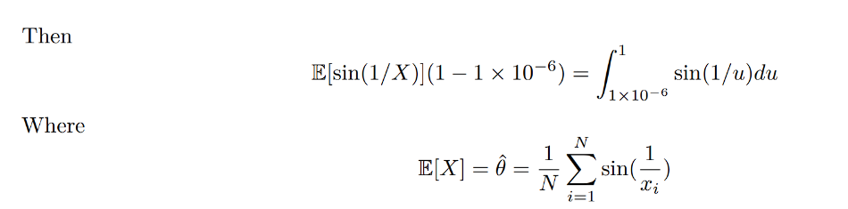

Evaluating an integral using monte carlo integration
b) We are then asked to use Monte Carlo integration to estimate the integral of sin(1/x) between 0 and 1. Since this function is undefined at x = 0, we can use a lower bound very close to zero and still get a good estimate.
So now, we can find an estimate for the integral by finding the estimate to E[sin(1/X)].

Slide 8
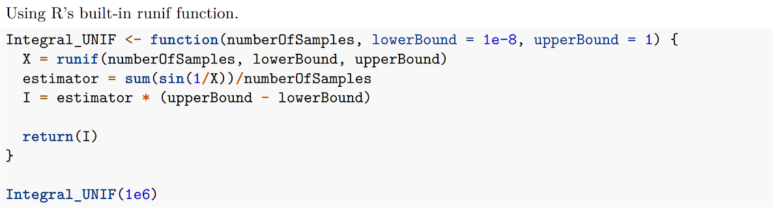
Evaluating an integral using monte carlo integration
Using the following algorithm in R, we compute the value to be approximately 0.5039177.
The approximate value is 0.5040670619 according to Wolfram Alpha, meaning that our approximation is correct to 3 significant figures. If we had used a larger sample, we would get an even better approximation.

Slide 9
Evaluating an integral using monte carlo integration
We approximated the integral using two methods of sampling a uniform distribution, the runif function in R and a linear congruence generator:
Using the recursive formula
X_{n+1} = aX_{n} + d (mod m)
we get pseudorandom samples of a uniform distribution.
For a full period:
d and m must be coprime
a-1 is divisible by all prime factors of m
If 4 divides m then a-1 must also be divisible by 4
(Hull-Dobell theorem, 1962)
Generally, we pick a = 1664525, d = 1013904223 and m = 2³²
X₀ is the seed for the congruential generator.
Keeping X₀ the same gives reproducible samples.
Changing X₀ changes the values given by the congruential generator.

Slide 10
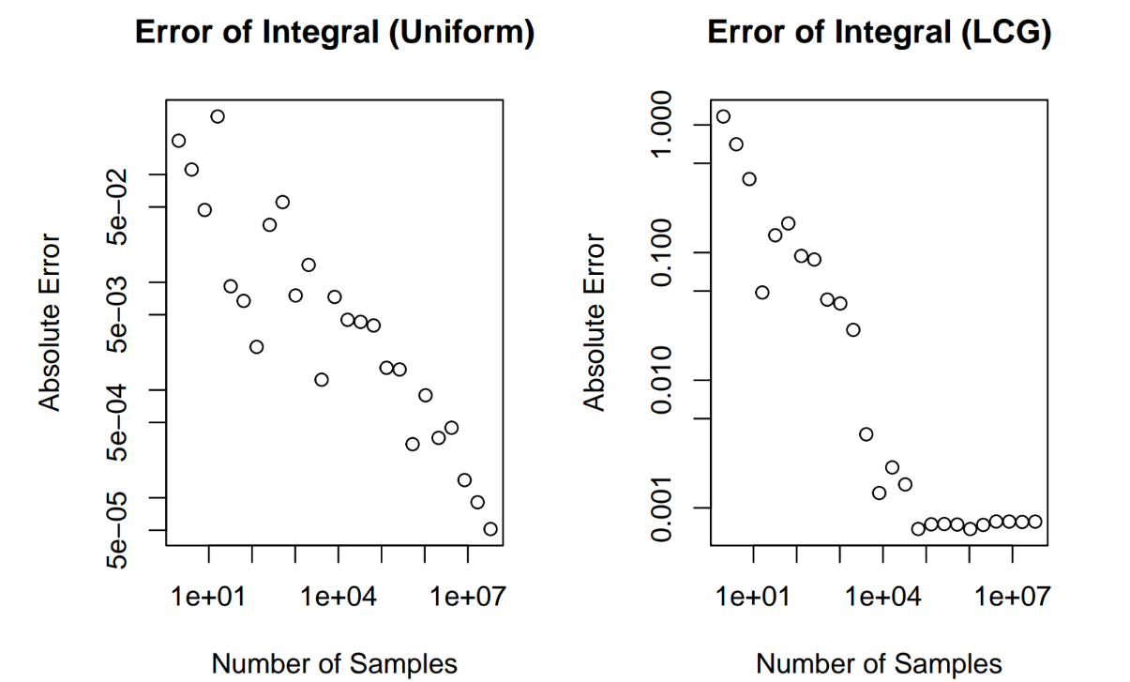
Evaluating an integral using monte carlo integration
Using runif in R is more accurate across all sample ranges as the LCG plateaus in accuracy past 1x10⁵
This could be due to floating point inaccuracies in our implementation, or due to correlations between samples of the LCG.

Slide 11
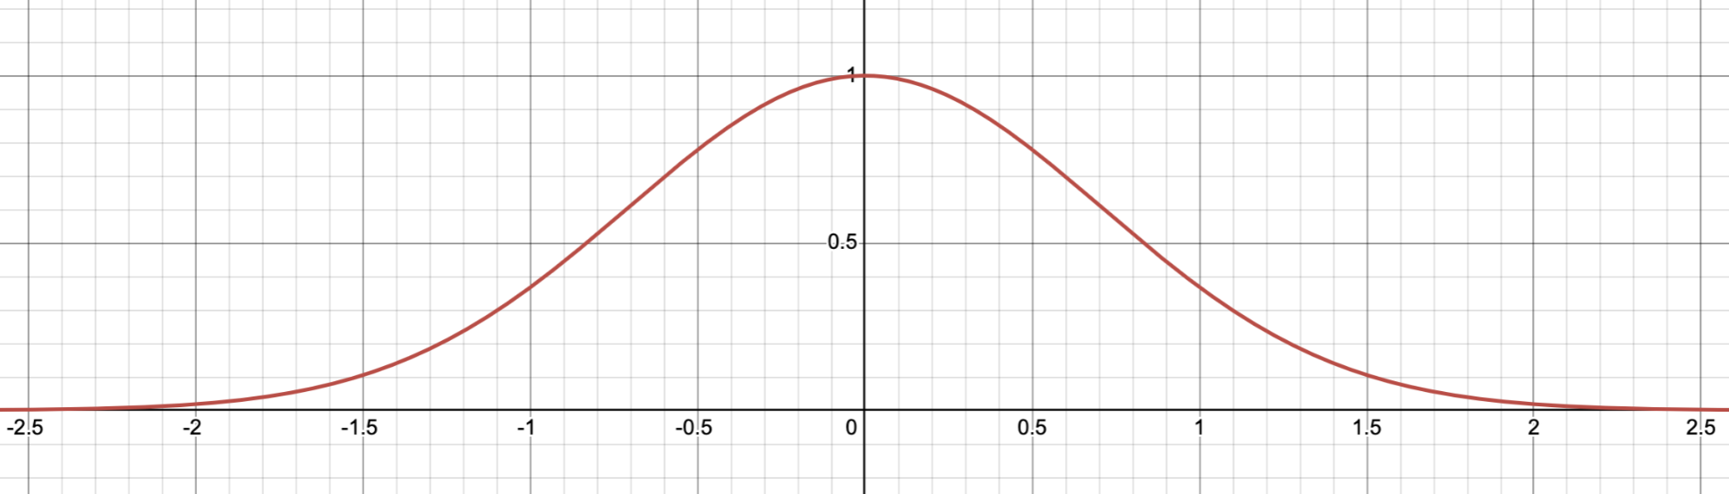

Normal distribution’s CDF using Monte carlo integration
The normal distribution is ubiquitous in statistics and modelling. The PDF of a normal random variable is a scaled gaussian. Unfortunately, gaussians do not have elementary anti-derivative. This makes calculating the CDF of a normal distribution more difficult.
Graph of the gaussian $e^{−x^{2}}$

Slide 12
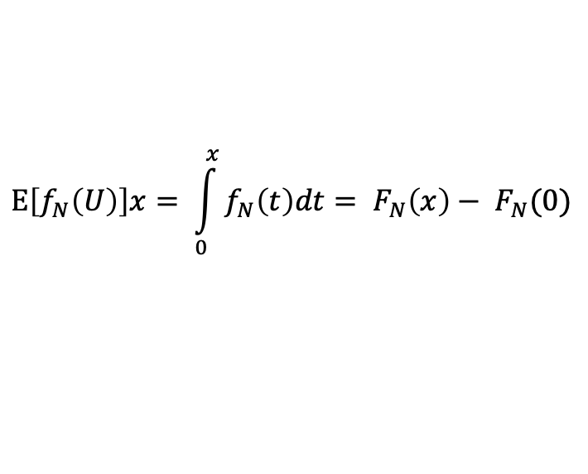
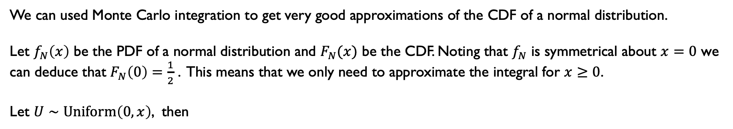
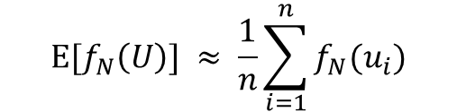
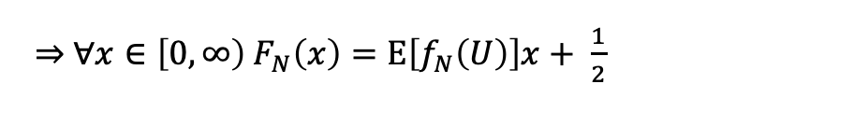
Normal distribution’s CDF using Monte carlo integration
We can used Monte Carlo integration to get very good approximations of the CDF of a normal distribution.
Let $f_{N}\left(x\right)$ be the PDF of a normal distribution and $F_{N}(x)$ be the CDF. Noting that $f_{N}$ is symmetrical about $x=0$ we can deduce that $F_{N}\left(0\right)=\frac{1}{2}$ . This means that we only need to approximate the integral for $x≥0$.
Let $U∼\text{Uniform}\left(0, x\right)$, then
$$\text{E}\left[f_{N}\left(U\right)\right]x= \int_{0}^{x}{f_{N}\left(t\right)dt}= F_{N}\left(x\right)− F_{N}(0)$$
$\underset{⇒}{ } ∀x∈\left[0, ∞\right) F_{N}\left(x\right)=\text{E}\left[f_{N}\left(U\right)\right]x+ \frac{1}{2}$
By taking many samples of $\text{Uniform}\text{(}0, x\text{)}$ and calculating
$$\text{E}\text{[}f_{N}\left(U\right)\text{]} ≈ \frac{1}{n}\sum_{i=1}^{n}{f_{N}(u_{i})}$$
where $n$ is the number of samples taken and $u_{i}$ is the $i^{\text{th}}$ sample of the uniform distribution.
It is possible to get very accurate approximations for the CDF of a normal distribution.

Slide 13
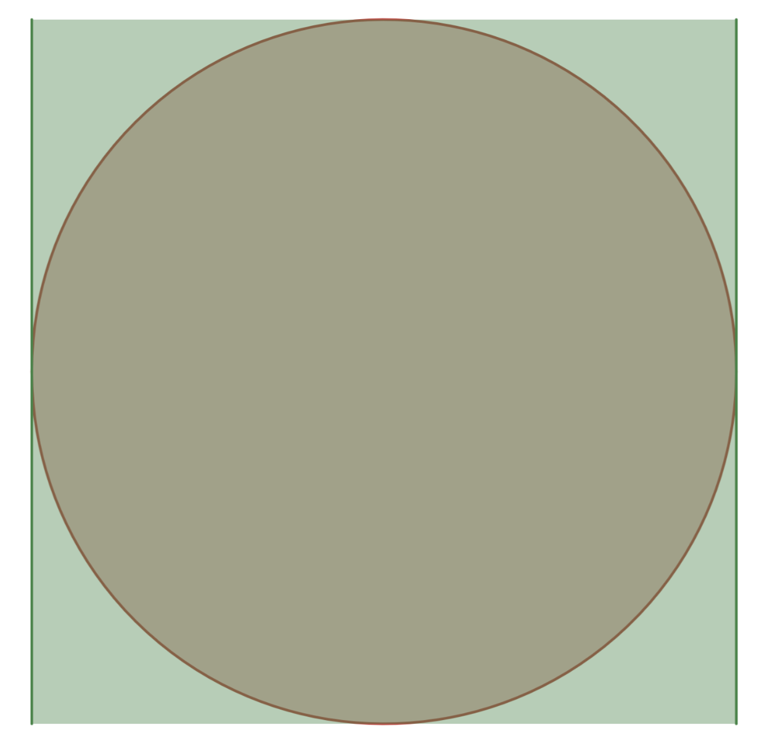
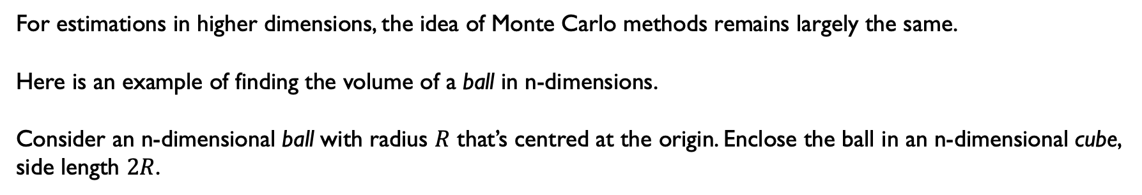
Monte Carlo Methods in n-dimensions
For estimations in higher dimensions, the idea of Monte Carlo methods remains largely the same.
Here is an example of finding the volume of a ball in n-dimensions.
Consider an n-dimensional ball with radius $R$ that’s centred at the origin. Enclose the ball in an n-dimensional cube, side length $2R$.
Note: cube and ball are italicised as the notion of a ball in dimensions higher than 3 is very difficult to grasp.
Here n = 2

Slide 14
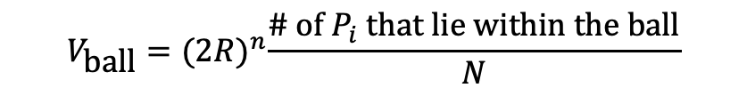
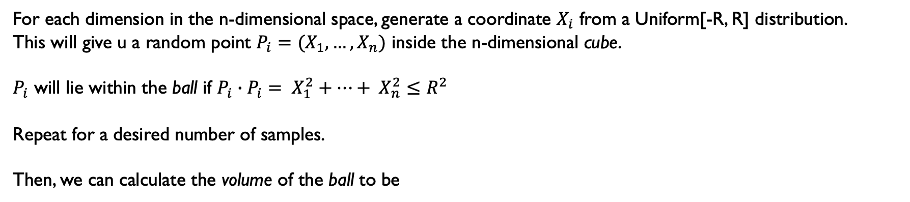
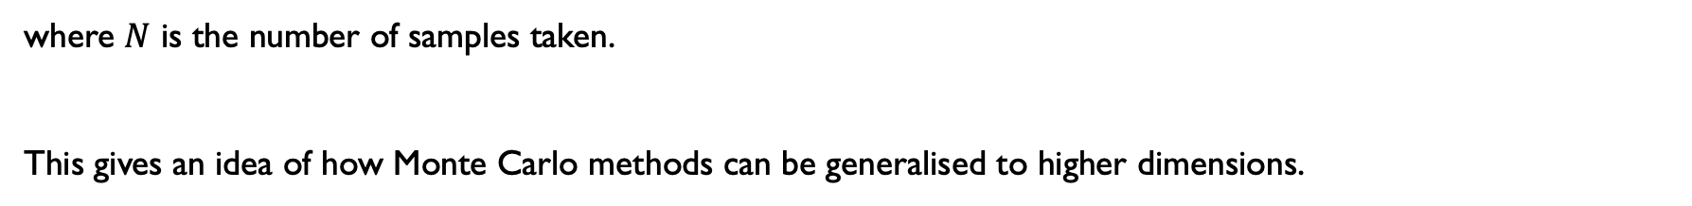
Monte Carlo Methods in n-dimensions
For each dimension in the n-dimensional space, generate a coordinate $X_{i}$ from a Uniform[-R, R] distribution.
This will give u a random point $P_{i}=(X_{1},…,X_{n})$ inside the n-dimensional cube.
$P_{i}$ will lie within the ball if $P_{i}∙P_{i}= X_{1}^{2}+…+ X_{n}^{2}≤R^{2}$
Repeat for a desired number of samples.
Then, we can calculate the volume of the ball to be
$$V_{\text{ball}}={(2R)}^{n}\frac{\text{\# }\text{of} P_{i} \text{that} \text{lie} \text{within} \text{the} \text{ball}}{N}$$
where $N$ is the number of samples taken.
This gives an idea of how Monte Carlo methods can be generalised to higher dimensions.

Slide 15

Applications in the real world

Slide 16
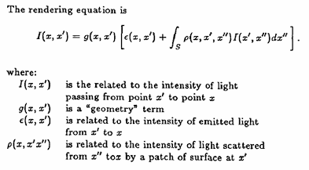
3d graphics
Monte Carlo integration can be used for and is widely considered the best method for ray tracing. In a 3D rendering of a realistic scene, for example an architectural model or CGI in a film, there needs to be accurate lighting. With multiple light sources, reflections, shadows this quickly becomes very complicated. So, in 1986, Kajiya devised the "rendering equation" which accurately defined the light level at different points.
The rendering equation, as shown on the right, is a complex integral which by itself was not very useful as it is too complex to solve, especially in real time to run a simulation. However, with the use of Monte Carlo methods and improvements in technology, it has become feasible to use, and many 3D games or simulations now use ray tracing.
This works by repeatedly tracing random samples of the paths light rays can take, and finding an average solution, which would converge to the actual solution to the rendering equation as the number of repetitions increases.
The rendering equation, taken from Kajiya's article "The rendering equation" (Kajiya J. T., 1986)

Slide 17
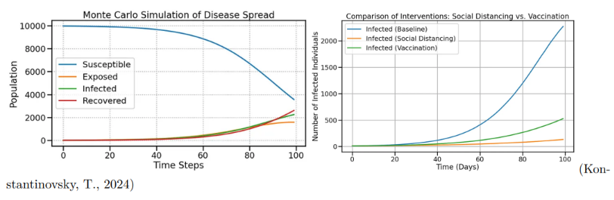
Disease outbreaks
Monte Carlo simulations can model disease transmission and recovery rates
Crucial for estimating uncertainty, lengths and peak of infection
Tests for interventions such as social distancing and vaccinations

Slide 18
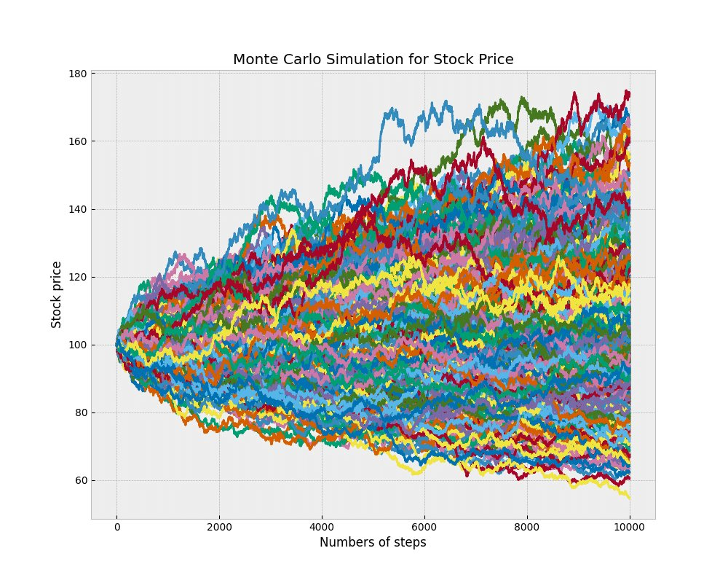
Options pricing
Options are contracts in which you can buy/sell an asset at a later date
for a stated price. Commonly traded by institutional investors running
many large simulations of price movements, based on stochastic
models like Geometric Brownian Motion.​
The 3 basic steps are as follows;​
1) Simulate many potential price paths for the assets over the
lifespan of the contract.​
2) Determine the payoff, which depends on the volatility, strike price,
simulated underlying asset price etc.​
3) Discount the simulated return, back to the present value and find
an average to assess the options fair price. This is the price you
would pay considering the value relative to a risk-free investment.
(Lab, T.P., 2023)​
Stochastic methods such as this are often used when numerical-
analysis methods like the Black-Scholes equation, can’t be applied for
various reasons, such as lack of flexibility and difficulty with volatility.​

Slide 19
References
Casino de Monte-Carlo (no date) Encyclopædia Britannica. Available at: https://www.britannica.com/topic/Casino-de-Monte-Carlo (Accessed: 20 April 2025).
Cragg, J.G. (2018). Monte Carlo Methods. The New Palgrave Dictionary of Economics, pp.9128–9130.
doi:https://doi.org/10.1057/978-1-349-95189-5_733.(Accessed: April 2025).
Kajiya, J. T. (1986). “The rendering equation”. Proceedings of the 13th annual conference on Computer​
graphics and interactive techniques. ACM. (Accessed: April 2025).​
Lab, T.P. (2023). Implementing Option Pricing Models using Monte Carlo Simulations. [online] Medium. Available at: https://thepythonlab.medium.com/implementing-option-pricing-models-using-monte-carlosimulations-1b9c0a62436f (Accessed: April 2025).
Konstantinovsky, T. (2024). Monte Carlo Simulation: Ideas and Examples for Advanced Applications. [online] Medium. Available at: https://medium.com/pythoneers/monte-carlo-simulation-ideas-and-examples-foradvanced-day-to-day-applications-447ec3ce9063. (Accessed: April 2025).

