Slide 1
Monte Carlo methods
Archie dowds, Bobby bazin, Tom Watson, Joshua Hescot, Eoin Mag Ualghairg

Slide 2
Introduction to monte carlo methods

Slide 3
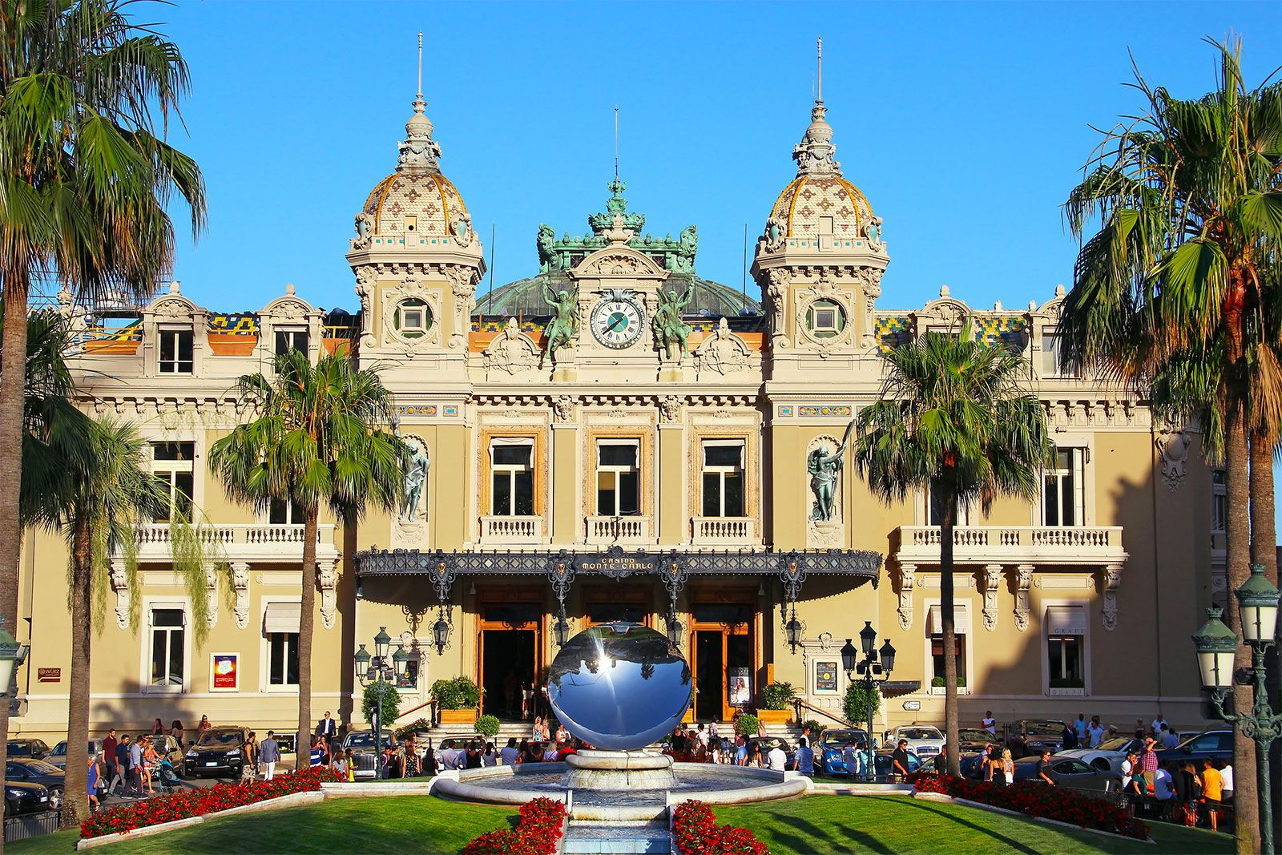
What are monte carlo methods
Named after the Monte Carlo casino in Monaco, Monte Carlo simulation is a type of stochastic simulation.
These methods use randomness to create mathematical models.
Casino de Monte-Carlo, Monaco (Britannica, 2025)
Monte Carlo methods are often used when problems have inherent randomness, like in financial markets, climate modelling, and population growth.

Slide 4

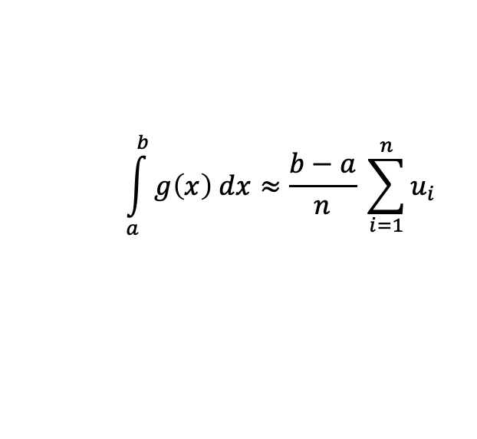
Monte carlo integration
Monte Carlo integration is a method for approximating definite integrals using random variables. It is commonly applied in Monte Carlo Simulation and is widely used in fields such as physics, computer graphics, and biology to solve deterministic problems through randomness (Cragg, J.G., 2018).
Here is an example using uniform distributions.
For a function g(x) that might be difficult to integrate using traditional methods,
$$\int_{a}^{b}{g\left(x\right) dx≈\frac{b−a}{n} \sum_{i=1}^{n}{u_{i}}}$$
where each
$$u_{i}$$
is a sample of a Uniform[a, b] random variable.
Different distributions can be used for Monte Carlo integration depending on the situation. Using different distributions can yield more accurate results with less samples.

Slide 5

Solving problems with monte carlo methods

Slide 6
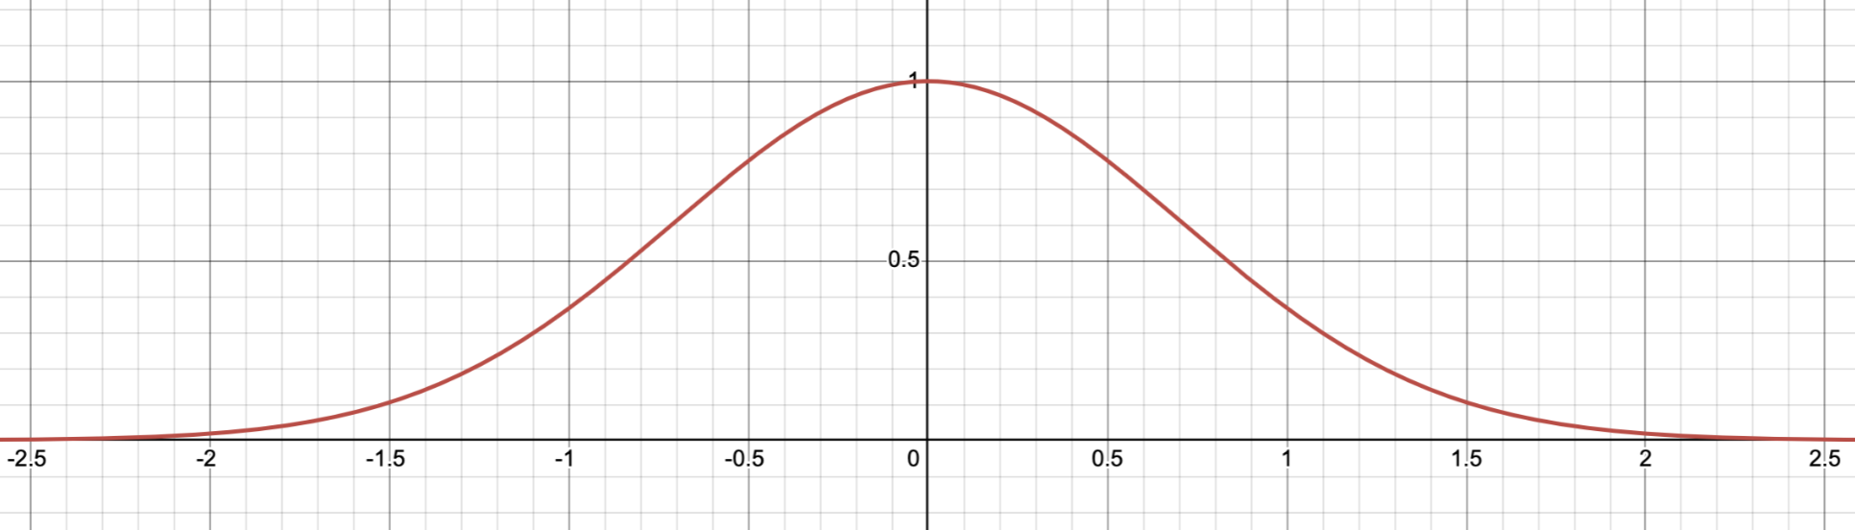

Normal distribution’s CDF using Monte carlo integration
The normal distribution is ubiquitous in statistics and modelling. The PDF of a normal random variable is a scaled gaussian. Famously, gaussians do not have elementary anti-derivative. This makes calculating the CDF of a normal distribution more difficult.
Graph of the gaussian $e^{−x^{2}}$

Slide 7
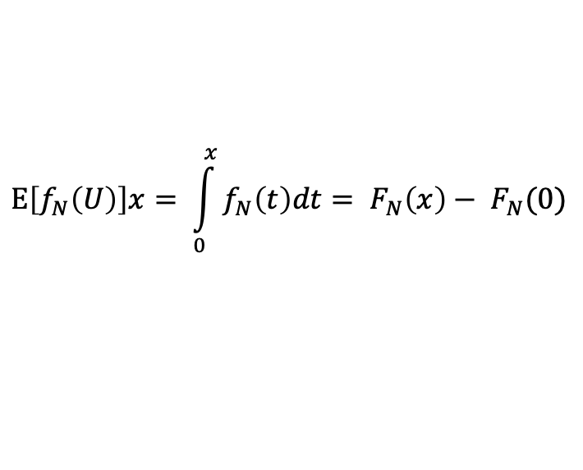
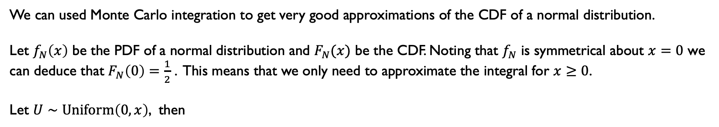
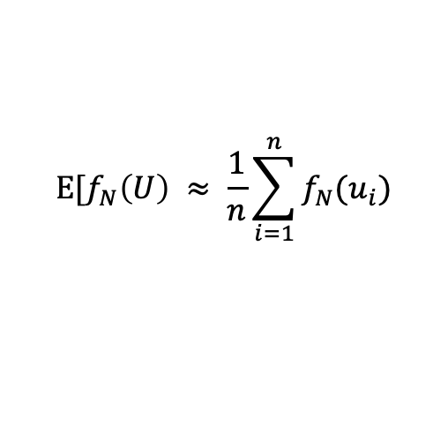
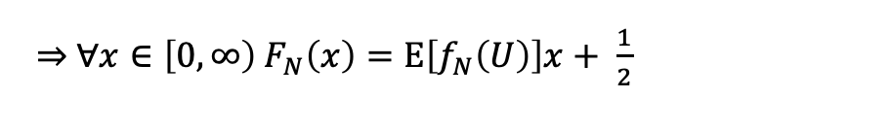
Normal distribution’s CDF using Monte carlo integration
We can used Monte Carlo integration to get very good approximations of the CDF of a normal distribution.
Let $f_{N}\left(x\right)$ be the PDF of a normal distribution and $F_{N}(x)$ be the CDF. Noting that $f_{N}$ is symmetrical about $x=0$ we can deduce that $F_{N}\left(0\right)=\frac{1}{2}$ . This means that we only need to approximate the integral for $x≥0$.
Let $U∼\text{Uniform}\left(0, x\right)$, then
$$\text{E}\left[f_{N}\left(U\right)\right]x= \int_{0}^{x}{f_{N}\left(t\right)dt}= F_{N}\left(x\right)− F_{N}(0)$$
$\underset{⇒}{ } ∀x∈\left[0, ∞\right) F_{N}\left(x\right)=\text{E}\left[f_{N}\left(U\right)\right]x+ \frac{1}{2}$
By taking many samples of $\text{Uniform}\text{(}0, x\text{)}$ and calculating
$$\text{E}\text{[}f_{N}\left(U\right) ≈ \frac{1}{n}\sum_{i=1}^{n}{f_{N}(u_{i})}$$
where $n$ is the number of samples taken and $u_{i}$ is the $i^{\text{th}}$ sample of the uniform distribution.
It is possible to get very accurate approximations for the CDF of a normal distribution.

Slide 8
Congruential generator
Uses the formula X_{n+1} = aX_{n} + d (mod m)
For a full period:
d and m must be coprime
a-1 is divisible by all prime factors of m
If 4 divides m then a-1 must also be divisible by 4
(Hull-Dobell theorem, 1962)
Generally, we pick a = 1664525, d = 1013904223 and m = 2³²
Reproducible if X₀ is the same each time, but only producing a pseudorandom result
Or generate X₀ randomly for a more effective approach

Slide 9
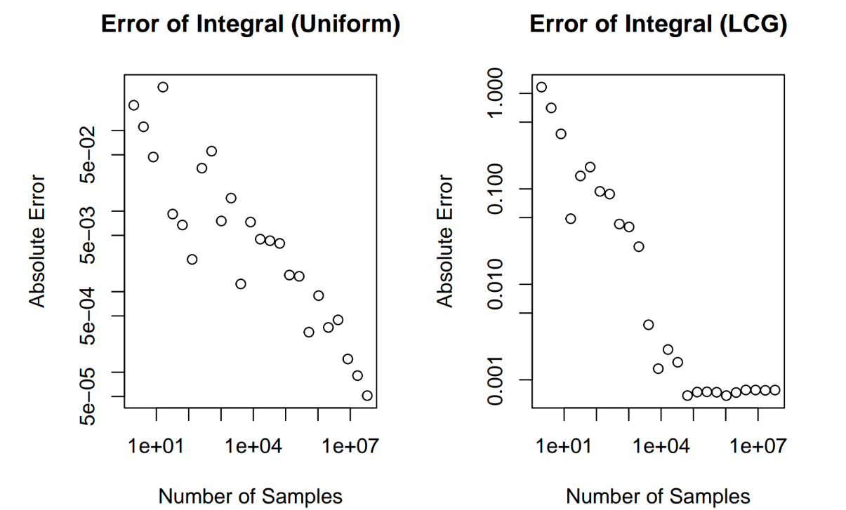
Uniform or LCG?
Uniform is more accurate across all sample ranges as the LCG plateaus in accuracy past 1x10⁵

Slide 10
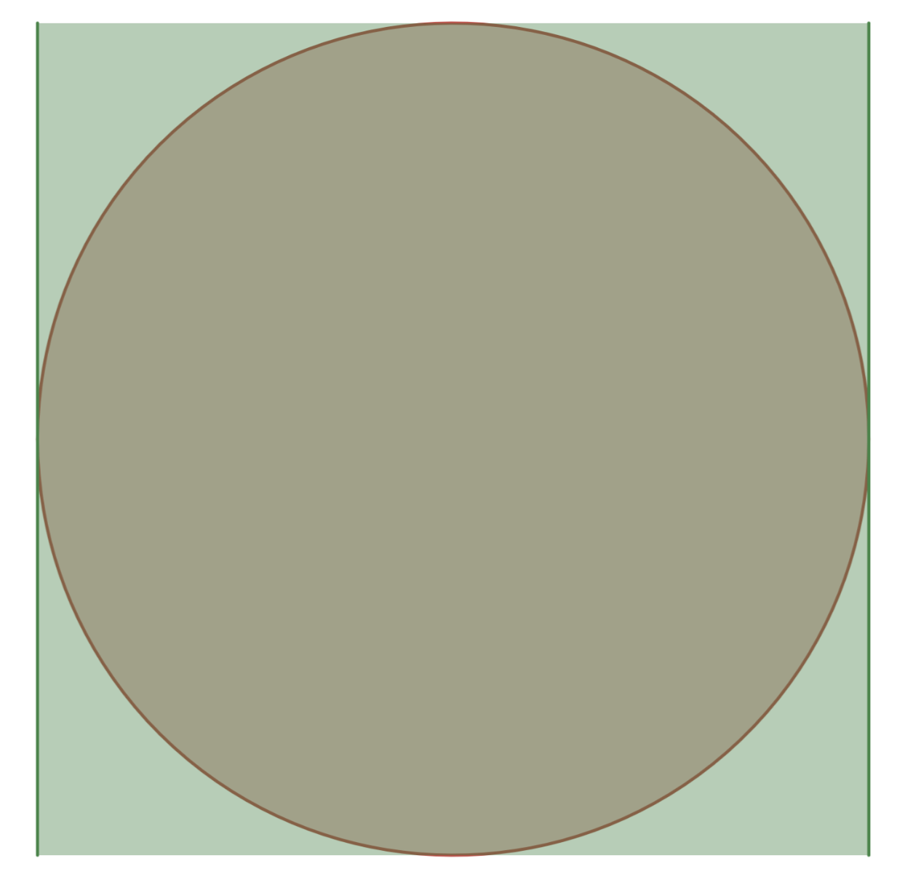
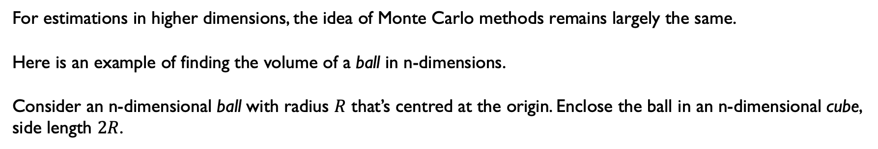
Monte Carlo Methods in n-dimensions
For estimations in higher dimensions, the idea of Monte Carlo methods remains largely the same.
Here is an example of finding the volume of a ball in n-dimensions.
Consider an n-dimensional ball with radius $R$ that’s centred at the origin. Enclose the ball in an n-dimensional cube, side length $2R$.
Note: cube and ball are italicised as notion of a ball in dimensions higher than 3 is very difficult to grasp.
Here n = 2

Slide 11
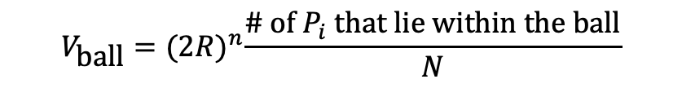
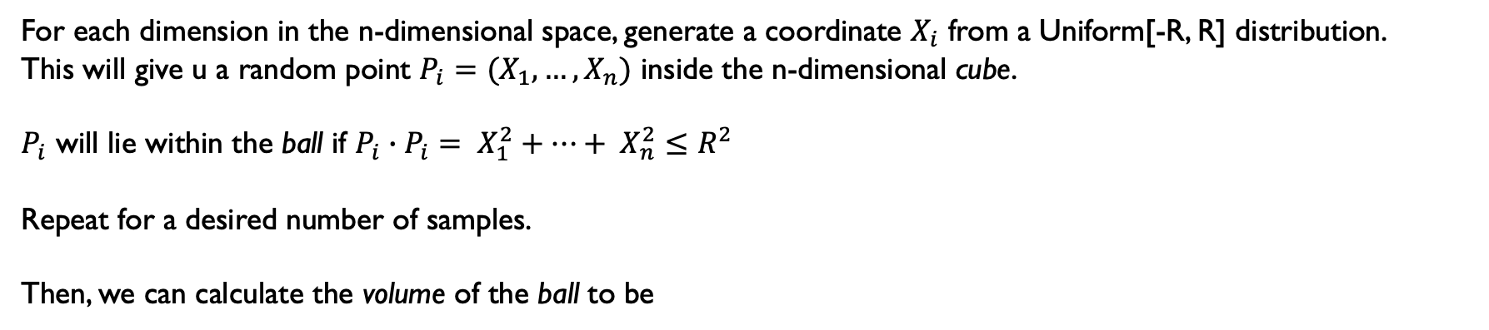
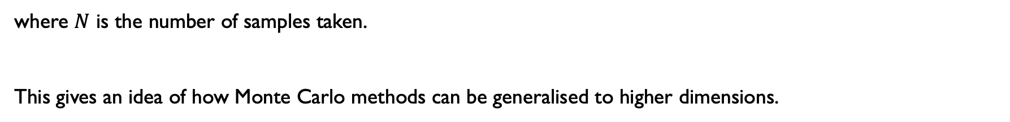
Monte Carlo Methods in n-dimensions
For each dimension in the n-dimensional space, generate a coordinate $X_{i}$ from a Uniform[-R, R] distribution.
This will give u a random point $P_{i}=(X_{1},…,X_{n})$ inside the n-dimensional cube.
$P_{i}$ will lie within the ball if $P_{i}∙P_{i}= X_{1}^{2}+…+ X_{n}^{2}≤R^{2}$
Repeat for a desired number of samples.
Then, we can calculate the volume of the ball to be
$$V_{\text{ball}}={(2R)}^{n}\frac{\text{\# }\text{of} P_{i} \text{that} \text{lie} \text{within} \text{the} \text{ball}}{N}$$
where $N$ is the number of samples taken.
This gives an idea of how Monte Carlo methods can be generalised to higher dimensions.

Slide 12
Monte Carlo Methods in n-dimensions
For each dimension in the n-dimensional space, generate a coordinate $X_{i}$ from a Uniform[-R, R] distribution.
This will give u a random point $P_{i}=(X_{1},…,X_{n})$ inside the n-dimensional cube.
$P_{i}$ will lie within the ball if $P_{i}∙P_{i}= X_{1}^{2}+…+ X_{n}^{2}≤R^{2}$
Repeat for a desired number of samples.
Then, we can calculate the volume of the ball to be
$$V_{\text{ball}}={(2R)}^{n}\frac{\text{\# }\text{of} P_{i} \text{that} \text{lie} \text{within} \text{the} \text{ball}}{N}$$
where $N$ is the number of samples taken.
This gives an idea of how Monte Carlo methods can be generalised to higher dimensions.

Slide 13

Applications in the real world

Slide 14
3d graphics

Slide 15
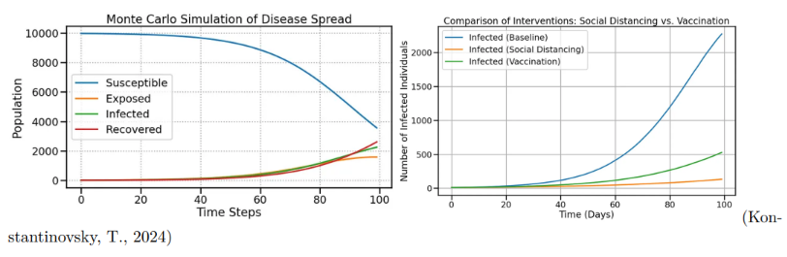
Disease outbreaks
Monte Carlo simulations can model disease transmission and recovery rates
Crucial for estimating uncertainty, lengths and peak of infection
Tests for interventions such as social distancing and vaccinations

Slide 16
References
Casino de Monte-Carlo (no date) Encyclopædia Britannica. Available at: https://www.britannica.com/topic/Casino-de-Monte-Carlo (Accessed: 20 April 2025).
Cragg, J.G. (2018). Monte Carlo Methods. The New Palgrave Dictionary of Economics, pp.9128–9130.
doi:https://doi.org/10.1057/978-1-349-95189-5_733.(Accessed: April 2025).

