Slide 1
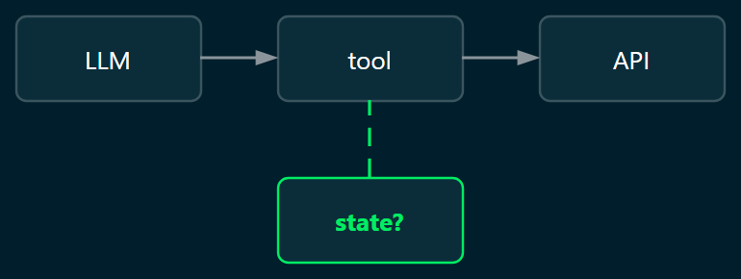
What Should a Local Agent Remember?
Saving state for agents running at the edge
By the end you will be able to: 1 · model and index the state of an agent workflow as documents the agent can read in one go 2 · decide what the agent remembers: what reacts to change, what expires, and what it must be able to explain
Eoin Jordan · 40 minutes · live on a RUBIK Pi 3 (Qualcomm QCS6490) · Ubuntu 24.04 · MongoDB 9.0 Community
Notes:
[0:00] The title is the question the panel was promised; answer it with the hook, to the lens: 'That question came out of a demo. The demo wasn't the hard part. Reliability was.' Say where everything runs, once, pointing at the footer: a RUBIK Pi on the desk, Qualcomm silicon, Ubuntu, MongoDB Community, no cloud behind it; that is what 'local' and 'edge' mean for the next forty minutes. The two objectives are on the next slide, so do not read the line at the bottom of this one; it is there for the recording. Don't say the word database yet. The reveal that this is a data-modelling problem comes about five minutes in.
TRANSITION: 'Thirty seconds on who's talking, then what you will leave with.'

Slide 2

After this session you will be able to
1
Model and index the state of a workflow
as documents the agent can read in one go, with the index each question needs
2
Decide what the agent remembers
what reacts to change, what expires, and what it must be able to explain
Follow the database side live
MongoDBSimCity: walk through a MongoDB 9.0 server in your browser while we talk
For experienced engineers who know documents, indexes and change streams, and have not yet built an agent that has to survive a restart.
eoinjordan.github.io/MongoDBSimCity
Eoin Jordan
Senior Developer Relations Engineer, Edge Impulse / Qualcomm · eight years at IBM Galway on distributed systems · PhD, Insight Centre, University of Galway · MongoDBSimCity on the side
MongoDB skill badges, October 2026: Building AI Agents with MongoDB · AI and Innovation: How MongoDB Enables a Resilient AI Strategy · Schema Design Patterns (in progress)
Notes:
[Use during the 5-minute introductions segment; the panel has met you.] Thirty seconds, no more: Eoin Jordan, developer relations at Edge Impulse, now part of Qualcomm; eight years at IBM Galway on distributed systems before that; the PhD at Insight on semantics; the two MongoDB skill badges from this month. If it comes up: three weeks before this talk I had not used mongosh, PyMongo or the LangGraph checkpointer. The demos are the first things I wrote with them; the toolbox is on the last backup slide.
Then the audience line, to the lens, reading the green sentence: 'This is for experienced engineers who know documents, indexes and change streams, and have not yet built an agent that has to survive a restart.'
Then the map, reading the slide: 'After this session you will be able to do two things. One: model and index the state of an agent workflow as documents the agent can read in one go. Two: decide what the agent remembers: what reacts to change, what expires, and what it must be able to explain.' Say the word: 'Those are the two learning objectives. Slide 8 restates them when we start fixing things, and the last three lines of the talk are them again.' Point at the QR: the SimCity model is open if they want to follow the database side live.
TRANSITION: 'Before we start, three questions for you.'

Slide 3
Before we start: three questions for you
1
Are you running an agent in production?
Zoom poll is open
Yes
Piloting
Not yet
Or type 1 / 2 / 3 with your answer in the chat, e.g. “2: prompt”.
2
Where does your agent's state live today?
In the prompt
Files or cache
A database
Nowhere, honestly
2: prompt
3: polling
3
What has hurt most?
Lost IDs / orphaned jobs
Polling and latency
Token cost
Nobody can explain what it did
We come back to your answers twice during the talk.
Notes:
[0:00–1:30 of the 40] Launch the Zoom poll as you share screen; read each question aloud and watch the chat. Ninety seconds. Read two or three chat answers back by name. Keep the poll results tab open, you return to them at 'Where does this live?' and at 'What to take back'. The panel should say the problem out loud before you name it. TRANSITION: 'Hold those answers. Let me show you where mine came from.'
Who is in the room: engineers who know documents, indexes and change streams and have not built an agent's memory. Every section bridges from the first to the second: the familiar MongoDB feature first, then what it becomes when an agent is the client. Any term that might be new is defined before its mechanism.

Slide 4

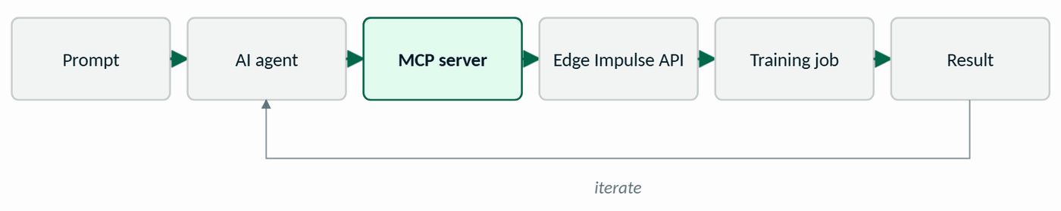
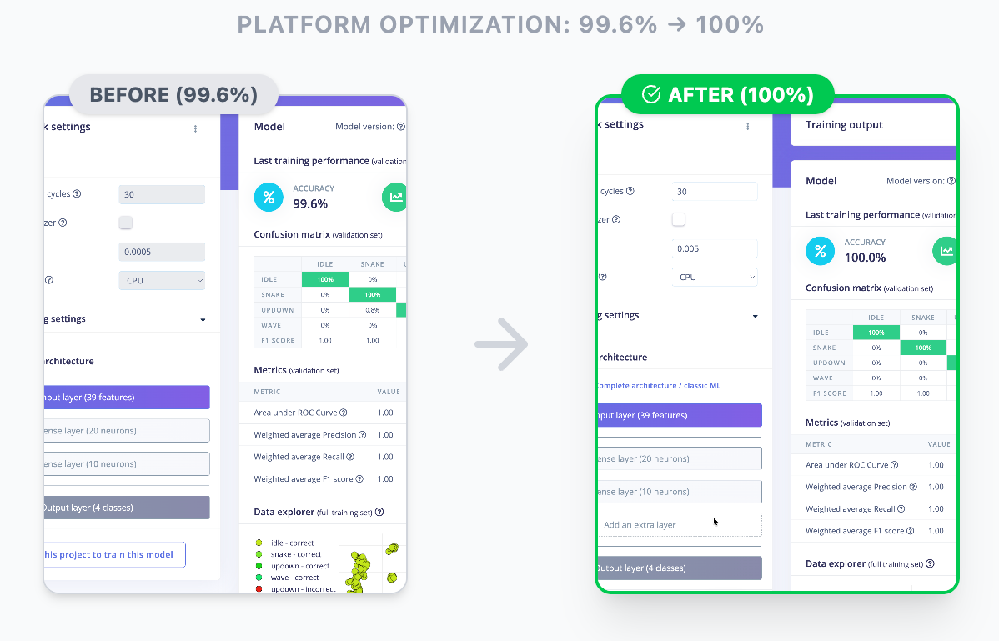
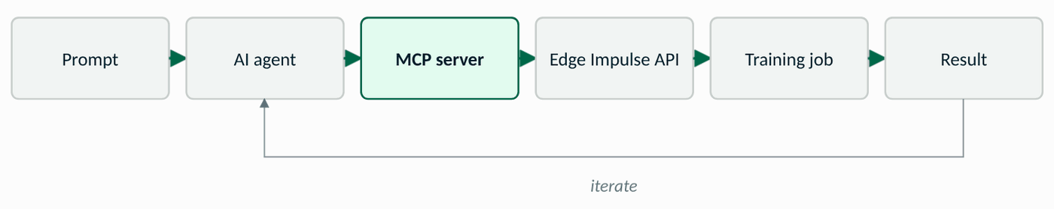
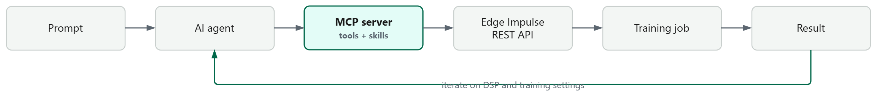
What I actually built
The write-up
A natural-language control plane over Edge Impulse Studio
“Train this project, optimise for accuracy under constraints, and tell me what changed.”
What came back: the same project, retrained by the agent under those constraints, 99.6% to 100%, with a summary of what it changed. (Screenshot from the blog post.)
Notes:
[1:30–3:30] The real system, in your own words. Question I started with: can a AI agent act like a natural-language control plane over Edge Impulse Studio, not one endpoint, the whole workflow: projects, data, DSP blocks, training jobs, results. Five evenings. Built off the public Postman collection so no source left the laptop. Low-level tools stayed close to the REST API; skills on top for the things agents keep trying to do, train, wait, tune, compare. The sentence that made it feel real: 'Train this project, optimise for accuracy under constraints, and tell me what changed.' Edge context in one line: this is a platform that puts ML on devices the size of a coin, the device used to classify, now an agent is configuring it. Facts to say, not show: five evenings; built from the public Postman collection so no source left the laptop; low-level tools close to the REST API (projects, DSP and windowing, hyperparameters, jobs); skills on top (train + wait + summarise, safe config edits, ID discovery), MongoDB now ships the same idea for its own database as Agent Skills, which comes back on the where-to-go-next slide. DROP IN: the MCP server response screenshot from the blog post. ONE LINE for the LangChain crowd, no more in a two-minute slot: 'If you know LangChain tools, same contract to the model, different home. A @tool lives in your process; an MCP tool is a separate server any client can plug into. Neither holds state, which is the next slide.' The full version (wall-socket analogy, MCP adapters, they compose) is in the slide 25 notes for Q&A. TRANSITION: 'It worked. Here's how I made sure it wasn't lying to me.'
The loop draws itself when the slide opens, left to right: prompt, agent, MCP server, API, training job, result, then the iterate arrow back to the agent. Say each box as it appears; the MCP server is the highlighted one, because that is the natural-language control plane: the agent never sees the API, only tools. Pause on 'iterate': that loop is where state has to live.
Most of the room has the write-up already (it went round before the session), so do not retell it: one sentence on what it did, then straight to the sentence that broke it. If someone has not read it, the QR is on the slide and the toolbox backup lists what it was built with.

Slide 5
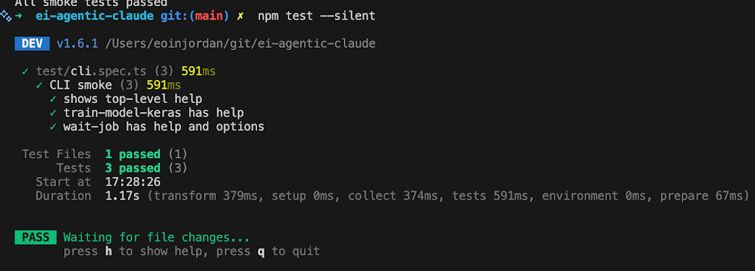
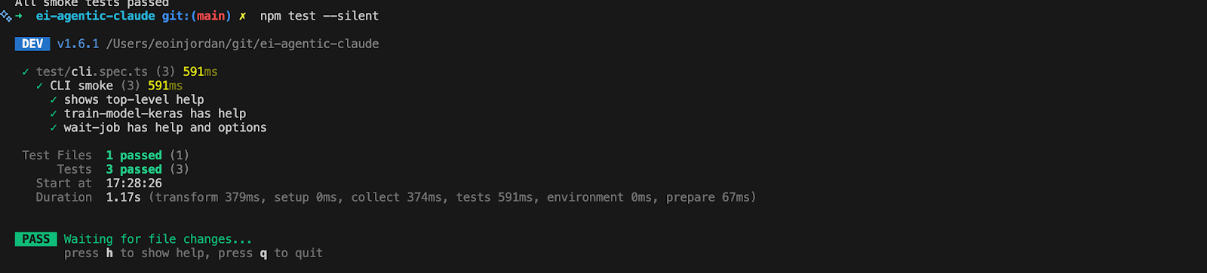
How I stopped it bluffing
Three moves, before any database was involved:
1
Stub the whole API
mock first, real jobs later
2
Test every tool
The per-tool test run from the blog post: happy path, failure path, missing params, edge cases.
happy · failure · missing params · edge cases
The key wasn't MCP. It was discipline so the agent couldn't bluff its way through.
3
Add agent-friendly helpers
wait / status / retry · scoping · validation
Remember helper 3: it's the second half of this talk.
Notes:
[3:30–5:00] Conversational, not a lecture, this is you telling a story about your own evenings. The key wasn't MCP, it was engineering discipline so the agent couldn't bluff its way through. Three moves. One: walk the API and stub everything, a mock server so I could shape the tool surface without hammering real jobs. Two: tests for every tool, happy path, failure path, missing params, weird edge cases. That was the biggest unlock: without tests the agent happily moves forward on assumptions; with them I could tell whether a failure was my wrapper, the endpoint, or the agent being silly. Three: agent-friendly helpers, waiting and polling on long jobs, clear org-vs-project scoping, stricter validation. Flag the third one: 'remember those three helpers, they are the whole second half of this talk.' DROP IN: the testing-framework screenshot from the blog post.
Read the lead-in line first, then the three moves.
TRANSITION: 'And then it started leaking state.'

Slide 6
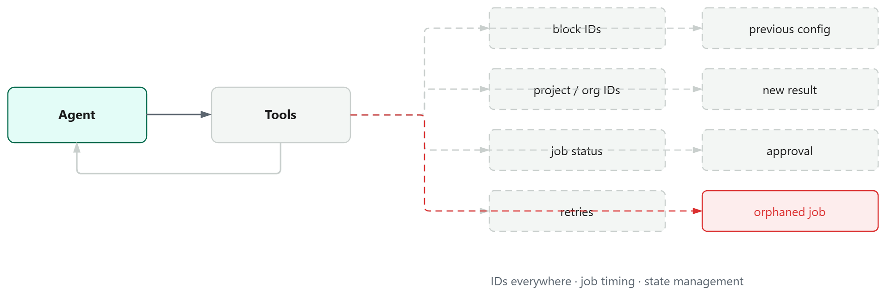
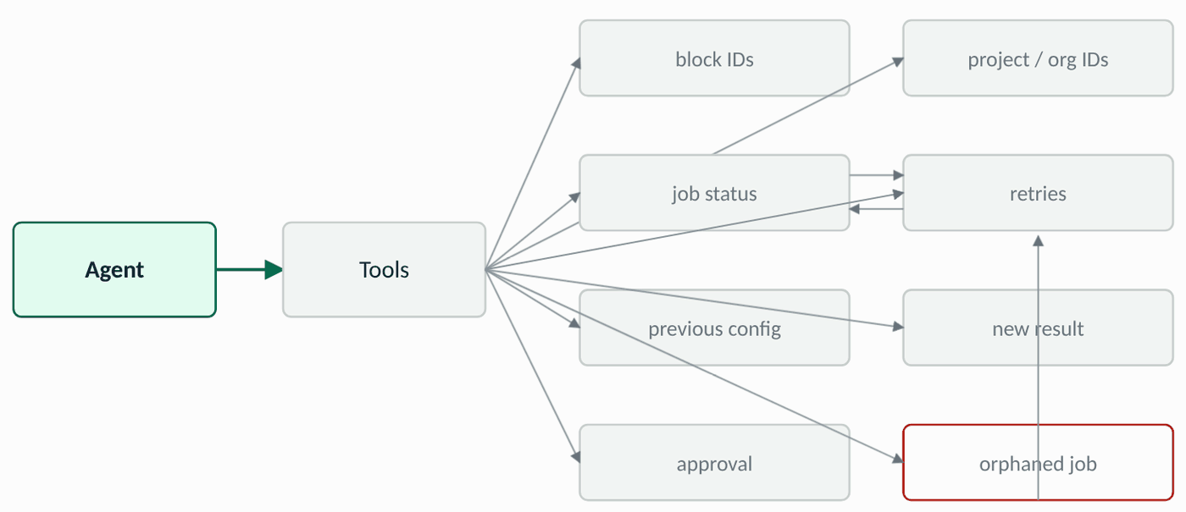
Then it started leaking state
IDs everywhere
Job timing
State management
None of this is an LLM problem.
It is a state problem.
Notes:
[5:00–7:00] The bottlenecks were not capability, they were plumbing. Straight from the logs: IDs everywhere, block IDs, project IDs, org numbers, and the agent had to be told them or go and discover them before doing anything destructive. Job timing, training takes minutes, so wait / status / retry, and if the process died in between, the job was orphaned. State management, the agent loses context unless you design around it; it would start a second training job because it forgot the first, or act on a stale result. 'None of this is an LLM problem. It is a state problem.' That's the reveal. Pause on it. TRANSITION: 'So where does all of this live? I want your answer before mine.'

Slide 7
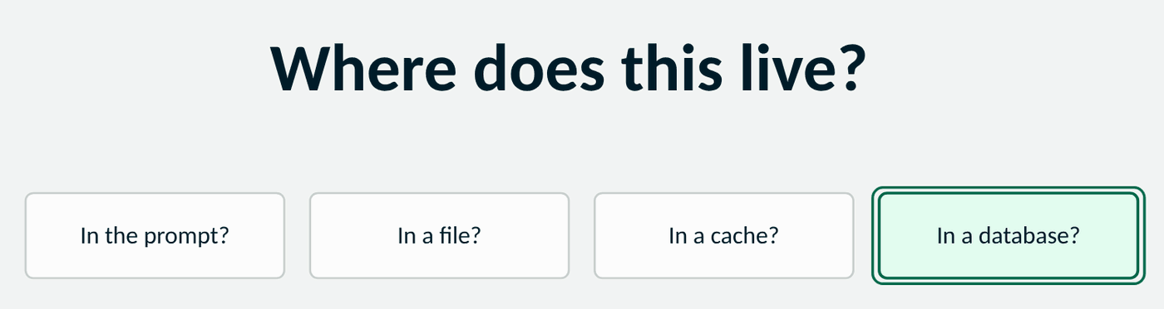
Where does this live?
Notes:
[7:00–8:00] Stop. Ask the room, then pull up the poll: most people said prompt or files. Reflect answers back without judging: prompt, works until the context fills or the process restarts; a file, one agent, one machine; a cache, until it evicts the job ID you needed. 'Let's put it in a database and see what that forces us to decide.' TRANSITION: 'Here's what we're going to be able to do by the end.'

Slide 8
Today we fix that: two objectives
You already know documents, indexes and change streams. New today: using them as an agent's memory.
1
Model and index the state
of an agent workflow as documents the agent can read in one go, with the index each question needs
2
Decide what memory means
short-term versus long-term: what reacts to change, what expires, what must be explainable later
Three parts: the document and its indexes · reacting to change · what to keep, what to expire, what to explain
Each idea is applied to the same running example, a training run.
Notes:
[8:00–9:00] Two objectives, not five. Say them as promises and return to them at the end as the takeaways. TRANSITION: 'Objective one, modelling the state. And the odd thing about modelling in a document database is that you don't start with the data.'
Say the word: 'Two objectives, in three parts.' Point at the bridge line first: they already know the features; the new thing is using them as memory.

Slide 9
Start with the questions
What will the system ask when things go wrong?
What runs are active for this project?
What changed since the last good run?
Which jobs are still pending?
Which actions were approved by a human?
What previous failure looks like this one?
Decide the questions first. The document's shape follows them.
Relationships, read patterns and write patterns decide what goes where.
Objective 1 · Model and index the state
Notes:
[9:00–11:00] The first schema is not a collection diagram; it is a set of questions, specifically, what will the system ask when things go wrong? These five are the ones my agent needed answered before it could safely take the next step. MongoDB's own schema-design process starts here: workload and query patterns first, shape second. ANALOGY: you don't design a filing cabinet by looking at the paper; you design it by asking who comes to the cabinet and what they ask for. TRANSITION: 'So let's answer those questions with a first document, and then pick it apart.'
Application, twenty seconds: 'What is the sixth question your operator asks when something goes wrong? Type it.' Read one back by name. If it fits, it becomes the index example on slide 12: the question creates the index.

Slide 10

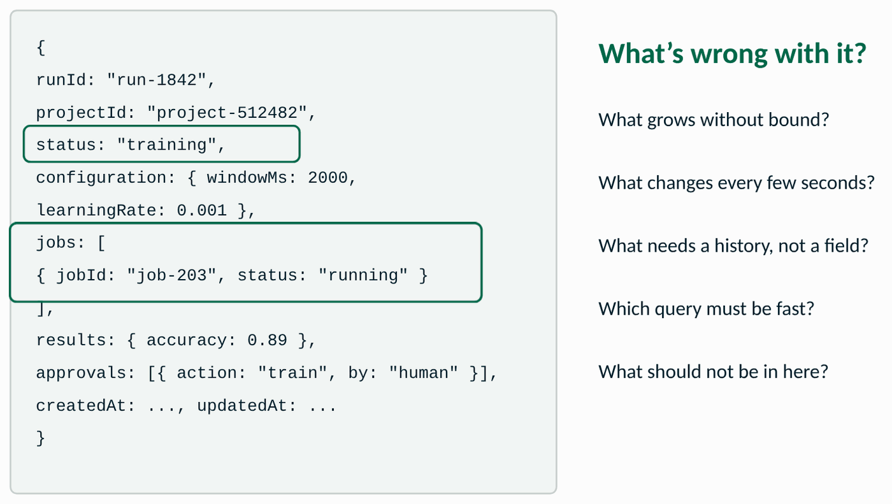
Our first document
live on the RUBIK Pi
Data modelling docs
{
runId: "run-1842",
projectId: "project-512482",
orgId: "org-71",
objective: { metric: "accuracy", target: 0.92 },
status: "training",
configuration: { windowMs: 2000,
learningRate: 0.001 },
jobs: [
{ jobId: "job-203", type: "training",
status: "running", startedAt: ... }
],
results: { accuracy: 0.89, latencyMs: 14 },
approvals: [
{ action: "train", by: "human", at: ... }
],
createdAt: ..., updatedAt: ...
}
What's wrong with it?
What grows without bound?
What changes every few seconds?
What needs a history, not a field?
Which query must be fast?
What should not be in here at all?
A useful first model to challenge.
Objective 1 · Model and index the state
Notes:
[11:00–14:00] One run = one document. Read it top to bottom as the story of a training run. Then: 'Don't take this as the answer. What's wrong with it?' Give the room thirty seconds. The prompts on the right are the ones you want them to find: jobs grows; status changes every few seconds; approvals need a history, not a field; the fast query is by project and status. DEMO CUE: db.runs.findOne() on the Rubik Pi, same document. TRANSITION: 'Most of what you found wrong is one decision: what lives inside this document, and what lives next to it.'

Slide 11
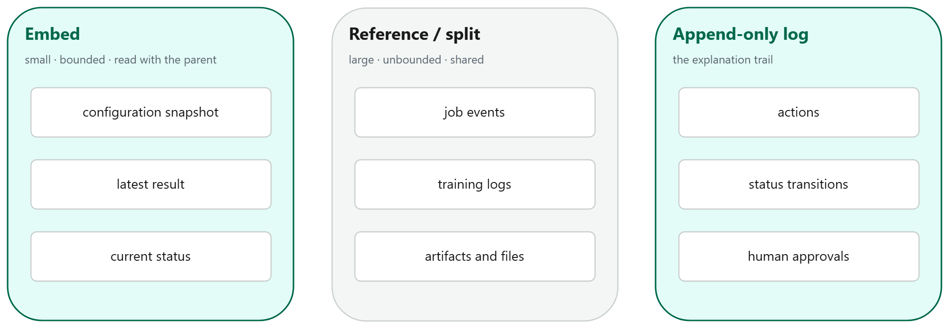
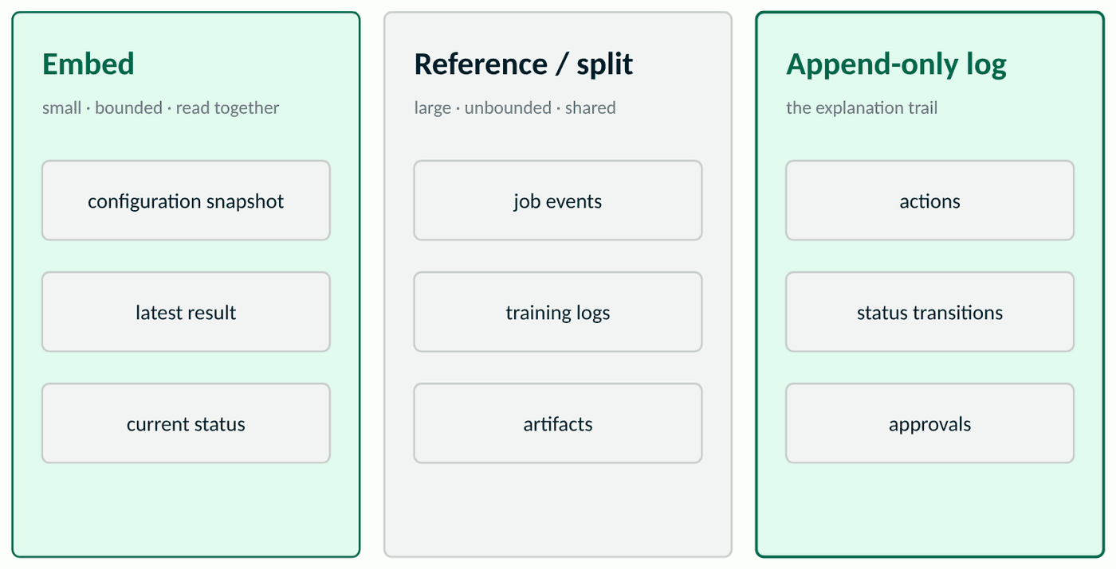
Embed, reference, or log?
Decide by change, growth and access. The reasoning matters more than any rule of thumb.
Objective 1 · Model and index the state
Notes:
[14:00–17:30] The core document-model decision, driven by change, growth and access. Embed what is small, bounded and read with the parent. Reference or split what is large, unbounded or shared, job events, training logs, artifacts. And a third column people forget: the append-only log, actions, status transitions, approvals, because the question 'why did it do that?' is a history question. Q&A fodder: the 16 MB limit, unbounded arrays, the subset pattern, duplication versus a second read. ANALOGY: embedding is a passport with your photo printed in it, everything you need in one read. Referencing is a reference number to a file held somewhere else, a second lookup, but the file can grow and be shared. TRANSITION: 'That's objective one done, we have a shape. Objective one, second half: what will the system ask of it, and how fast?'

Slide 12
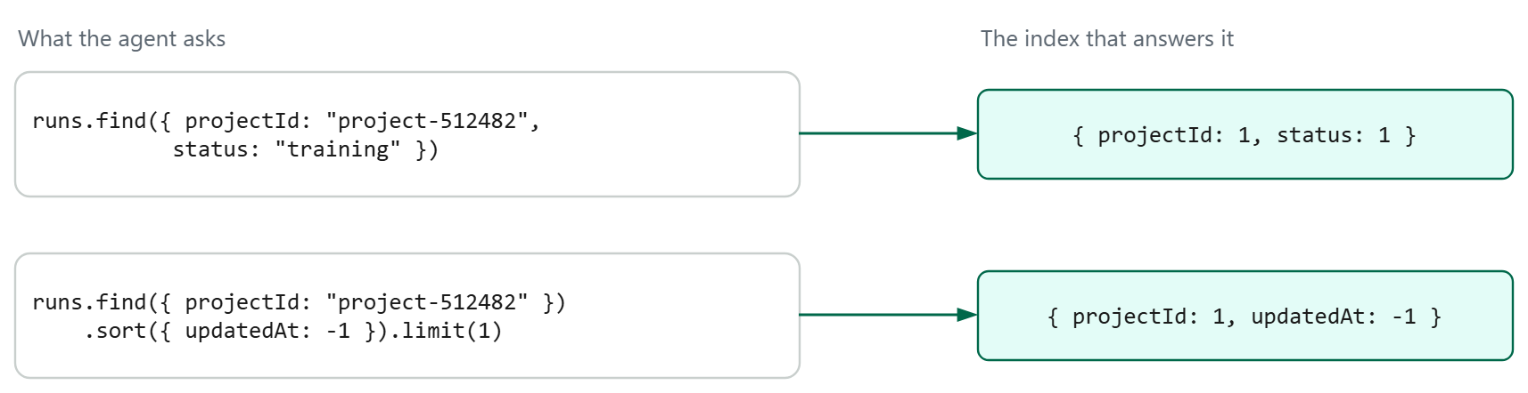
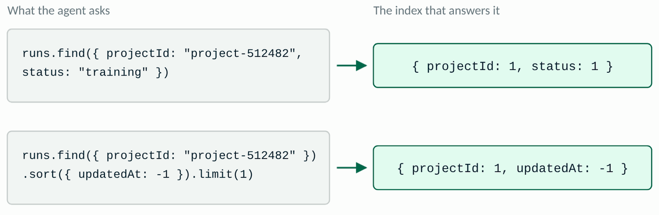
The question creates the index
Reads
Writes
Storage
Equality, then sort, then range. An index is a prediction about how the system will be used. Build them for the questions you actually ask.
faster
slower
larger
Objective 1 · Model and index the state
Notes:
[17:30–21:00] From 'here is my schema' to 'what will the system ask?'. Two questions my agent asked constantly: is anything still training for this project, and what happened most recently. Derive the index from each; mention ESR once, equality first, then sort, then range. Then the trade: every insert and every status update now maintains both indexes; for an agent writing a status change every few seconds that matters. Ask: could one index serve both? ({projectId, status, updatedAt:-1} serves the first and a filtered version of the second, let them argue it.) ANALOGY: an index is the index at the back of a textbook, you build it for the questions readers actually ask, and every page you add means updating it. TRANSITION: 'Reads sorted. That's objective one done: a shape, and the index for each question. Objective two, what the agent should remember, starts with the part that actually hurt me: waiting.'

Slide 13
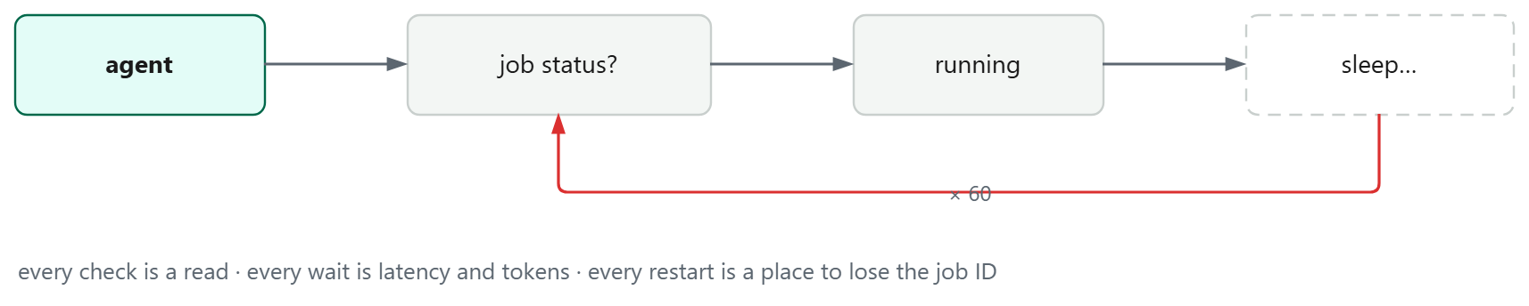
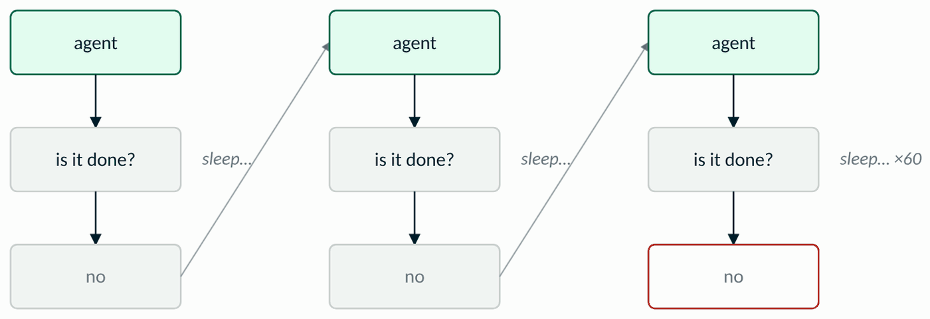
Then the wait loop hurt
The “train + wait + summarise” skill, as actually implemented
Every check is a read. Every wait is latency and tokens. Every restart is a place to lose the job ID.
The agent was doing the database's job..
Objective 2 · Decide what memory means
Notes:
[21:00–23:00] This is helper number three from the blog, the one I told you to remember. The 'train + wait + summarise' skill: start a job, poll until it completes, summarise what changed. Training takes minutes. Every poll is a read; every poll through the LLM is tokens; and if the process died between polls the job was orphaned, that's the 'orphaned job' box from the leak slide. 'The agent was doing the database's job.' ANALOGY: this is checking the front door every ten seconds to see if a parcel has arrived. TRANSITION: 'What you want is a doorbell.'

Slide 14

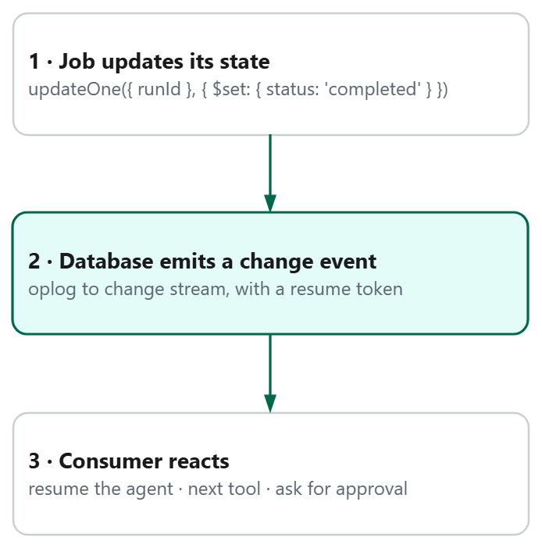
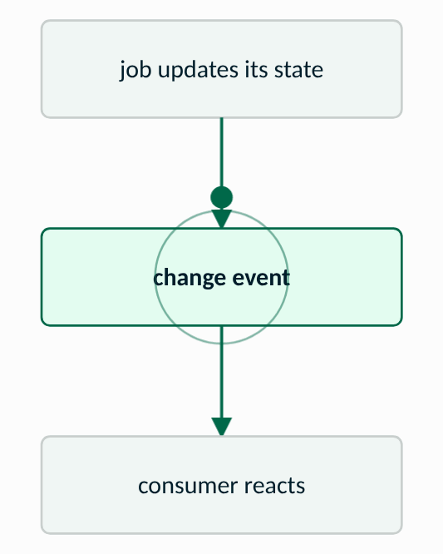
From polling to events
live on the RUBIK Pi
Change streams docs
pipeline = [{"$match": {
"operationType": "update",
"updateDescription.updatedFields.status":
{"$in": ["completed", "failed"]}
}}]
with runs.watch(pipeline,
full_document="updateLookup") as cs:
for change in cs:
run = change["fullDocument"]
agent.resume(thread_id=run["runId"])
Still design the failure path: missed events, retries, idempotency, resume.
No polling loop. No lost job IDs. The event carries the document the agent needs next.
Objective 2 · Decide what memory means
Notes:
[23:00–26:00] Flip it: the job updates its own status document; the database emits a change event; a consumer reacts, resumes the agent, triggers the next tool, or hands off for approval. Say the failure path out loud rather than on the slide: what if the consumer is down (resume token), what if the event is delivered twice (idempotent handlers), what if you missed the window. DEMO CUE: watcher in one terminal on the Rubik Pi, update a run's status in another, consumer fires. SimCity: the lime change-stream particle to the consumer pod. ANALOGY: the change stream is the doorbell, the database rings when the thing you care about changes. TRANSITION: 'Objective two, second part: what expires. First question, how long should any of this live?'

Slide 15

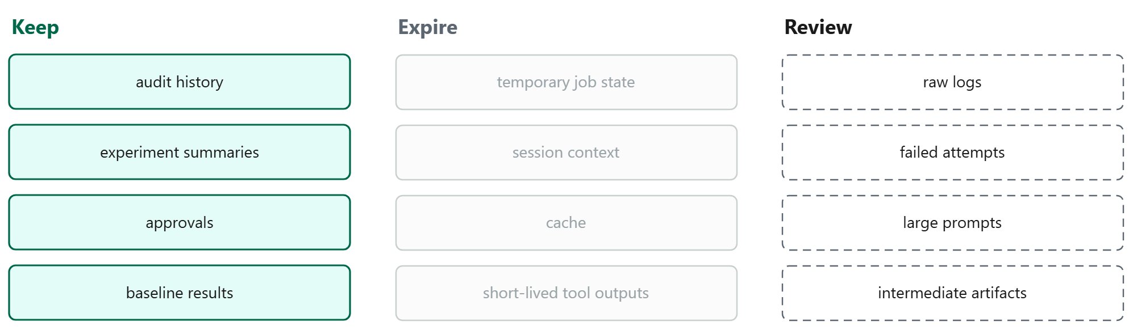
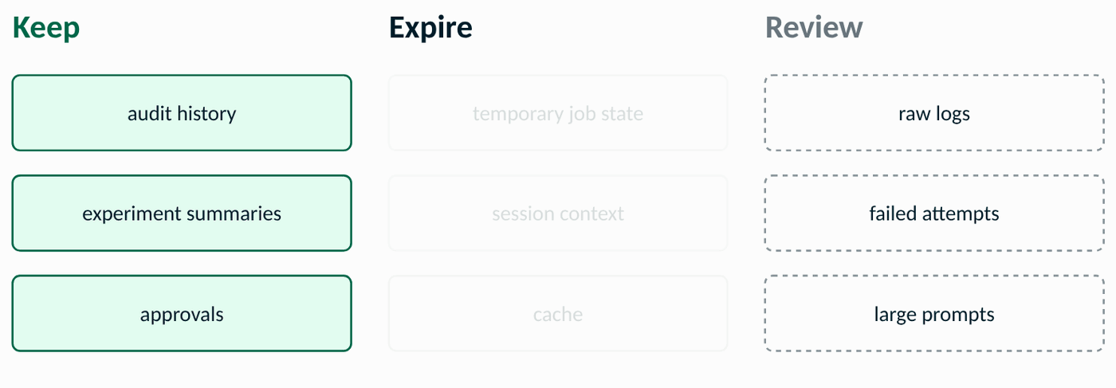
Memory has a half-life
TTL index docs
db.sessions.createIndex(
{ expiresAt: 1 }, { expireAfterSeconds: 0 })
// the writer sets expiresAt per document
Lifetime becomes a schema decision, set when the document is written, not a cron job.
Short-term memory expires; long-term memory is kept and audited. TTL enforces the first. It never decides which is which.
Objective 2 · Decide what memory means
Notes:
[26:00–28:00] This is the slide where the outline's 'short-term versus long-term memory' becomes a data-model decision, so use those words: short-term is what the agent needs for the job in front of it and should expire; long-term is what the agent or a human will come back to and should be kept, indexed and audited. Keep history deliberately; expire scratch data deliberately. Three columns: keep, expire, review, 'review' is the honest one, because raw logs and failed attempts are where the next debugging session lives, and nobody has decided yet. Per-document expiry with expiresAt lets the writer decide the lifetime at write time. TTL is a tool for finite-lifetime data, not a substitute for deciding what matters. If asked how prompt the expiry is: the TTL monitor sweeps about once a minute, so a document can outlive expiresAt by up to a minute, fine for scratch data, which is the point; nothing with a correctness requirement should rely on it. ANALOGY: expiresAt is a best-before date stamped when the milk is bottled, the writer decides, the fridge enforces. TRANSITION: 'Let me make you decide.'

Slide 16
What would you delete?
Everything the agent wrote this week, in one list. Which of these has to live?
Audit history · Experiment summaries · Approvals
Session context · Raw logs · Failed attempts · Cache
Notes:
[28:00–29:00] Second audience moment. Someone will say session context. Push back gently: if a human disputes an action, is the session context the evidence? 'Review' is a product decision, the database should make it cheap to change your mind. TRANSITION: 'So far every question has had an exact answer. Not every question does.'
Read the lead-in before the list, then ask the question and wait.

Slide 17

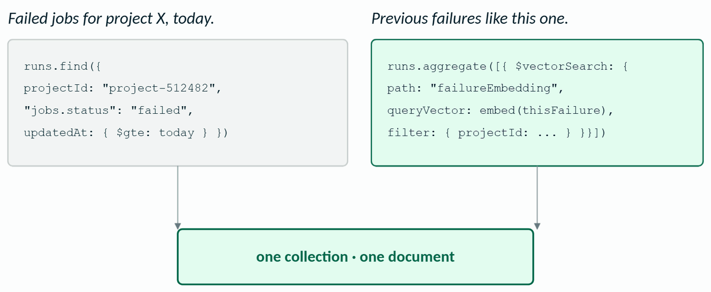
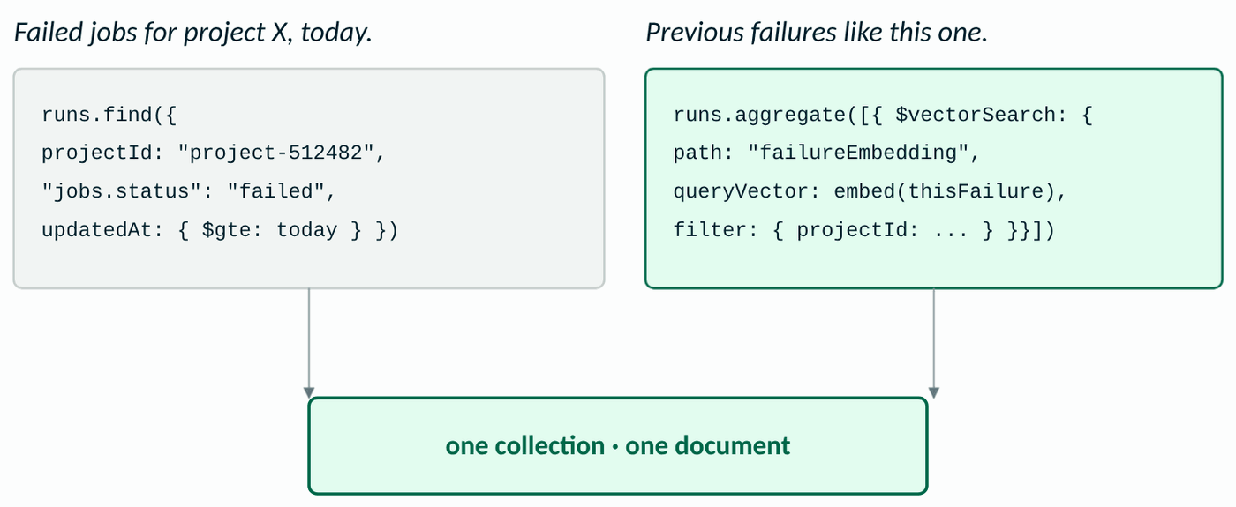
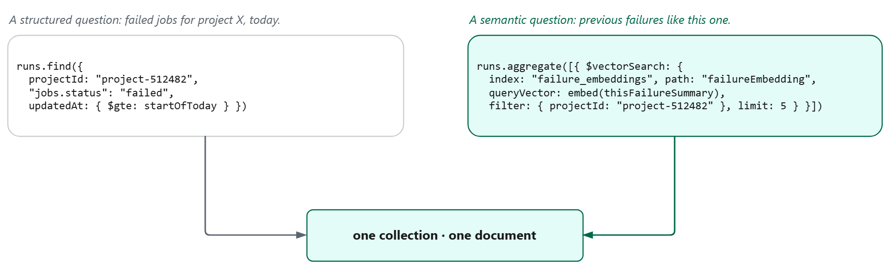
Not every question is semantic
Vector Search docs
The same collection and the same document answer a different kind of question.
A reliable agent needs both: exact operational state, and similarity over messy context, governed by the same rules.
Objective 2 · Decide what memory means
Notes:
[29:00–31:30] Only now bring in vectors, and make the distinction do the work. Left: exact fields, exact answer. Right: 'experiments that failed for reasons like this one', no field to filter on. Same collection, same document; the embedding of the failure summary sits beside the structured fields and is filtered by them. You don't bolt a vector store onto the side; you add a query mode to data you already govern. ANALOGY: a structured query is looking someone up by their employee number; a semantic query is 'who here has dealt with something like this before?', same staff directory, different question. TRANSITION: 'Last piece of memory: not what the agent knows, but what it was allowed to do.'
The animation draws the two queries one after the other, then the arrows meet on one box. Left first: the exact question, a find with three fields. Then the right: the same collection, one aggregation stage, a vector. Wait for the box before the next sentence: one collection, one document, two query modes.

Slide 18

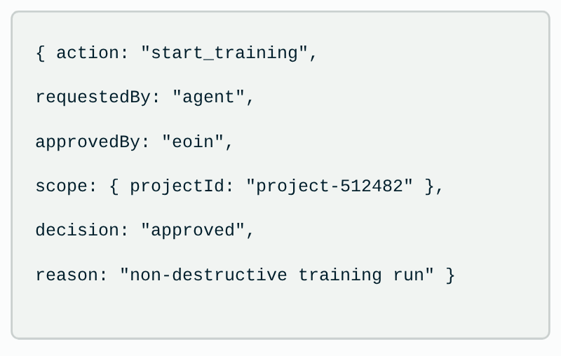
An agent that can act must be explainable
IDC: the control point
{
action: "start_training",
requestedBy: "agent",
approvedBy: "eoin",
scope: { orgId: "org-71",
projectId: "project-512482" },
decision: "approved",
reason: "non-destructive training run",
at: ISODate("...")
}
If a system can act, it must be able to explain how that action was allowed.
Approvals and audit live in collections with a schema. The database checks the policy before the action fires, so a bad model output cannot become a bad action.
Guardrails are data.
Objective 2 · Decide what memory means
Notes:
[31:30–34:00] Back to the blog's closing warning, now with a data model behind it: least privilege, confirmation gates for destructive actions, an audit trail, sane rate limits. The approval record is a document, who asked, who approved, what scope, what decision, why. Tie to the edge demo if it's running: the policy collection refuses the action before the actuator ever fires. 'If a system can act, it must be able to explain how that action was allowed.' Point at the poll: whoever voted "nobody can explain what it did", this is the collection. TRANSITION: 'Let's put the whole picture back together.'

Slide 19
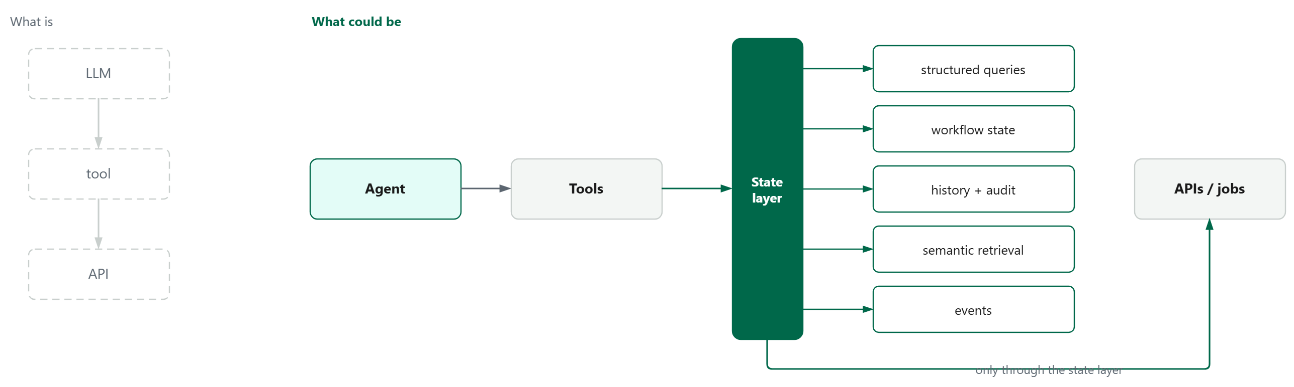
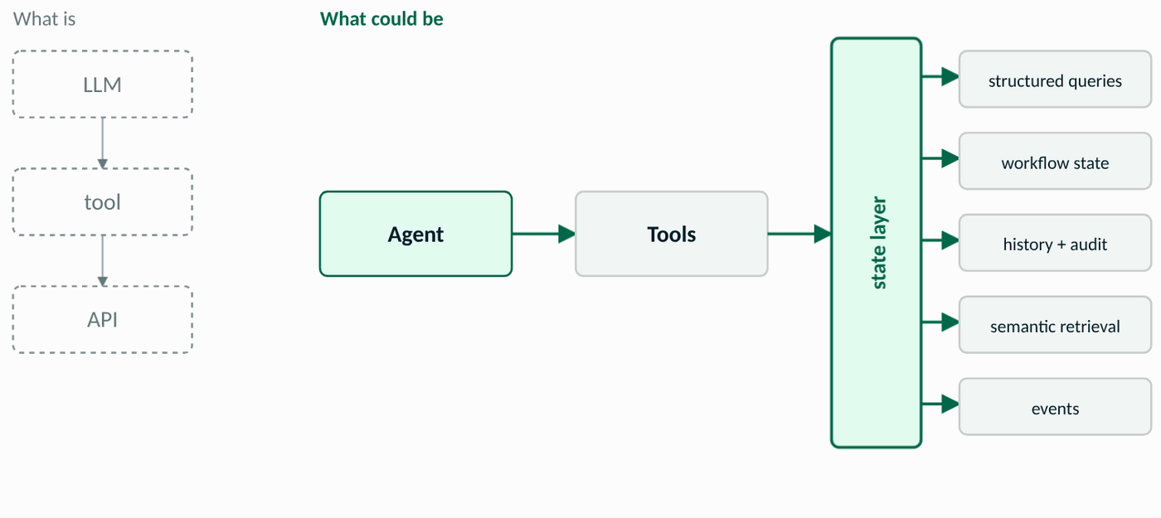
The resolved architecture
Giving an agent tools is easy. Giving it reliable state is the hard part.
Notes:
[34:00–35:00] Return to the first diagram and resolve the tension. Left, greyed: the version that worked for a demo. Right: the agent still has tools, but between the tools and the platform there is a state layer that answers structured questions, holds workflow state and history, keeps the audit trail, serves semantic retrieval, and emits events. One database, several query modes, one set of rules. TRANSITION: 'Before the three takeaways, what this means for each of you on Monday.'

Slide 20
What to take back
One Monday-morning action for each of you:
Developer
Architect
Give every workflow a document and a thread ID.
Put a state layer between tools and the world.
Data / platform lead
Product / engineering manager
Index from the query log; make lifetimes a schema decision with TTL.
Ask one question of any agent project: can it explain what it did?
Back to your chat answers: which of these is yours?
Notes:
[35:00–36:00] One Monday-morning action per role. Tie the last one to the poll: 'If you voted that nobody can explain what the agent did, that's the audit collection. It's a field, not a feature.'
The cards carry one line each; say the second half of each: Replace your polling loop with a change stream this week. Decide embed versus reference by read pattern, not by habit. Keep audit and approvals out of the expiry list. If the answer isn't a collection, it isn't ready.
Read the lead-in, then one card per role, slowly.
TRANSITION: 'Three things I want you to remember.'

Slide 21
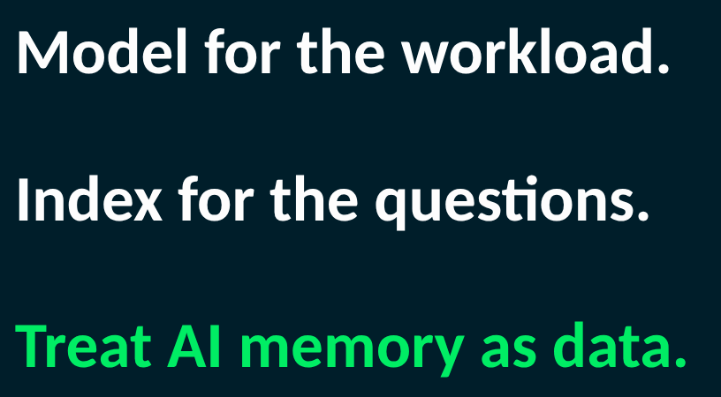
Three things I want you to remember
Model for the workload.
Index for the questions.
Treat AI memory as data.
Notes:
[36:00–37:00, then Q&A] Say the three lines slowly, then stop talking. Model for the workload, start with the questions. Index for the questions, every index is a trade. Treat AI memory as data, persist what matters, expire what doesn't, make actions explainable.
Reflection, ten seconds of silence after the third line: 'Which of the three would have saved you a restart last quarter?' Nobody answers aloud; that is the point. Then move on.
TRANSITION: 'Where to go next, routed by what you need.'

Slide 22




Where to go next
Routed by what you need next, one QR each:
Learn
Ask
Build
Scale
Badges and books
Answered directly
Give your coding agent the skills
Customers and partners
Skill Badges: Building AI Agents with MongoDB, Schema Design Patterns
Community Forums: engineers answer
MongoDB Agent Skills: schema design, query optimizer, MCP setup
Your account team
Book: From Systems of Record to Agentic Systems of Action (Packt, 2026)
Docs, and the docs assistant
npx skills add mongodb/agent-skills
Or connect with an expert
The Official MongoDB Guide
The four doc pages behind this talk (corner QRs)
Bundled in the Claude, Codex, Cursor and Gemini plugins
Bring the run document: it's the conversation starter
learn.mongodb.com/skills · mongodb.com/books
mongodb.com/community/forums
mongodb.com/docs/agent-skills
mongodb.com/company/contact
Notes:
[Q&A, leave up] Route people by what they need, not by what I have. Learn: the free Skill Badges, sixty to ninety minutes each with a Credly badge; AI Agents with MongoDB and Schema Design Patterns follow this talk directly, and the book: From Systems of Record to Agentic Systems of Action, Packt 2026, written by MongoDB practitioners; it covers exactly this ground at enterprise scale, agent memory and working state, event-driven sync, controlled writeback, human oversight, auditability. Ask: the Community Forums, where the engineering team answers, and the docs, the four pages behind this talk are on the corner QRs; the docs assistant answers most 'how do I' questions directly. Build: MongoDB Agent Skills, the helpers I wrote by hand for my MCP server, MongoDB now ships for its own database: a schema-design skill, a query optimizer, MCP setup, natural-language querying; one npx command, or bundled in the Claude, Codex, Cursor and Gemini plugins with the MCP server. Scale: customers and partners go to their account team or the contact page. Say it once: 'The point of the talk isn't to make you ask me, it's to leave you knowing where the answer lives.'
Read the lead-in, then route them: learn, ask, build, scale.
TRANSITION: 'Thank you. The Pi is on the desk; questions.'

Slide 23

Thank you
Questions. I can screen-share the RUBIK Pi demo for any of this.
Code
The model
The write-up
github.com/eoinjordan
linkedin.com/in/eoin-jordan
eoinjordan.github.io/MongoDBSimCity
Lessons learned building an agentic MCP server (Edge Impulse blog)
Notes:
Close, then hand over to Q&A. 'I have the Rubik Pi on the desk, happy to screen-share any of this live, including killing the agent mid-job and watching it resume.' Leave the slide up; links are in the chat too. If someone asks a 'how do I' question you can't finish in the time, point at the previous slide: forums for the discussion, docs for the answer, account team if they're a customer.

Slide 24
A 10-minute lab from this talk
1
Given a messy agent workflow log, identify the state that must persist.
2
Create a first run document and argue what to embed, reference or log.
3
Write two query patterns and derive one compound index, then name its write cost.
4
Replace one polling loop with a change-stream consumer that survives a restart.
5
Add TTL for temporary session data and keep the audit history.
Build the design habit on a problem the learner has already felt.
Notes:
Pull up only if asked how this becomes MongoDB University material. Five steps, each one a design habit, all on the same running example. Step 1 uses a real sanitised workflow log from the MCP project.
If asked how the lab is paced: diminishing coaching. Step 1 is fully worked on the slide-10 document, steps 2 and 3 give the shape and ask for the index, steps 4 and 5 are open. Varied problems: the same five steps on their own workflow log, not mine.

Slide 25

Agent memory is data: short-term and long-term
LangGraph integration
Short-term
Long-term
State between steps
What the agent learned across runs
Checkpoint per node transition, keyed by the run. Survives a restart. Pauses for human approval.
Memories namespaced by project. Looked up by key, or semantically with a vector index.
MongoDBSaver(client)
thread_id = run["runId"]
interrupt_before=["tools"]
MongoDBStore(...)
namespace = ("project-512482",
"experiments")
The helpers I bolted on in five evenings are what these libraries now do for you, on top of the same collections.
Notes:
Pull up if asked about LangChain / LangGraph or agent frameworks. Tie to tooling people actually use, briefly. Short-term memory is workflow state between steps, in LangGraph the checkpointer, keyed by thread_id, which is exactly our runId. Long-term memory is what the agent learned across runs, the Store, namespaced by project. Both are collections; both get indexes, TTL and audit like everything else. If they raise LangChain tools versus my MCP tools: same contract to the model, different home, a `@tool` is a function in the agent's process, an MCP tool is served by a separate process over a standard protocol so any client can call it; LangGraph consumes MCP servers through the MCP adapters, so you can run this exact graph over my Edge Impulse tools. Neither holds state; the checkpointer does. DEMO CUE: `python3 resume.py` on the Rubik Pi, Ctrl-C mid-step, run it again, it resumes at the step it was on because the thread document, not the process, holds the state. Thirty seconds, the whole thesis. The MongoDB University AI Agents skill builds this same graph; `course-on-pi/` in the repo is that code running on this Pi, and `check_memory.py` shows the checkpoints collection it writes.

Slide 26
When documents aren't enough
Documents
Vectors
Graph / RDF
Records and workflow state
Similarity over messy context
Relationships and inference
“What is the status of run 1842?”
“Which failures look like this one?”
“Which devices are affected by this dataset change?”
the operational truth: fast, indexed, audited
a query mode beside the record, filtered by it
$graphLookup for bounded hops; a triple store when you need reasoning
Pick the store by the shape of the question, not the shape of the data.
Notes:
Only if asked where this breaks down, or about relationships, graphs or RDF. One minute, then stop. The honest line: once the questions are about relationships and inference rather than records, documents plus vectors stop being enough. $graphLookup covers bounded traversals, runs that derived from runs, a device's deployments, but it is a recursive join, not a triple store: no SPARQL, no OWL reasoning. For inference you reach for a dedicated store and keep MongoDB as the operational record. That's the semantic-interoperability work in my PhD, and it's the module I'd teach after this one.

Slide 27
Answering off-script
1
Say it back
one sentence, so you're answering the question they asked
2
Name the mechanism
“this is really a question about where the write cost lands”
3
Walk it on the example
two or three steps: a run, a job, a status change
4
Say what you'd check
what you'd measure before committing, and where you're unsure
They are scoring the method, not the answer. Reasoning aloud is the deliverable.
Notes:
Never show this slide, it's the method for the tricky question, kept here so it's in the deck you rehearse from. Say the question back in one sentence. Name the mechanism or trade-off underneath. Walk it in two or three steps on the running example (a run, a job, a status change). Say what you'd measure before committing, and where you're unsure. Practice set: (1) one document per project with every run embedded, when does it stop working? read pattern first; unbounded growth; 16 MB is the symptom, the hot cache page is the disease; split runs out, keep a summary in the project. (2) change-stream consumer down for an hour, resume token; oplog window; past it, re-scan by updatedAt since last processed; idempotent handler either way. (3) two agents pick up the same approved action, the approval record is the lock: conditional update approved to executing with the agent id, one wins, the other matches zero. (4) why not Postgres JSONB, it works; depends whether hot queries are over the document shape or across it; be honest, then name what you'd lose: change streams, per-document TTL, vector index beside the document. (5) what's wrong with your index, write amplification on a churning status field; status cardinality is tiny so it's second for a reason; a partial index on status: training is cheaper.

Slide 28
The helpers I wrote by hand now ship
What I built in five evenings
What MongoDB ships as Agent Skills
Stub the whole API
MongoDB MCP Server
the agent talks to the real database: real schemas, real indexes, no guessing
Test every tool
Query Optimizer skill
checks the index serves the query; finds the equality-sort-range order
Agent-friendly helpers
Schema Design + NL Querying skills
embed vs reference, validation rules, natural language to aggregation
npx skills add mongodb/agent-skills · /schema-design /query-optimizer
Skills are the curriculum, written for the agent. Bundled with the MCP Server in the Claude, Codex, Cursor and Gemini plugins.
Notes:
Pull up if asked about tooling, Agent Skills, the MCP server, or 'how would a developer actually apply this'. The three moves from slide 5 map onto what MongoDB ships today. Stub and test to the MongoDB MCP Server gives a coding agent the live database, so it reads real schemas and indexes instead of guessing. Agent-friendly helpers to Agent Skills: a Schema Design skill (embed vs reference, validation), a Query Optimizer (checks the index actually serves the query, it will find the ESR point from the index slide), Natural Language Querying, and MCP Setup. Install is one npx command, or the Claude / Codex / Cursor / Gemini plugins bundle skills and server together. If you want a demo: in Claude Code with the plugin, /schema-design on the run document and /query-optimizer on the two queries, have it recorded rather than live. The teaching point: skills are the curriculum, encoded for the agent. That is literally this job.

Slide 29
Likely questions
Schema
What if jobs grow without bound? When would you split runs / jobs / events? The 16 MB limit and the subset pattern.
Indexing
Why this compound order? What write cost is acceptable for a status field that changes every few seconds? Covered queries.
Change streams
What happens when the consumer is down? Resume tokens, at-least-once delivery, idempotent handlers.
Lifecycle
TTL runs roughly once a minute: what does that mean for correctness? What never gets a TTL?
Vectors
What to embed, what to filter on metadata, how to evaluate retrieval. Why not a separate vector store?
Safety
How to represent approvals, scopes and destructive actions. Transactions for the approval step.
Notes:
Prepared depth. Don't present this; use it.

Slide 30
If runs outgrow one node: sharding
runId
Unique, spreads evenly, but every project query becomes scatter-gather. Wrong key for our questions.
projectId
Targets both hot queries. Risk: one very busy project is a hot shard.
orgId
Even coarser. Fine for isolation, worse for balance.
{ projectId, createdAt }
Targeted and time-ordered within a project; the usual compromise for append-heavy workflows.
hashed projectId
Best spread, loses range-by-time. Choose when balance matters more than recency scans.
Shard by what you query by. Change streams still work across shards; ordering is per-shard.
Notes:
Only if asked. Shard key is the question they'll want reasoned, not recited. runId is unique and high-cardinality but it's what the agent reads by least, it would scatter a project's runs across every shard, so 'what's active for this project' becomes a scatter-gather. projectId keeps a project's runs together so the two hot queries are targeted, but one huge project becomes a hot shard; orgId is worse for that. Compound {projectId, createdAt} or hashed projectId are the usual answers depending on whether range-by-time or spread matters more. Change streams still work across shards; the event order is per-shard, which matters for the consumer design. ANALOGY: shard by the thing you query by, the way a library shelves by subject rather than by acquisition date.

Slide 31
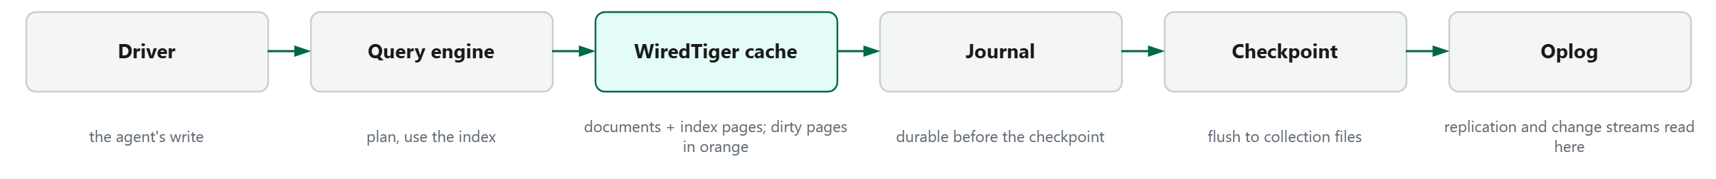
What the server is doing underneath
Why it matters for the agent
A status write every few seconds dirties a page every few seconds. Unbounded arrays make that page large and the eviction (80% target, 95% trigger) more expensive.
Every index is pages in the same cache as the documents, so the write cost on the index slide is cache pressure, not just disk.
Change streams read the oplog, so the consumer is never on the write path.
Live view: eoinjordan.github.io/MongoDBSimCity: illustrative numbers, documented thresholds.
Notes:
Only if asked to explain memory or storage mechanics simply. Screen-share SimCity's cache district if they want to see it move. Documents and index pages share the WiredTiger cache; a write makes a page dirty (orange in the model); the journal makes it durable before the checkpoint writes it to the collection files every sixty seconds or so; the oplog ring is what replication and change streams read from. The eviction rules are real and documented: the cache tries to stay under 80% and evicts harder past 95%, which is why an agent writing status every second to a document with an unbounded array is a cache problem, not just a schema problem. ANALOGY: the cache is the desk, the journal is the carbon copy you keep in case the desk is cleared, the checkpoint is filing the desk into the cabinet.

Slide 32
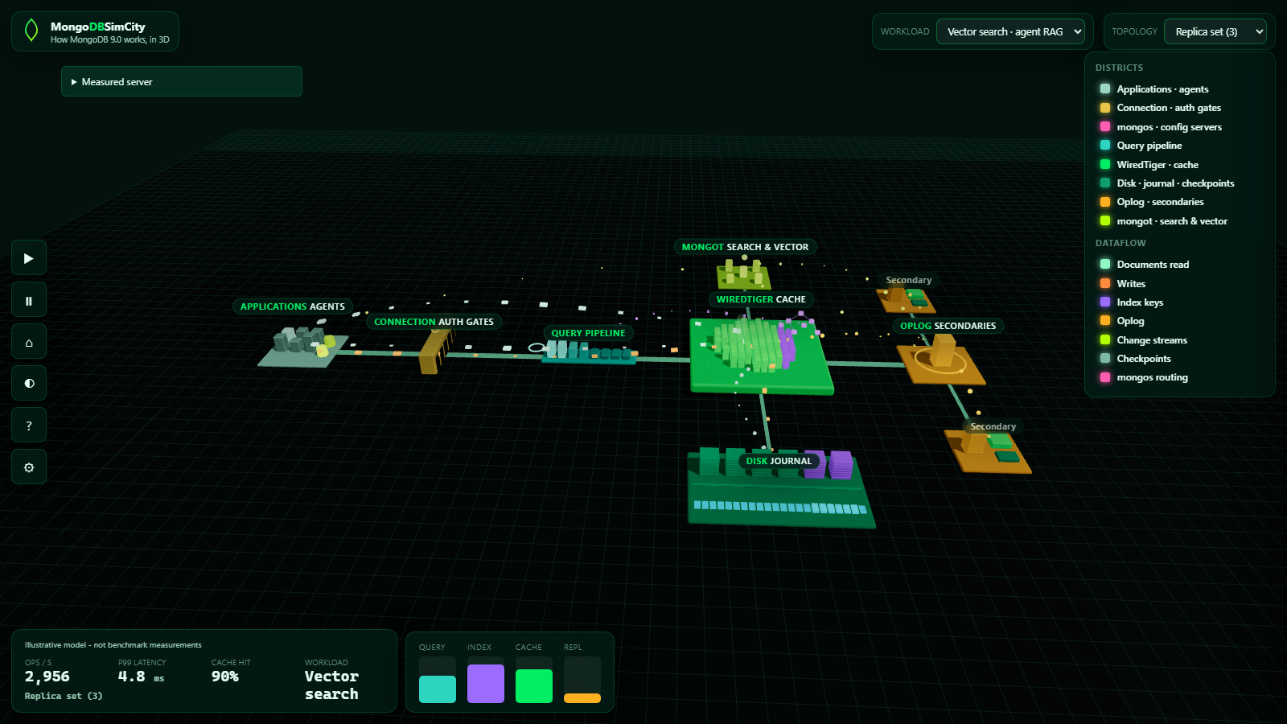
Backup: the database side, live (MongoDBSimCity)
eoinjordan.github.io/MongoDBSimCity: a mongod as a city. Applications and agents on the left, the query pipeline, the WiredTiger cache, disk and journal, the oplog where change streams read, and mongot for search and vector. Workload: vector search, agent RAG. Illustrative model, not benchmarks.
Notes:
Keep sources here so the main deck never reads like documentation.

Slide 33
Sources
Lessons learned building an agentic MCP server
edgeimpulse.com/blog/lessons-learned-from-building-an-agentic-ai-mcp-server-for-edge-impulse/
MongoDB data modelling
mongodb.com/docs/manual/data-modeling/
Change streams
mongodb.com/docs/manual/changeStreams/
TTL indexes
mongodb.com/docs/manual/core/index-ttl/
Atlas Vector Search overview
mongodb.com/docs/atlas/atlas-vector-search/vector-search-overview/
LangGraph + MongoDB (checkpointer, store)
mongodb.com/docs/atlas/ai-integrations/langgraph/
IDC: Your database just became your AI control point
mongodb.com/company/blog/news/your-database-just-became-your-ai-control-point
MongoDB Agent Skills
mongodb.com/docs/agent-skills/ · github.com/mongodb/agent-skills
From Systems of Record to Agentic Systems of Action (Packt, 2026)
mongodb.com/books
GB Studio MCP server (skills vs tools, education)
github.com/eoinjordan/gb-studio-agent
Notes:
Keep sources here so the main deck never reads like documentation.

Slide 34
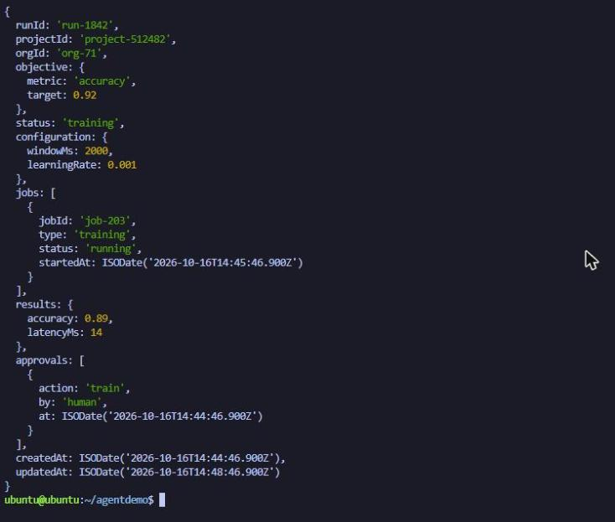
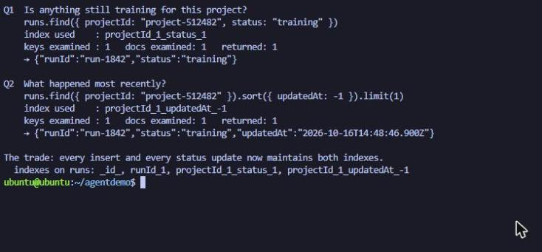
Backup: the first document, live (slide 10)
Left: db.runs.findOne() for run-1842 on the RUBIK Pi. Right: the two slide-12 questions with explain(): each hits its index, one key examined.
Notes:
Only if the live Pi fails. Left: the slide-10 document as findOne() returns it. Right: the two slide-12 queries with explain() - index name and one key examined each. Say: 'this is the same document, on a device the size of a book, with no cloud behind it.'

Slide 35
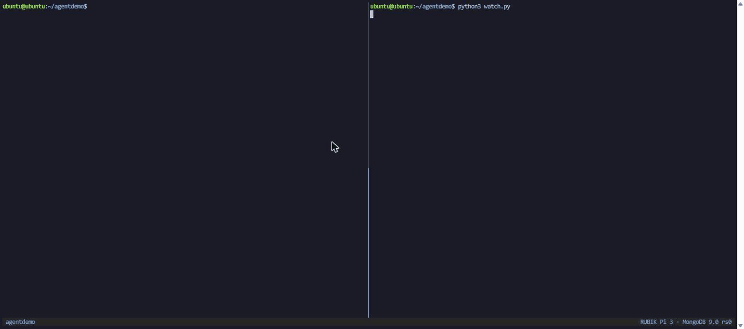
Backup: from polling to events, live (slide 14)
complete.js updates the run; the change stream fires; the consumer resumes the agent by thread_id and saves its resume token.
Notes:
Only if the live Pi fails. Walk the GIF: the left pane updates the run's status, the right pane is the consumer. No polling - the event carries the full document, the consumer resumes the agent by thread_id and saves the resume token.

Slide 36
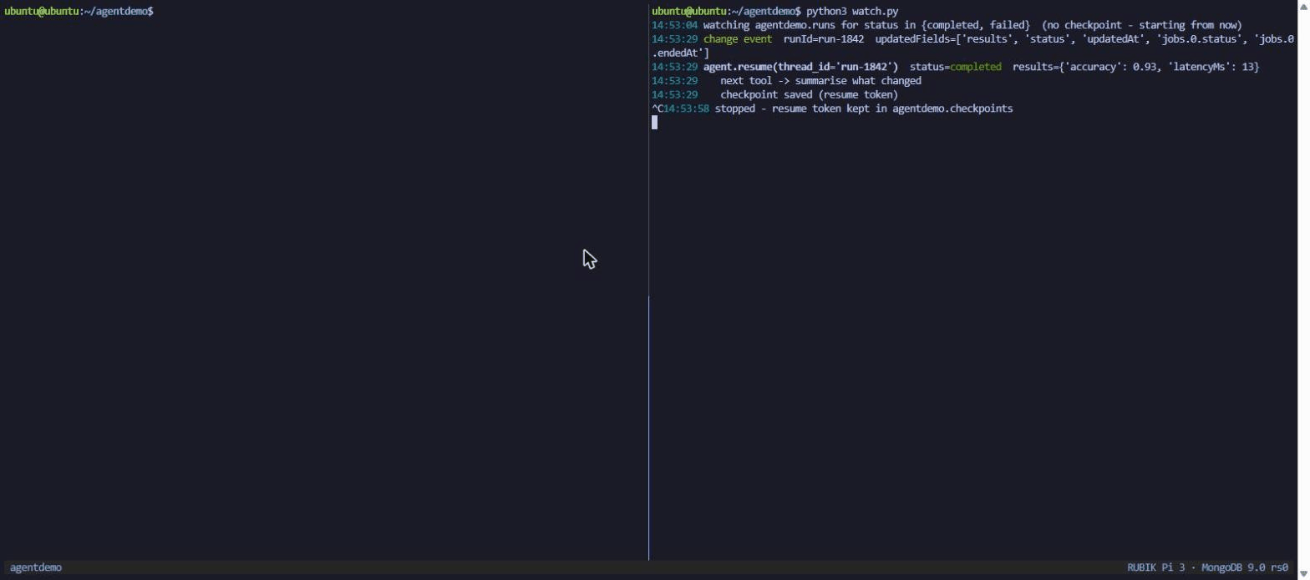
Backup: the consumer survives a restart (slide 25)
The consumer is killed, the run fails while it is down, and the restarted consumer receives the missed event from the saved resume token.
Notes:
Only if asked about the failure path or restarts. Consumer killed with Ctrl-C, the run fails while nothing is listening, the consumer restarts and the missed event arrives from the saved token. Same mechanism as the LangGraph checkpointer on slide 25: the database holds the place, not the process.

Slide 37
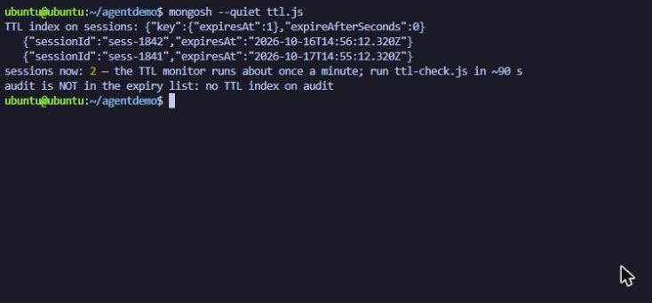
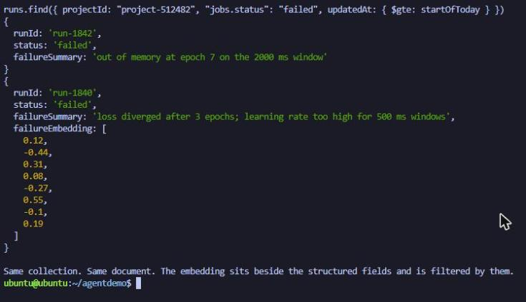
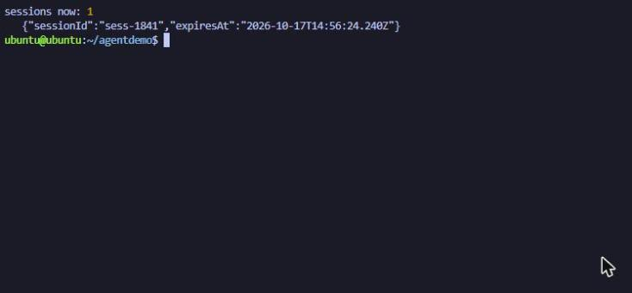
Backup: memory has a half-life, live (slide 15)
Two sessions written with per-document expiresAt; a minute later the short one is gone and audit has no TTL. Right: the slide-17 structured query, embedding stored beside the fields.
Notes:
Only if the live Pi fails. Two sessions written with expiresAt, the short one gone a minute later; audit has no TTL. Right: the slide-17 structured query returning the failed runs with the embedding stored beside the fields.

Slide 38
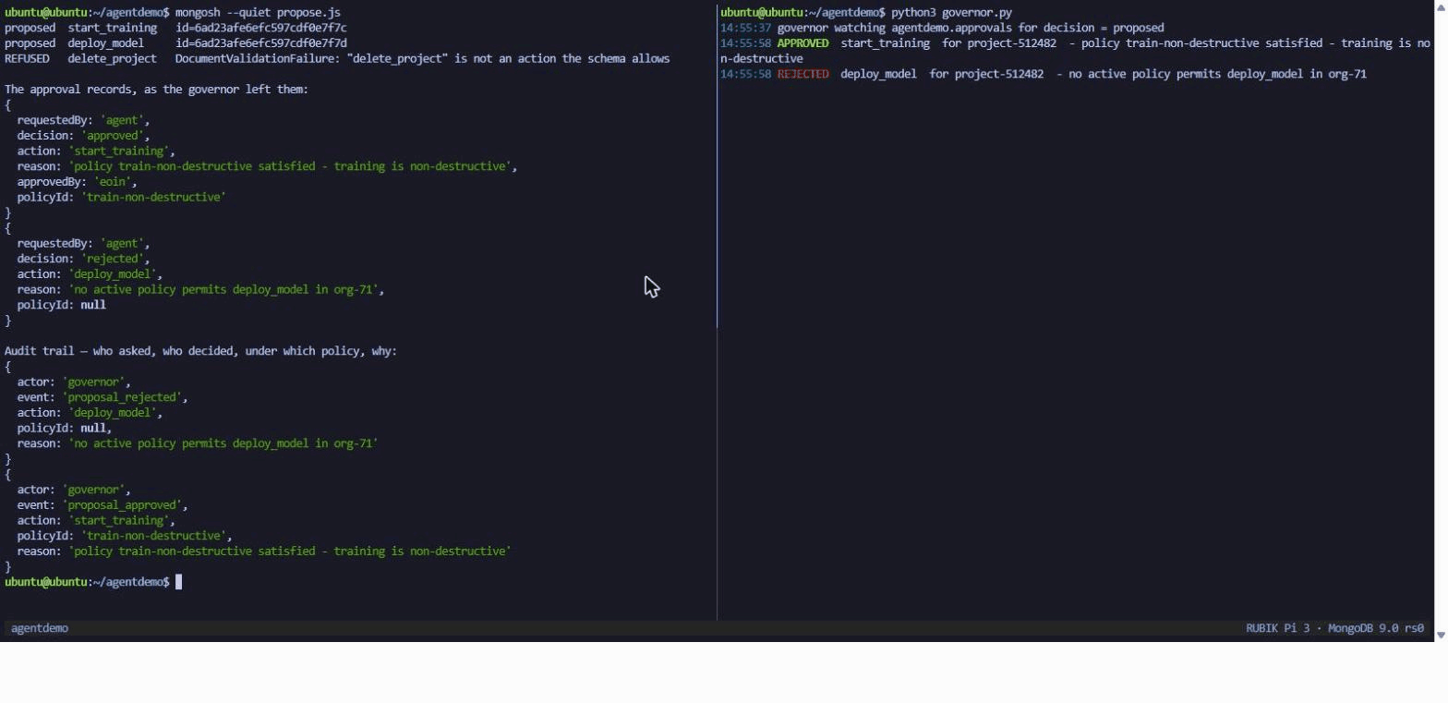
Backup: guardrails are data, live (slide 18)
The agent proposes three actions. start_training is approved by policy, deploy_model is rejected because no policy permits it, delete_project is refused by the schema before any decision. Every decision is in audit.
Notes:
Only if the live Pi fails. Three proposals: start_training approved under a policy, deploy_model rejected because no policy permits it, delete_project refused by the schema before any decision. The audit collection records who asked, who decided, under which policy and why.

Slide 39
Backup: the toolbox, learned for this talk
mongosh, the shell
Python
Around it
db.runs.findOne({ runId })
createIndex({ projectId: 1, status: 1 })
find(...).explain("executionStats")
updateOne({ _id }, { $set: { status } })
createCollection + expireAfterSeconds
runs.watch([{ $match: ... }])
aggregate([...]) over stored vectors
pymongo: MongoClient, find_one, insert_one, update_one
watch(pipeline, full_document="updateLookup",
resume_after=token)
DuplicateKeyError as the idempotency check
langgraph-checkpoint-mongodb: MongoDBSaver(thread_id),
MongoDBStore(namespace)
langchain_openai: ChatOpenAI(base_url=local server)
embeddings: voyage-3-lite, or bge-small on the Pi
MongoDB MCP server + Agent Skills
npx skills add mongodb/agent-skills
llama.cpp server on the Pi: OpenAI-compatible,
json_schema responses
MongoDBSimCity: what the server does underneath
mongosh scripts in demo/, Python consumers beside them
New to me three weeks before this talk: mongosh, PyMongo, the LangGraph MongoDB checkpointer. Every demo is the first thing I wrote with each of them.
Notes:
Only if asked what you used, or how long it took to learn. Left to right: the shell, the Python, what sits around it. The honest line is the footer: three weeks before this talk none of these were familiar, and the demos are the first things written with each of them. That is the point of the lab and the handout: the same path, in the same order, for someone starting on Monday. If they want one thing to try: open mongosh, findOne a document, createIndex for the question you ask most, then watch the collection and update it from a second window.

Slide 40
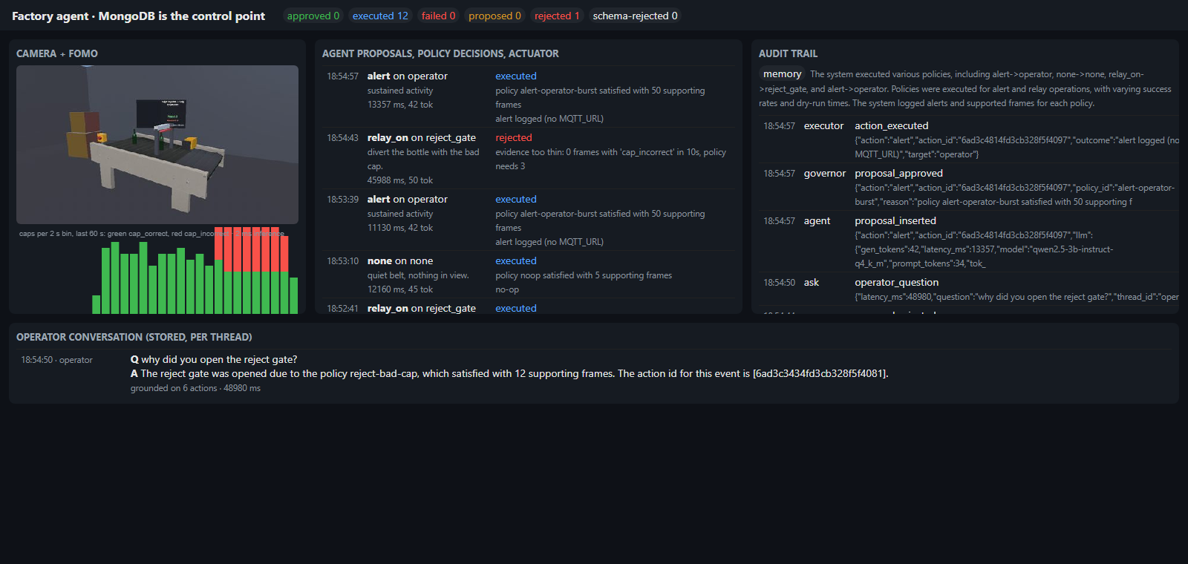
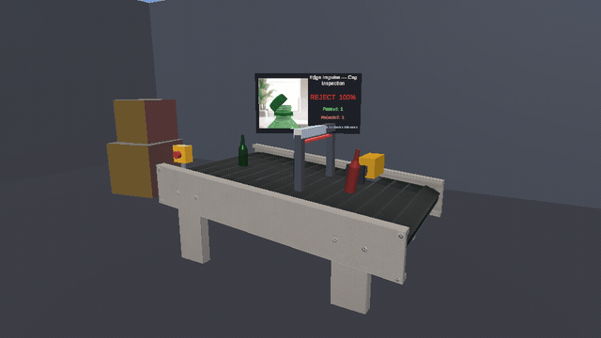
Backup: the same design on a bottling line
Camera and model write events. The agent proposes. The governor decides from the device's own evidence. The executor fires only on an approval.
Same collections, same policy gate, hardware on the end: a reject gate instead of a training job.
The factory version of this talk, running on the same RUBIK Pi: bottles with a bad cap on the Unity factory-floor belt, a 3B model proposing, MongoDB deciding. Repo on request.
Notes:
Only if asked whether this works with hardware on the end, or for the factory-automation notes promised in the abstract. Ninety seconds: the camera and the model write events into the same kind of time series; the agent proposes an action the way the training agent proposed a job; the governor approves from the device's own frame counts, never from the model's claim; the executor pulses a relay only on an approval, and the operator can ask the line why. Same collections, same policy gate, same explainability; the only new thing is that a wrong decision moves a bottle. Say what you would measure: approvals per bad cap, and whether the gate ever fired without one. The dashboard is on the Pi if they want it live.

