Slide 1


On photon emission processes from site-controlled quantum dots.
Eoin Murray
Epitaxy and physics of Nanostructure's group, Tyndall National Institute.
Project objectives:
New photon counting cards - higher resolution and lower power measurements.
Time resolved entanglement - theoretical/experimental.
Hot Trion states - theoretical/experimental.
Emanuele Pelucchi
Gediminas Juska
Valeria Dimastrodonato
Tung-Hsun Chung
Agnieszka Gocalinski
Marina Manganaro

Slide 2
Introduction to quantum dots and entangled photons.
Time resolved entanglement.
Hot trion states.

Slide 3



Quantum dot
GaAs
InGaAs
GaAs
CB
VB
Energy
photon
CB
XX- Biexciton
VB
X - Exciton states
Photon emission - no FSS.
Photon emission - FSS ~ ueV.
XX
M=0
XX
L
R
H
V
M=-1
M=+1
X
X
fss ~ ueV
R
L
H
V
0
M=0
0

Slide 4
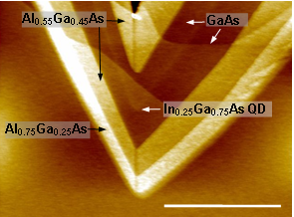
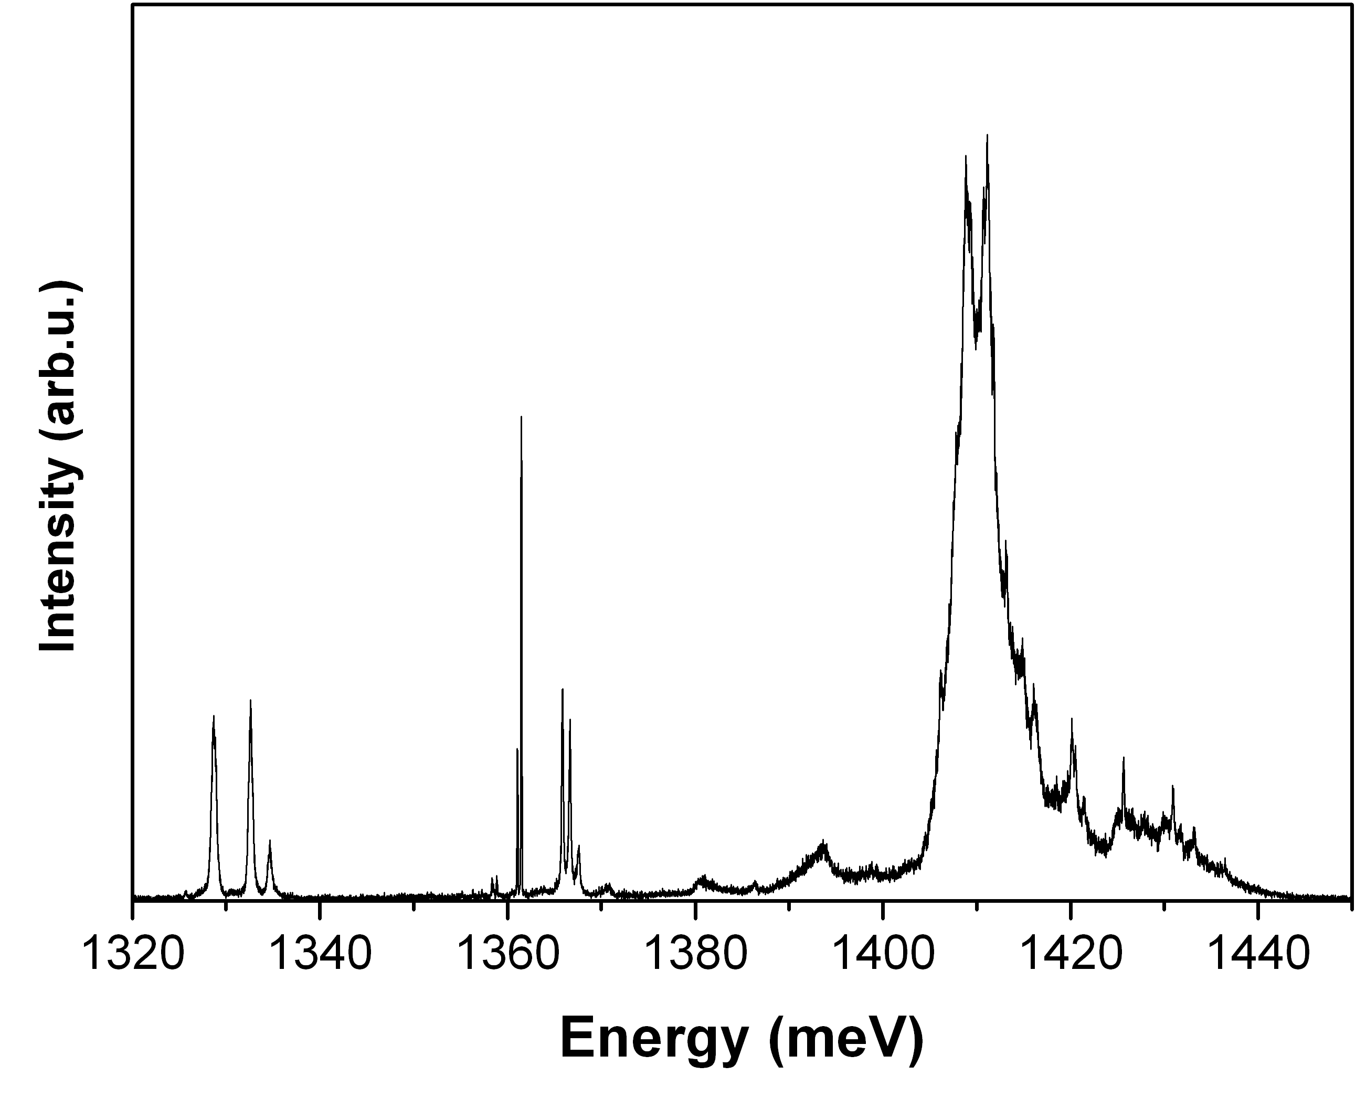
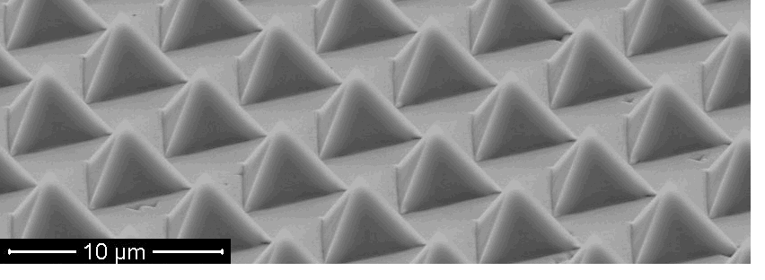
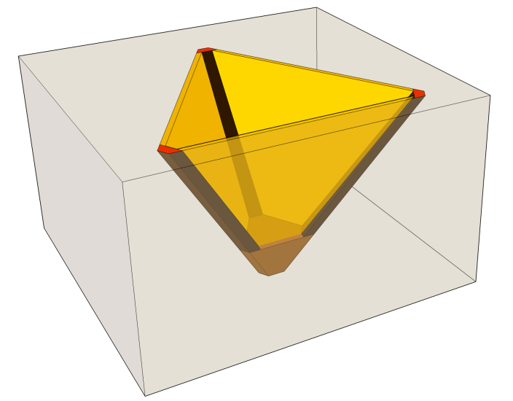
MOVPE site controlled system.
Epitaxially grown layers - lattice matched.
LQWrs
LQDs
3 LQDs
QD
3 LQWLs
QD
(111)B
3 LQWrs
LQWLs

Slide 5

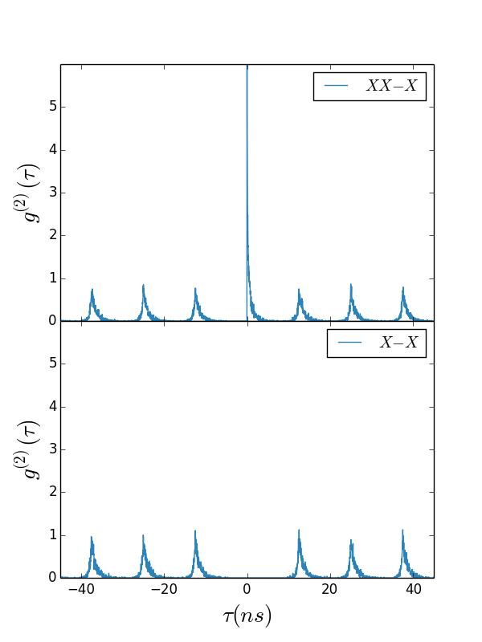
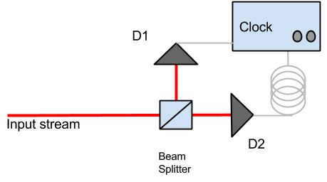
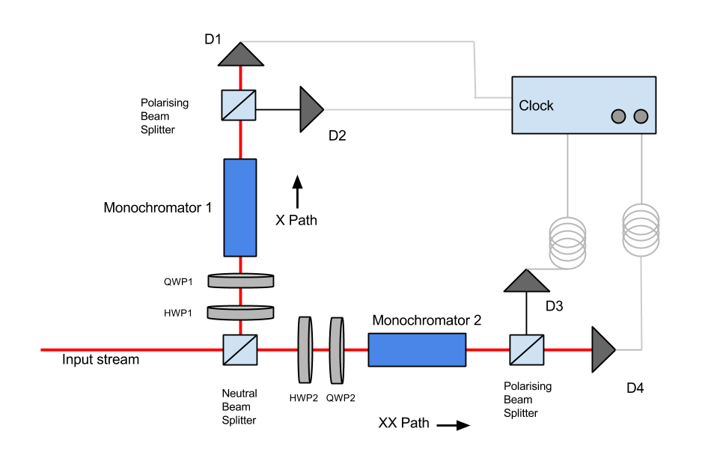
Second order correlation function
Pulsed stream
HBT Correlator - same but for entanglement.

Slide 6
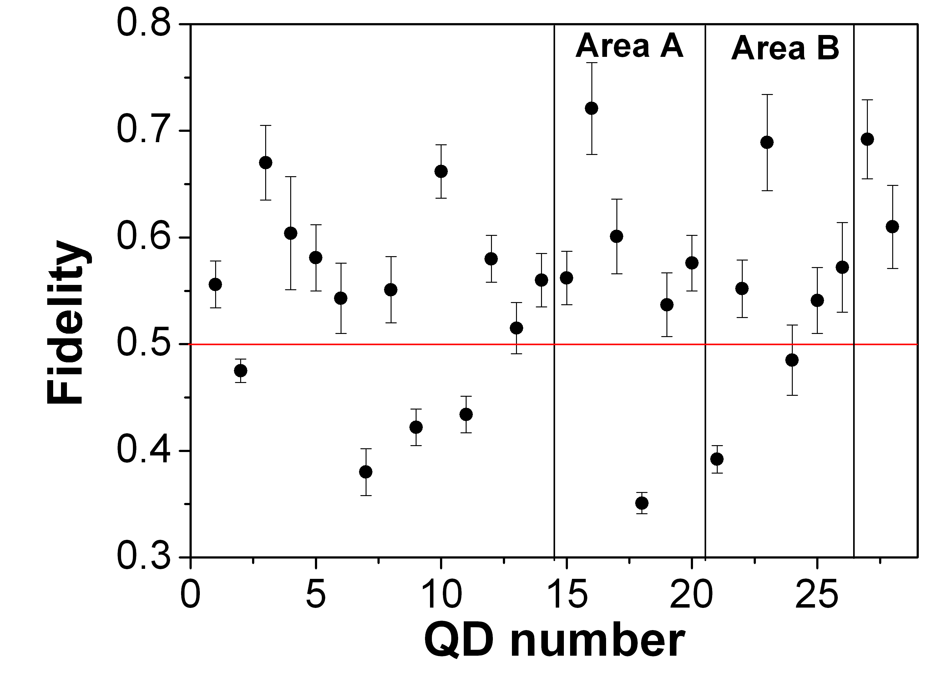
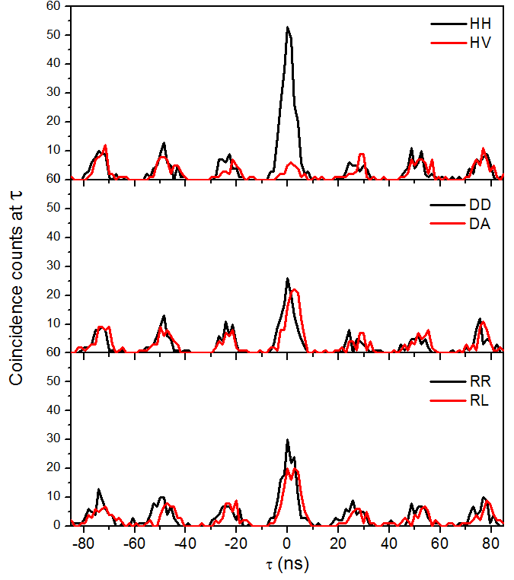
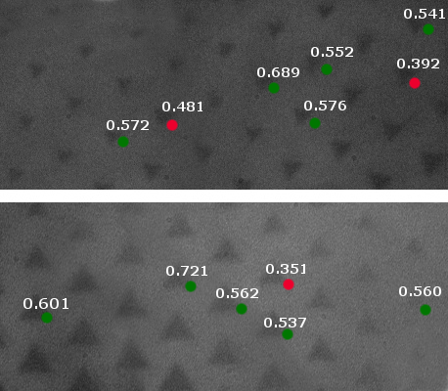
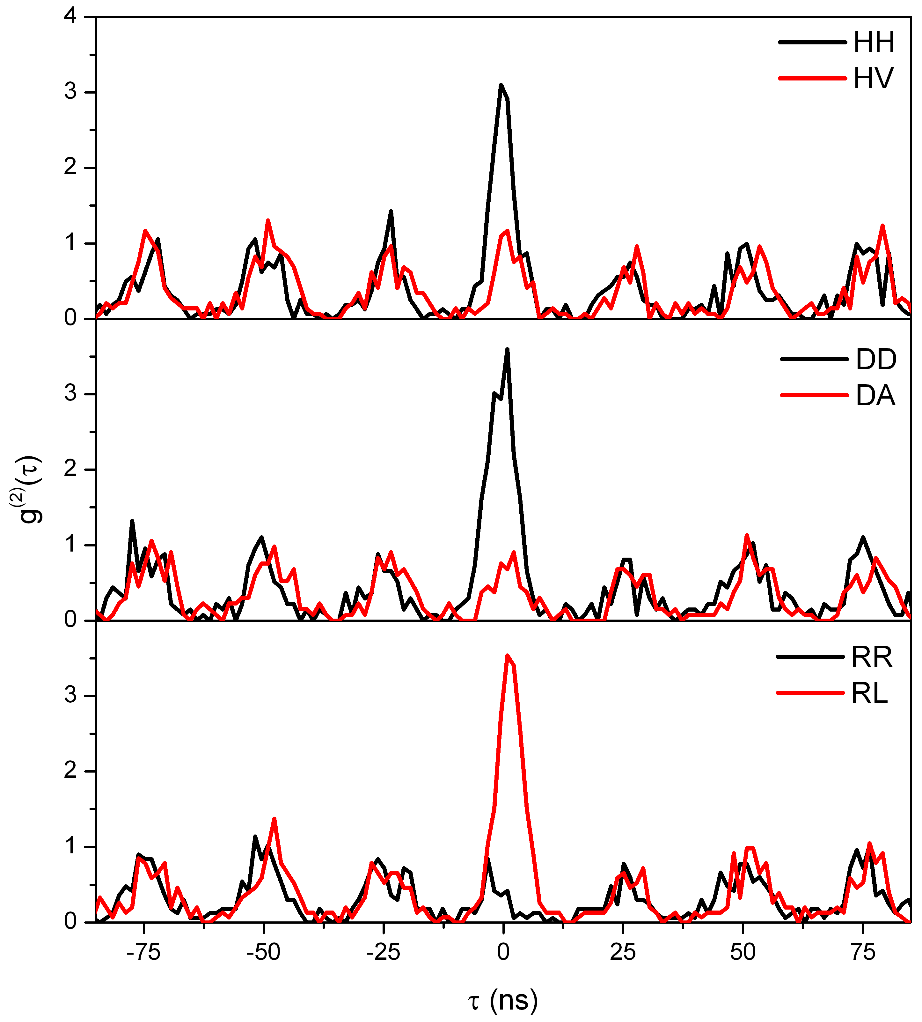
FSS ~ 3ueV
No FSS
G, Juska et al, NATURE PHOTONICS, 7, 527 (2013).

Slide 7
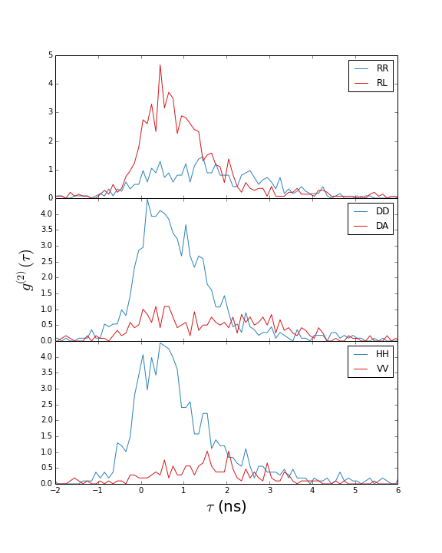
Time tagging entanglement measurements.
Gate
Time gating:
Move gate
Change gate size
Individual QD we don’t change FSS. Instead discriminate by lifetime.
Only recently able to measure with enough resolution.
R.M. Stevenson, PHYSICAL REVIEW LETTERS 101, 170501

Slide 8
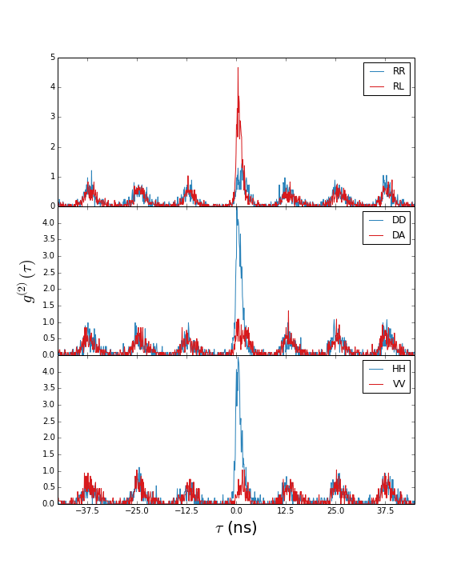
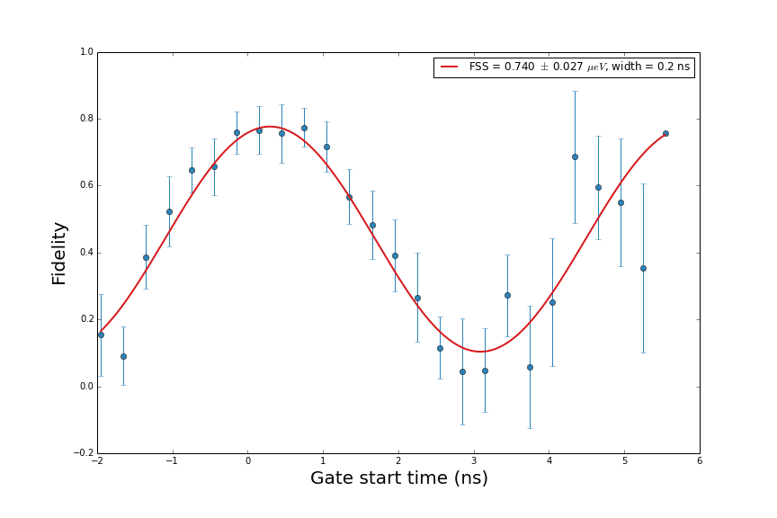
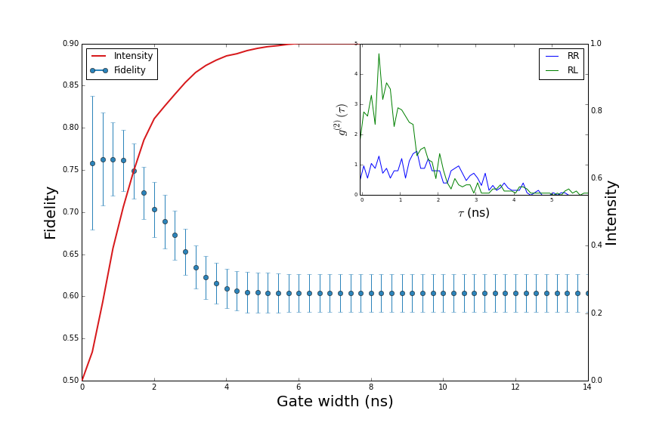
Data

Slide 9
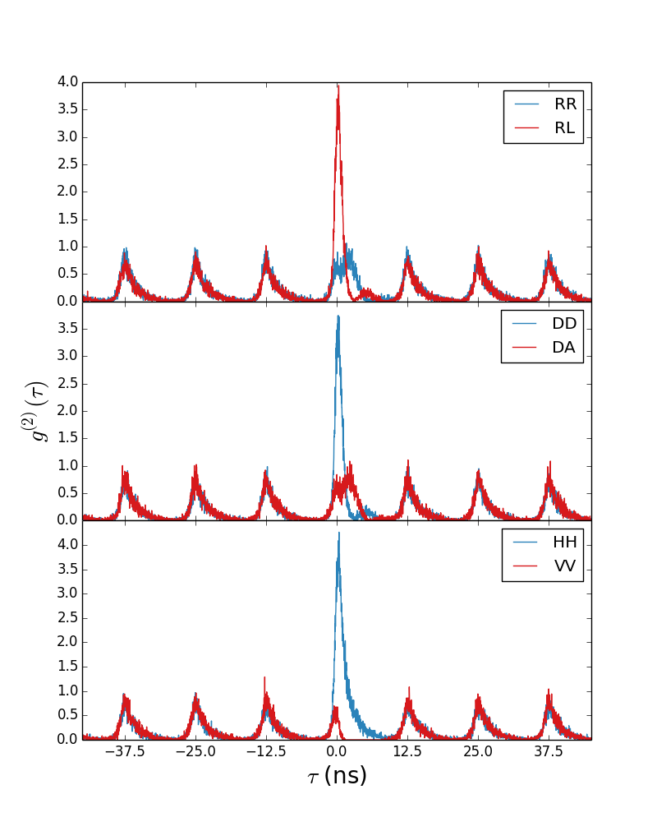
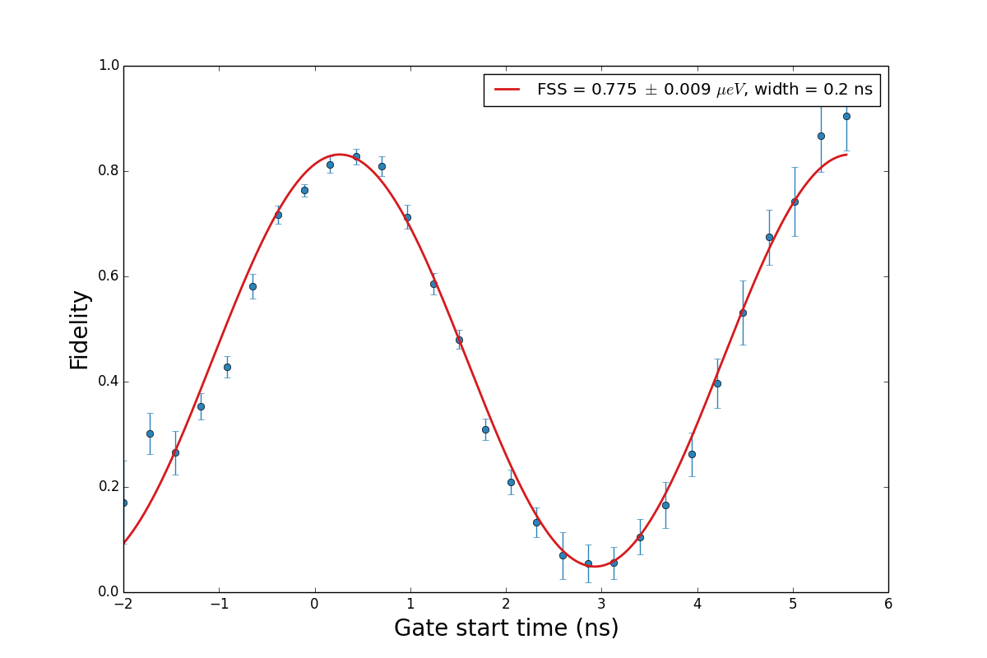
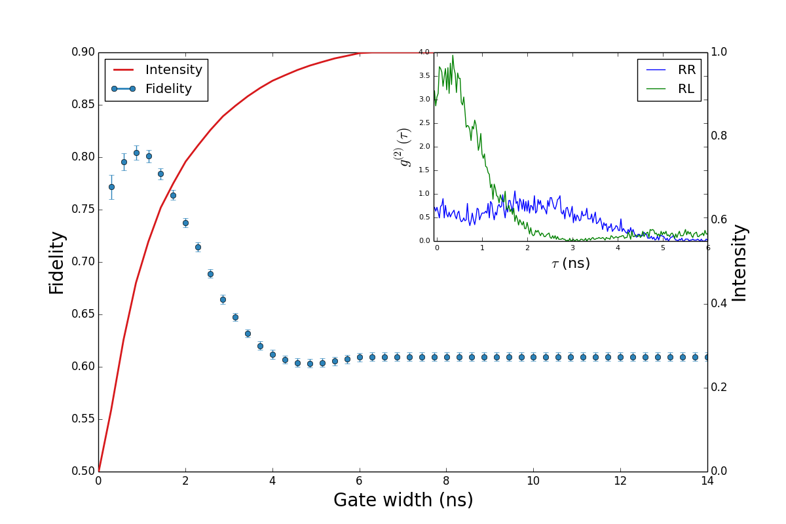
Simulation

Slide 10
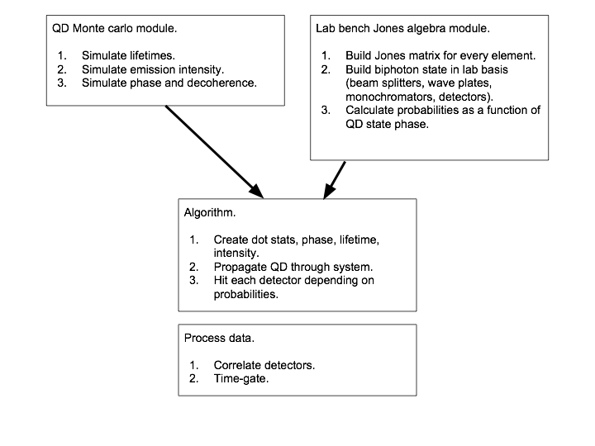
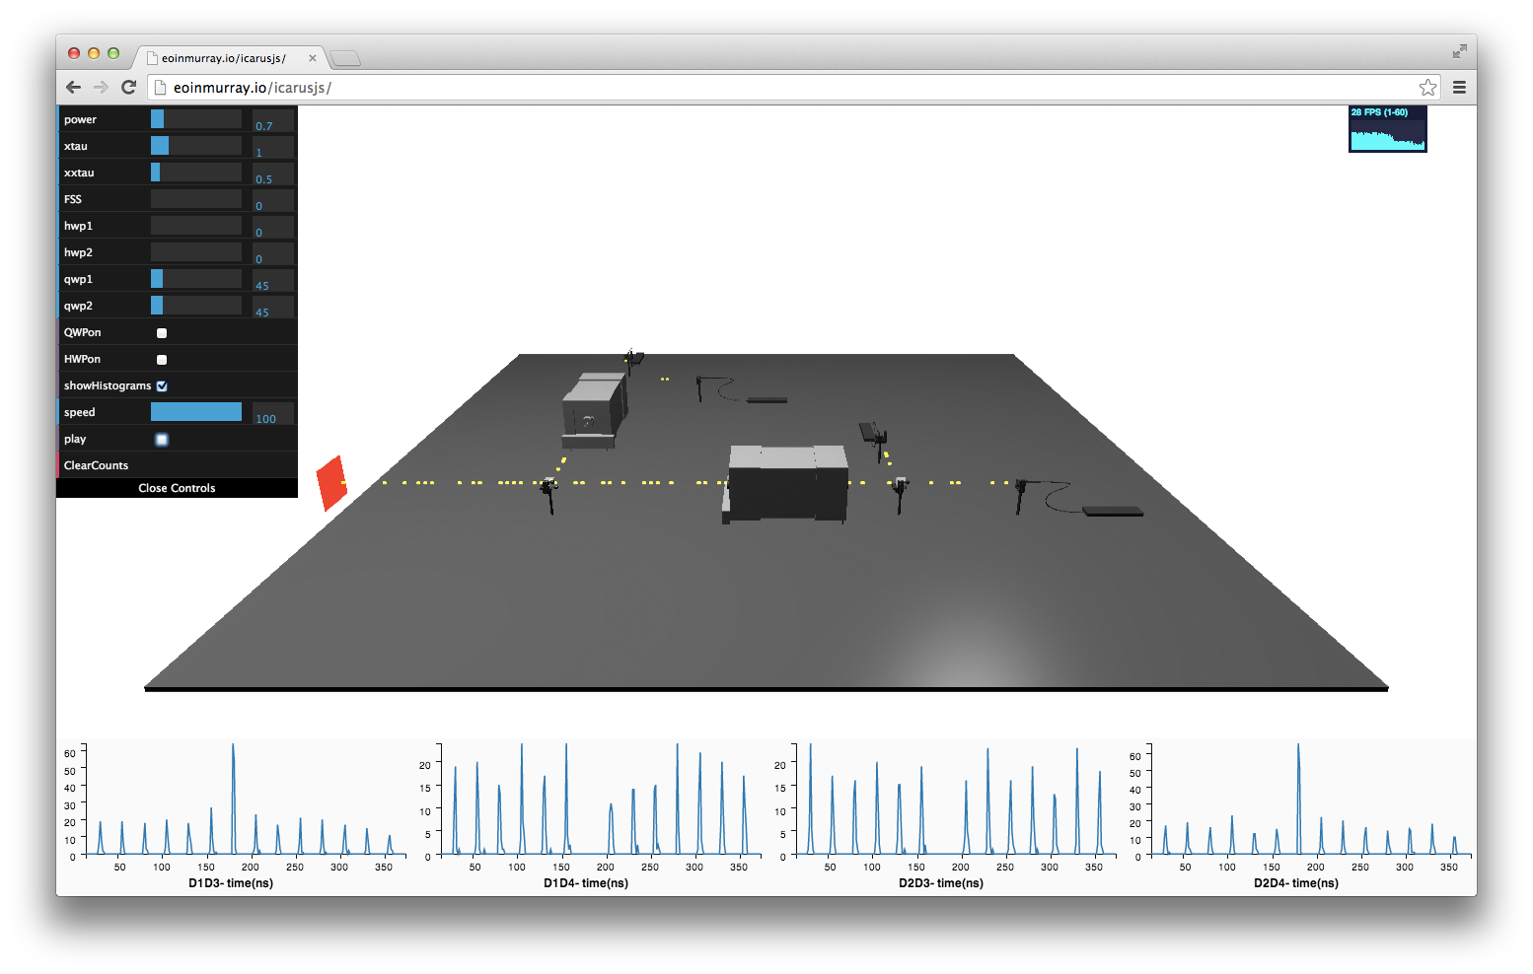

Slide 11
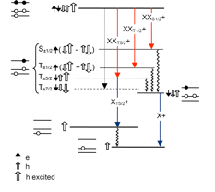
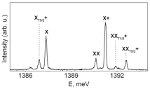
Hot trion states
H. Kramer, PROC. AMST. ACAD 33 959 (1930)
T. Warming et al, PHYSICAL REVIEW B 79, 125316 2009
Y. Igarashi, et al. PHYSICAL REVIEW B 81, 245304 2010

Slide 12
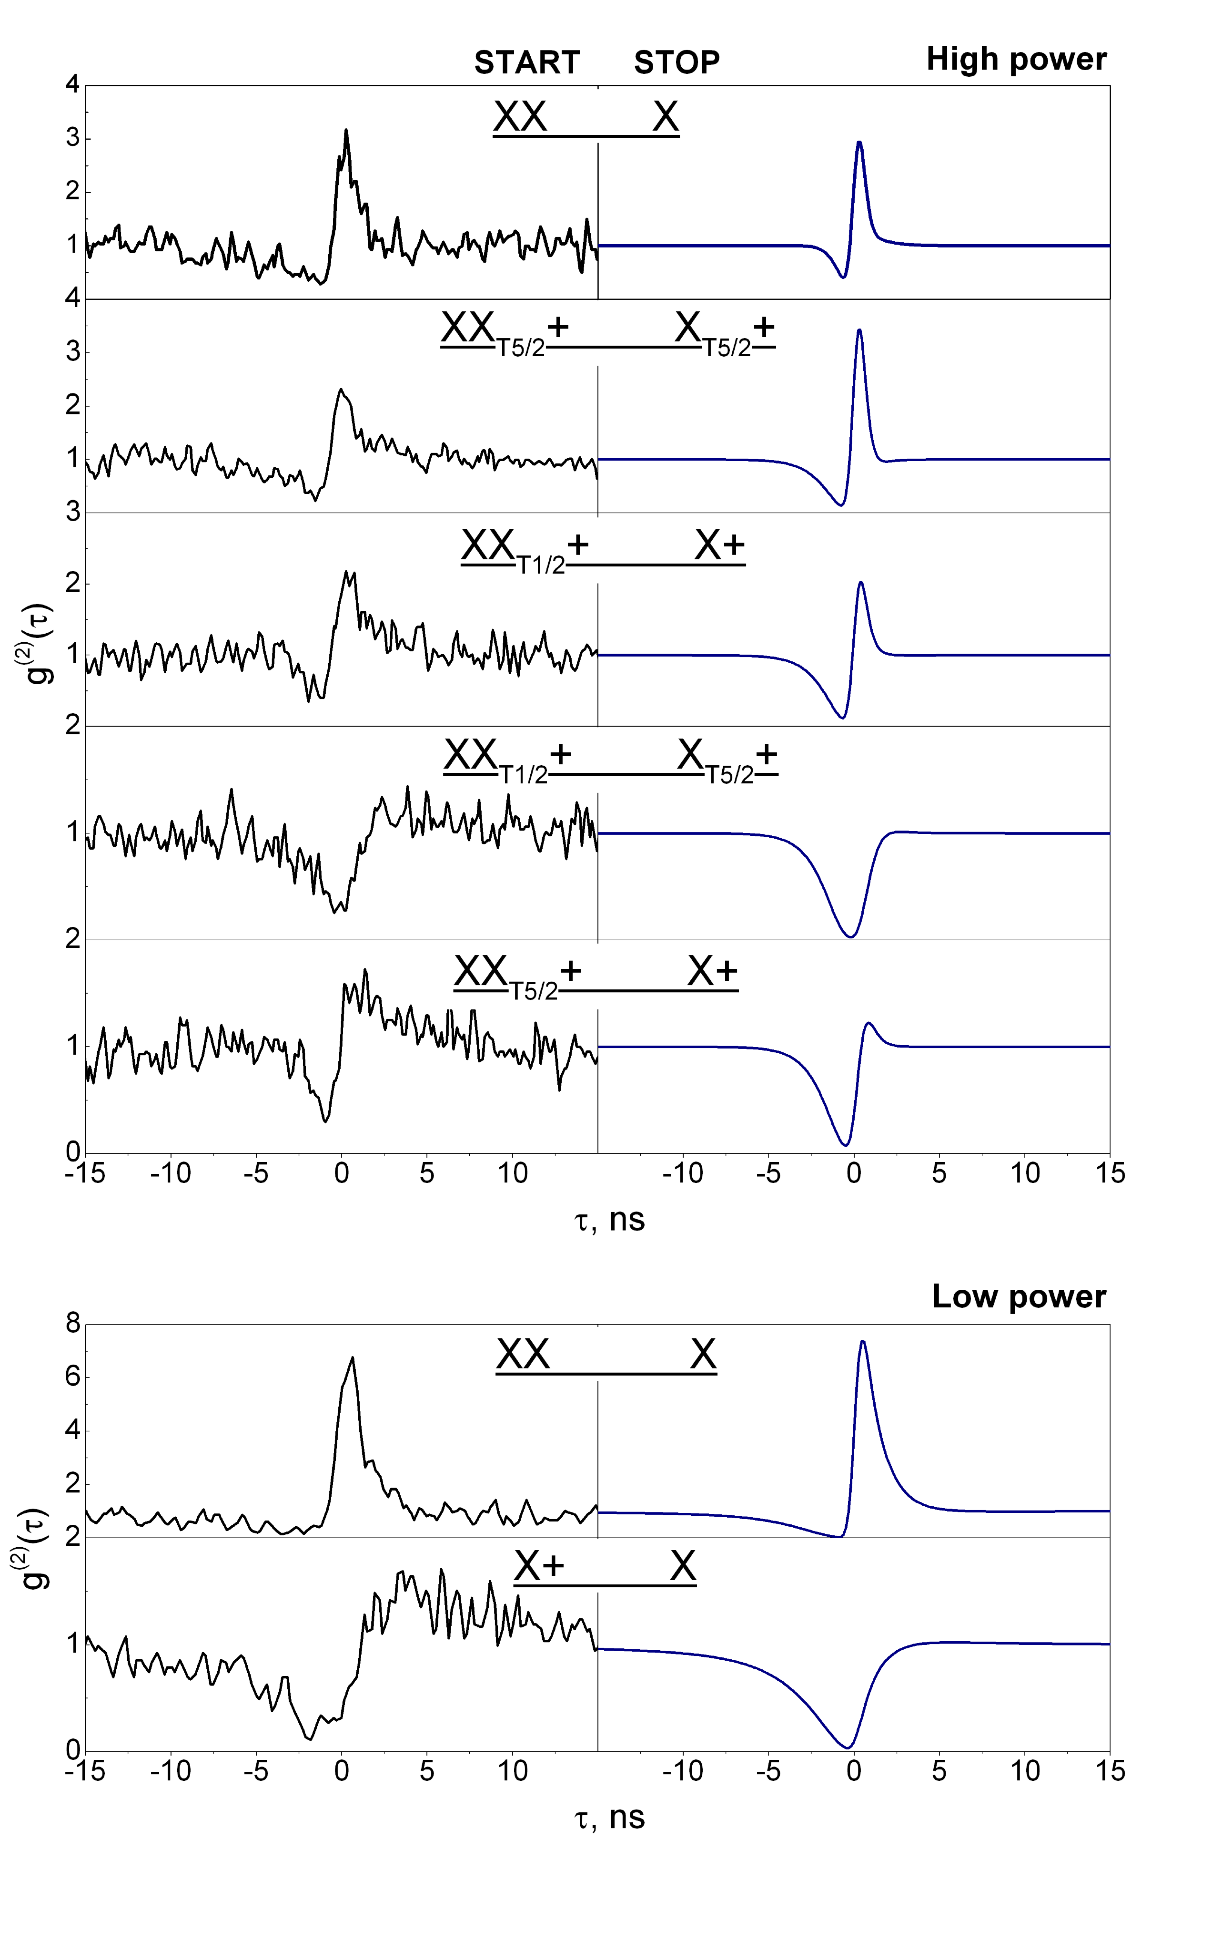
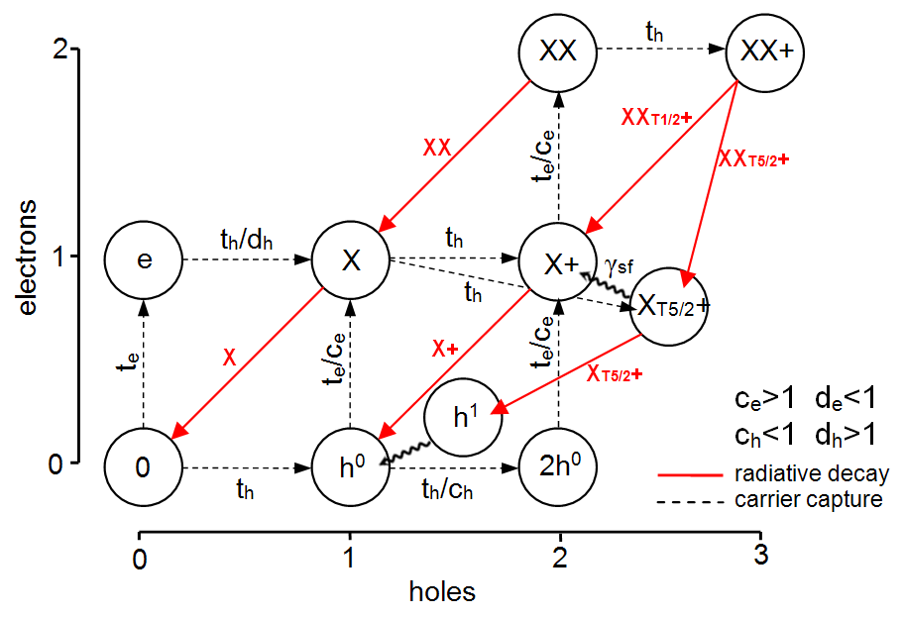
Modelling correlations
To be submitted to PRB.
M. H. Baier et al, PHYSICAL REVIEW B 73, 205321 2006
M. Grundmann and D. Bimberg, PHYSICAL REVIEW B 55, 9740 1997

Slide 13
Summary
Site-controlled array of entangled photon emitters.
Verified entanglement time-dependance.
Observation of hot trion states.
Further work
Tailor the growth for more neutral QDs.
Tune emission wavelength and FSS.
Simulation : Interferometry, Teleportation.

