Slide 1
Predicting House Prices in Kings County, WA
Evan Okin
September 14, 2019

Slide 2
Problem
How can we maximize home value?
21,000 data points (Kings County, WA)
Many variables to analyze (square footage, number of rooms, etc.)
Notes:
https://www.google.com/search?q=house+price&source=lnms&tbm=isch&sa=X&ved=0ahUKEwj1p4yl59HkAhUkhOAKHfffCrYQ_AUIFCgD&biw=1440&bih=685#imgrc=6-MSxbS8lALYmM:

Slide 3
Why Should We Care?
Maximum home value is over 14 times average home value
The Winners
The Ordinary

Slide 4

Results
Model accuracy: High
R-Squared: 83%
Positive relationship with price
Good zip codes
Waterfront view
High grade
Number of views
Square footage
Basement
Good condition
Notes:
https://www.google.com/search?biw=1440&bih=685&tbm=isch&sa=1&ei=CaF9Xcv9MYbl5gKs24boCA&q=math&oq=math&gs_l=img.3..0i67j0j0i67l4j0l4.99956.101699..101973...1.0..0.94.344.5......0....1..gws-wiz-img.CAPyez8A9Ow&ved=0ahUKEwiLpoCU49HkAhWGslkKHaytAY0Q4dUDCAc&uact=5#imgrc=hr8nsBn1hf48BM:

Slide 5
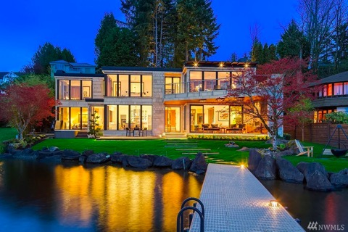
Key Recommendations
Location
Invest in desirable zipcodes including Medina, Bellevue, and Seattle
Waterfront View
Invest in properties with a waterfront view
High Grade
Invest in properties that have a high chance of getting a good grade
Notes:
https://www.google.com/search?biw=1440&bih=685&tbm=isch&sa=1&ei=4Z99XdLbBKG9ggeSp5D4BA&q=medina+wa+location&oq=medina+wa+location&gs_l=img.3...10515.15032..15260...2.0..0.185.1426.20j2......0....1..gws-wiz-img.....0..0j0i67j0i30j0i24.qE2B47umWvU&ved=0ahUKEwiS0MCG4tHkAhWhnuAKHZITBE8Q4dUDCAc&uact=5#imgrc=e9cmz_7r0o9wfM:
https://www.google.com/search?biw=1440&bih=685&tbm=isch&sa=1&ei=cqB9XaWYGO6O5wL5-a34CA&q=location&oq=location&gs_l=img.3..0l10.19089.20017..21321...0.0..0.65.280.5......0....1..gws-wiz-img.......0i5i30j0i8i30j0i24.BamL1VNvJbs&ved=0ahUKEwilmebL4tHkAhVux1kKHfl8C48Q4dUDCAc&uact=5#imgrc=0hZ7DDcwRSTaDM:

Slide 6
Further Recommendations
Square Footage
Invest in properties with high square footage
Basement
Invest in properties with a basement
Notes:
https://www.google.com/search?q=square+footage&source=lnms&tbm=isch&sa=X&ved=0ahUKEwiQicDG5NHkAhUt01kKHb7jApMQ_AUIEigB&biw=1440&bih=685&dpr=2#imgrc=etY1QbXTOb_C-M:

Slide 7
Next Steps
Analyze more variables
Latitude, longitude, day of week of sale
Run other types of algorithms
Decision trees/random forests
Non-linear regression
Notes:
https://www.google.com/search?q=next+steps+images&tbm=isch&source=iu&ictx=1&fir=OqY5-Tysx6L5UM%253A%252CcQe_t0w793l08M%252C_&vet=1&usg=AI4_-kQD1Pr6LvIt3UXwt6ZzpqbTUTBCfA&sa=X&ved=2ahUKEwii94___dHkAhUmtlkKHY0_BpQQ9QEwC3oECAYQGg#imgrc=OqY5-Tysx6L5UM:

Slide 8
Questions?
Project location:
https://github.com/eokin324/FlatIron-Module-1-Final-Project
Contact information:
eokin324@gmail.com
Notes:
https://www.google.com/search?q=%3F&source=lnms&tbm=isch&sa=X&ved=0ahUKEwjK74Sn5tHkAhWHiOAKHSNvAw4Q_AUIFCgD&biw=1440&bih=685#imgrc=PvW0R1JjZu2_PM:

