Slide 1
GSE 552 · Spring 2026 · Replication Project
Replicating Figure 1 from
Catastrophic Natural Disasters
and Economic Growth
Cavallo, Galiani, Noy & Pantano
Review of Economics and Statistics, 95(5): 1549–1561 · 2013
Ese Okitiakpe · Cal Poly SLO · June 2026

Slide 2
2. The Research Question
Do catastrophic natural disasters cause lasting declines in GDP per capita?
?
★
The Core Problem
Paper's Contribution
Establishing a credible counterfactual for disaster-affected countries.
Without a control group, how do you know what would have happened to GDP if the disaster hadn't occurred?
Use the synthetic control method construct a weighted average of unaffected countries whose pre-disaster GDP path closely matches the treated country.
Exploit the fact that disaster timing is exogenous.

Slide 3
3. Estimation Technique: Synthetic Control
Y ᴺᵢₜ = δₜ + θₜZᵢ + λₜμᵢ + εᵢₜ
Factor model for counterfactual GDP per capita (Eq. 4, Abadie, Diamond & Hainmueller 2010)
Yᴺᵢₜ
Counterfactual GDP per capita country I would have had without the disaster
Zᵢ
Observed predictors: trade openness, capital stock, population, education, latitude, institutions
λₜμᵢ
Unobserved time-varying confounders the key advantage over fixed-effects / DiD
εᵢₜ
Transitory GDP shock with zero mean

Slide 4
4. Why Synthetic Control?
Standard panel regression requires many treated units — but truly catastrophic disasters are extremely rare.
✗
✗
✗
✓
Cross-section OLS
Panel Fixed Effects
Diff-in-Differences
Synthetic Control ✓
Biased poor countries face larger disasters AND grow more slowly
Assumes constant effect of unobservables over time too restrictive for long-run growth
Needs parallel pre-trends and many treated units violated here
Allows time-varying unobserved confounders. Works with a single treated unit. Timing of disasters is exogenous.

Slide 5
5. The Data
Variable
Description
Value
Source
EM-DAT — Centre for Research on the Epidemiology of Disasters (CRED), Louvain
Period
Disaster events worldwide
1970 – 2008
Countries
Full coverage
196
Total events
Earthquakes, storms, floods
6,530
Key variable
People killed ÷ country population (killed_pop)
Normalized
Large event
killed_pop > world pooled mean
Binary flag
Data access
Harvard Dataverse
doi:10.7910/DVN/26717
Treatment variable: occurrence of a large natural disaster (binary)
Outcome variable: real GDP per capita (PPP, World Bank WDI)

Slide 6
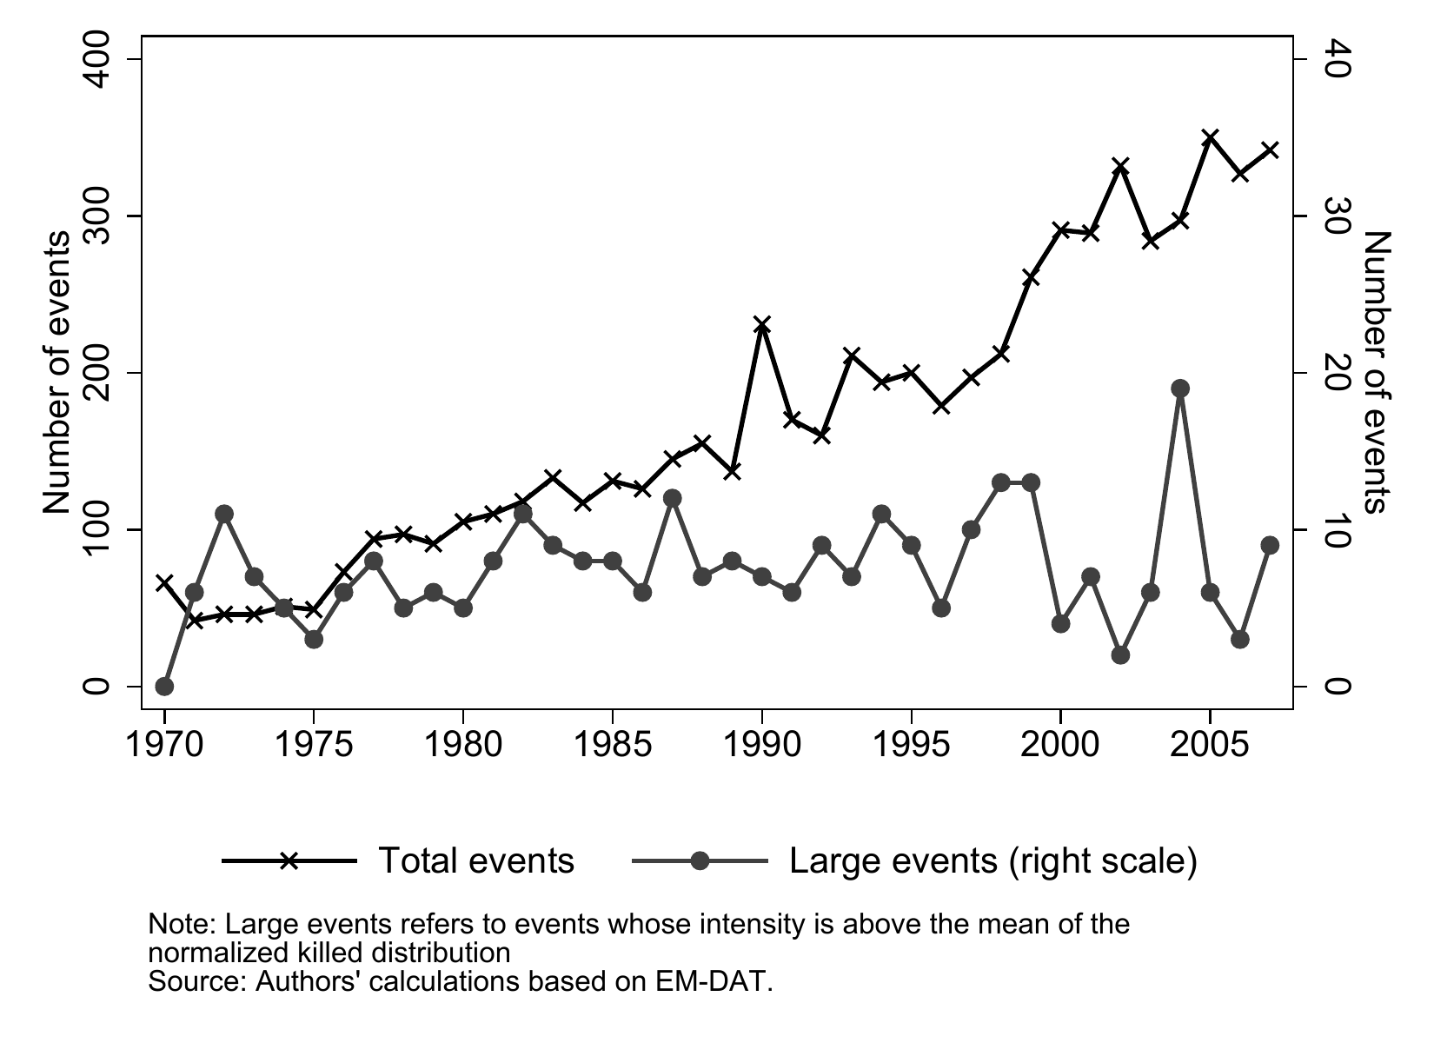

6. What I Replicated
Figure 1 — Increasing Prevalence of Natural Disasters
The figure plots two annual series from 1970 to 2007: ① Total recorded natural disaster events (left axis) ② Large events those whose intensity (killed/pop) exceeds the world pooled mean (right axis) Replication tool: R — preprocess.R + analysis.R → output/figures/fig1.png

Slide 7
7. Replication Results
66 → 342
Total events per year
1970 to 2007
Stable
Large events — no
upward trend
✓ Match
Qualitative result
identical to paper

Slide 8
8. What the Results Mean
Plain-English Interpretation
1
The disaster count increase is a recording artifact
The upward trend in total events is driven by better reporting of minor events, not more catastrophes. Truly large disasters have not become more frequent.
2
Large disasters are extremely rare
Only 4 events in 1970–2000 exceed the P99 threshold this low count directly motivates using synthetic control rather than regression, which needs many treated units.
3
Economic magnitude
Among P99 disasters followed by political revolution (Nicaragua 1972, Iran 1978), GDP per capita was ~10% lower than at disaster time after 10 years, vs ~18% higher in the counterfactual.
4
Without political revolution: no lasting GDP effect
This is the paper's headline finding natural disasters alone, even catastrophic ones, do not significantly damage long-run growth.

Slide 9
9. Replication Challenges
⚙ Software dependency failure
🔒 Proprietary data
The synth package for Stata could not install on Windows 64-bit — missing synthopt.win64a plugin. The main synthetic control figures (3, 9, 10) could not be reproduced in Stata.
Sovereign bond spread data used in related analyses requires Bloomberg access. Code being public is not sufficient for reproducibility when underlying data is paywalled.
⏱ Computational cost
✓ What worked
Authors' README warns of ~4 hours of runtime for the synthetic control estimation. Matching each treated country to a large donor pool is computationally intensive.
Figure 1 replicated cleanly in R using publicly available EM-DAT data and the authors' Harvard Dataverse package. The descriptive result is fully transparent.

Slide 10
10. Conclusion
01
Disaster count growth ≠ catastrophe growth
Improved reporting explains the trend the paper's Figure 1 shows this clearly and motivated the entire synthetic control design.
02
Natural disasters alone don't harm long-run GDP
Only P99 events followed by political revolution (Nicaragua, Iran) show lasting damage. The disaster is not the cause — the political instability is.
03
Reproducibility is harder than it looks
Public code + public data is the floor, not the ceiling. Software compatibility, OS-specific plugins, and compute time are underappreciated barriers.
Cavallo, Galiani, Noy & Pantano (2013) · Ese Okitiakpe · Cal Poly SLO, June 2026

