Slide 1
FALCON 9 / FIRST-STAGE LANDING PREDICTION
Winning the Space Race with Data Science
From raw launch records to geographical intelligence and predictive modelling
Eke Uka Okoro
IBM Data Science Professional Certificate • Capstone presentation
github.com/eokorouka-jpg/SpaceX-Falcon9-Data-Science-Capstone
EKE UKA OKORO • SPACEX FALCON 9 CAPSTONE
1

Slide 2
IBM DATA SCIENCE CAPSTONE
Executive summary
90
56
83.33%
labelled ML launches
Folium / Dash records
best held-out accuracy
End-to-end workflow: collection → cleaning → SQL / EDA → mapping → dashboard → classification
Landing success varies across launch sites, payload bands and booster versions in the sampled data
Logistic Regression, SVM and KNN tied on the 18-flight held-out test set
EKE UKA OKORO • SPACEX FALCON 9 CAPSTONE
2

Slide 3
IBM DATA SCIENCE CAPSTONE
Business question & analytical objectives
Can historical launch characteristics help explain and predict successful Falcon 9 first-stage landings?
Explore landing outcomes by site, orbit, flight history and payload
Investigate geographical context and transportation access
Create interactive tools for filtering and inspecting launches
Compare tuned classifiers and evaluate prediction errors
EKE UKA OKORO • SPACEX FALCON 9 CAPSTONE
3

Slide 4
IBM DATA SCIENCE CAPSTONE
Methodology: one connected workflow
01
02
03
04
05
COLLECT
PREPARE
EXPLORE
VISUALISE
PREDICT
SpaceX API + Wikipedia
clean, label, encode
Python EDA + SQLite
Folium + Plotly Dash
4 tuned classifiers
Python • pandas • SQL • Folium • Plotly Dash • scikit-learn
EKE UKA OKORO • SPACEX FALCON 9 CAPSTONE
4

Slide 5
IBM DATA SCIENCE CAPSTONE
Data collection: two complementary sources
SpaceX REST API
Wikipedia launch tables
Request historical launch records
Inspect HTML tables with BeautifulSoup
Expand rocket, core, payload and pad IDs
Extract booster, launch and mission fields
Flatten JSON to a structured table
One saved attempt returned HTTP 403
Open Web Scraping notebook on GitHub
Source note: an HTTP 403 attempt is not presented as a successful scrape.
EKE UKA OKORO • SPACEX FALCON 9 CAPSTONE
5

Slide 6
IBM DATA SCIENCE CAPSTONE
Data wrangling | documented cleaning steps
Evidence from the API collection notebook (90 rows x 17 columns)
print(data_falcon9.isnull().sum())
mean_payload = data_falcon9["PayloadMass"].mean()
data_falcon9["PayloadMass"] = (
data_falcon9["PayloadMass"]
.fillna(mean_payload)
)
5 -> 0
missing PayloadMass values
LandingPad remains null when no pad was used (26 values).
Cleaned file: dataset_part_1_cleaned.csv | Source: API notebook, cells 34–35
Open the cleaning notebook on GitHub
EKE UKA OKORO • SPACEX FALCON 9 CAPSTONE
6

Slide 7
IBM DATA SCIENCE CAPSTONE
Feature engineering | 12 features to 80 predictors
Evidence from Python EDA & feature engineering notebook
features_one_hot = pd.get_dummies(
features,
columns=["Orbit", "LaunchSite",
"LandingPad", "Serial"]
)
features_one_hot = features_one_hot.astype("float64")
90 x 12
original features
90 x 80
encoded features; 0 missing
All 80 columns converted to float64; dataset_part_3.csv exported.
Open the feature-engineering notebook on GitHub
EKE UKA OKORO • SPACEX FALCON 9 CAPSTONE
7

Slide 8
IBM DATA SCIENCE CAPSTONE
Why the dataset sizes differ
Analytical component
Records
Purpose
API / ML labels
90
Model training and evaluation
SQL launch table
101
Structured launch-history queries
Folium + Dash
56
Interactive geographic and dashboard analysis
These are different lab extracts and should not be combined into a single denominator.
EKE UKA OKORO • SPACEX FALCON 9 CAPSTONE
8

Slide 9
IBM DATA SCIENCE CAPSTONE
Exploratory analysis: launch-site success
CCAFS LC-40
26.92%
CCAFS SLC-40
42.86%
KSC LC-39A
76.92%
VAFB SLC-4E
40.00%
KSC LC-39A: 10 successful landings / 13 launches — strongest observed site in the 56-row sample.
EKE UKA OKORO • SPACEX FALCON 9 CAPSTONE
9

Slide 10
IBM DATA SCIENCE CAPSTONE
EDA result: launch volume & landing outcomes
Launch-site label
Launches
Successful
Success rate
CCAFS LC-40
26
7
26.92%
CCAFS SLC-40
7
3
42.86%
KSC LC-39A
13
10
76.92%
VAFB SLC-4E
10
4
40.00%
TOTAL
56
24
42.86%
Data quality: CCAFS LC-40 and CCAFS SLC-40 are near-duplicate location labels; treat carefully.
EKE UKA OKORO • SPACEX FALCON 9 CAPSTONE
10

Slide 11
IBM DATA SCIENCE CAPSTONE
EDA: payload mass & booster generations
0–2,000 kg
23.08%
2,000–4,000 kg
61.90%
4,000–6,000 kg
38.46%
6,000–8,000 kg
0.00%
8,000–10,000 kg
60.00%
Highest observed payload-band success: 2,000–4,000 kg (13 / 21 launches).
Small groups and historical confounding limit causal interpretation.
EKE UKA OKORO • SPACEX FALCON 9 CAPSTONE
11

Slide 12
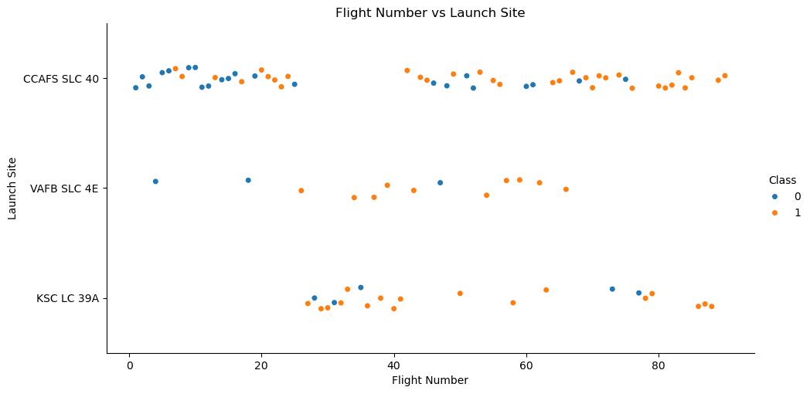
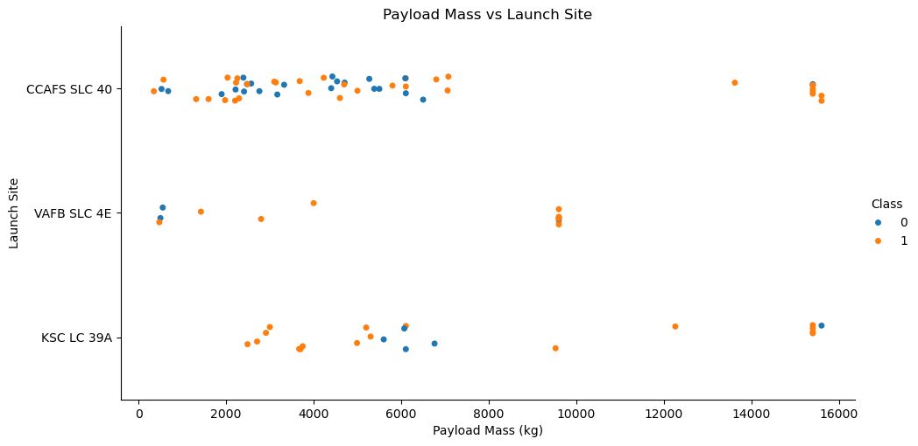
IBM DATA SCIENCE CAPSTONE
Python EDA | launch site & payload evidence
Flight number vs launch site
Payload mass vs launch site
Notebook charts colour landing class (0 = unsuccessful, 1 = successful).
View the original Python EDA notebook on GitHub
EKE UKA OKORO • SPACEX FALCON 9 CAPSTONE
12

Slide 13
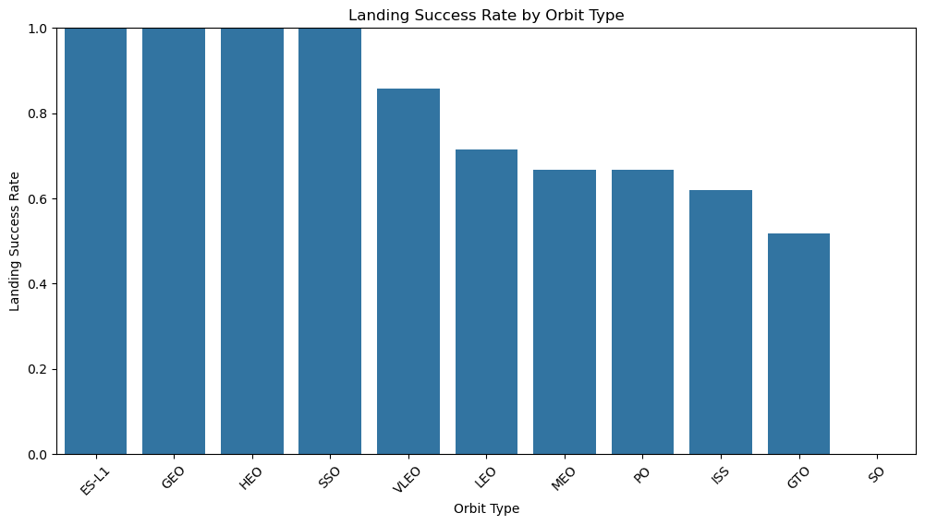
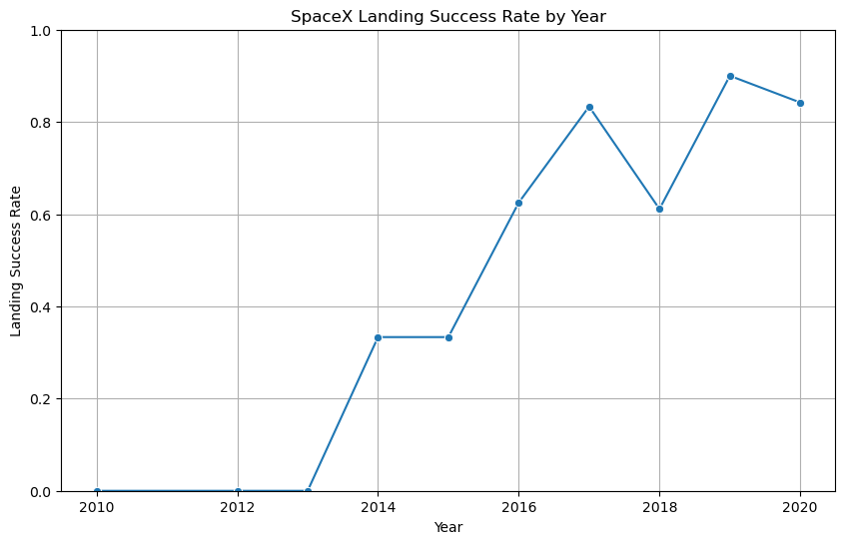
IBM DATA SCIENCE CAPSTONE
Python EDA | orbit & yearly patterns
Orbit-level landing success
Landing success by launch year
Descriptive associations only: these charts do not establish causality.
View the original Python EDA notebook on GitHub
EKE UKA OKORO • SPACEX FALCON 9 CAPSTONE
13

Slide 14
IBM DATA SCIENCE CAPSTONE
SQL analysis: queries answered with evidence
101
45,596 kg
2,928.4 kg
launch records in SQL
NASA CRS total payload
F9 v1.1 average payload
Earliest successful ground-pad landing: 22 December 2015
SQL distinguished mission success from first-stage landing outcomes
Date text was converted from DD-MM-YYYY to ISO order for filtering
EKE UKA OKORO • SPACEX FALCON 9 CAPSTONE
14

Slide 15
IBM DATA SCIENCE CAPSTONE
SQL evidence | payload mass queries
TASK 3 • NASA CRS payload
SELECT SUM(PAYLOAD_MASS__KG_) AS Total_Payload_Mass
FROM SPACEXTABLE
WHERE Customer = 'NASA (CRS)';
45,596 kg
Sum of payload masses for NASA CRS missions
TASK 4 • Falcon 9 v1.1 payload
SELECT AVG(PAYLOAD_MASS__KG_) AS Average_Payload_Mass
FROM SPACEXTABLE
WHERE Booster_Version = 'F9 v1.1';
2,928.4 kg
Mean payload mass for the specified booster version
SOURCE • Executed SQL cells and stored output tables in the SQL notebook (click to open)
EKE UKA OKORO • SPACEX FALCON 9 CAPSTONE
15

Slide 16
IBM DATA SCIENCE CAPSTONE
SQL evidence | first ground-pad landing
TASK 5 • Find earliest successful ground-pad landing
SELECT MIN(
SUBSTR(Date, 7, 4) || '-' ||
SUBSTR(Date, 4, 2) || '-' ||
SUBSTR(Date, 1, 2)
) AS First_Successful_Landing
FROM SPACEXTABLE
WHERE "Landing _Outcome" = 'Success (ground pad)';
QUERY OUTPUT
2015-12-22
SOURCE • Date strings converted to ISO format before taking MIN() (click to open notebook)
EKE UKA OKORO • SPACEX FALCON 9 CAPSTONE
16

Slide 17
IBM DATA SCIENCE CAPSTONE
SQL output: landing outcomes, 2010–2017
Outcome
Count
No attempt
10
Success (drone ship)
5
Failure (drone ship)
5
Success (ground pad)
3
Controlled (ocean)
3
Uncontrolled (ocean)
2
Failure (parachute)
2
Precluded (drone ship)
1
Period: 4 Jun 2010 – 20 Mar 2017 • 31 records
EKE UKA OKORO • SPACEX FALCON 9 CAPSTONE
17

Slide 18
IBM DATA SCIENCE CAPSTONE
SQL findings: booster and landing history
Drone-ship landing attempts
Maximum-payload booster IDs
5 / 10
12
successful in the 2010–2017 filtered period
distinct IDs; all labelled F9 B5 in the SQL results
Two failed drone-ship landings in 2015 were identified in January and April.
EKE UKA OKORO • SPACEX FALCON 9 CAPSTONE
18

Slide 19
IBM DATA SCIENCE CAPSTONE
Folium evidence | proximity calculations & map
TASK 3 • Haversine distance, map markers and connecting lines
# Reference: CCAFS LC-40
launch_site = (28.562302, -80.577356)
railway_point = (28.572277, -80.653919)
highway_point = (28.493048, -80.674388)
railway_distance = calculate_distance(
launch_site, railway_point)
highway_distance = calculate_distance(
launch_site, highway_point)
folium.PolyLine(
locations=[launch_site, highway_point],
color="orange", weight=3,
popup=f"Highway: {highway_distance:.2f} km"
).add_to(site_map)
Measured examples
Coastline 0.58 km
Railway 7.56 km
Highway 12.21 km
City point 18.19 km
Distances are straight-line to selected points, not road distances or proven nearest features.
Open the original Folium notebook (Task 3) on GitHub
EKE UKA OKORO • SPACEX FALCON 9 CAPSTONE
19

Slide 20
IBM DATA SCIENCE CAPSTONE
Folium evidence | launch sites & landing outcomes
TASK 1 + TASK 2 • Interactive site markers and success/failure clusters
# Label each launch site on the map
for _, site in launch_sites.iterrows():
coordinate = [site["Lat"], site["Long"]]
folium.Circle(location=coordinate, radius=1000,
color="#d35400", fill=True).add_to(site_map)
# Encode landing outcome and cluster launch records
spacex_df["marker_color"] = spacex_df["class"].apply(
lambda outcome: "green" if outcome == 1 else "red")
marker_cluster = MarkerCluster().add_to(site_map)
for _, record in spacex_df.iterrows():
folium.Marker([record["Lat"], record["Long"]],
icon=folium.Icon(color=record["marker_color"])).add_to(marker_cluster)
Interactive notebook output: click clusters to expand launches; green = landing success, red = failure.
Open the original Folium notebook (Tasks 1–2) on GitHub
EKE UKA OKORO • SPACEX FALCON 9 CAPSTONE
20

Slide 21
IBM DATA SCIENCE CAPSTONE
Folium: interactive geographical exploration
Launch-site coordinates plotted with circles and labels
Green / red landing-outcome markers and MarkerCluster for exploration
MousePosition and Haversine straight-line distances
Lines connect LC-40 to selected coast, rail, highway and city points
Map evidence: screenshot captured from the completed Jupyter Folium notebook.
EKE UKA OKORO • SPACEX FALCON 9 CAPSTONE
21

Slide 22
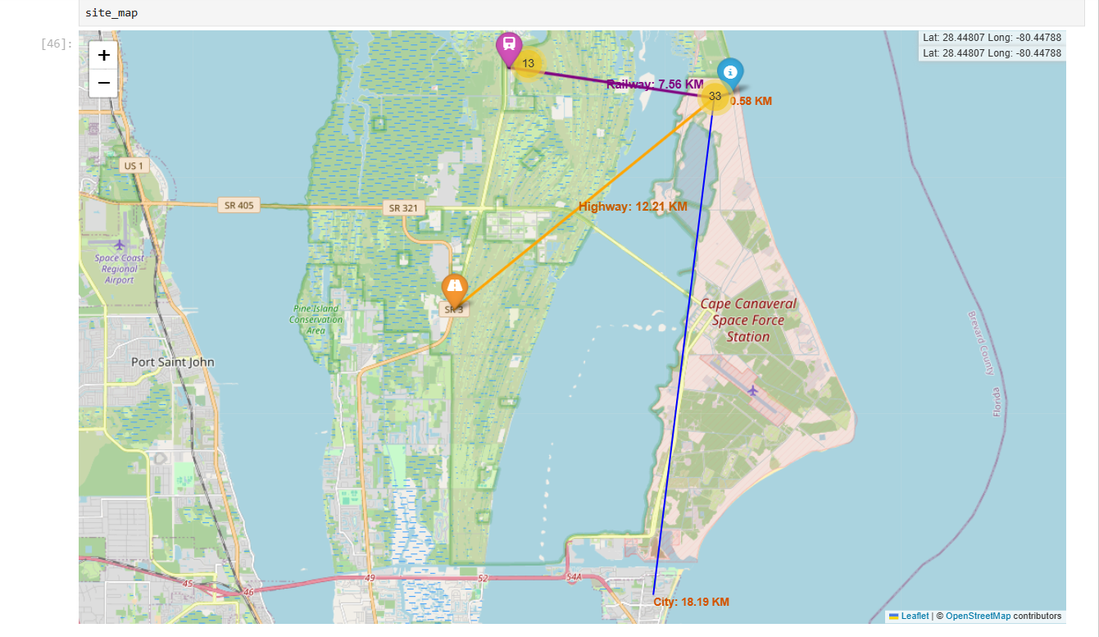
IBM DATA SCIENCE CAPSTONE
Folium results: LC-40 proximity map
Measured to selected points, not verified nearest features • Coast 0.58 km • Rail 7.56 km • Highway 12.21 km • City 18.19 km
EKE UKA OKORO • SPACEX FALCON 9 CAPSTONE
22

Slide 23
IBM DATA SCIENCE CAPSTONE
Geographic interpretation & limitations
Selected geographical point
Distance from LC-40
Coastline
0.58 km
NASA railway point
7.56 km
Florida SR 3 highway point
12.21 km
City reference point
18.19 km
Coastal placement may facilitate trajectories over water; transport links may support logistics. These distances do not prove site-selection causes or nearest-feature proximity.
EKE UKA OKORO • SPACEX FALCON 9 CAPSTONE
23

Slide 24
IBM DATA SCIENCE CAPSTONE
Plotly Dash: an interactive analytics app
Launch-site dropdown: all sites or a selected location
Pie chart: successful versus unsuccessful landings
Payload-range slider: interactively filter launches
Scatter plot: payload mass × outcome, coloured by booster version
Open Plotly Dash application code on GitHub
Working locally at http://127.0.0.1:8050/ • source code included in GitHub repository
EKE UKA OKORO • SPACEX FALCON 9 CAPSTONE
24

Slide 25
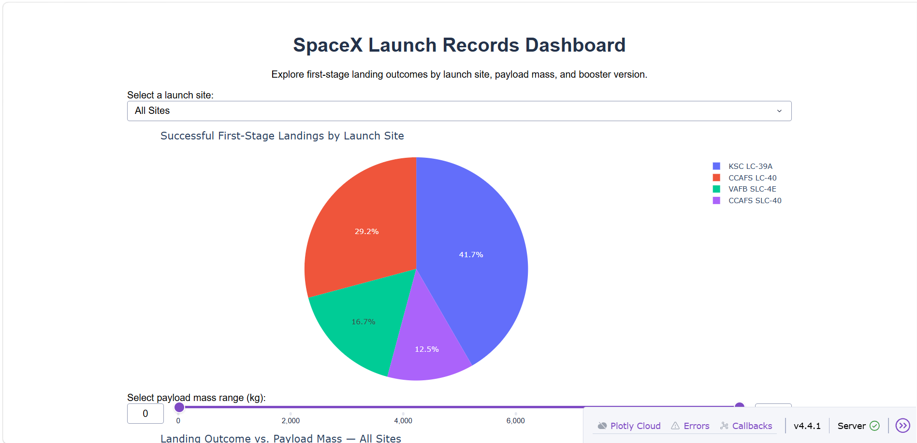
IBM DATA SCIENCE CAPSTONE
Dashboard result | successful landings by site
Of 24 successful landings, KSC LC-39A contributes 10 (41.7%). Its site-specific success rate is 10/13 = 76.92%.
EKE UKA OKORO • SPACEX FALCON 9 CAPSTONE
25

Slide 26
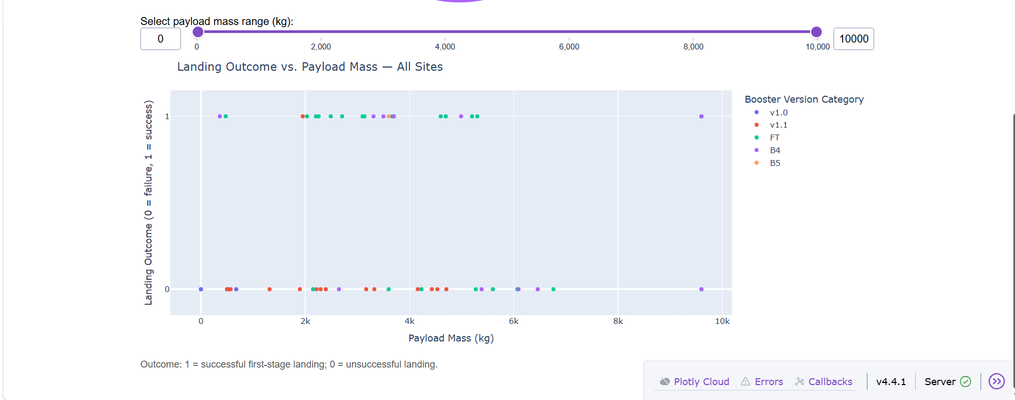
IBM DATA SCIENCE CAPSTONE
Dashboard result | payload and booster version
Interactive scatter: each point represents a launch; 1 = successful landing, 0 = unsuccessful. Colours distinguish booster versions.
EKE UKA OKORO • SPACEX FALCON 9 CAPSTONE
26

Slide 27
IBM DATA SCIENCE CAPSTONE
Dashboard insights: what changed with filters
76.92%
61.90%
66.67%
KSC LC-39A success
2–4 tonne payload band
FT booster version
KSC LC-39A: 10 successful of 13 sampled launches
2,000–4,000 kg: 13 successful of 21 launches
FT boosters: 16 successful of 24 launches; B5 had only one record
EKE UKA OKORO • SPACEX FALCON 9 CAPSTONE
27

Slide 28
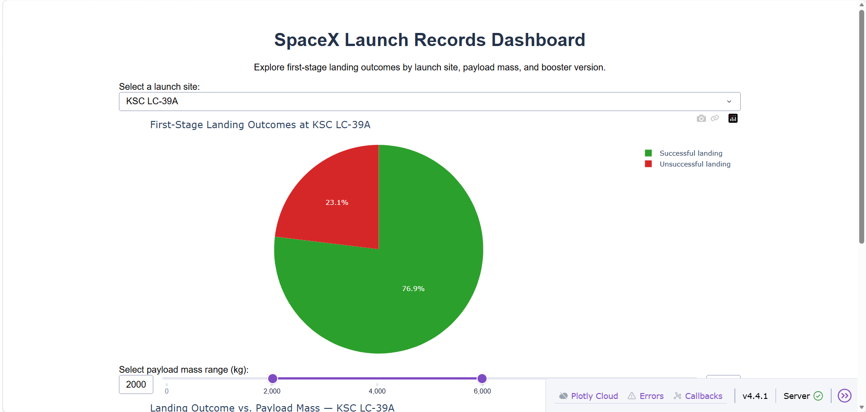
IBM DATA SCIENCE CAPSTONE
Dash evidence | site dropdown changes landing outcomes
Interactive control: launch-site dropdown set to KSC LC-39A
SELECTED SITE
KSC LC-39A
76.9%
Successful landings
10 of 13 launches
23.1% unsuccessful
(3 of 13)
EKE UKA OKORO • SPACEX FALCON 9 CAPSTONE
28

Slide 29
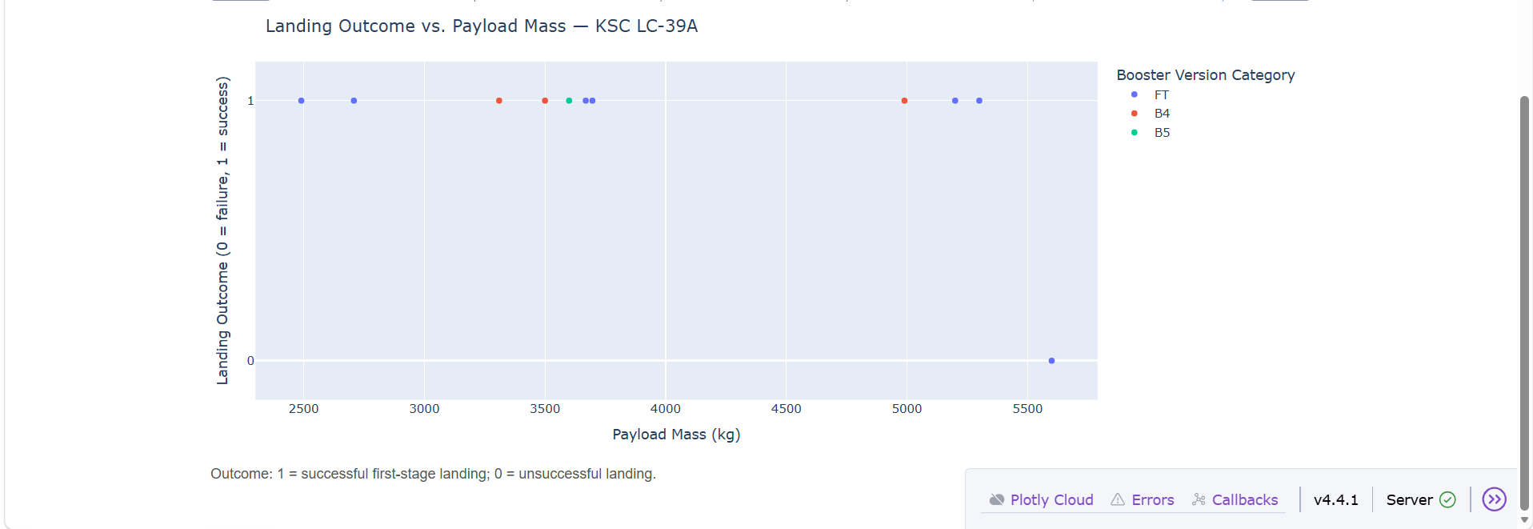
IBM DATA SCIENCE CAPSTONE
Dash evidence | payload slider & booster scatter
Interactive controls: KSC LC-39A selected; payload slider filtered to 2,000–6,000 kg
FILTERS
Launch site
KSC LC-39A
Payload mass
2,000–6,000 kg
Colour = booster version
Y-axis: 1 success, 0 failure
EKE UKA OKORO • SPACEX FALCON 9 CAPSTONE
29

Slide 30
IBM DATA SCIENCE CAPSTONE
Machine learning: modelling pipeline
01
02
03
04
FEATURES
SPLIT
TUNE
COMPARE
80 encoded predictors
80% train / 20% test
GridSearchCV; 10 folds
LR, SVM, Tree, KNN
Evaluation: 18 held-out launches; accuracy plus confusion matrices.
EKE UKA OKORO • SPACEX FALCON 9 CAPSTONE
30

Slide 31
IBM DATA SCIENCE CAPSTONE
ML evidence | splitting and tuning classifiers
Notebook code and modelling design: 90 labelled launches, 80 encoded predictors
# Train/test partition and model search
TEST SET
X_train, X_test, Y_train, Y_test = train_test_split(
X, Y, test_size=0.2, random_state=2
)
logreg_cv = GridSearchCV(lr, parameters, cv=10)
logreg_cv.fit(X_train, Y_train)
18 / 90
20% held out for testing
10-fold cross-validation
for model selection
Open machine-learning notebook on GitHub
EKE UKA OKORO • SPACEX FALCON 9 CAPSTONE
31

Slide 32
IBM DATA SCIENCE CAPSTONE
ML evidence | model accuracy and error types
Held-out test performance (18 records) and interpretation of confusion matrices
MODEL
TEST ACCURACY
TIED BEST MODELS
Logistic Regression
83.33%
15 / 18
Correct test predictions
Support Vector Machine
83.33%
Confusion matrix (LR / SVM / KNN)
K-Nearest Neighbours
83.33%
TN 3 • FP 3
FN 0 • TP 12
Decision Tree
77.78%
Results summary: three models tied; no unique winner.
EKE UKA OKORO • SPACEX FALCON 9 CAPSTONE
32

Slide 33
IBM DATA SCIENCE CAPSTONE
Classification results: held-out accuracy
Logistic Regression
83.33%
Support Vector Machine
83.33%
Decision Tree
77.78%
K-Nearest Neighbours
83.33%
Three classifiers tied at 83.33% (15 correct out of 18). No unique winner on this test split.
EKE UKA OKORO • SPACEX FALCON 9 CAPSTONE
33

Slide 34
IBM DATA SCIENCE CAPSTONE
Confusion matrices: what models missed
Model
TN
FP
FN
TP
Test accuracy
Logistic Regression
3
3
0
12
83.33%
SVM
3
3
0
12
83.33%
Decision Tree
3
3
1
11
77.78%
KNN
3
3
0
12
83.33%
For the tied models, all 12 actual positive cases were detected, but three negative cases were classified positive.
EKE UKA OKORO • SPACEX FALCON 9 CAPSTONE
34

Slide 35
IBM DATA SCIENCE CAPSTONE
Key insights: evidence, not assumptions
Landing success differs substantially by launch-site label in the 56-launch sample
Payload and booster-generation patterns vary, but group sizes and time trends matter
LC-40 is coastal; selected road and railway points are within ~12 km straight-line distance
Model test accuracy reached 83.33%, but the hold-out contains only 18 launches
Observed associations do not establish that geography or payload caused landing outcomes
EKE UKA OKORO • SPACEX FALCON 9 CAPSTONE
35

Slide 36
IBM DATA SCIENCE CAPSTONE
Conclusions & practical next steps
Delivered a reproducible capstone spanning acquisition, SQL, EDA, mapping, Dash and ML
Use the dashboard and Folium map to explore patterns rather than infer causality
Validate on later launch periods and larger datasets; examine class imbalance and calibration
Standardise launch-site names and verify nearest geographic features before stronger claims
Retrain with leakage-safe preprocessing inside cross-validation pipelines
EKE UKA OKORO • SPACEX FALCON 9 CAPSTONE
36

Slide 37
IBM DATA SCIENCE CAPSTONE
Portfolio, sources & reproducibility
GitHub repository
github.com/eokorouka-jpg/SpaceX-Falcon9-Data-Science-Capstone
Notebooks: API, scraping, SQL, Python EDA, Folium and classification
Dash application and supporting CSV datasets
Interactive map: spacex_folium_final_map.html (save and commit if available)
Presentation figures are from the project data; Folium map is a notebook screenshot
Source context: IBM Data Science Professional Certificate capstone labs; SpaceX API and Wikipedia launch data.
EKE UKA OKORO • SPACEX FALCON 9 CAPSTONE
37

