Slide 1
Winning the Space Race with Data Science
SpaceX Falcon 9 first-stage landing prediction | Capstone technical report
From raw launch records to interactive analytics and predictive modelling
Eke Uka Okoro
14 October 2026
GitHub project: github.com/eokorouka-jpg/SpaceX-Falcon9-Data-Science-Capstone
Eke Uka Okoro | IBM Data Science Capstone
1

Slide 2
Executive summary
What we investigated and what we learned
• Goal: estimate the likelihood that a Falcon 9 first stage lands successfully.
• Prepared 90 labelled launches; 60 successful and 30 unsuccessful (66.7% success).
• Explored flight history, orbit, payload, launch site, geography and booster outcomes.
• Compared four tuned classifiers on 18 held-out flights.
• Best observed test accuracy: 83.33% — Logistic Regression, SVM and KNN (tie).
Eke Uka Okoro | IBM Data Science Capstone
2

Slide 3
Business problem and research questions
• Reusable boosters can reduce launch costs, so predicting landing outcomes matters.
• Which launch sites, orbits and payload ranges are associated with landing success?
• How do outcomes change over flight history?
• Can supervised learning predict a landing from pre-landing launch characteristics?
• How reliably do results generalize beyond this small historical sample?
Eke Uka Okoro | IBM Data Science Capstone
3

Slide 4
End-to-end data science journey
Evidence across collection, wrangling, exploration and modelling
API / Wikipedia
Clean + label
SQL + EDA
Folium + Dash
ML + evaluation
Python • pandas • SQL • seaborn/matplotlib • Folium • Plotly Dash • scikit-learn
Eke Uka Okoro | IBM Data Science Capstone
4

Slide 5
Data collection: SpaceX API and Wikipedia
• API lab: retrieve SpaceX launch JSON and expand rocket, payload, core and launchpad references.
• Wikipedia lab: use BeautifulSoup to extract Falcon 9 launch-table information.
• The saved web-scraping notebook shows an HTTP 403 response in one run; do not treat that blocked attempt as successful scraping.
• Data sources and intermediate CSV files should be committed with their notebooks.
Eke Uka Okoro | IBM Data Science Capstone
5

Slide 6
Data wrangling and target construction
• Filtered to 90 Falcon 9 launches with a binary landing label.
• Class = 1: successful first-stage landing; Class = 0: otherwise.
• Imputed missing payload masses; retained launch site, orbit and booster attributes.
• Prepared 80 model features in the completed feature-engineering lab (one-hot encoding).
• Dataset_part_2.csv contains the 90 labelled rows; feature and label rows must remain aligned.
Eke Uka Okoro | IBM Data Science Capstone
6

Slide 7
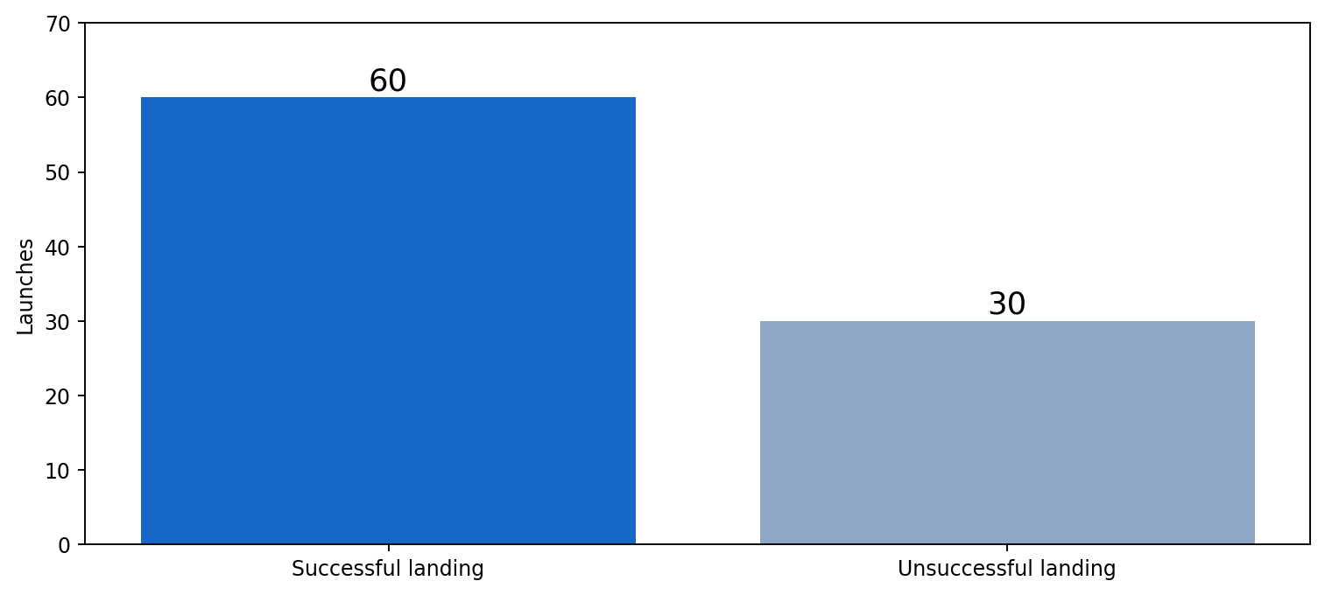
Dataset profile: 90 launches
Eke Uka Okoro | IBM Data Science Capstone
7

Slide 8
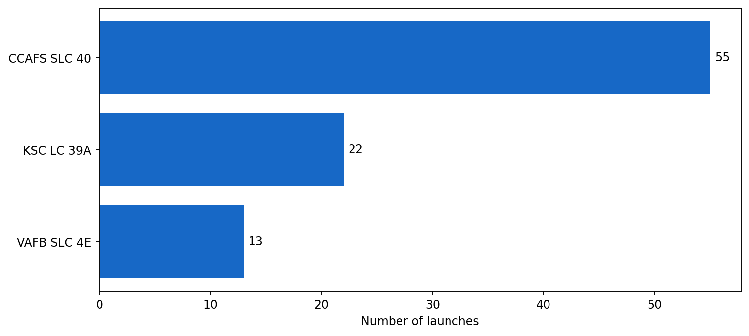
Exploratory data analysis: launch-site distribution
Eke Uka Okoro | IBM Data Science Capstone
8

Slide 9
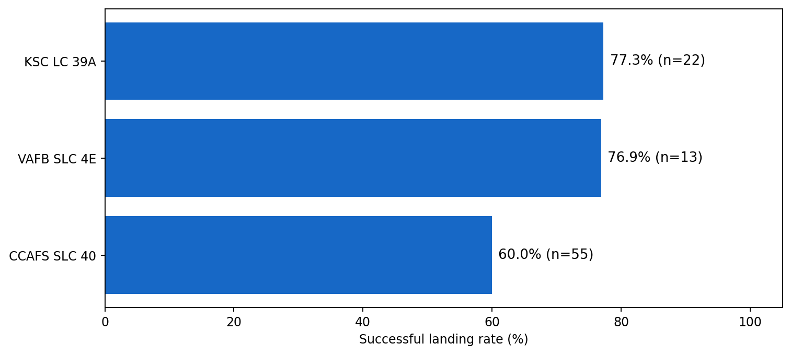
EDA: landing success by launch site
Eke Uka Okoro | IBM Data Science Capstone
9

Slide 10
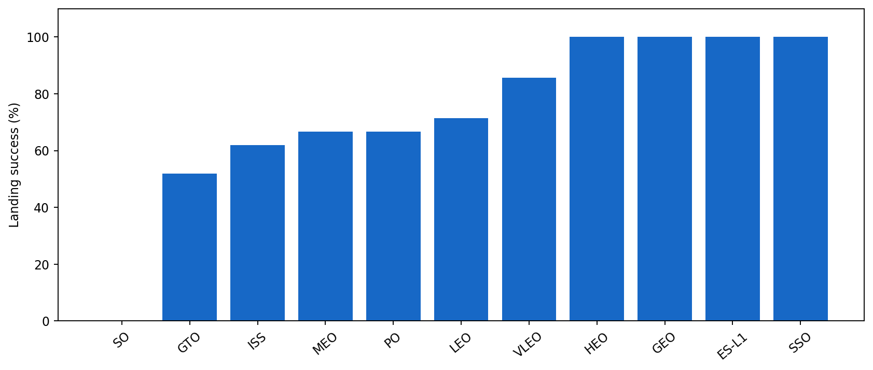
EDA: landing success by orbit
Rates are descriptive; some orbit categories contain very few launches
Eke Uka Okoro | IBM Data Science Capstone
10

Slide 11
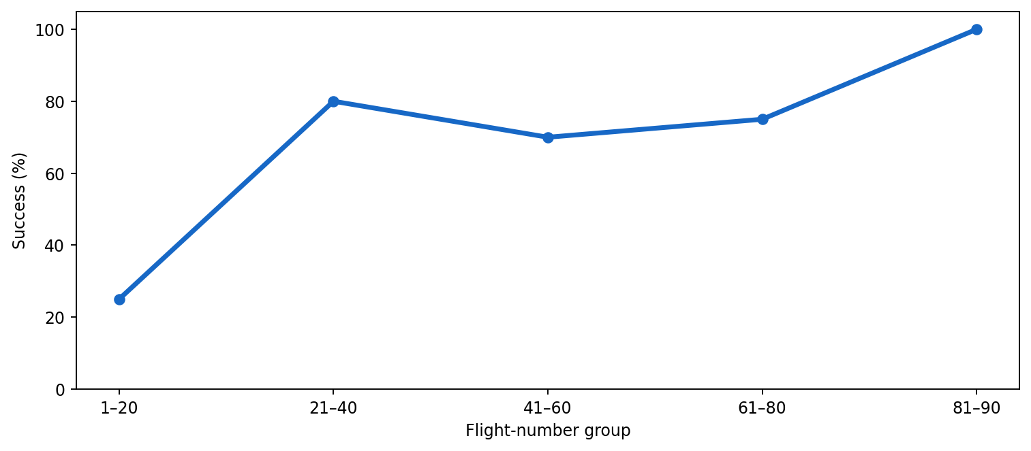
EDA: landing success across flight history
Eke Uka Okoro | IBM Data Science Capstone
11

Slide 12
SQL exploratory analysis
Notebook evidence and key analytical questions
• SQL lab uses a local SQLite database to query Falcon 9 launch records.
• Analytical tasks include launch sites, payload mass, booster versions, landing outcomes and dates.
• The submitted SQL notebook contains query execution, but its saved outputs are not sufficient to verify every requested numeric answer.
• For reproducibility, upload the SQL notebook and database/CSV inputs, then rerun all queries before submission.
Eke Uka Okoro | IBM Data Science Capstone
12

Slide 13
Folium: geographic analysis of launch sites
• Mapped launch-site coordinates and annotated their locations.
• Used outcome-coloured markers and MarkerCluster to explore successful and unsuccessful landings.
• Geographic context helps assess coastal proximity and differences between launch sites.
• Distance-to-city/rail/highway sections require verified destination coordinates; do not report unsupported distances.
• The interactive HTML map/notebook should be included in GitHub.
Eke Uka Okoro | IBM Data Science Capstone
13

Slide 14
Plotly Dash: an interactive landing dashboard
• Built and ran a working local Dash app at http://127.0.0.1:8050/.
• Launch-site dropdown updates the successful-landing pie chart.
• Payload-range slider filters a scatter plot; booster versions provide additional context.
• Dashboard lab uses a separate 56-row dataset — its percentages must not be mixed with the 90-row modelling dataset.
• Commit spacex-dash-app.py, its source CSV and a screenshot of the running dashboard.
Eke Uka Okoro | IBM Data Science Capstone
14

Slide 15
Dashboard findings: 56-launch sample
• KSC LC-39A: 10 successful landings in 13 launches (76.92%).
• Best observed payload band: 2,000–4,000 kg (61.90% landing success).
• 6,000–8,000 kg: 0% observed success in this small sample.
• Booster B5: 100% observed success, but based on only one flight — not a robust estimate.
• These findings describe the dashboard dataset, not the full 90-flight modelling dataset.
Eke Uka Okoro | IBM Data Science Capstone
15

Slide 16
Predictive methodology: reproducible classification
• Target Y: Class; predictors X: encoded and standardized launch attributes.
• Train/test split: 80% training (72 flights), 20% test (18 flights), random_state = 2.
• GridSearchCV with 10-fold cross-validation selects model hyperparameters.
• Models: Logistic Regression, Support Vector Machine, Decision Tree and KNN.
• Test accuracy and confusion matrices assess out-of-sample performance.
Eke Uka Okoro | IBM Data Science Capstone
16

Slide 17
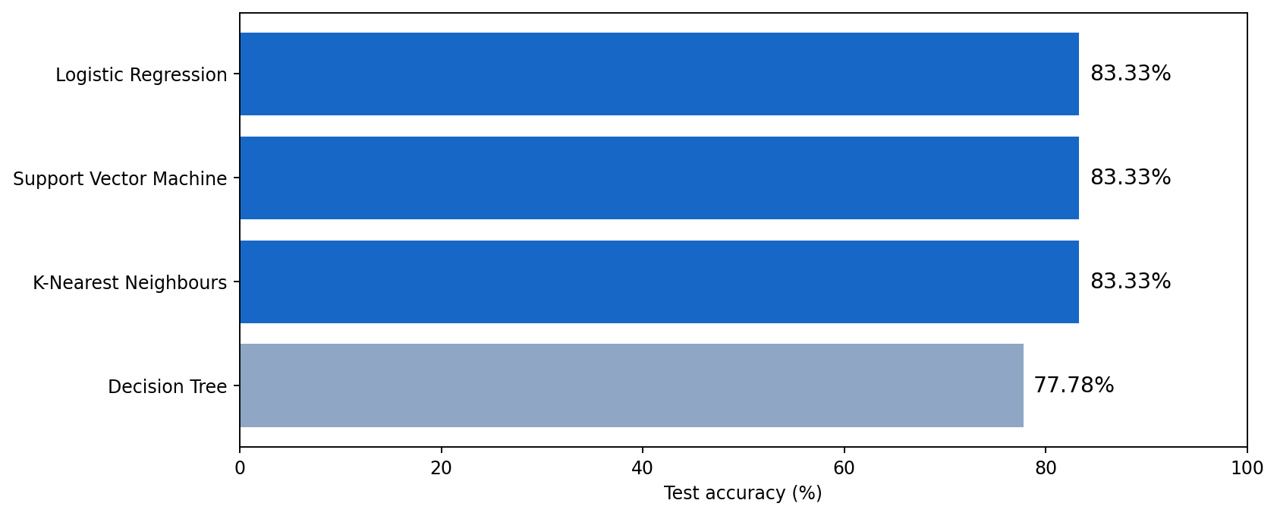
Model comparison: held-out test accuracy
Eke Uka Okoro | IBM Data Science Capstone
17

Slide 18
Confusion matrices: what the predictions missed
• Logistic Regression, SVM and KNN: 12 true positives, 3 true negatives, 3 false positives, 0 false negatives.
• Each correctly classified 15 of 18 held-out flights (83.33%).
• Decision Tree: 11 true positives, 3 true negatives, 3 false positives, 1 false negative.
• Decision Tree correctly classified 14 of 18 flights (77.78%).
• Main error pattern: predicting a landing when the booster did not land (false positive).
Eke Uka Okoro | IBM Data Science Capstone
18

Slide 19
Interpretation and limitations
• Flight history, launch site, orbit and payload show useful associations with landing outcomes.
• A three-way model tie means no single best model can be established from accuracy alone.
• Only 18 test launches: one additional mistake changes accuracy by 5.56 percentage points.
• Model features were standardized before the split in the lab; a production-quality rerun should fit scaling on training data only.
• Historical observational patterns do not prove causality or future operational reliability.
Eke Uka Okoro | IBM Data Science Capstone
19

Slide 20
Conclusions and recommendations
• Built a complete analytical workflow from collection and cleaning to interactive dashboards and ML.
• Landing success improved over the historical flight sequence in the 90-launch dataset.
• Three classifiers tied at 83.33% on the 18-launch test set; inspect false positives before deployment.
• Next steps: collect more recent flights, avoid data leakage, compare precision/recall and calibrate predicted probabilities.
• Use the dashboard for exploration, not as a validated real-time prediction service.
Eke Uka Okoro | IBM Data Science Capstone
20

Slide 21
GitHub portfolio and reproducibility
• Project repository: https://github.com/eokorouka-jpg/SpaceX-Falcon9-Data-Science-Capstone
• Public repository created: SpaceX-Falcon9-Data-Science-Capstone.
• Repository contains the API, Wikipedia, SQL, EDA, Folium and machine-learning notebooks.
• CSV inputs, README.md and the PDF report have been uploaded; verify dashboard scripts and screenshots.
• Keep source data, figures and notebook outputs organised so a reviewer can reproduce the work.
Eke Uka Okoro | IBM Data Science Capstone
21

Slide 22
Grading checklist: 15-point submission
• Included: executive summary, introduction and data collection/wrangling methods.
• Included: EDA visualisations, SQL methodology, Folium and Dash analytics.
• Included: predictive modelling methodology, tuned-model results and conclusion.
• Included: original figures, limitations, comparative insights and direct GitHub repository link.
• Before submission: verify SQL/map evidence and ensure the uploaded PDF matches this revised version.
• Submit the accompanying PDF as the assessed presentation.
Eke Uka Okoro | IBM Data Science Capstone
22

Slide 23
Appendix: source files and dataset definitions
• dataset_part_2.csv — 90 rows × 18 columns; labelled modelling data.
• Model feature matrix — 90 rows × 80 encoded predictors (as shown in the completed lab).
• spacex-dash-app.py — interactive Dash dashboard; 56-row dashboard sample.
• jupyter-labs-eda-sql-coursera_sqllite.ipynb — SQL lab.
• jupyter-labs-webscraping.ipynb — Wikipedia scraping lab.
• lab_jupyter_launch_site_location.ipynb — Folium geographic lab.
Eke Uka Okoro | IBM Data Science Capstone
23

