Slide 1
Problem Statement:
To develop an optimal supermarket store location recommender system that would be instrumental to the Supermarket exco and planning team in identifying optimal locations for new stores. the objective entails analyzing geographical, demographic and open street data to pinpoint areas with high potential for store expansion based on key factors such as accessibility based on the road network from open street data, market demand based on demographic data and competition based on the competitors present. By leveraging data analysis and visualization techniques such as isochrone maps, choropleths maps, population metrics, and market saturation levels, the recommender system will provide actionable insights that support strategic planning and decision-making for expanding the supermarket’s store network.

Slide 2

Introduction
Nairobi is the capital city of Kenya and the most populous city in Kenya, with estimated population of 4,356,024 and an estimated population of 54,341,935 in the whole country.
The city is the main economic hub for the country and the East African region and has many supermarkets, coffee shops, cafes and hotels. The variety of FMCG are provided by the supermarkets.
Thus, there are many supermarket chains with stores in the various parts of the city and across the country.
Therefore, to open a new store in the capital city or any other part of the country, selecting the best suitable place for the store is key.
To get the information about this suitable place, optimal store location recommender system will be used.

Slide 3
questions to be answered
Which place is the most suitable and popular for the supermarket?
What type of supermarket should be provided ?
What type is preferred by people in that area ?
What type of people live in that area ( students, company employees, etc ) ?
How many supermarkets are present in that area ?
What other specialties should be provided to attract customers ?

Slide 4

TARGET AUDIENCE
The target audience for this analysis includes the top executives and the strategic planning team who are interested in opening a new supermarket store in a specific city or area. The leadership seeks locations that are most popular and well-known within the city.

Slide 5
DATA
-I obtained the required information from various sources such as KNBS, census report websites, web scraping, open street data, etc
To open a new store, the following information would be required
-Accurate latitude and longitude coordinates are necessary to precisely pinpoint the location of interest
-The population of the neighborhood is gathered to understand the potential customer base and market size
-Demographic information: Information regarding the type of people residing in each neighborhood is collected. This includes factors such as age groups, occupation types (students, employees), Average income and other relevant demographic characteristics
-The preference of people towards a certain type of food which would help in determining the type of food that will resonate with the target audience
-Other service details such as transport, taxi, etc.
-Competitors in the neighborhood

Slide 6
METHODOLOGY
The following steps were followed –
got the demographic data of Kenya from the KNBS website
used the python selenium and beautiful soup libraries for web scraping to collect data about the existing stores and the competitors present
got the longitude and latitude coordinates of all the existing stores for the top 6 supermarket chains in Kenya (Naivas, Quickmart, Chandarana, Carrefour, Cleanshelf, Khetia’s)
visualized the stores on the map of Kenya using the Folium library package to understand the spatial distribution of current stores, identifying saturated areas, and spot geographical gaps.
Created choropleths to visualize demographic distribution per county and isochrone maps for each store location for accessibility analysis based on the area’s road network, public transit routes and traffic conditions
Performed data analysis and developed a store location recommender system.
Deployed the system on Heroku using a web interface and provided a link for client access. the system allows the client to input their preferred coordinates for a new store, displays the location on a map with isochrones for a specified time alongside preferred demographics for the given county. The system highlights the isochrone area, nearby competitors, and whether the isochrone overlaps with those of competitors or existing branches.

Slide 7
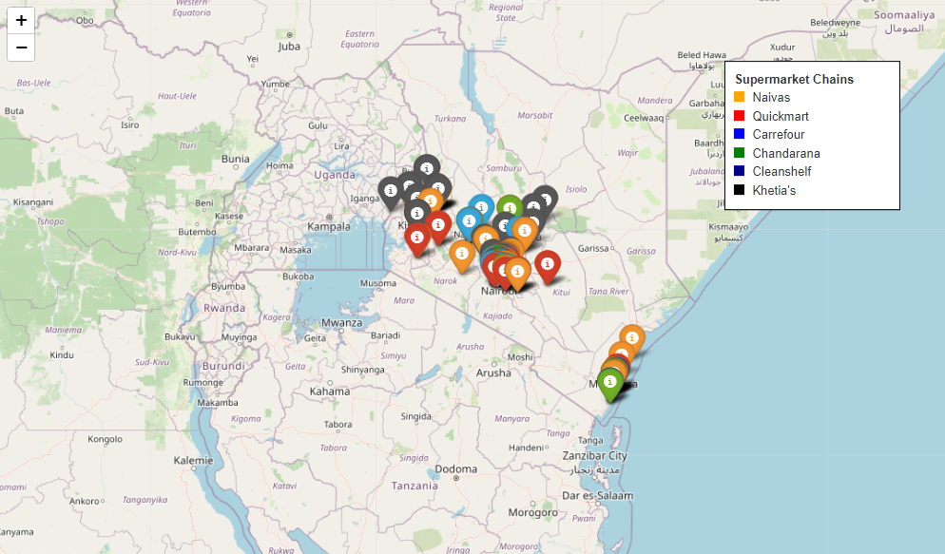
distribution of stores for top 6 supermarket chains in Kenya. Most stores are concentrated in Nairobi and environs with moderate number of stores in the western part of the country and coast. The Northern and north-eastern parts of the country have no stores.

Slide 8
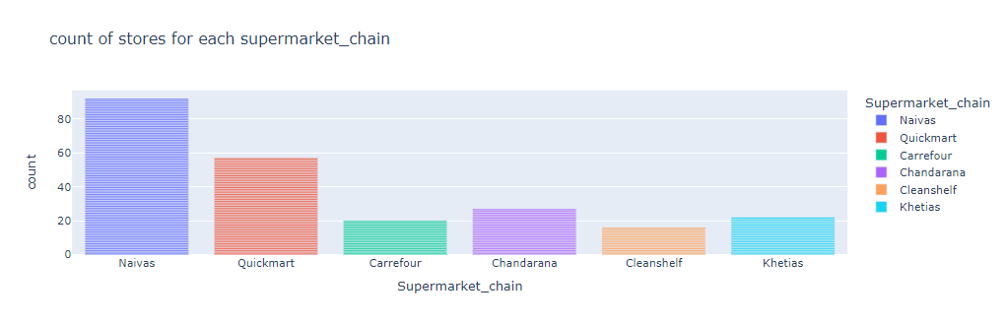
Countrywide stores count for each supermarket chain. Naivas leading in the number of stores followed by Quickmart, Chandarana and Khetia’s. Cleanshelf has the least number of stores

Slide 9
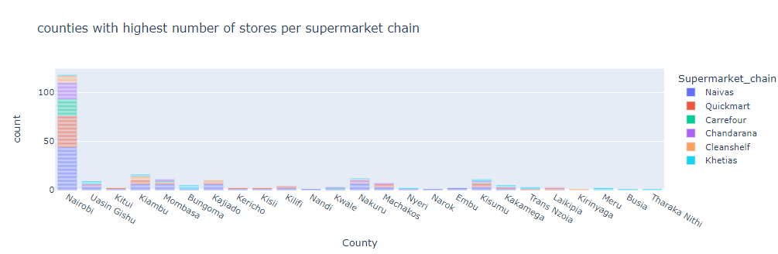
Nairobi county leads with the highest number of stores followed by Kiambu, Nakuru, Mombasa then Kisumu. Stores present in only 25 counties out of the 47 counties in Kenya

Slide 10
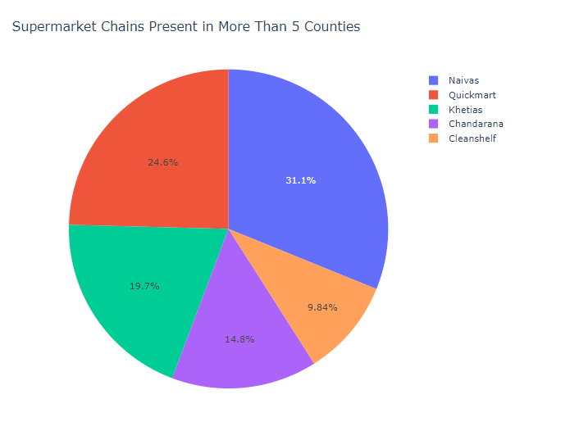
All the top 6 supermarket chains are present in at least 5 counties in Kenya except for carrefour that is only present in 3 counties (Nairobi, Mombasa and Kisumu)

Slide 11
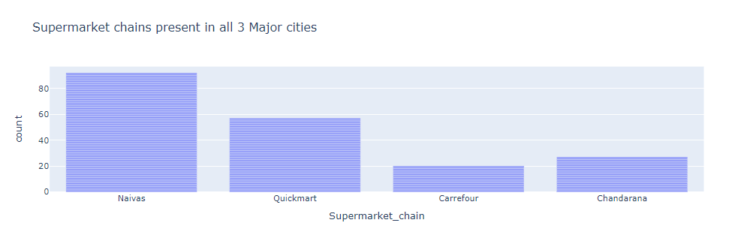
Naivas, Quickmart, Chandarana and Carrefour are the only supermarket chains present in all Kenya’s 3 major cities (Nairobi, Mombasa & Kisumu)

Slide 12
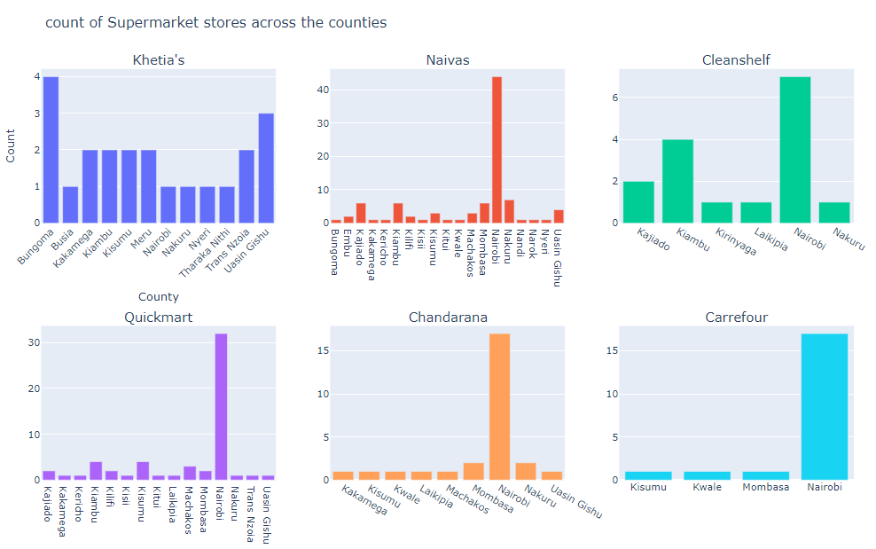
Nairobi county tops in the number of stores for all chains except for Bungoma county where Khetia’s supermarket takes the lead in the number of stores. Khetia’s notably present in the western counties of Kenya in Bungoma, Busia, Kakamega, Kisumu, Kitale and Uasin Gishu counties with sparse presence in Nairobi, Mombasa and central Kenya

Slide 13
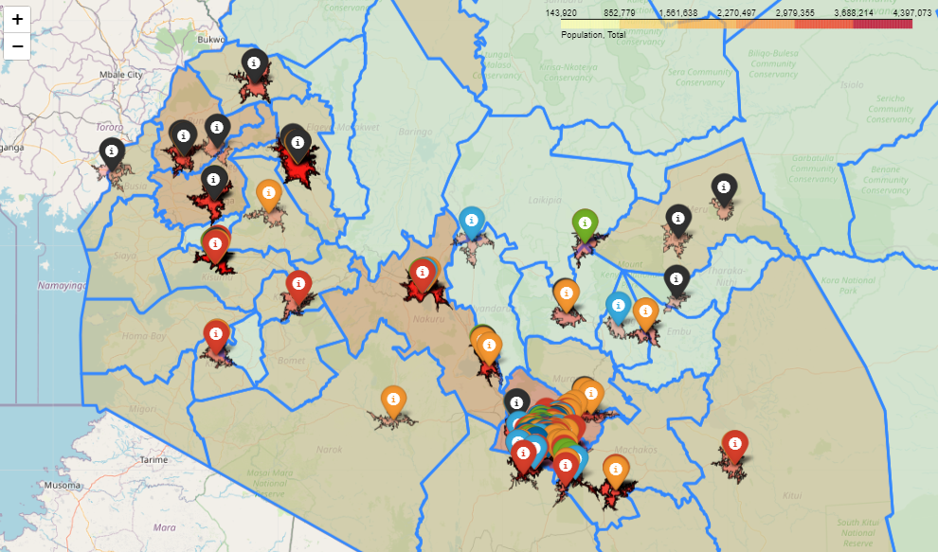
Isochrone Analysis: isochrones are irregular circles or shaded areas around a location that show how far you can travel from a certain point in a specific amount of time. For example, an isochrone for 15 minutes on a map shows all the areas you can reach within 15 minutes of driving, walking, or using public transportation from that point. A larger isochrone means more people can reach the location quickly, making it more accessible. This helps to understand whether the location is convenient for customers. By layering isochrones from multiple stores on the map, you can see where stores overlap in terms of reach. If several stores' isochrones overlap in one area, it means that market is saturated—there are already plenty of options for customers, which may reduce the need for another store in that area. If your store's isochrone overlaps with that of a competitor, it shows you’re likely to be competing for the same customers. This can help you decide whether the area is too competitive or if there’s still enough customer demand to support your new store.

Slide 14
Recommendation & Conclusion
Evaluating Isochrone Overlaps: Compare isochrones of potential new store locations with those of existing stores. Look for areas where isochrones overlap minimally to reduce competition and identify underserved markets. Target areas that fall outside the isochrones of existing stores but still within a desirable travel time. This will help to find locations with high accessibility and potential demand.
Competition assessment: If a new location overlaps with existing store isochrones, evaluate the level of competition in that area. Count the number of existing stores from competing chains within the overlapping isochrone. Focus on areas with 3 or more stores from leading chains. High concentrations of top chains suggest strong competition and possible market saturation. Avoid highly saturated areas to prevent challenges in gaining market share.

Slide 15
Recommendation & Conclusion
Making Informed Decisions:
High Competition: If an area has 3 or more top-chain stores, consider alternative locations with less competition.
Low Competition: If fewer than 3 top-chain stores are present, and the area shows potential based on population and number of households, it may be viable to introduce competition even in overlapping isochrones.
Balance Accessibility and Competition:
Accessibility: Ensure that potential locations are easily accessible and not too distant from key residential or commercial areas.
Strategic Placement: Aim for locations that are accessible yet not oversaturated with competitors. Consider placing stores on the periphery of existing isochrones to capture untapped demand.
Additional Considerations:
Customer Demand: Assess local demand and market potential through demographic and economic data.
Infrastructure and Visibility: Ensure that the location offers good infrastructure, visibility, and accessibility to attract customers effectively.

Slide 16
Recommendation & Conclusion based on Demographic Analysis
The variables Population Total, Population Density, Number of Households, Total Number of Stores, and % of Population Financially Healthy exhibit strong positive correlations (greater than 0.8) with each other. This indicates that as the total population increases, both the number of households and population density tend to rise proportionally, leading to a higher number of stores, reflecting an increased demand for goods.
Areas with a high number of households also tend to have a higher percentage of financially healthy individuals. Such locations are promising for new stores due to their large and potentially lucrative customer base. Higher numbers of households generally correlate with greater total population and population density, making these areas ideal for new supermarket locations.
Although a high number of existing stores in an area signifies a competitive market, it also points to high demand. It is crucial to analyze market saturation and competition in these regions. If entering a saturated market, consider differentiating your store’s offerings or targeting underserved areas to capture market share effectively.

Slide 17
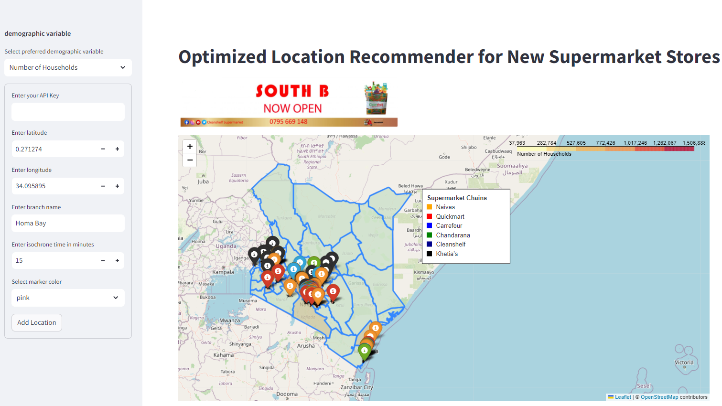
OPTIMIZED STORE LOCATION RECOMMENDER
The attached snippet showcases the store location recommender system, accessible via a web interface. It allows users to input coordinates for their preferred location and generates isochrones for that location, along with selected demographic data for the corresponding county. I would be happy to discuss how this system can benefit your business and explore the possibility of working together. I can provide further details as needed.

