Slide 1




















Slide 2



















Slide 3

01
02
03
04
05
06
07
Project
content
Project
design
System
Scenario
Development
Diagram
Expected
effect
Schedule

Slide 4

01
02
03
04
05
06
07
Project
content
Project
design
System
Scenario
Development
Diagram
Expected
effect
Schedule

Slide 5

01
02
03
04
05
06
07
Project
content
Project
design
System
Scenario
Development
Diagram
Expected
effect
Schedule

Slide 6

01
02
03
04
05
06
07
Project
content
Project
design
System
Scenario
Development
Diagram
Expected
effect
Schedule

Slide 7

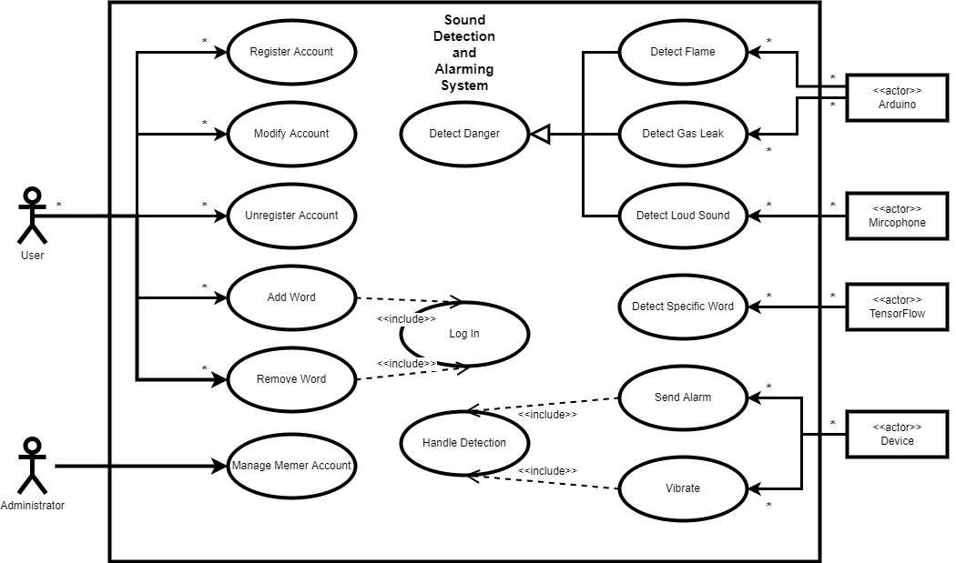
01
02
03
04
05
06
07
Project
content
Project
design
System
Scenario
Development
Diagram
Expected
effect
Schedule
(1) Use-Case

Slide 8
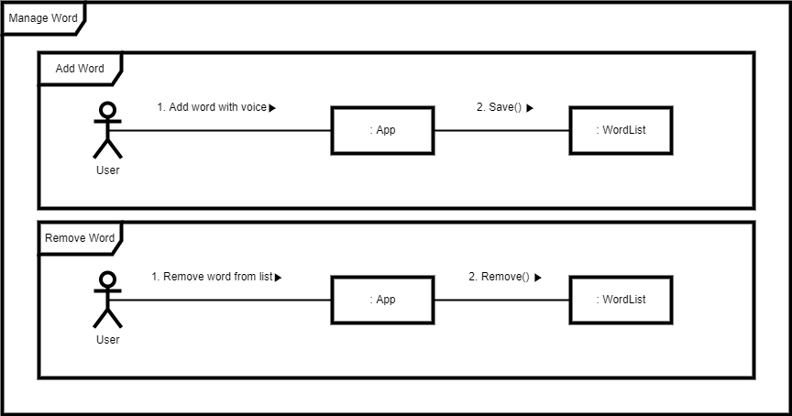
01
02
03
04
05
06
07
Project
content
Project
design
System
Scenario
Development
Diagram
Expected
effect
Schedule
(2) Communicaton

Slide 9
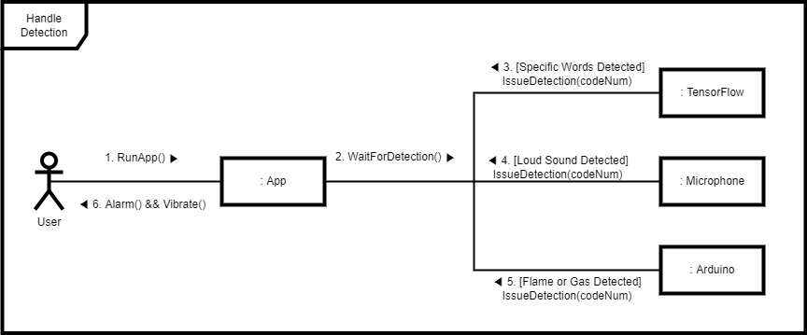
01
02
03
04
05
06
07
Project
content
Project
design
System
Scenario
Development
Diagram
Expected
effect
Schedule
(3) Communication

Slide 10

01
02
03
04
05
06
07
Project
content
Project
design
System
Scenario
Development
Diagram
Expected
effect
Schedule

Slide 11

01
02
03
04
05
06
07
Project
content
Project
design
System
Scenario
Development
Diagram
Expected
effect
Schedule

Slide 12




