Slide 1
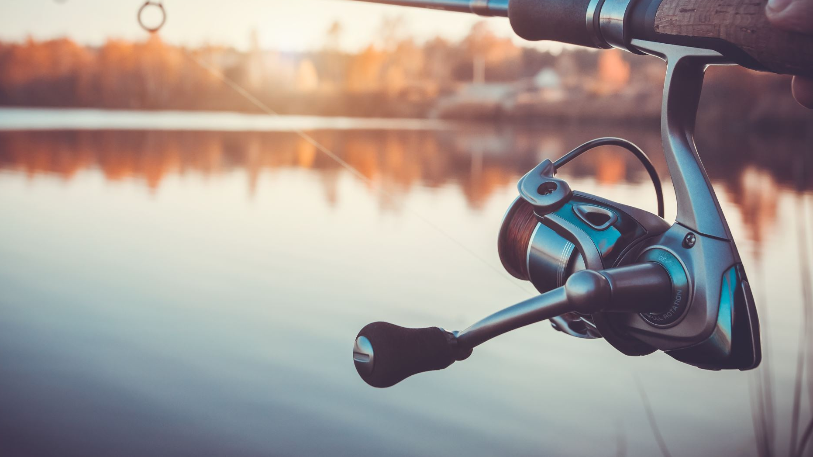
Fishing_Trip.py
Created By: Brandon Barrett
Aka
Eomkid or Eomchy

Slide 2
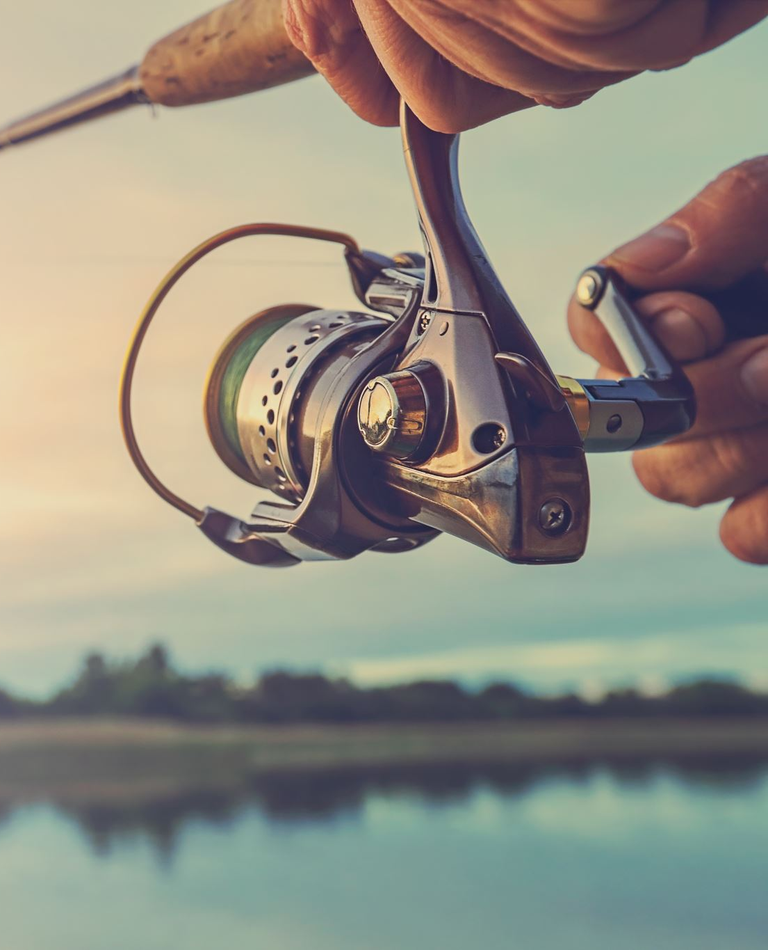
Fishing Trip
This program is simply called Fishing Trip.
Authored by Brandon Barrett also known online as both Eomkid and Eomchy
This is a gaming about catch fish, selling fish and using that money to buy bait to catch more fish.

Slide 3
Successes in the project
The project primarily started on a good foot as the idea of creating a fishing game is something I have wanted to do for awhile however didn’t understand enough about programming to do so, so while I didn’t have the know how I had a good idea of the basics of the game, and it was a matter of turns the ideas into something playable. Simple put I had a good plan going to build this program.
During the early stage of the project I basically wrote out some ideas of how I wanted things to work primarily the rng of actually fishing and stored the fish caught keep these at the top of my code I built the rest of the game more so around the mechanics I wanted which seems to have worked well.

Slide 4
Places of improvement
The primarily thing that needs improve is my time management. As I was behind on starting both projects for this week. While yes I did finish the fact of the matter is I didn’t have as much time to play around and expand on things as I would’ve liked too. I also got to a point where I left things to do later as I wanted to finish more than I wanted to fix. This can primarily be seen in places where I choose to do minimal input validation or if any at all.
I would say my ability to test code needs a lot of work, because as I built different things I test as much as I felt was necessary but later on I would play the game only to discover something I test and thought was fine don’t work under this specific situation that I didn’t think. Not a situation that is impossible just something that didn’t cross my mind while building the program. So in short my bug finding abilities need improvement.

Slide 5
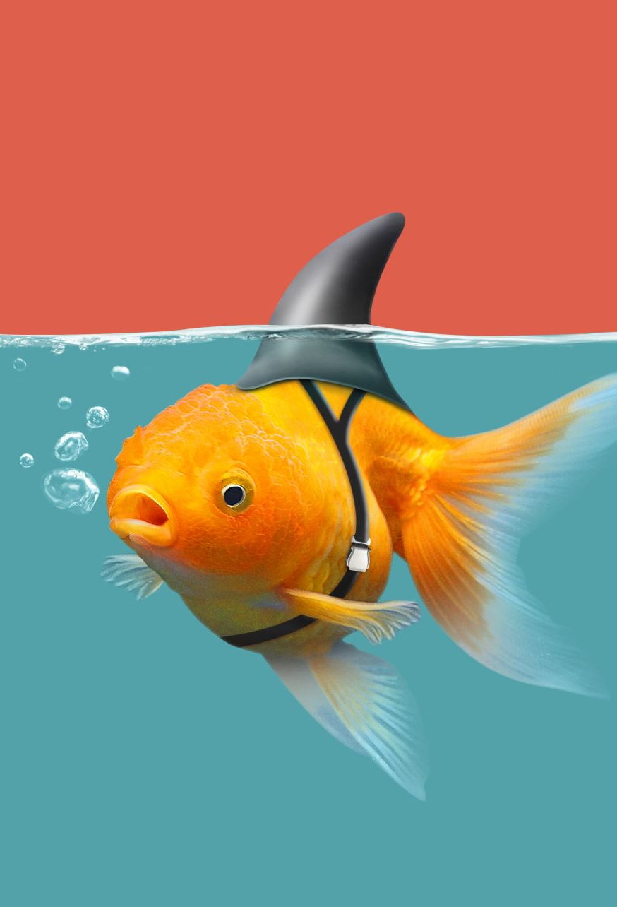
Things Change
Initially I had planned to have fish with more detail rather than simply being a name with a value assigned to it, which is why I initially choose to use a dictionary to store these creatures. However I discover while building my dictionary that while they are useful for associating pairs information together about single thing or type of thing, it not as useful when we are speaking in terms of multiple different things in my case types of fish. While I could have just made multiple dictionary for each fish. I felt it would have become complicated to keep tracked of all the different dictionary if their were to be any significant amount of fish in our case of which their would’ve been 10 dictionaries each going through the details of each fish while most player would likely not care and only want to know the value, and if I added a size how big that one is.

Slide 6
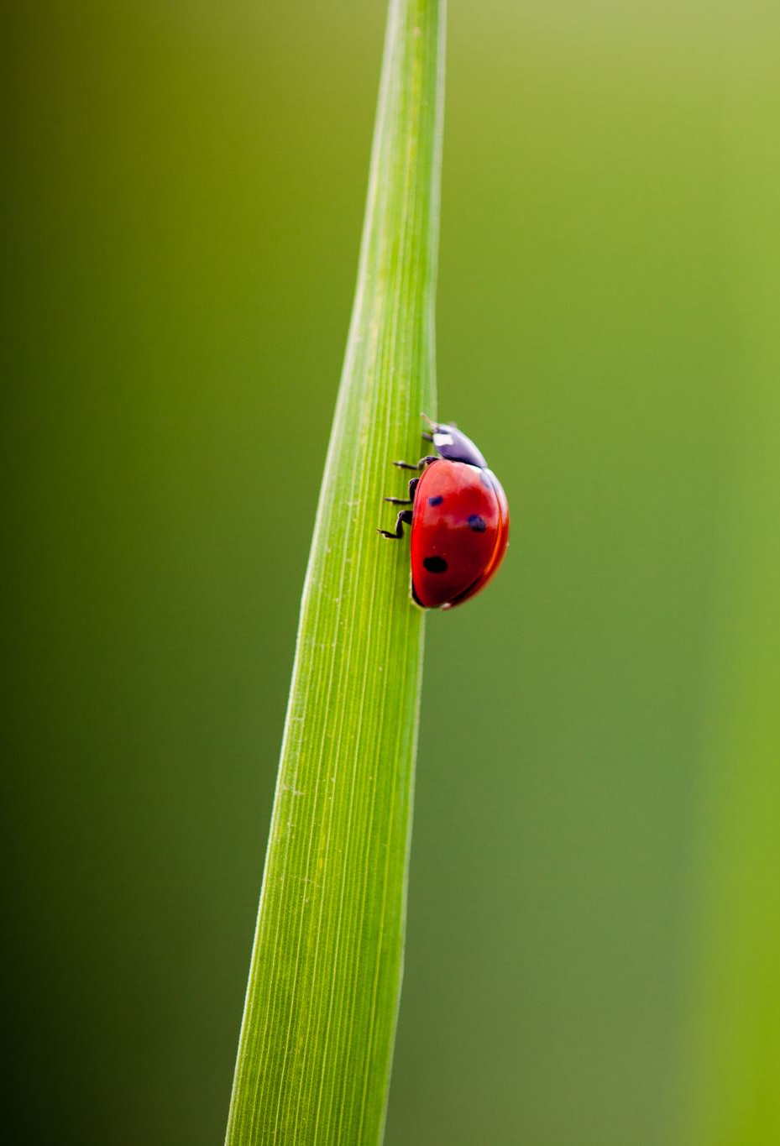
To my Future self
Do not leave input validation and major bug fixing for last as you will only end up finding more bugs than what you thought was there. Test every significant features as it is made and if input validation is required which it probably easy just create it. As doing both will probably help harden the program against edge case long before they happen.
At least half of your code probably could’ve been a function. In the future start with the mechanic as they will like be the most complicated part of the game and build the code around what you need the game to be able to do. As start with the mechanics at the top helped to keep me focused on where the project is going.

