Slide 2
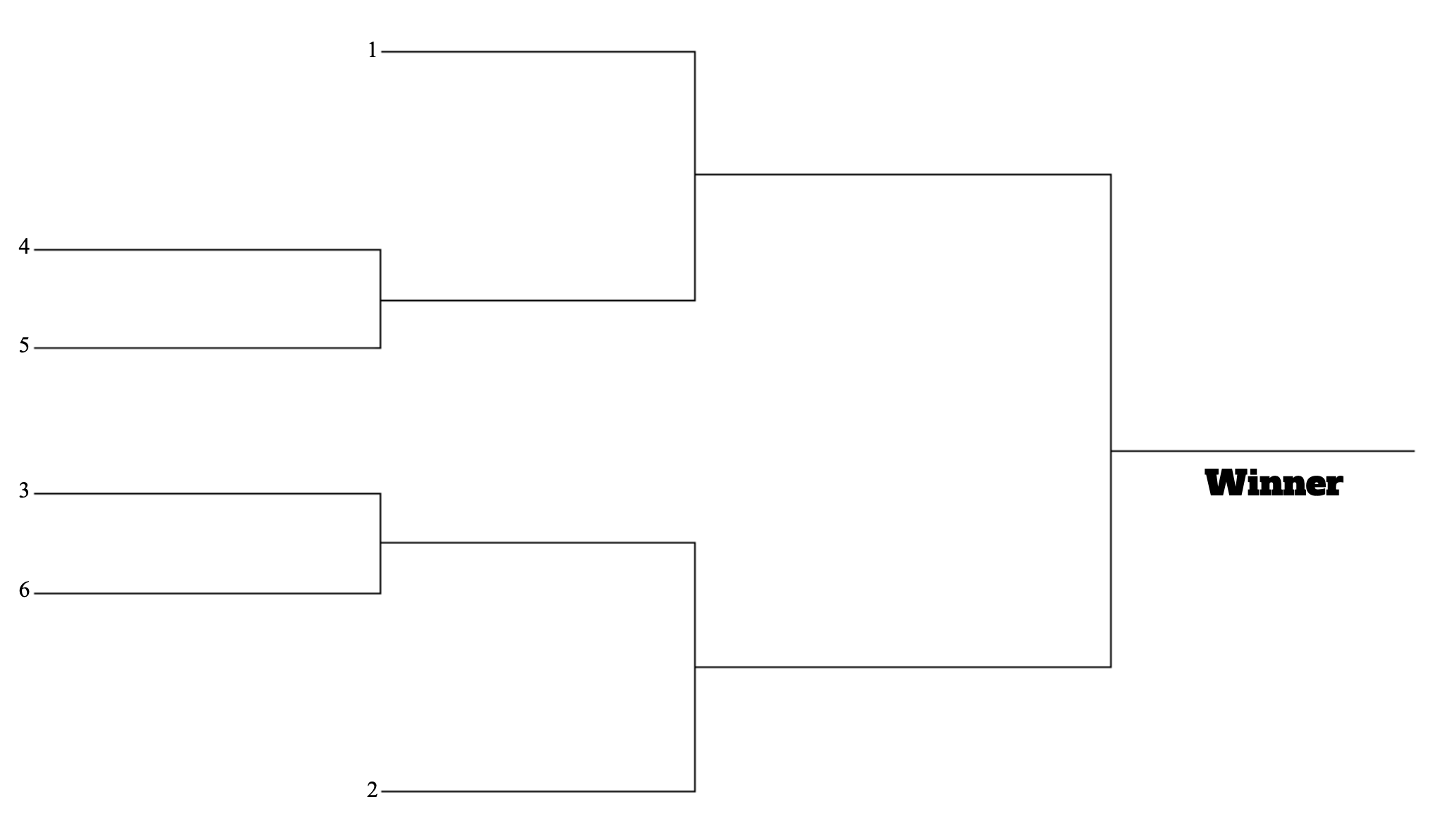
Eric
Quinn
Luke
Ben
League Winner
Lo
Nate

