Slide 1
CONNECTOMES FOR AI
The blueprint for better AI is
wired into the brain.
Some problems that are effortless for brains still challenge the best AI models — recalling, recognizing, learning from a handful of examples. The brain's edge is its architecture, refined over hundreds of millions of years. We read that wiring diagram— the connectome — and built it directly into recurrent neural networks to ask if they could learn brain-native tasks.
Collect Connectome Data
→
Brain-Derived Models
→
Alignment on Brain-Native Tasks

Slide 2
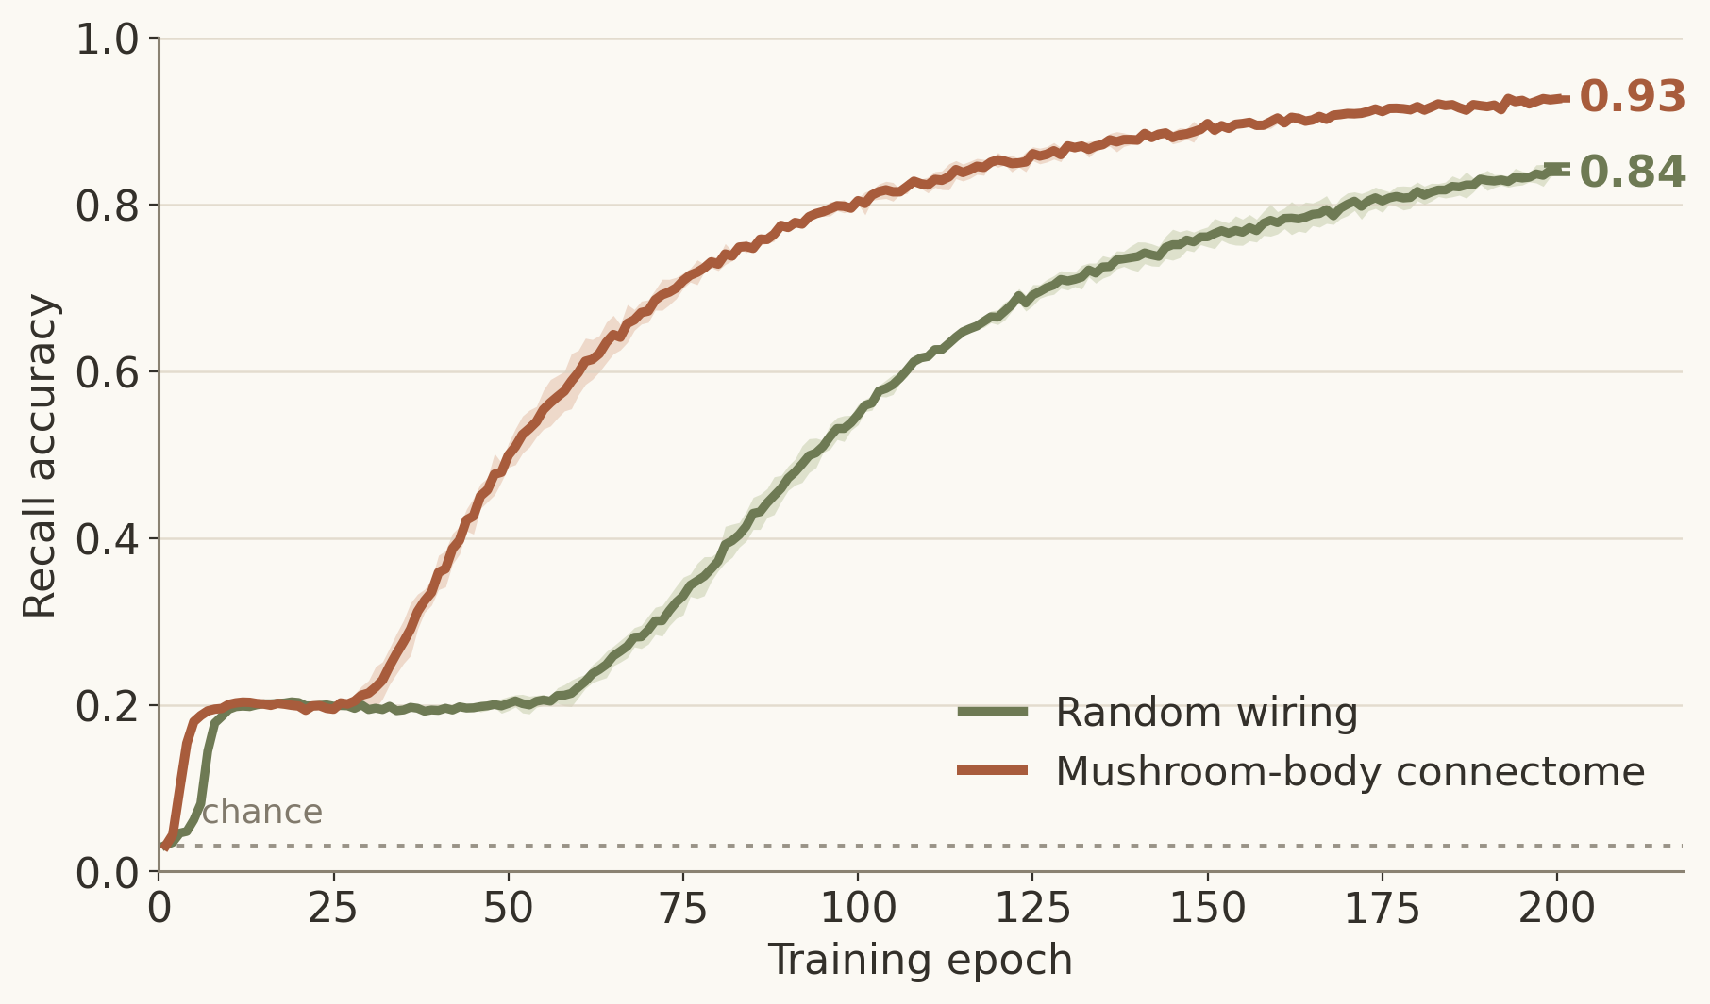
FINDING 1 · THE CONNECTOME WIRING IS OPTIMIZED FOR ITS TASK
The connectome learns faster and remembers more than artificial models
The fly mushroom body performs associative learning by binding sensory cues to outcomes. We asked how this circuit, when packaged as a recurrent neural network, compares to size-matched sparse models on the task it evolved for. The connectome learned associative pairings more accurately and quickly than randomly wired circuits.
0.93 vs 0.84
final recall accuracy — connectome vs random wiring
~1.7× less time
wall-clock training to reach 80% recall (same-size networks)
FlyWire mushroom body, 14,025 neurons, 2 seeds (shaded band = range). A stricter degree-matched control does worse still (0.77); the connectome's lead is statistically significant (p = 0.048).
Notes:
Experiment 1 (scott/experiment_01). MQAR associative recall. Figure from committed data (mqar_associative_recall/fullMB_D8_learning_curves.json): connectome (hemibrain-seeded) 0.93 vs random-sparse 0.84, 2 seeds, mean+/-range, 200 epochs; connectome reaches 80% at ~100 vs ~170 epochs (same-size nets, so ~1.7x less wall-clock). Definitive degree-matched full-fleet run: 0.918+/-0.007 vs 0.769+/-0.140, permutation p=0.048, wins at every lr; spectral radius matched so it's the wiring at equal gain.

Slide 3
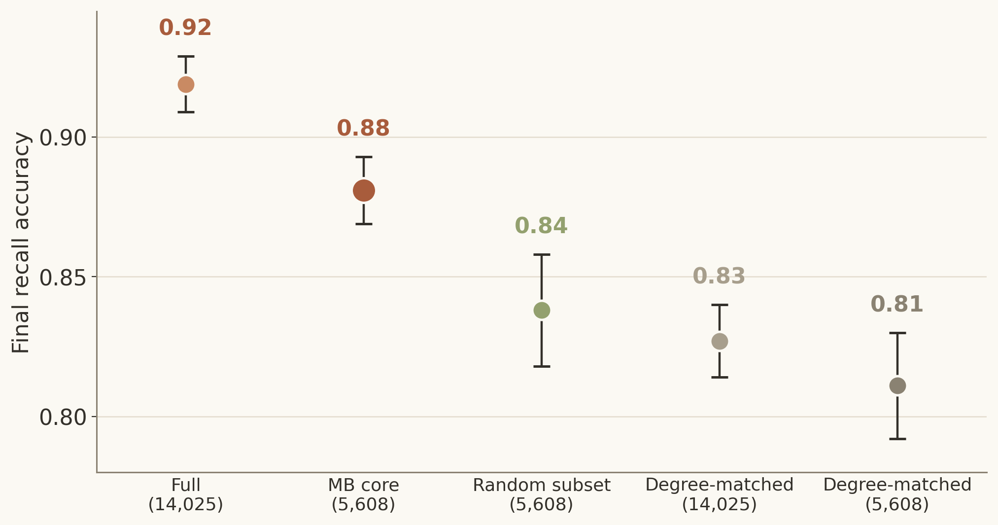
FINDING 2 · SMALLER MODELS THAT TRAIN FASTER
Biologically-informed pruning produces smaller models at minimal cost
Based on knowledge of the mushroom body circuit, we pruned the original neuron count from 14,025 to 5,608 – keeping only the cells that are biologically important to learning. Despite a 2.5x reduction in parameter count, task performance marginally moved (0.92 → 0.88), training ran 2.5× faster, and the pruned circuit beat every random circuit with more parameters.
0.92 → 0.88
recall after removing 60% of the neurons — keeps ~96% of full accuracy after the same number of training runs
2.5× faster
wall-clock training time – suggesting better performance in less time.
MQAR, lr 1e-3, 20 seeds (degree-matched controls n=14–17); error bars = ±1 SD. The MB core beats every control graph (rank 0 of N).
Notes:
Experiment 2 (scott/experiment_02_mb_core_pruning). Prune the 14,025-neuron substrate to the ~5,608-neuron canonical MB core (Kenyon cells/MBON/DAN/MBIN). Final recall accuracy (lr 1e-3, completed runs, +/-1 SD): full 0.919+/-0.010 (n20), core 0.881+/-0.012 (n20), random subset 0.838+/-0.020 (n20), degree-matched 14k 0.827+/-0.013 (n17), degree-matched core 0.811+/-0.019 (n14). Core beats every control (rank 0/N; perm p 0.048-0.067). Wall-clock: core 4,128 s vs full 10,238 s (~2.5x). Advantage intrinsic to the MB core, not the halo.

Slide 4
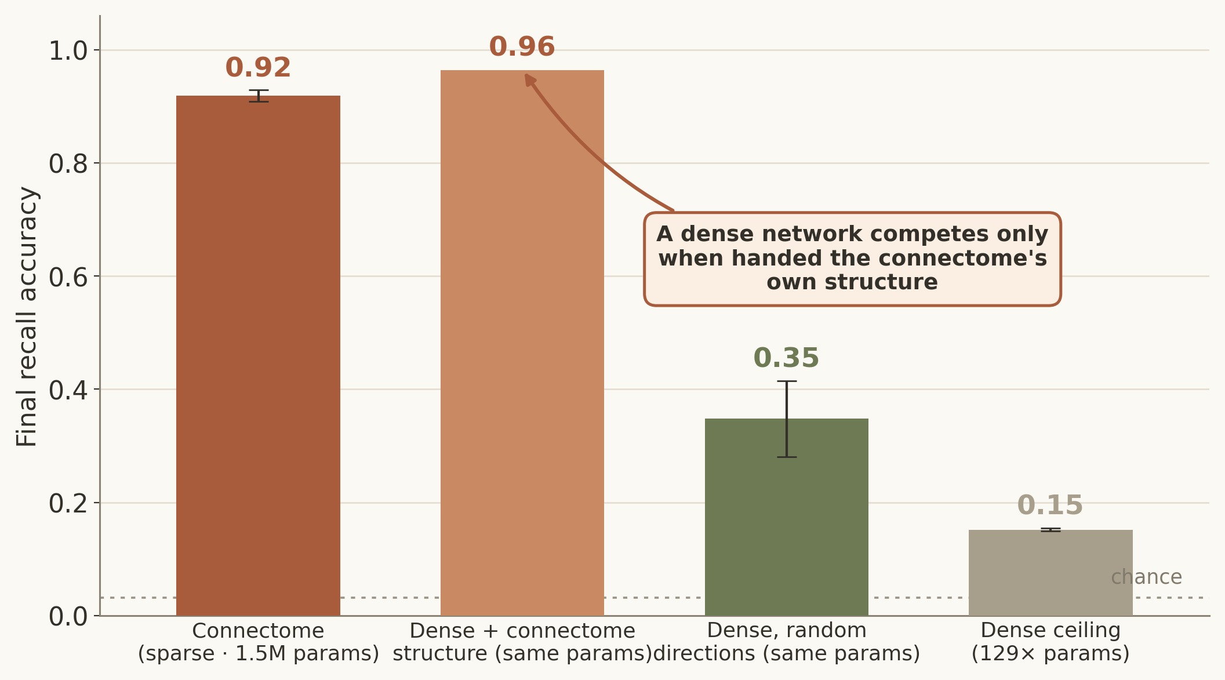
FINDING 3 · CONNECTOME WIRING vs RAW PARAMETERS
It's the structure, not the parameter count
To test if the connectome’s performance can be matched by simply boosting parameter count, we compared it to fully-dense recurrent networks. Despite having up to 129x more parameters, the naïve dense approach yields minimal learning. Only when handed the connectome's own structure do dense networks compete.
0.15 recall with 129× params
a dense net with 129× the parameters still fails to learn
~2.8× faster
the sparse connectome also trains quicker than matched dense nets
MQAR, 14,025-neuron network, 20 seeds; error bars = ±1 SD. “Dense + connectome structure” = a dense net carrying the connectome's directions (Exp 2). Matched = equal trainable params (~1.5M).
Notes:
Experiment 3 (scott/experiment_03) + Exp 2 follow-up. Full 14k arm, final test acc (+/-1 SD, n20): connectome (sparse, 1.53M trainable params) 0.919+/-0.010; dense+connectome-structure (eigvec_matched, Exp 2) 0.964; dense random-directions reservoir (C2, matched params) 0.348+/-0.067; dense ceiling (C1, 197.7M params = 129x) 0.152+/-0.003; smaller dense C3 0.162. C2 permutation p=0.048 (0/20). Wall-clock full: connectome 10,238 s vs C2 28,537 s (~2.8x). HONEST CAVEAT: dense arms were also worse-conditioned at init (sigma_max ~2.5 vs 1.08), so the clean reading is 'structure-as-conditioner' rather than 'sparse beats a well-tuned dense net' in the abstract — but capacity at matched budget clearly does not explain the connectome's score (random directions collapse to 0.35/0.20; connectome's own directions rescue a dense net to 0.96).

Slide 5
THE BET
Collecting more connectome data is the path to a new class of AI that solves what brains find easy and machines find hard.
Fruit fly → mouse → human

