Slide 1
Kilobot Swarm
Ferris Wheel

Slide 2
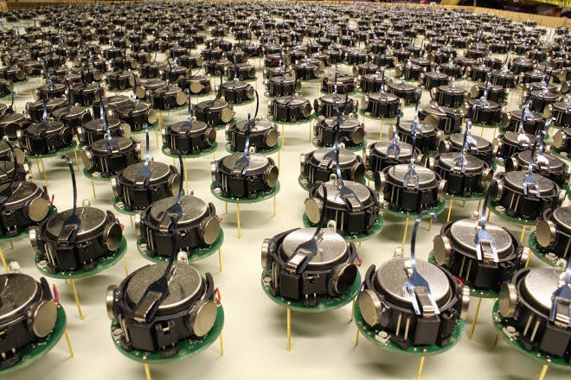
Without human intervention, can we deploy infrastructure in remote and hostile areas?
Figure 1
Notes:
ZACK:
Possible deployment of bots for military application
Build FOB
Modern application is in war of Iraq
Place barracks or structures throughout
Reduce physical threat to humans during build by external forces
Build surrounding infrastructure for a Mars base
Place pipes, lines, foundations, surrounding buildings
Reduce environmental threats to humans during build
Maximize or minimize area covered
Localization around center will allow structures or materials to be placed to cover the optimal area.
Area can be covered in a natural way

Slide 3
Overview
Kilobots:
Mobile agents
Communications
Distributed
Coverage:
Maximum distance of nodes from one to another
Maximum area
Localization:
Location of neighboring nodes
Pattern Formation:
Creation of object through location.
Notes:
ZACK:
Kilobots are mobile agents capable sensing, moving, and of which communicate with each other and can be used to model large distributed systems.
Coverage: Mobile agents are spread apart at a maximum distance from on another in order to cover the maximum distance.
Localization is a method used by mobile agents to know where other mobile agents in the system are located.
Pattern Formation is a technique used to make mobile agents form a specific pattern.

Slide 4
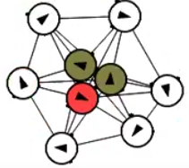
Motivation And Description
Capture content learned in CECS 574
Utilize distributed topics for goal achievement
Implement a unique and awesome idea
Notes:
Moris: This project was motivated by the content presented in CECS 574. Distributed system topics such as leader election, broadcast and coverage cast are used to achieve localization, coverage and pattern formation. Each topic aided in creating
These distributed system topics were applied to form the pattern (POINT) shown in figure 2

Slide 5
Assumptions
9 Kilobots
3 nodes for seeding
6 nodes randomly placed
Algorithm initiation
Completion when placed.
Notes:
Moris:
The pattern requires 15 kilobots and the following assumptions are made:
1. 3 nodes are set in a triangle (which is used as the seed)
2. 12 nodes random placement within broadcast range.
3. Seed of three has space around it.
If these conditions are not met, then the pattern will not be formed.

Slide 6
Algorithm: Seeding Algorithm (aka leader election)
Start:
Each node will find their neighbors
A seed is formed by getting the closest neighbors
Seeds will set state to potential leader
Upon receiving a message:
Seeds with larger IDs
No longer seeds
State is safe
Nodes with the same leader
State is safe
All nodes safe
Final leader is decided
Notes:
Morris:
Seeding Algorithm (aka leader election):
Each node cycles all neighbors. If two neighbours with distance of set threshold (40) set status as potential leader (warlord)
If status is potential leader, then share id and election flag true.
Upon receiving a message:
If status is not seed or status is seed and received message is a potential leader with id less than the current then set the received message id to leader. Updated distance if necessary and status to potentially safe.
If neighbors have same potential leader and all are safe neighbours, then set status to safe.
If status is potential leader and all nodes are safe, then set status to final leader..

Slide 7
Algorithm: Movement Code
Seeded nodes will broadcast a move command
Target node will move towards seeded nodes
Target node will place itself
New command will be sent by seeded node
Notes:
ERICK:
Movement: Assumption: All nodes in range due to tree structure if target_id != my_id fwd msg else target node orbits nearest neighbor orbit continues until it see next nearest neighbor orbiting node compares static node with next static node orbiting node will orbit next static node node orbits until it encounters OVERLORD nodes node orbits overlord node node stops orbit when it encounters designated position relative to OVERLORD. Node sends PLACED response to OVERLORD OVERLORD issues new movement command to new target node

Slide 8
Algorithm Example

Slide 9
Implementation Problems
Transitioning between phases
Many flags
Forced delays
Networking among the bots
Single messages may be lost
Forwarded messages don’t leave the system
Not enough payload slots
Notes:
JUSTIN:
Async system; can’t easily determine when each phase finishes; use of flags to indicate current phase
Needed delays to allow for the flag updating to propagate through broadcast
Unreliable to send only single messages. Must set bot state and constantly send to ensure receipt
Messages can target bots; if bot receives a message not intended for it, forwards the message but enqueuing it as is
Forwarded messages don’t have TTL; are forwarded constantly; have target check to block
Has a cleaning flag that disables the forwarding function: causes any messages not being actively generated to die out
No TTL because not enough payload slots
Must reuse slots for different phases

Slide 10
Results
The simulation worked
It did not work on the actual Kilobots
Simulations do not always match up with real world counterparts.
There are numerous reasons why the simulation succeeded while real version failed.
Notes:
Ahmed

Slide 11
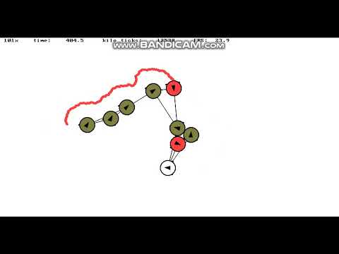
Results
Notes:
Ahmed

Slide 12
Conclusion
Reasons why the Kilobots failed:
The movement was not consistent.
Real time debugging was not available and/or very difficult.
There was no way to check the actual gradient.
Teams experience with Kilobots movement was limited.
The time allowed with Kilobots was limited.
Notes:
Ahmed

Slide 13
Future Work
Implement observer controller
Model surface behavior and interaction with bots
Motor calibration
Determine the quality of each motor
Model message passing
Improve communication range
Surface used
Interference
Improve scalability
Allow fractal formation

