Slide 1
EOS Coalition
Program and Operations Health
19 MAY 2022

Slide 2
Health Scorecard
 |  | Program | Headline | Apr | May | Jun | Jul | Aug | Sep | Oct | Nov | Dec | Jan | Feb | Mar
 |  | 1 - ARP Team | RFP development in process
 |  | 2 - Transaction Lifecycle | Code complete; ready for Mandel 3.1 deployment
 |  | 3 - Specialized APIs | RFP development in process
 |  | 4 - Centralized APIs | RFP development in process
 |  | 4 - Secure Smart Contract Libraries | RFP review by Working Group
 |  | 6 - Automated Security Audit Tools | RFP development in process
 |  | 8 - EOSIO External Security Audit | RFP development in process
 |  | 1 - Faster Finality | RFP ready for Coalition approval
 |  | 4 - Trustless Cross-chain IBC | RFP development in process
 |  | 3 - P2P Code Rewrite | RFP development in process
 |  | 6 - RAM Limitation Fixes | RFP development in process
 |  | 9 - State Proofs and Full Validation | RFP development in process
 |  | 1 - SDKs | RFP ready for Coalition approval
 |  | 2 - Application Registry | RFP review by Working Group
 |  | 3 - Request for Permission | RFP development in process
 |  | 2 - Synchronous Calls | Executive Summary and requirements in process
 |  | 13 - Improved Token Standards | Executive Summary and requirements in process
 |  | 10 - dStor Concept | Executive Summary and requirements in process
 |  | 5 - Read Only Actions | Executive Summary and requirements in process
 |  | Core+ 27- Contract Pays | Executive Summary and requirements in process
API+
Audit+
Scalability+
Wallet+
Ad Hoc
 | Active Project
 | Planned Future Schedule

Slide 3
 | API+ Program |  |  | Three projects in RFP development stage. Transaction Lifecycle is code complete and mating for Mandel 3.1 Release. |  |  |  |  |  |  |  | 19 MAY 2022
 | Schedule |  |  |  |  | Scope |  |  |  |  | Risks
 | Project Name |  | Completion |  |  | Project |  |  |  |  | Feedback from working groups on RFPs often delayed
 | 1 - ARP Team RFP |  | 02 JUN 22 |  |  | 1 - ARP Team RFP |  |  | N/A
 | 2 - Transaction Lifecycle |  | 31 MAY 22 |  |  | 2 - Transaction Lifecycle
 | 3 - Specialized APIs RFP |  | 09 JUN 22 |  |  | 3 - Specialized APIs RFP |  |  | N/A
 | 4 - Centralized APIs RFP |  | 23 JUN 22 |  |  | 4 - Centralized APIs RFP |  |  | N/A
 | Integration / Dependencies |  |  |  |  | Communication |  |  |  |  | Budget
 | None |  |  |  |  | Target | Last | Next |  |  | Project | Planned | EAC
 |  |  |  |  |  | Core Team (weekly) |  |  |  |  | 1 - ARP Team RFP | N/A
 |  |  |  |  |  | Working Group (weekly) |  |  |  |  | 2 - Transaction Lifecycle
 |  |  |  |  |  | Community (monthly) |  |  |  |  | 3 - Specialized APIs RFP | N/A
 |  |  |  |  |  |  |  |  |  |  | 4 - Centralized APIs RFP | N/A
 | Quality / Total Open Bugs |  |  |  |  | Procurement |  |  |  |  | Resources
 | Project | Current | Previous |  |  | 1 - ARP Team RFP | Waiting on RFP |  |  |  | Project
 | 1 - ARP Team RFP | N/A | N/A | N/A |  | 3 - Specialized APIs RFP | Waiting on RFP |  |  |  | 1 - ARP Team RFP | Contract Needed
 | 2 - Transaction Lifecycle |  |  |  |  | 4 - Centralized APIs RFP | Waiting on RFP |  |  |  | 2 - Transaction Lifecycle
 | 3 - Specialized APIs RFP | N/A | N/A |  |  |  |  |  |  |  | 3 - Specialized APIs RFP | Contract Needed
 | 4 - Centralized APIs RFP | N/A | N/A |  |  |  |  |  |  |  | 4 - Centralized APIs RFP | Contract Needed

Slide 4
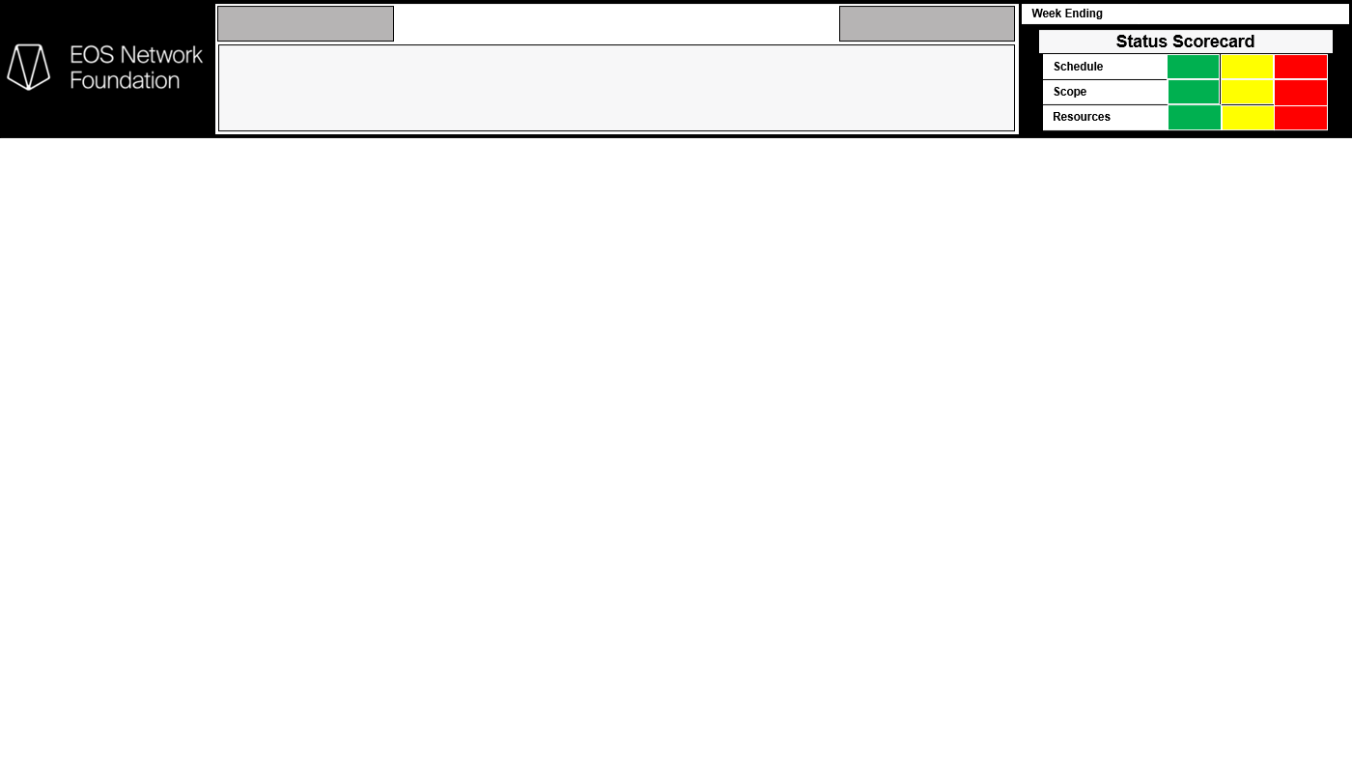

API+
Transaction Lifecycle
Object Computing
2022/05/17
Project Description:OCI, in collaboration with EOS Network Foundation (Client), will develop enhancements to EOS Core functionality to improve the end-user experience. OCI will focus on four (4) primary Scope Items as follows: Transaction Retry; Transaction Finality Status; Transaction Resource Cost Estimation; and Subjective Billing Improvements.
Highlights / Accomplishments
Key Milestones
March 2022
Completed 90% of the Limited Storage Epic
Completed atl requirements Jira stories for the remaining 4 epics
April and May 2022 (current as of the week ending May 13)
Limited Storage epic: 100% complete
Subjective Billing Improvements epic: 100% complete
Transaction Resource Cost Estimation epic: 100% complete
Transaction Retry epic: 100% complete
Transaction Finality Status epic: 100% complete
Description | Planned Date | Actual Date
Limited Storage Epic | March 30 | April 3
Subjective Billing Improvements Epic | April 15 | May 6
Transaction Resource Cost Estimation Epic | April 30 | April 22
Transaction Retry Epic | May 15 | April 29
Transaction Finality Status Epic | May 31 | May 12
Upcoming Activities
Issues / Risks / Escalations
SOW 2 is well on the way. JIRA tasks are reflected as GitHub issues, along with GitHub pull requests.
All GitHub issues and PRs contain an OCI flag and are easily identifiable.
OCI is confident we will complete all assigned 3.1 Mandel issues prior to the June 1 deployment date.
OCI also is planning for additional work, post 3.1, including P2P Code Rewrite.
Nothing to report at this time

Slide 5
 | Audit+ Program |  |  | Three projects in RFP development stage. |  |  |  |  |  |  |  | 19 MAY 2022
 | Schedule |  |  |  |  | Scope |  |  |  |  | Risks
 | Project Name |  | Completion |  |  | Project |  |  |  |  | Feedback from working groups on RFPs often delayed
 | 4 - Secure Smt Ctrct Libraries |  | 26 MAY 22 |  |  | 4 - Secure Smt Ctrct Libraries |  |  | N/A
 | 6 - Auto. Security Audit Tools |  |  |  |  | 6 - Auto. Security Audit Tools |  |  | N/A
 | 8 - External Security Audit |  |  |  |  | 8 - External Security Audit |  |  | N/A
 | Integration / Dependencies |  |  |  |  | Communication |  |  |  |  | Budget
 | None |  |  |  |  | Target | Last | Next |  |  | Project | Planned | EAC
 |  |  |  |  |  | Core Team (weekly) |  |  |  |  | 4 - Secure Smt Ctrct Libraries | N/A
 |  |  |  |  |  | Working Group (weekly) |  |  |  |  | 6 - Auto. Security Audit Tools | N/A
 |  |  |  |  |  | Community (monthly) |  |  |  |  | 8 - External Security Audit | N/A
 | Quality / Total Open Bugs |  |  |  |  | Procurement |  |  |  |  | Resources
 | Project | Current | Previous |  |  | Project |  |  |  |  | Project
 | 4 - Secure Smt Ctrct Libraries | N/A | N/A | N/A |  | 4 - Secure Smt Ctrct Libraries | Waiting on RFP |  |  |  | 4 - Secure Smt Ctrct Libraries | Contract Needed
 | 6 - Auto. Security Audit Tools | N/A | N/A | N/A |  | 6 - Auto. Security Audit Tools | Waiting on RFP |  |  |  | 6 - Auto. Security Audit Tools | Contract Needed
 | 8 - External Security Audit | N/A | N/A | N/A |  | 8 - External Security Audit | Waiting on RFP |  |  |  | 8 - External Security Audit | Contract Needed

Slide 6
 | Scalability+ Program |  |  | Five projects in RFP development stage. Faster Finality RFP to be presented to Coalition for vote to release. |  |  |  |  |  |  |  | 19 MAY 2022
 | Schedule |  |  |  |  | Scope |  |  |  |  | Risks
 | Project Name |  | Completion |  |  | Project |  |  |  |  | Feedback from working groups on RFPs often delayed
 | 1 - Faster Finality RFP |  | 19 MAY 22 |  |  | 1 - Faster Finality RFP |  |  | N/A
 | 4 - Trustless IBC RFP |  | 02 JUN 22 |  |  | 4 - Trustless IBC RFP |  |  | N/A
 | 12 - P2P Code Rewrite RFP |  |  |  |  | 12 - P2P Code Rewrite RFP |  |  | N/A
 | 16 - RAM Limitation Fixes RFP |  |  |  |  | 16 - RAM Limitation Fixes RFP |  |  | N/A
 | 18 - State Domains RFP |  |  |  |  | 18 - State Domains RFP |  |  | N/A
 | Integration / Dependencies |  |  |  |  | Communication |  |  |  |  | Budget
 | None |  |  |  |  | Target | Last | Next |  |  | Project | Planned | EAC
 |  |  |  |  |  | Core Team (weekly) |  |  |  |  | 1 - Faster Finality RFP | N/A
 |  |  |  |  |  | Working Group (weekly) |  |  |  |  | 4 - Trustless IBC RFP | N/A
 |  |  |  |  |  | Community (monthly) |  |  |  |  | 12 - P2P Code Rewrite RFP | N/A
 |  |  |  |  |  |  |  |  |  |  | 16 - RAM Limitation Fixes RFP | N/A
 |  |  |  |  |  |  |  |  |  |  | 18 - State Domains RFP | N/A
 | Quality / Total Open Bugs |  |  |  |  | Procurement |  |  |  |  | Resources
 | Project | Current | Previous |  |  | Project |  |  |  |  | Project
 | 1 - Faster Finality RFP | N/A | N/A | N/A |  | 1 - Faster Finality RFP | Waiting on RFP |  |  |  | 1 - Faster Finality RFP | Contract Needed
 | 4 - Trustless IBC RFP | N/A | N/A | N/A |  | 4 - Trustless IBC RFP | Waiting on RFP |  |  |  | 4 - Trustless IBC RFP | Contract Needed
 | 12 - P2P Code Rewrite RFP | N/A | N/A | N/A |  | 12 - P2P Code Rewrite RFP | Waiting on RFP |  |  |  | 12 - P2P Code Rewrite RFP | Contract Needed
 | 16 - RAM Limitation Fixes RFP | N/A | N/A | N/A |  | 16 - RAM Limitation Fixes RFP | Waiting on RFP |  |  |  | 16 - RAM Limitation Fixes RFP | Contract Needed
 | 18 - State Domains RFP | N/A | N/A | N/A |  | 18 - State Domains RFP | Waiting on RFP |  |  |  | 18 - State Domains RFP | Contract Needed

Slide 7
 | Wallet+ Program |  |  | Five projects in RFP development stage. Faster Finality RFP to be presented to Coalition for vote to release. |  |  |  |  |  |  |  | 19 MAY 2022
 | Schedule |  |  |  |  | Scope |  |  |  |  | Risks
 | Project Name |  | Completion |  |  | Project |  |  |  |  | Feedback from working groups on RFPs often delayed
 | 1 - SDKs RFP |  | 19 MAY 22 |  |  | 1 - SDKs RFP |  |  | N/A
 | 2 - Application Registry RFP |  | 02 JUN 22 |  |  | 2 - Application Registry RFP |  |  | N/A
 | 3 - Request for Permission RFP |  |  |  |  | 3 - Request for Permission RFP |  |  | N/A
 | Integration / Dependencies |  |  |  |  | Communication |  |  |  |  | Budget
 | None |  |  |  |  | Target | Last | Next |  |  | Project | Planned | EAC
 |  |  |  |  |  | Core Team (weekly) |  |  |  |  | 1 - SDKs RFP | N/A
 |  |  |  |  |  | Working Group (weekly) |  |  |  |  | 2 - Application Registry RFP | N/A
 |  |  |  |  |  | Community (monthly) |  |  |  |  | 3 - Request for Permission RFP | N/A
 | Quality / Total Open Bugs |  |  |  |  | Procurement |  |  |  |  | Resources
 | Project | Current | Previous |  |  | Project |  |  |  |  | Project
 | 1 - SDKs RFP | N/A | N/A | N/A |  | 1 - SDKs RFP | Waiting on RFP |  |  |  | 1 - SDKs RFP | Contract Needed
 | 2 - Application Registry RFP | N/A | N/A | N/A |  | 2 - Application Registry RFP | Waiting on RFP |  |  |  | 2 - Application Registry RFP | Contract Needed
 | 3 - Request for Permission RFP | N/A | N/A | N/A |  | 3 - Request for Permission RFP | Waiting on RFP |  |  |  | 3 - Request for Permission RFP | Contract Needed

