Slide 1



Slide 2


Who am I?

Slide 3

Name: Evandro Osses.
Age: 24
City: Bauru.
I Work Grupo Facimus. Analyst Network & Security.
I love Information Security
My hobbies favority are Astronomy, technology and books.

Slide 4
IaC (Infrastructure as Code)

Slide 5
Manage na IT Infraestructure using configuration files.
Eliminating the need for developers to manually provision and manage servers.
Benefits:
Fast and efficient development.
Production time.
Consistency.
Low Cost.

Slide 6
What is Terraform??

Slide 7
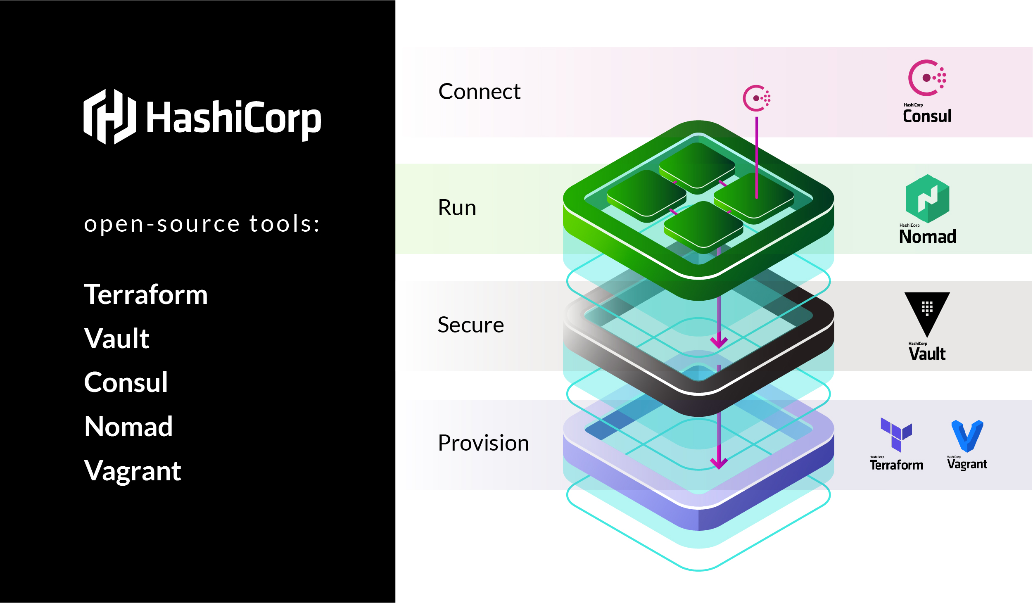
Build
Modify
Version
Programming Language: Golang
Opensource

Slide 8






Slide 9
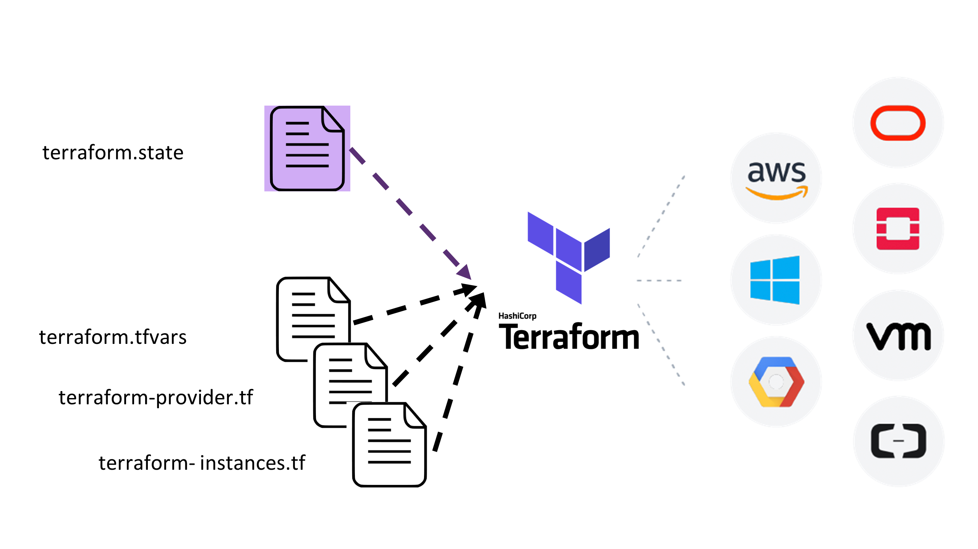

Slide 10
WorkFlows

Slide 11
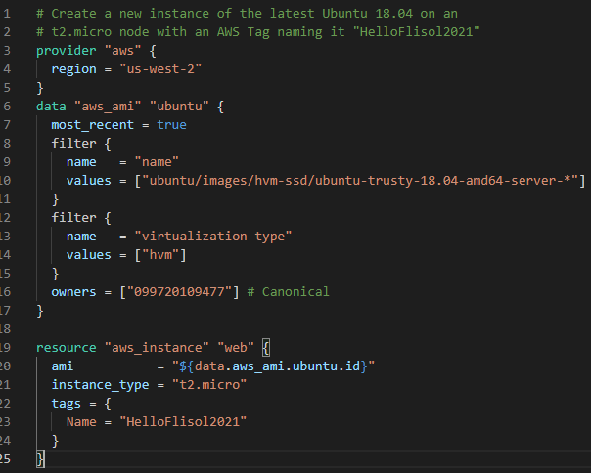

Slide 12
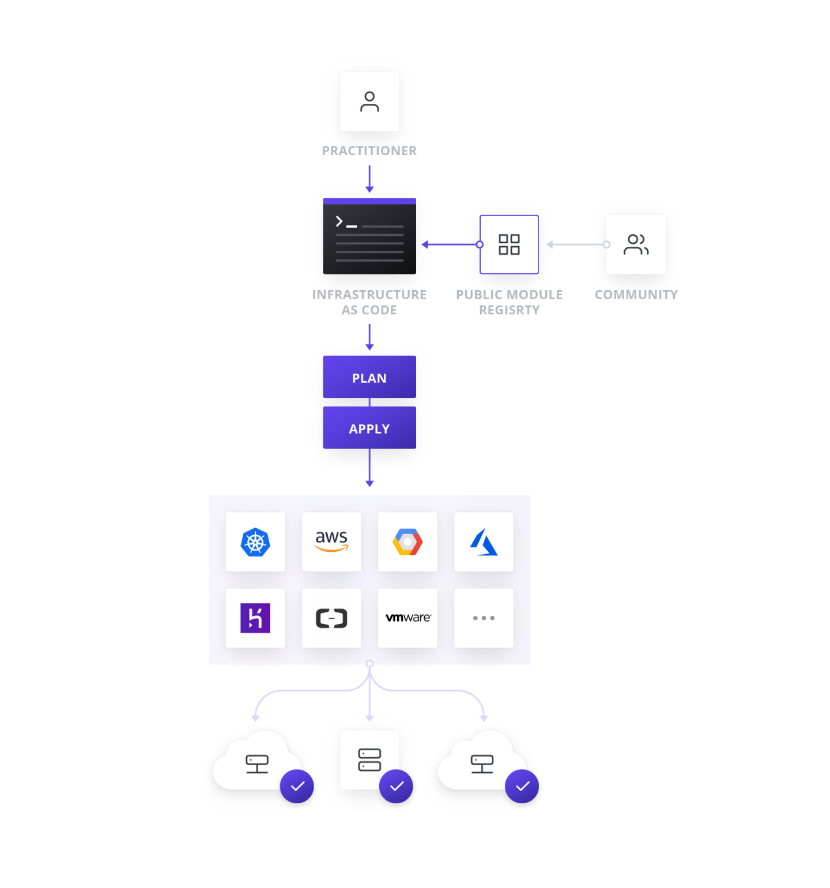

Slide 13
Hand-On !!

Slide 14



https://t.me/terraformbr
https://t.me/TerraformSupport
https://www.terraform.io/docs/index.html
https://github.com/hashicorp/terraform

Slide 15
Question?

Slide 16
Thank you for your attention!!

