Slide 1
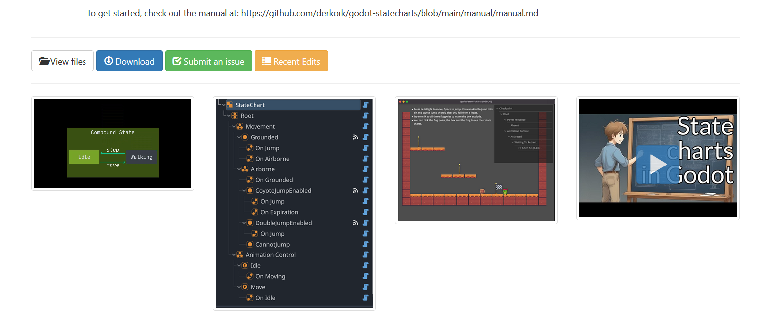
DAG PSM – avoid this kind of addon

Slide 2


Slide 4
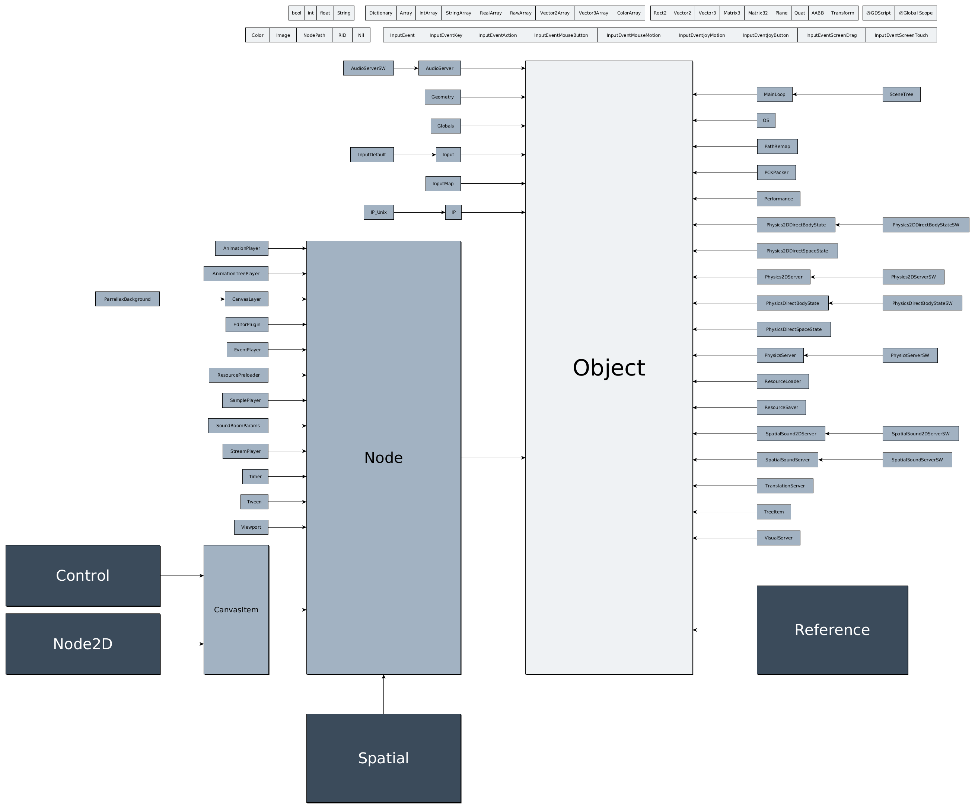

Slide 5
Hierarchical Finite State Machine
During 100ms only > layer10 is allowed
Layer 0
idle
Layer 10
<< left | right >>
<< shift >>
[boost]
walk
normal
run
speed run
Duration: 100ms
During 500ms only > layer20 is allowed
Layer 20
<< space >>
jump
Duration: 500ms
During 100ms only > layer 30 is allowed
Layer 30
<< enter >>
attack
Duration: 100ms

Slide 6
Implementation
Scene
Player (player_controller.gd)
→ Node state_machine (player_state_machine.gd)
→ idle, run, … nodes, with .gd script attached
→ AnimationPlayer
→ CollisionShape

Slide 7







Implementation
state
signal finished(next_state_name)
motion
state_machine
on_ground
signal state_changed(current_state)
idle
signal direction_changed(new_direction)
player_controller
player_state_machine
run
signal attack_finished
func _on_StateMachine_state_changed(current_state):
sword

Slide 8
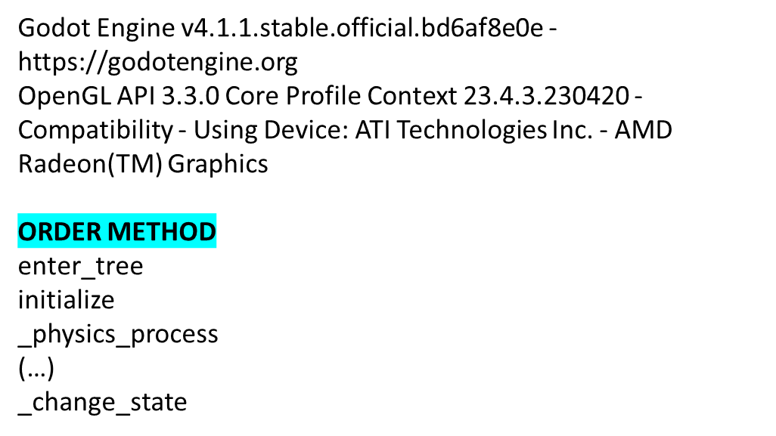
Implementation

Slide 9
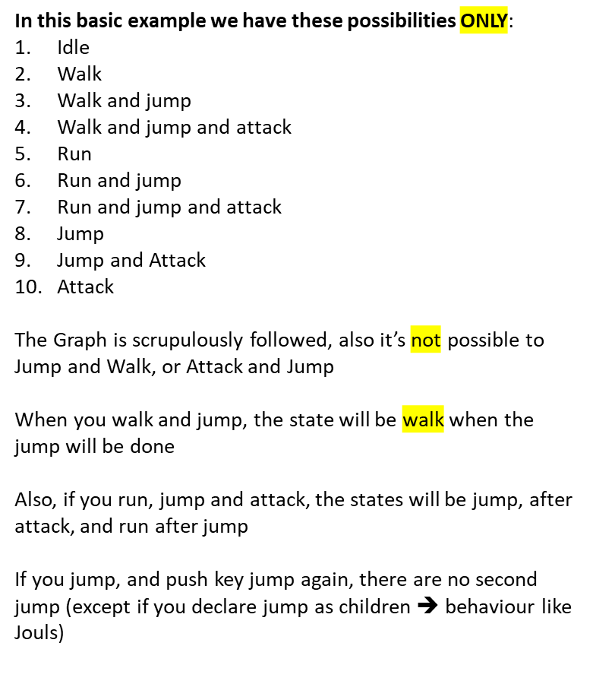
DAG Hierarchical Finite State Machine
walk
run
jump
attack
idle

Slide 10
DAG Hierarchical Finite State Machine
Un pointer sur une instance de JSON
On se deplace sur un node
en avant (on stack)
  On lit les children et on choisit un node , si pas de node = aucune action
en arrière (on destack)

Slide 11

DAG Hierarchical Finite State Machine
{
"root": {
"direction": "right",
"states": [
{
"children": [
"jump",
"attack"
],
"layer": 10,
"name": "walk",
"parent": "idle"
},

