Slide 1
Extreme Vetting
Open-source APM tools and their Resource Overhead

Slide 2
Erik Ostermueller
Performance Engineer, FIS Global
Author of Troubleshooting Java Performance -- apress.com
eostermueller@gmail.com
Twitter: @EOstermueller

Slide 3
Alternative title:
The Performance Penalty of APM Tools

Slide 4
The Problem? Lack of Trust

Slide 5
Question: How to trust a Monitoring tool?
Answer: Extreme Vetting!

Slide 6
How to vet a Monitoring tool?
Create Load Generation Scripts. Load Runner, JMeter, The Grinder, Etc..
Out of scope for this presentation!!!
TEST 1: Run the scripts without any monitoring
TEST 2: Repeat the test with monitoring tool plugged in.
Compare the following metrics:
Response Time
Throughput
CPU
RAM
If degradation in TEST 2 is acceptable, you can trust your monitoring tool!
Reasonable expectation?
< 5% extra CPU, Responses are < 5% slower

Slide 7
The Plan:
Self Sufficiency
Dark Environments
Extreme Vetting: Tests
The APM Tools
The Test Architecture
Extreme Vetting: The Results
Your turn.
Conclusion / What’s Next?

Slide 8
1
Self Sufficiency

Slide 9
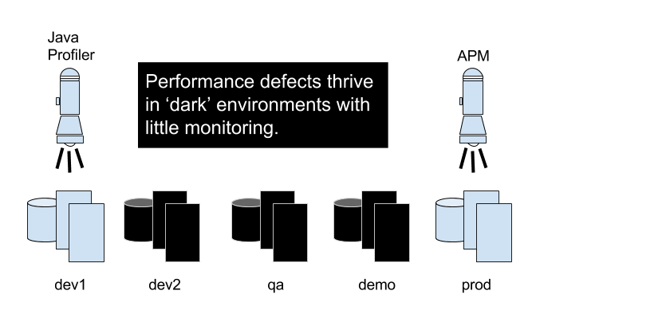
2
Dark Environments

Slide 10
2
Dark Environments
Why Monitor in all environments?

Slide 11
2
Dark Environments
Costly Retreat
from Performance Problems
Performance Rush Jobs -- healthcare.gov

Slide 12
2
Dark Environments
Monitoring options?
Commercial APM
Open Source APM < TODAY’s TOPIC >
JDK Tools

Slide 13
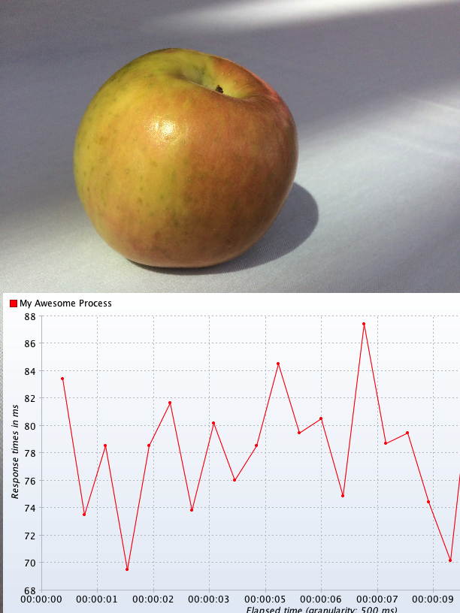
3
An Apple

Slide 14
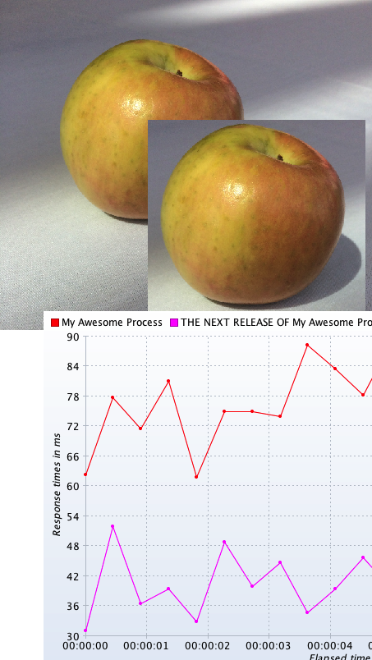
3
Apples-to-Apples

Slide 15
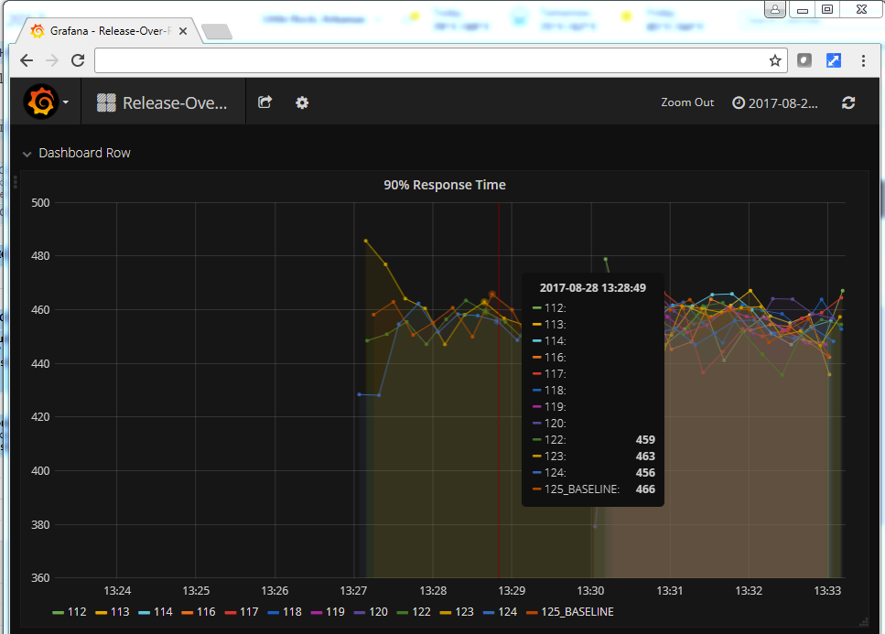
3
Apples-to-Apples

Slide 16
3
Apples-to-Apples Mode
We need more “Apples-to-Apples Mode”
for all Time Series Data
All Vendors.
All APM Tools.
All Load Generation Tools.

Slide 17
3
Extreme Vetting: Tests and Architecture
Baseline without any APM:
PERF DEFECT | W/O PERF DEFECT
1,2,3,4,5,6,7,8,10,11,12 | 1,2,3,4,5,6,7,8,10,11,12

Slide 18
3
Extreme Vetting: Tests and Architecture
The Tests: https://github.com/eostermueller/javaPerformanceTroubleshooting
https://glowroot.org/
https://github.com/javamelody/javamelody/wiki
https://www.moskito.org/

Slide 19
3
Tools NOT part of this review
https://github.com/sylvainlaurent/JDBC-Performance-Logger
https://stagemonitor.org
Review:
http://blog.takipi.com/java-performance-monitoring-5-open-source-tools-you-should-know/

Slide 20
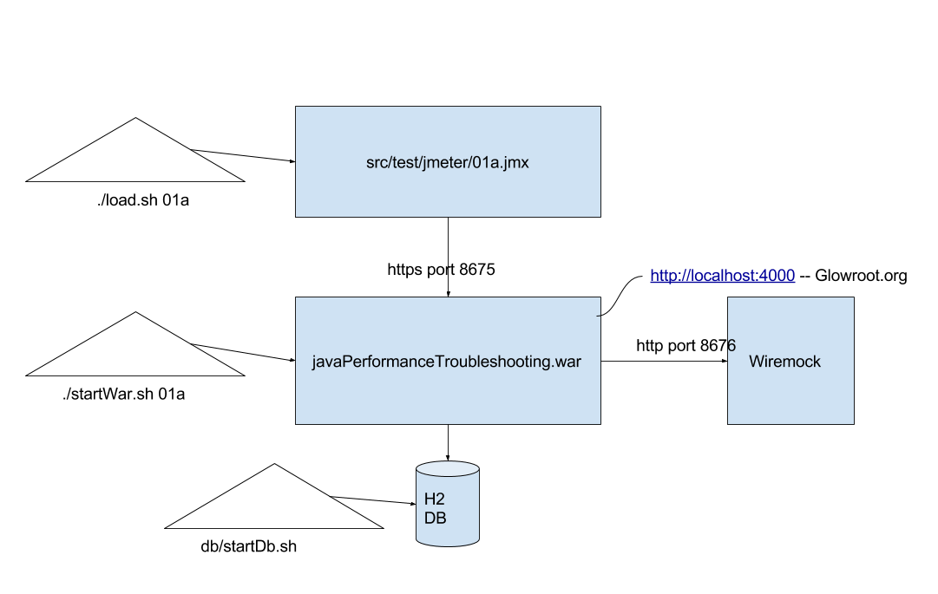
3
Extreme Vetting: Tests and Architecture

Slide 21
4
The Results
https://github.com/eostermueller/extremeVetting_JavaOne2017

Slide 22
5
Your Turn

Slide 23
6
Conclusion
Self Sufficiency helps productivity.
Good Performance Visibility and DevOps ~= Self Sufficiency
Press your vendors for more “Apples to Apples” Mode time series data
Get More Visibility in ALL your environments
Learn to trust your APM tool “Extreme Vetting”

Slide 24
The End
Erik Ostermueller
Performance Engineer, FIS Global
Author of Troubleshooting Java Performance -- apress.com
eostermueller@gmail.com
Twitter: @EOstermueller

