Slide 1
Students’ Social Media Addiction
Group 7 Team Members:
Theo lin 2025280425
迭戈 - Diego Matali Goya 2025280414
郑则 - Alexandre Justo 2025400412
Henrik Wild 2025280171

Slide 2
Introduction
Correlation analysis
Sunshine's Impact on Addiction
Social Media Platform Comparison
Academic Performance
Conclusion

Slide 3




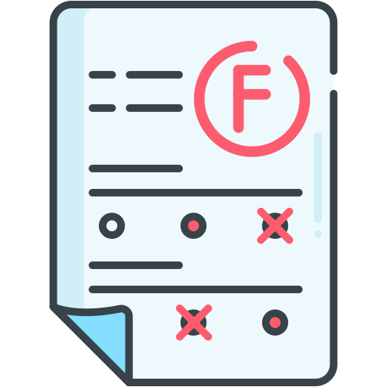
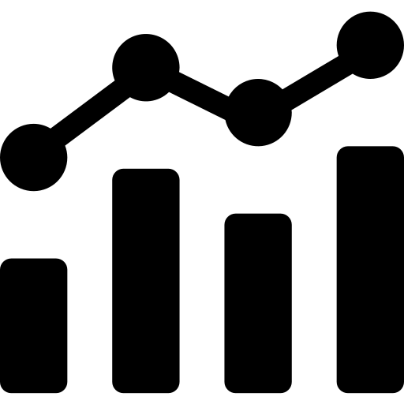
Overview
Demographics.
Population: Students aged 16-25
High School, Undergraduate, Graduate
Global
Timeline:
One-time online study (Q1 2025)
Dataset:
Student´s Social Media Addiction
Key behavioural variables
Average daily social media usage, most-used platform
Key outcome variables
Addiction score (1–10)
Mental health score (1–10)
Sleep hours
Social impact variables
Relationship conflicts due to social media, academic impact

Slide 4
Introduction
Correlation Analysis
Sunshine's Impact on Addiction
Social Media Platform Comparison
Academic Performance
Conclusion

Slide 5
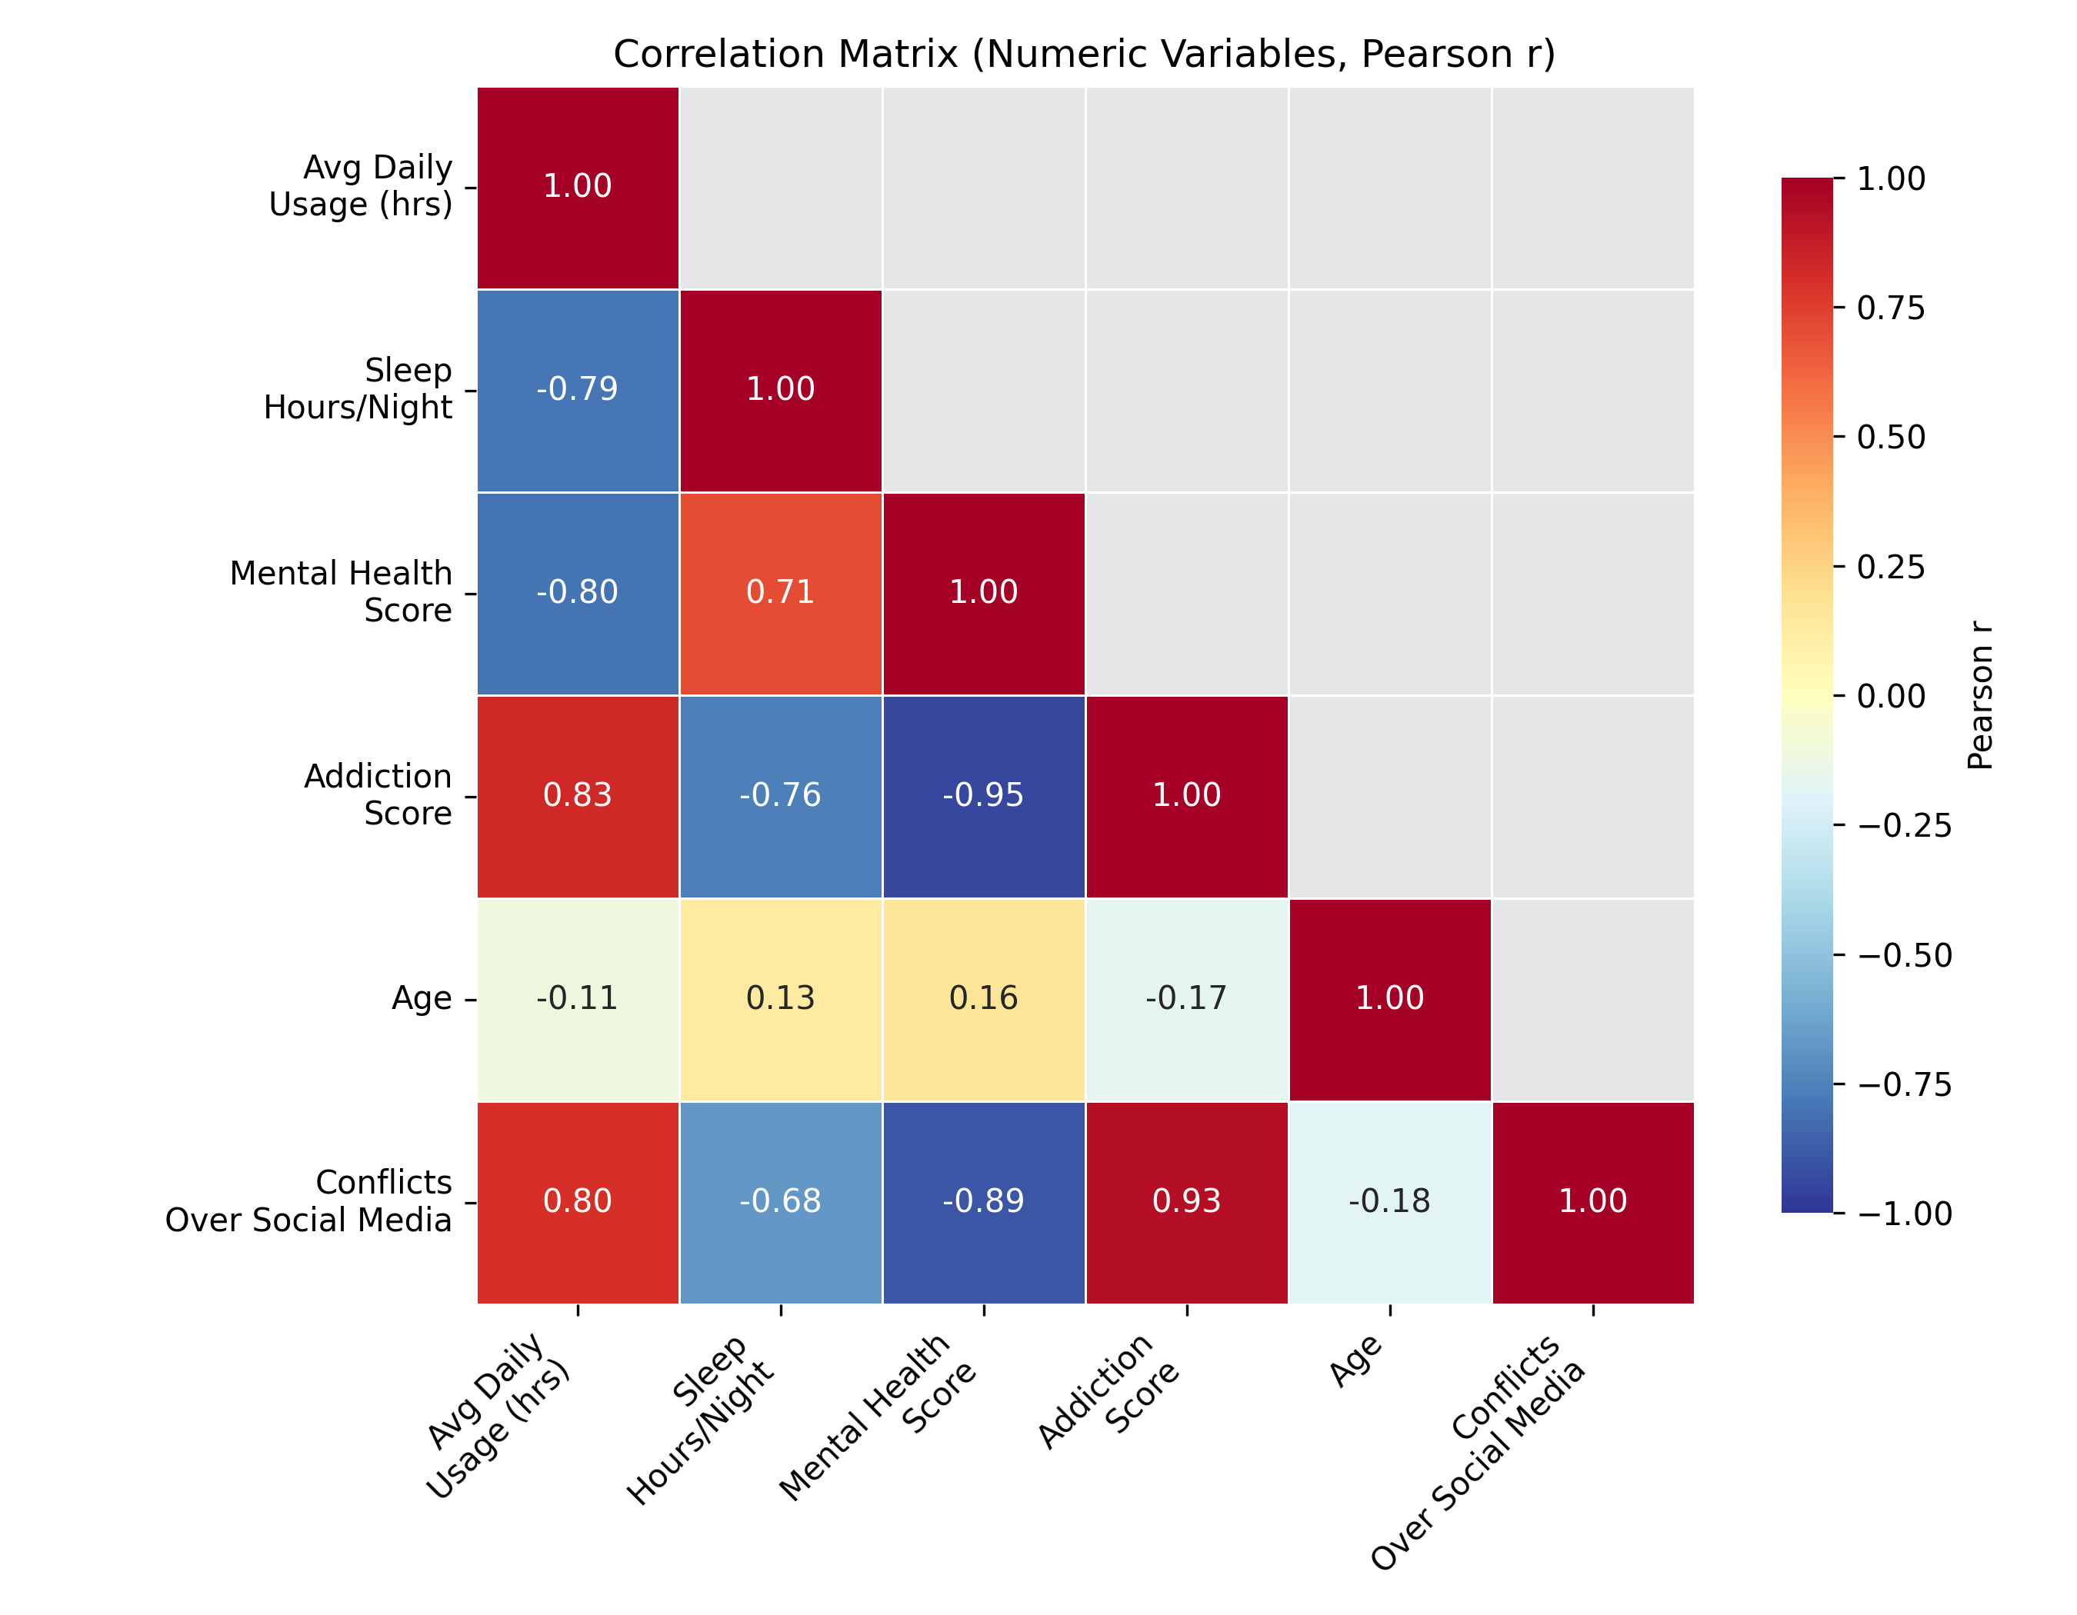
Correlation Analysis
Social media usage is strongly linked to negative outcomes
Higher daily social media use is strongly correlated with:
Less sleep (r ≈ −0.79)
Lower mental health scores (r ≈ −0.80)
Higher addiction scores (r ≈ 0.83)
More conflicts related to social media (r ≈0.80)

Slide 6
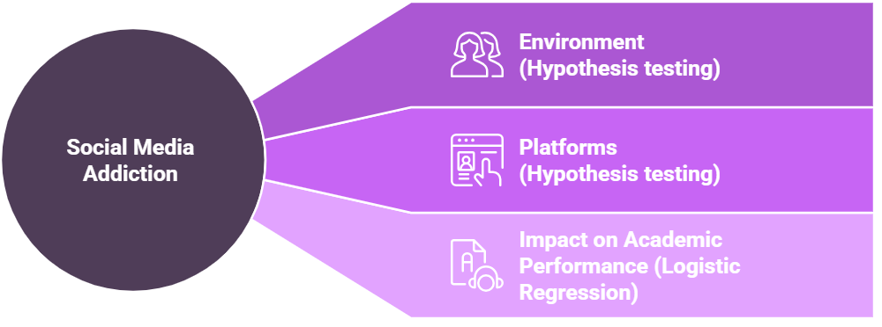
Study
Research Question
What are the key drivers of social media addiction among students, environmental
context or platform choice, and how does this addiction translate into academic impact?

Slide 7
Introduction
Correlation analysis
Sunshine's Impact on Addiction
Social Media Platform Comparison
Academic Performance
Conclusion

Slide 8
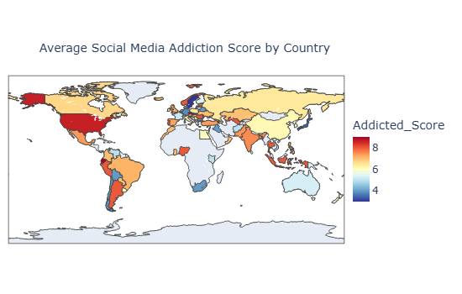
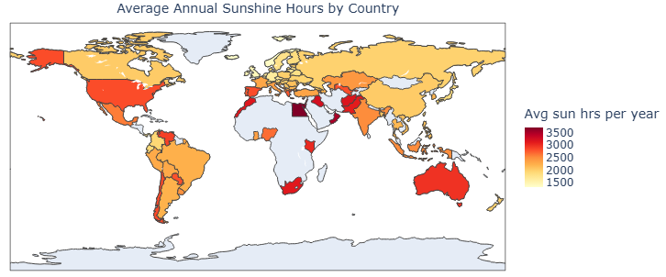
Hypothesis Testing: Investigating Sunshine's Impact on Addiction
Do students living in countries with higher average sunlight hours show lower
social media addiction scores than students living in countries with less sunlight?
Sunshine Data Source: World Bank Group. Climate Change Knowledge Portal. https://climateknowledgeportal.worldbank.org

Slide 9

Hypothesis Testing: Investigating Sunshine's Impact on Addiction
Aspect | One-way ANOVA (Global Test) | Independent Samples t-test (Pairwise)
Comparison | Low-, Moderate-, and High-Sunlight countries | Low-Sunlight vs. High-Sunlight countries
H₀ (Null Hypothesis) | No difference in average addiction scores across sunshine-based clusters | No difference in average addiction scores between Low- and High-Sunlight countries
H₁ (Alternative Hypothesis) | At least one sunshine-exposure group differs in average addiction scores | Lower sunshine exposure is associated with higher addiction scores
Purpose | Test for overall differences across multiple groups | Test directional research hypothesis
Statistics | Test Statistic F = 1.442 p-value = 0.2424 | t = 0.251 p-value = 0.8028
Decision (α = 0.05) | Not significant → Fail to reject H₀ | Not significant → Fail to reject H₀
Conclusion
At α = 0.05 the null hypothesis (H₀) cannot be rejected ❌
There is no statistical evidence that lower sunshine exposure is associated with higher student social media addiction at the country level

Slide 10
Introduction
Correlation analysis
Sunshine's Impact on Addiction
Social Media Platform Comparison
Academic Performance
Conclusion

Slide 11


The Engine of Addiction: Platform Comparison
VS.
Instagram
TikTok
#1 Most used App in Dataset
#2 Most used App in Dataset
71% Female
29% Male
58% Female
42% Male
Average Daily Usage
Average Daily Usage
4.6 hours/day
5.4 hours/day

Slide 12
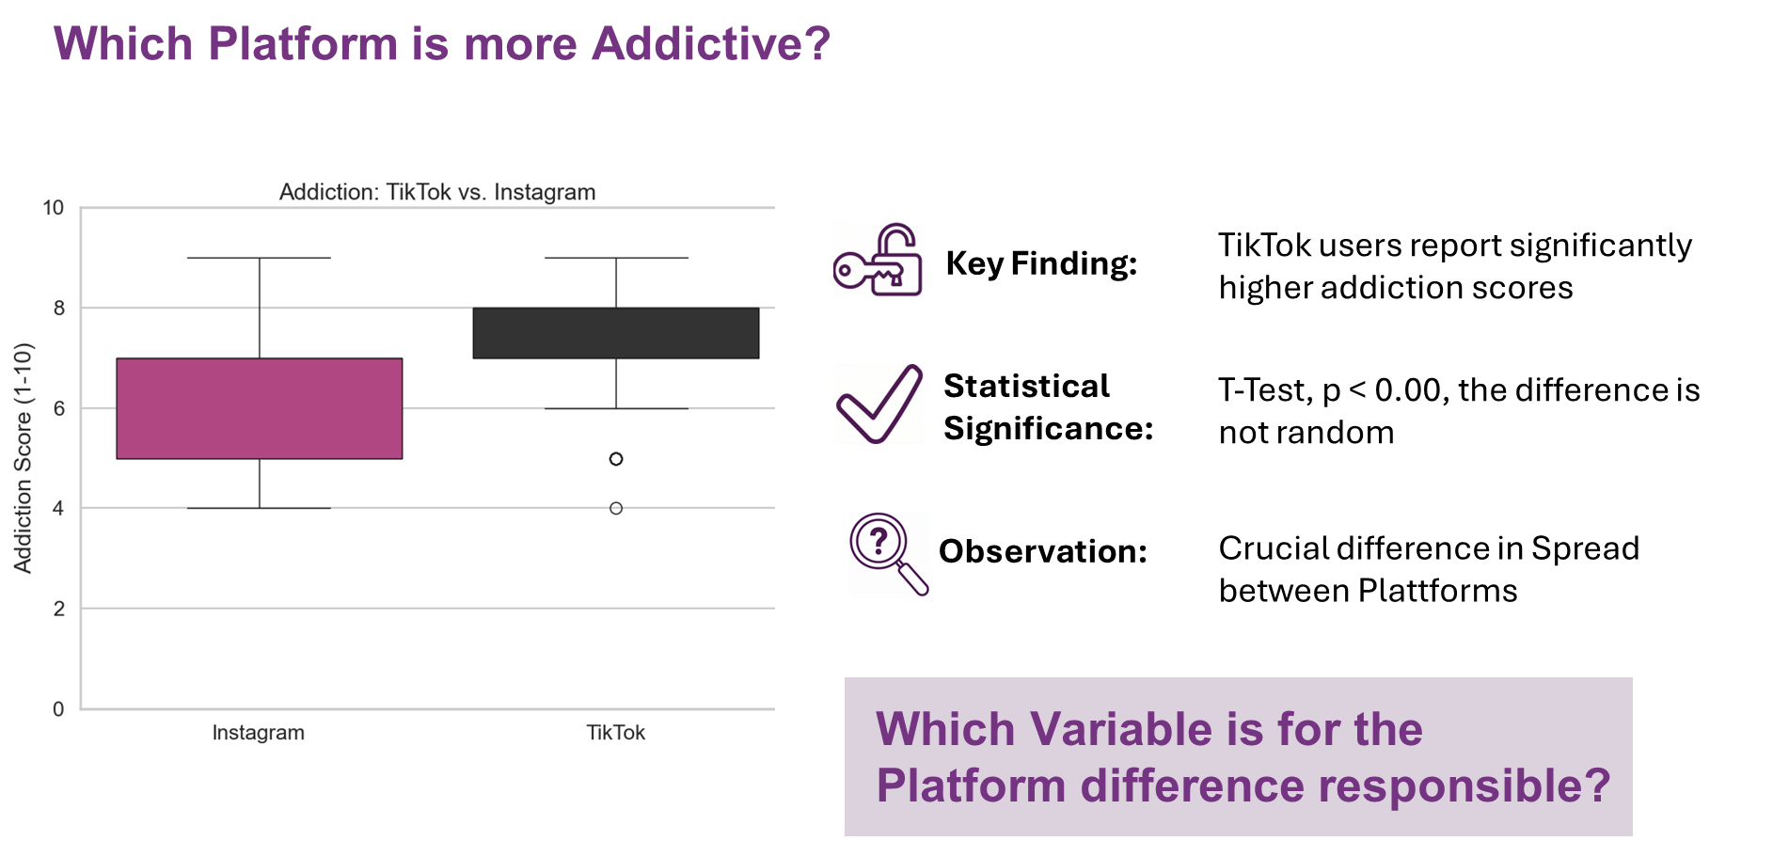

Slide 13
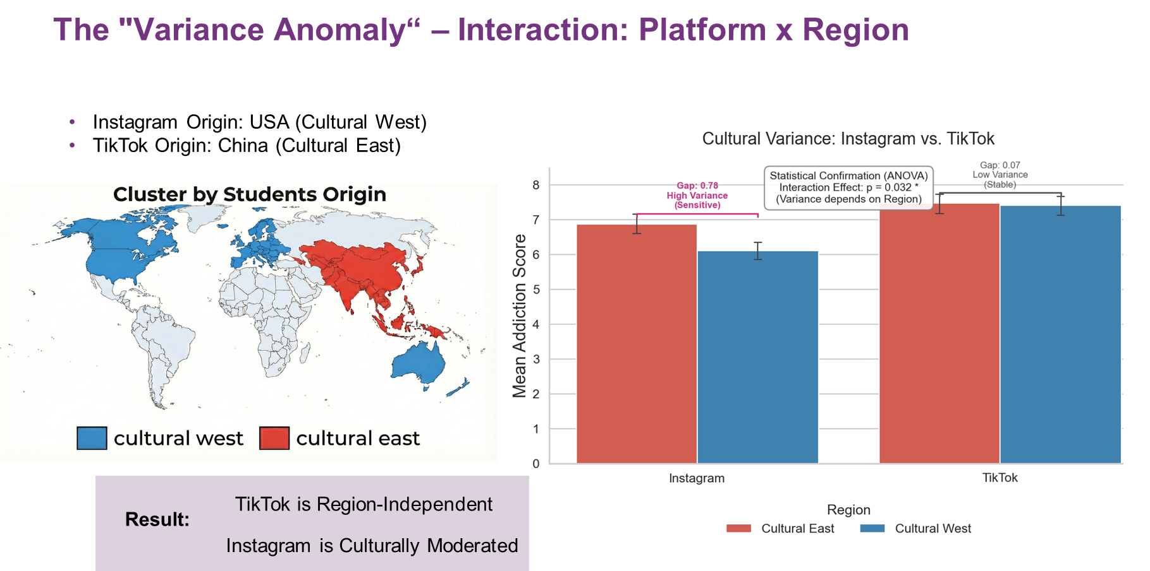

Slide 14
Introduction
Correlation analysis
Sunshine's Impact on Addiction
Social Media Platform Comparison
Academic Performance
Conclusion

Slide 15
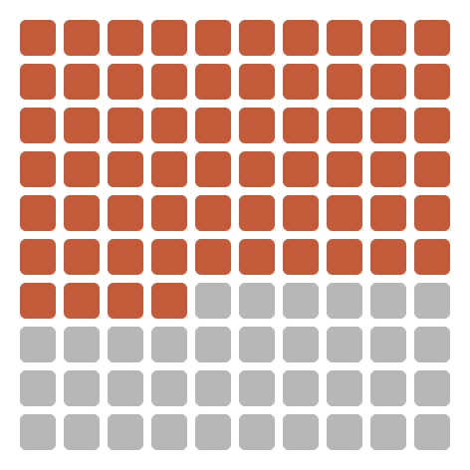
How does Social Media Impact Academic Performance?
The Global Problem: PISA math scores dropped 22 points (2012–2022).¹
STUDENT REPORTED IMPACT
453/705 students reported effect on academic performance:
64.3%
95% Confidence level: [60.6%, 67.7%]
Reported
No
Impact
Reported
Impact
Hypothesis | Statement
H1 | Higher daily social media usage, higher addiction scores, and more conflicts over social media are associated with a higher probability of reporting academic impact.
H2 | Lower sleep duration and lower mental health scores are associated with a higher probability of reporting academic impact.
H3 | The most-used social media platform and relationship status are associated with academic impact (i.e., they are not independent).
H4 | Gender shows weak or no association with academic impact.
¹Source: OECD (2023), PISA 2022 Results (Volume I)
Notes:
As we’ve seen in recent years, many young students are struggling in school, and we see a decline in performance as reported by PISA on math with decline of 22 points in 10 years. And when we analyzed the data from the large group of students, we also find out similar result with over 64% of students reporting that their academic performance had been impacted by social media. This raises the question: If social media contribute to this issue, what factors are influencing whether social media is affecting academic performance?
To answer this, we are going to test the following hypothesis.

Slide 16
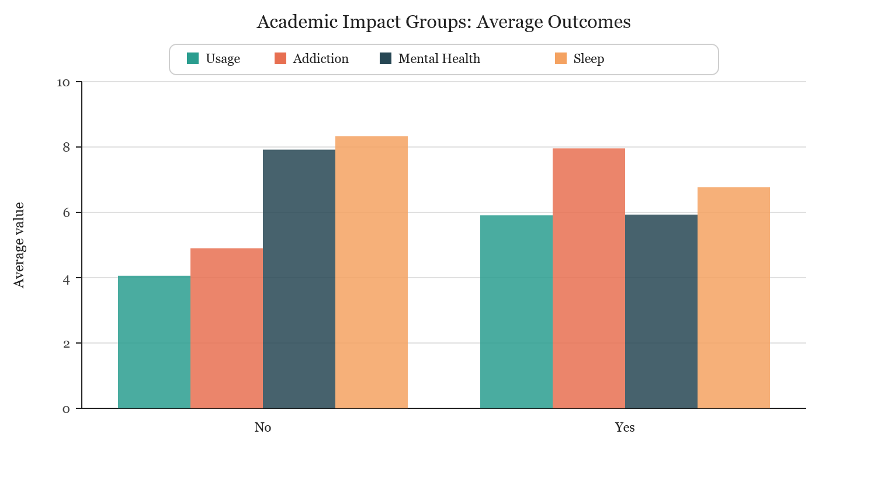
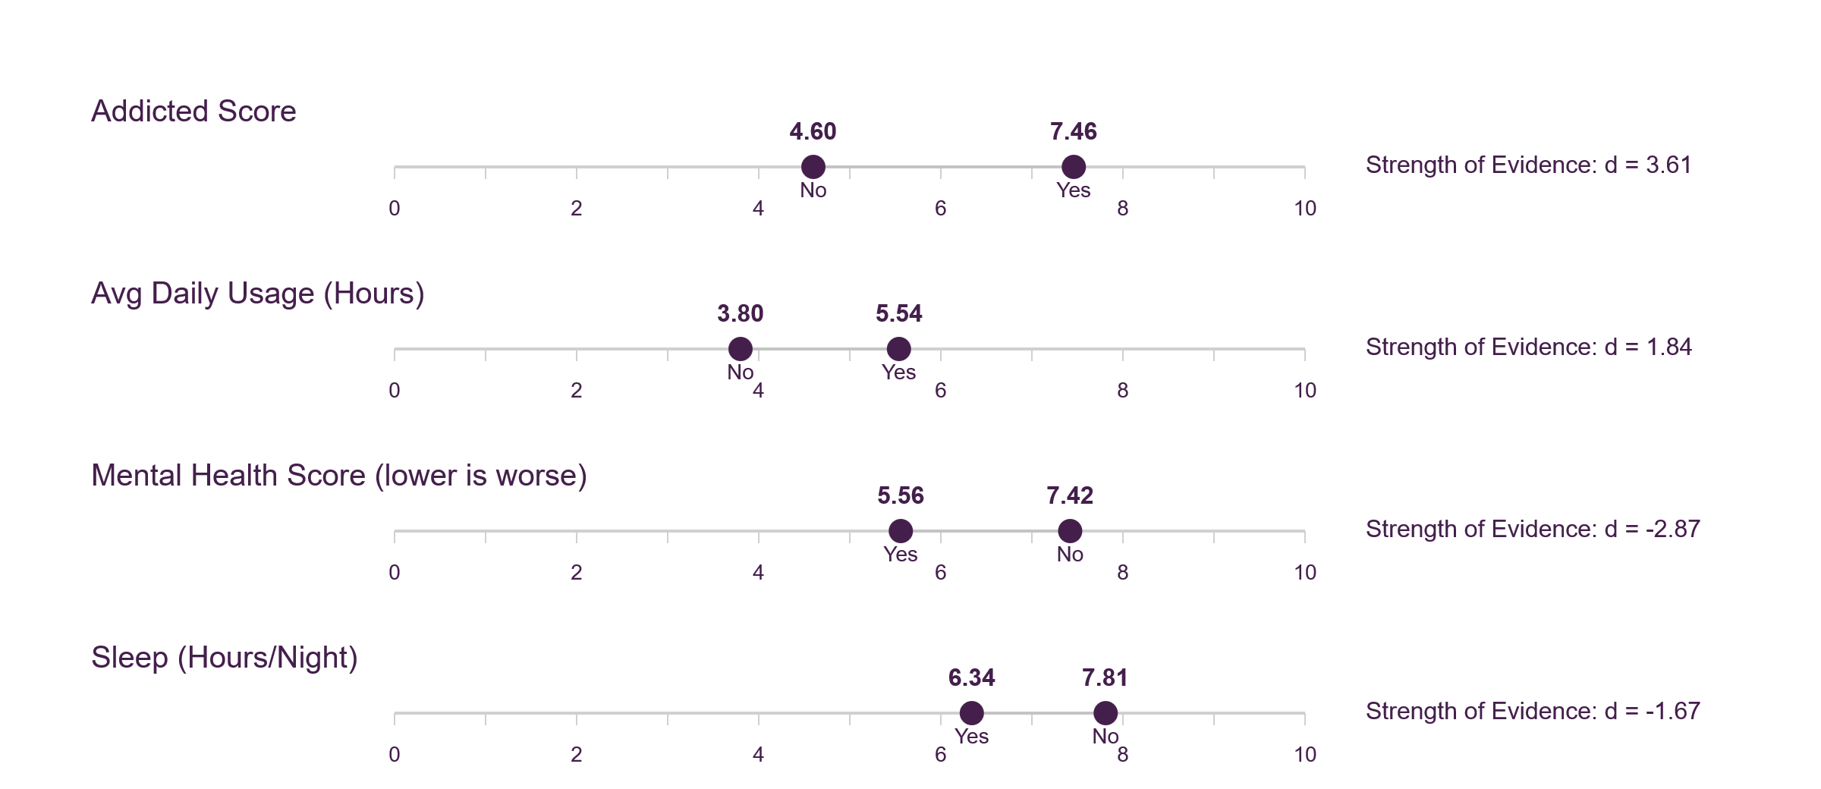
How individual factors contribute to the academic performance?
Strength of Evidence Cohen's |d| > 0.8 is considered large effect
Reject H0 at 95% confidence level
Higher addiction scores, daily usage, and frequent conflicts are significantly associated with a reported negative impact on academic performance.
Lower mental health scores and reduced sleep duration are also significantly associated with a reported negative impact on academic performance.
Notes:
Looking at the data, we observed a significant difference between the 'Yes' and 'No' impact groups. Students reporting no academic impact from social media had lower usage, addiction scores, and conflicts, along with better sleep and mental health.
To assess whether these differences were statistically significant, we conducted a two-sample z-test for the difference in means. And we reject the null hypothesis. Therefore, we support the first two hypothesis.
Additionally, we calculated Cohen's d to measure the effect sizes. For all factors, Cohen's d was larger than 0.8, indicating that the observed effects are not only statistically significant but also of substantial magnitude.
The most-used social media platform and relationship status are associated with academic impact. Both Most_Used_Platform and Relationship_Status were found to be significantly associated with academic impact, so we reject the null hypothesis and support H3.
We fail to reject the null hypothesis for H4, suggesting there is no significant relationship between gender and academic impact.

Slide 17
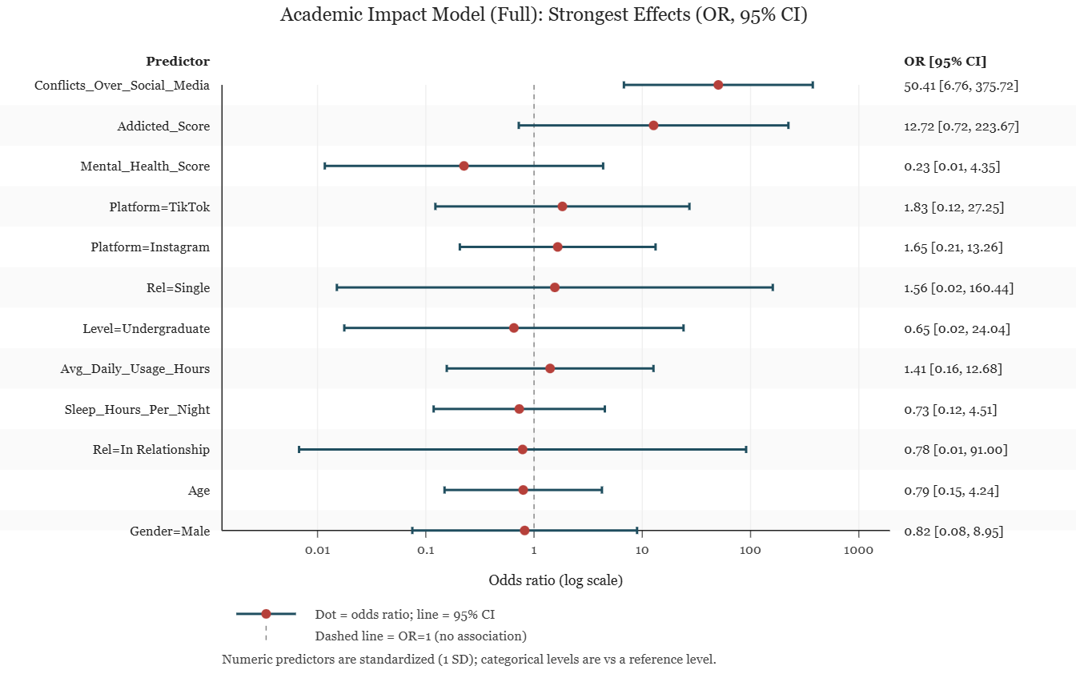
Which factors best predict academic harm together?
Odds of Negative Academic Impact (Yes = Performance Harmed)
Interpreting Odds Ratios (OR):
the OR tells us how the odds of reporting academic impact change for one-unit increase in a predictor, while holding other constants
Conflicts over social media:
Highest odds of harm (OR = 50). Strongest risk.
Mental health:
Better scores, much lower odds of harm (OR = 0,23).
Strongly protective.
Age:
no clear independent association
In this dataset, Conflicts_Over_Social_Media has the largest OR (strongest positive association with reporting academic impact).​
Many CIs are wide and some cross OR=1, so those effects are uncertain in the multivariable model.​
​
Notes:
Next, we used a logistic regression model to identify the most significant predictors. The factor with the highest odds ratio was conflicts over social media, which showed the strongest association with reporting academic impact. This indicates that students who experience more conflicts related to social media are far more likely to report negative effects on their academic performance.

Slide 18
Introduction
Correlation analysis
Sunshine's Impact on Addiction
Social Media Platform Comparison
Academic Performance
Conclusion

Slide 19



Conclusion
Key Drivers of Student Social Media Addiction and Academic Impact
X
No support for sunlight being relevant to digital addiction patterns | Platform choice emerges as a dominant driver of addictive behavior | Academic failure is driven by the emotional fallout (Conflict & Mental Health), and not just social media usage.
Better academic results will not come from reducing screen time alone. The real problem lies in how social media platforms increase stress and conflicts among students.

Slide 20

Do you have any questions?
Thank you for your attention

Slide 21
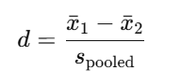
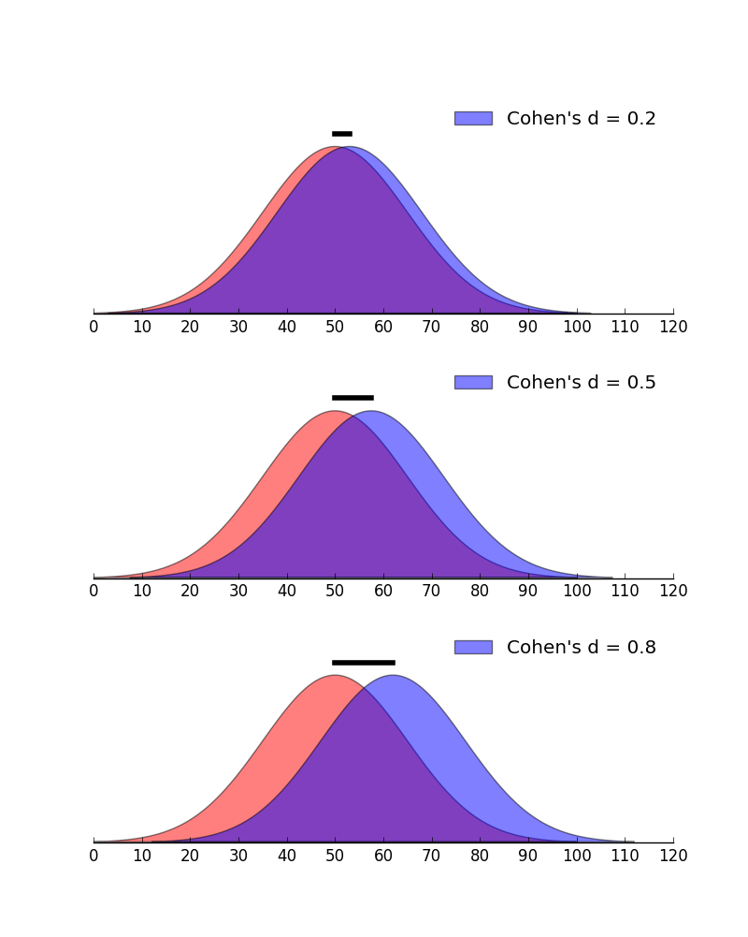
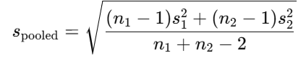
Appendix 1 : Cohen's d measure
Definition:
Cohen's d measures the standardized difference between two means:
Where:
Intuition:
Statistical significance tells us if an effect exists.
Cohen’s d tells us how large that effect is.
Interpretation scale:
Cohen’s d | Interpretation
0.2 | Small effect
0.5 | Medium effect
0.8 | Large effect

Slide 22
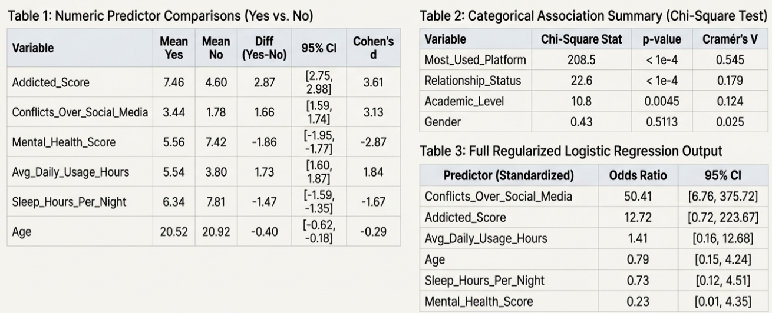
Appendix 2: Detailed Data Tables

Slide 23
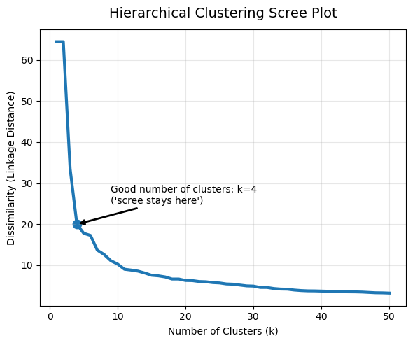
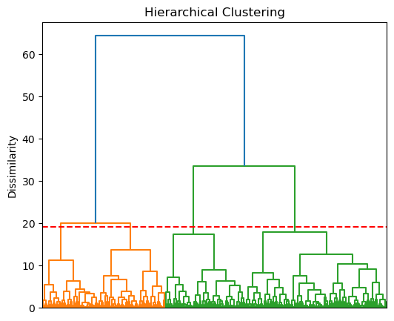
Appendix 3 : Clustering:
How many distinct social media usage behavior patterns can be identified among students?
First we find out the number of clusters to use : 4
Using this information, we then separated the data in the four following cluster.

Slide 24
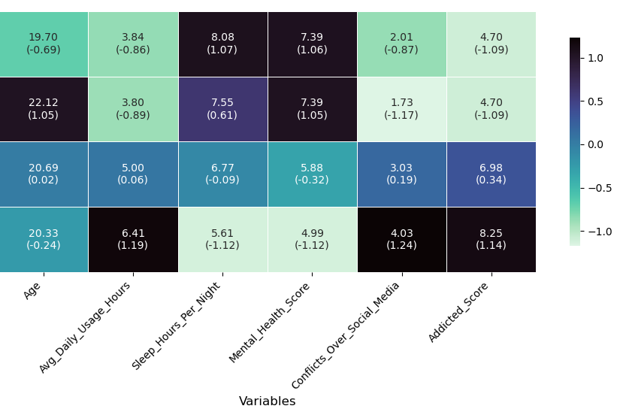
Appendix 4: Clustering
4 Profiles were identified
Low-Usage Users
Balanced Users
Moderate-Risk Users
High-Risk Addicted Users

Slide 25
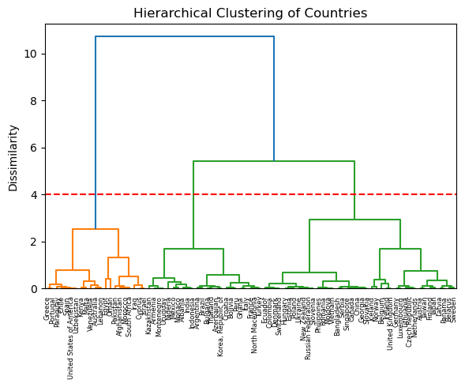
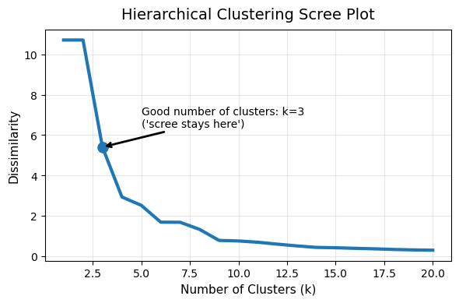
Appendix 5 : Clustering
How many distinct sunshine exposure patterns can be identified among countries?
Three patterns were identified:
  High-Sunlight Countries
  Moderate-Sunlight Countries
  Low-Sunlight Countries

Slide 26
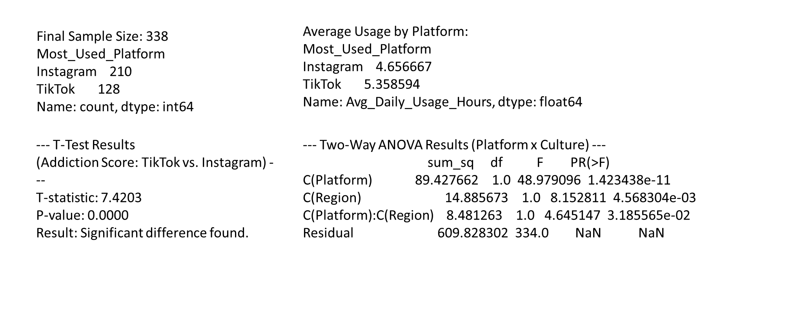
Appendix 6: ANOVA

Slide 27
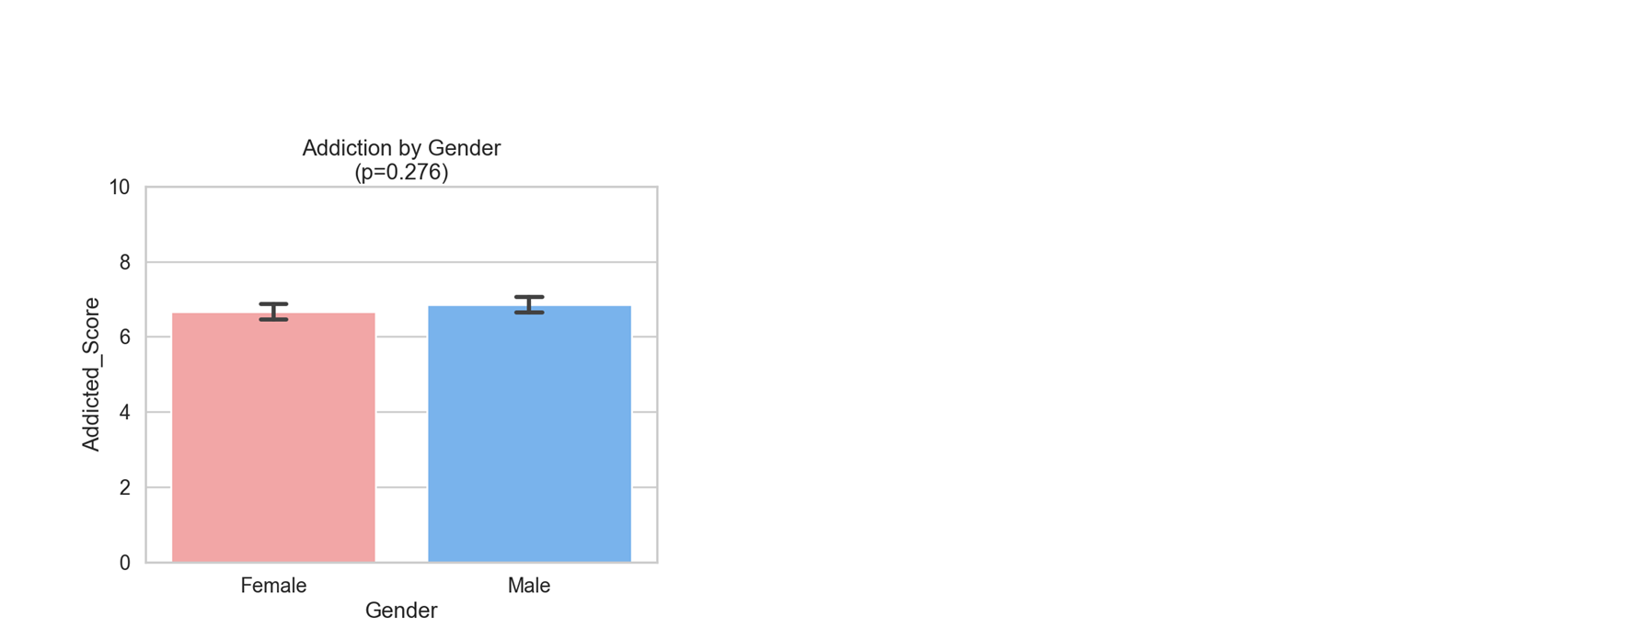
Appendix 7: Gender​

