Slide 1
Assessing Clustering Pipelines
Taylor Jaraczewski
Haixang Liu
Erkin Otles

Slide 2
Overview
Cancer ☹

Slide 3
Background

Slide 4
Background & Motivation
A grand debate has been present in the cancer biology research community in reference to the accuracy of using cell lines as accurate representations of a tumor. To delve into the efficacy of cancer cell lines many researchers have used hierarchical clustering to show the genomic difference between the two model systems. While some researchers have found cancer cell lines to be a useful model1 others have shown that many cell lines are poor representations of their respective primary samples. 2 Delving further into this paradox, it is readily obvious that one of the primary differences between these two findings is the clustering pipelines that each utilizes. Not only is the clustering algorithm itself different but also the pre processing steps to “prepare” the data is different. This project is being proposed to evaluate a number of different clustering algorithms to assess and validate the numerous assumptions that are used in each.
HOW DOES PREPROCESSING EFFECT RESULTS, NOT PICKING BEST PREPROCESSING STEPS
Notes:
TAYLOR

Slide 5
State of the Art
Notes:
TAYLOR

Slide 6
Experimental Question
Notes:
TAYLOR

Slide 7
Tumor Source vs. Cancer Type
Tumor Source
CCLE
TCGA
Cancer Type
Glioblastoma
Ovarian
Notes:
ERKIN

Slide 8
Methodological Overview
Investigate the relationship between analysis pipeline and clustering
Two step pipeline
Preprocessing
Clustering
Notes:
ERKIN

Slide 9
Methodological Overview
Raw Data
Normalization
PCA
Clustering
Notes:
ERKIN

Slide 10
Preprocessing
Normalization Methods
None
Quantile
Z-Score
Normalization Sets
Individual
Cancer Pair
All Data
None
http://www.people.vcu.edu/~mreimers/OGMDA/normalize.expression.html
Quantile
Stackoverflow
Z-Score
Notes:
ERKIN

Slide 11
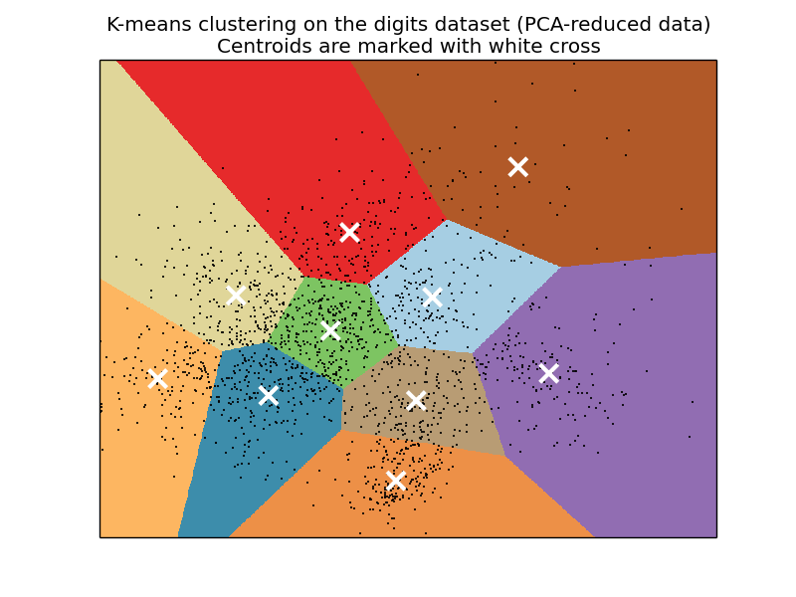
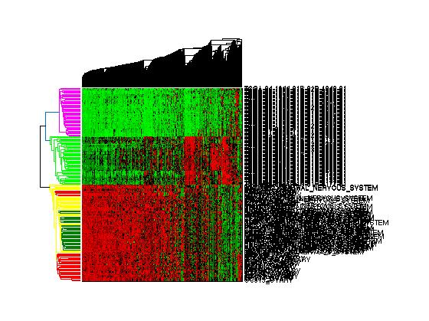
Clustering
K-Means (sklearn)
Heirarchical
Notes:
LIU

Slide 12
Anticipated Results & Questions For Experiementation
We expect different algorithms may have a to have differing clustered output.
Questions:
is the clustered output, and transitively, the efficacy of cell lines dependent on the specific pipeline used
Can the output of certain pipelines be modulated by changing some of the assumptions.
Notes:
LIU

Slide 13
Results

Slide 14
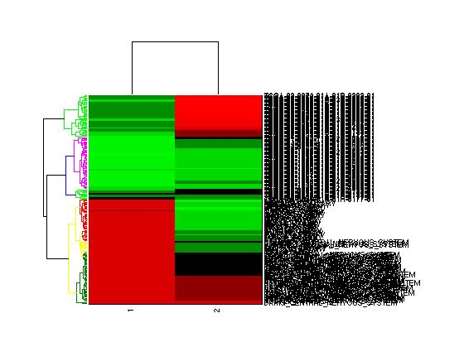
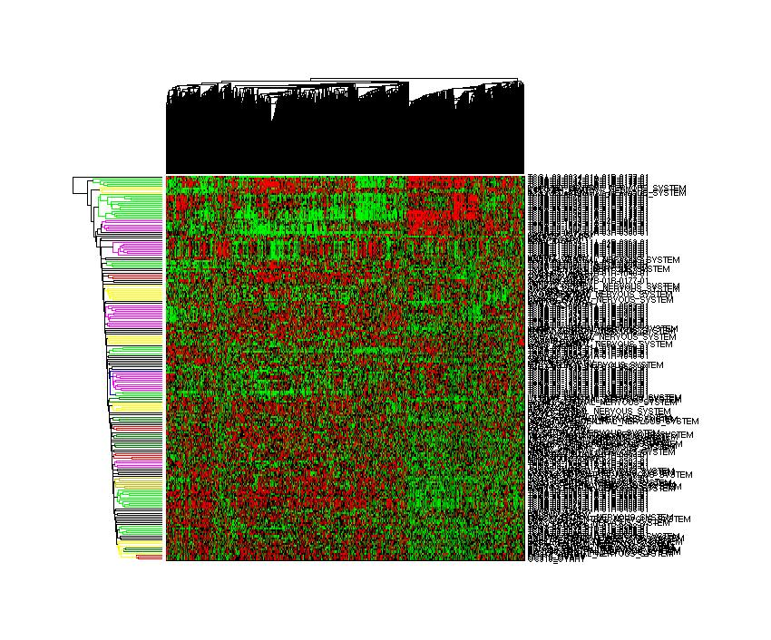
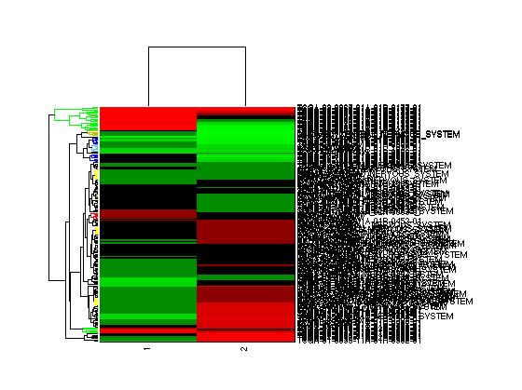
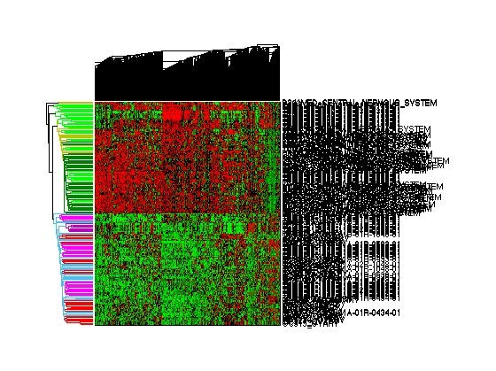
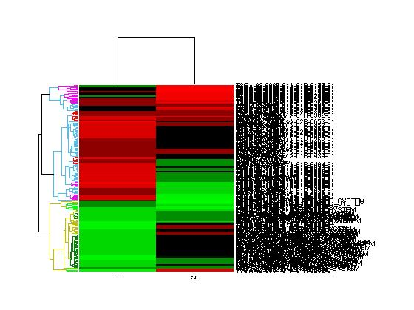
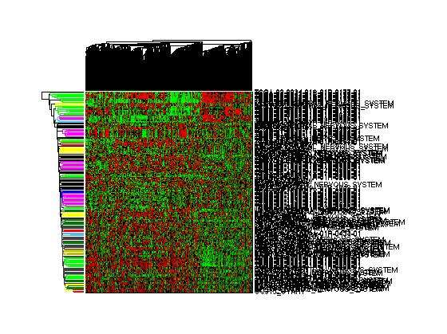
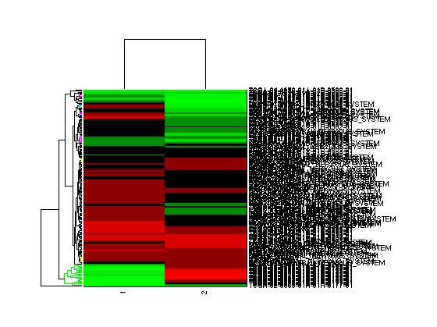
No PCA
PCA
Raw Data
Quantile
Pair Quantile
Z-Score
Notes:
ERKIN/TAYLOR
Do PCA
If norm do it along cancer types
1)Legend – and explain exactly what this is showing
Graph before giving an example of how this could look
2) Raw data separated by source, not tumor type
3) Biases for tumor type if performed on tumor types (eg. Pair quantile) more random with quantile and z-score (all 4 or individually performed respectively)
4) PC2 for raw data splits based on source PC2 for Pair Quantile splits based on cancer type. Kind of an internal control

Slide 15
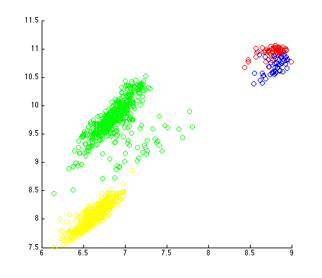
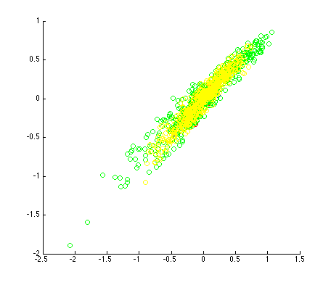
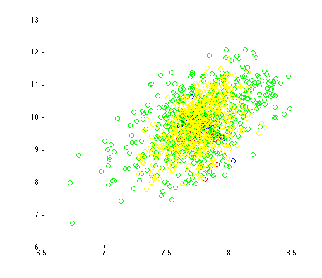
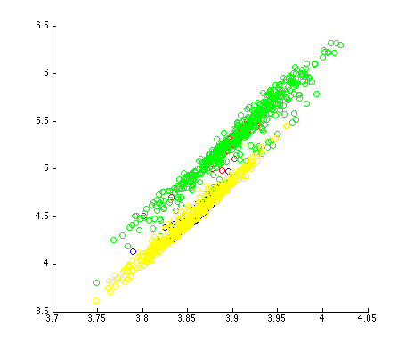
Normalization Comparison
Raw data with PCA
Z-score data with PCA
Quantiled data with PCA
Pair quantiled data with PCA

Slide 16
K-means
 | Raw |  |  |  | Z-score
CCLE gbmlgg | 3 | 0 | 0 | 47 | 41 | 3 | 0 | 6
CCLE ov | 45 | 0 | 0 | 5 | 35 | 5 | 0 | 10
TCGA gbmlgg | 0 | 1 | 49 | 0 | 17 | 5 | 22 | 6
TCGA ov | 0 | 50 | 0 | 0 | 12 | 9 | 0 | 29
 | Quantile |  |  |  | Pair Quantile
CCLE gbmlgg | 13 | 0 | 2 | 35 | 0 | 0 | 48 | 2
CCLE ov | 9 | 0 | 5 | 36 | 45 | 0 | 0 | 5
TCGA gbmlgg | 14 | 22 | 8 | 6 | 1 | 23 | 24 | 2
TCGA ov | 12 | 0 | 25 | 13 | 43 | 0 | 0 | 7

Slide 17
K-means with PCA
 | Raw |  |  |  | Z-score
CCLE gbmlgg | 47 | 3 | 0 | 0 | 33 | 0 | 17 | 0
CCLE ov | 5 | 45 | 0 | 0 | 38 | 0 | 11 | 1
TCGA gbmlgg | 0 | 0 | 47 | 3 | 17 | 21 | 8 | 4
TCGA ov | 0 | 0 | 0 | 50 | 12 | 0 | 28 | 10
 | Quantiled |  |  |  | Pair Quantiled
CCLE gbmlgg | 2 | 10 | 4 | 34 | 3 | 47 | 0 | 0
CCLE ov | 1 | 20 | 6 | 23 | 7 | 0 | 12 | 31
TCGA gbmlgg | 16 | 10 | 12 | 12 | 20 | 29 | 0 | 1
TCGA ov | 4 | 28 | 11 | 7 | 4 | 0 | 29 | 17

Slide 18
K-means with 2 Groups
 | Raw |  |  |  | Z-score
 | No PCA |  | With PCA |  | No PCA |  | With PCA
CCLE gbmlgg | 50 | 0 | 50 | 0 | 0 | 50 | 0 | 50
CCLE ov | 50 | 0 | 50 | 0 | 0 | 50 | 0 | 50
TCGA gbmlgg | 0 | 50 | 30 | 20 | 22 | 28 | 22 | 28
TCGA ov | 0 | 50 | 0 | 50 | 0 | 50 | 0 | 50
 | Quantiled |  |  |  | Pair Quantiled
 | No PCA |  | With PCA |  | No PCA |  | With PCA
CCLE gbmlgg | 0 | 50 | 9 | 41 | 50 | 0 | 48 | 2
CCLE ov | 0 | 50 | 9 | 41 | 0 | 50 | 1 | 49
TCGA gbmlgg | 23 | 27 | 23 | 27 | 30 | 20 | 41 | 9
TCGA ov | 0 | 50 | 27 | 23 | 0 | 50 | 0 | 50

Slide 19
Implications
Notes:
TAYLOR

Slide 20
Discussion

Slide 21
Challenges
Heatmap generation can be slow and cumbersome
Data in “rawest” form is difficult to handle
Downloading data
Different chips: CCLE v2
Notes:
LIU

Slide 22
Future Work
Normalization on pan cancer
Notes:
ERKIN

Slide 23
References
[1] Barretina, Jordi, et al. "The Cancer Cell Line Encyclopedia enables predictive modelling of anticancer drug sensitivity." Nature 483.7391 (2012): 603-607.
[2] Domcke, Silvia, et al. "Evaluating cell lines as tumour models by comparison of genomic profiles." Nature communications 4 (2013).
[3] Leek, Jeffrey T., et al. "The sva package for removing batch effects and other unwanted variation in high-throughput experiments." Bioinformatics 28.6 (2012): 882-883.
[4] Cancer Genome Atlas Research Network. "Integrated genomic analyses of ovarian carcinoma." Nature 474.7353 (2011): 609-615.

