Slide 1
Assessing Clustering Pipelines
Taylor Jaraczewski
Haixang Liu
Erkin Otles

Slide 2
Overview
Cancer ☹

Slide 3
Background

Slide 4
Background & Motivation
A grand debate has been present in the cancer biology research community in reference to the accuracy of using cell lines as accurate representations of a tumor. To delve into the efficacy of cancer cell lines many researchers have used hierarchical clustering to show the genomic difference between the two model systems. While some researchers have found cancer cell lines to be a useful model1 others have shown that many cell lines are poor representations of their respective primary samples. 2 Delving further into this paradox, it is readily obvious that one of the primary differences between these two findings is the clustering pipelines that each utilizes. Not only is the clustering algorithm itself different but also the pre processing steps to “prepare” the data is different. This project is being proposed to evaluate a number of different clustering algorithms to assess and validate the numerous assumptions that are used in each.
HOW DOES PREPROCESSING EFFECT RESULTS, NOT PICKING BEST PREPROCESSING STEPS
Notes:
TAYLOR

Slide 5
State of the Art
Notes:
TAYLOR

Slide 6
Experimental Question
Notes:
TAYLOR

Slide 7
Matrix of source vs. type
Notes:
ERKIN

Slide 8
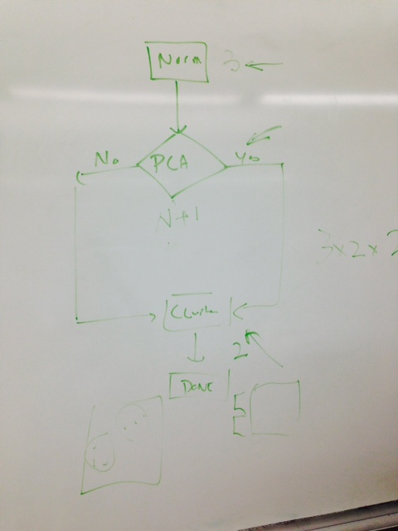
Methodological Overview
In order to investigate the relationship between analysis pipeline and clustering results the authors will build out a two step pipeline with modular components. The first step will represent the preprocessing that is typically done on gene expression data. Clustering will be housed in the second step module.
Notes:
ERKIN

Slide 9
Preprocessing
For the preprocessing module we would like to implement at least two methods:
Individual Data Set Normalization Joint Data Set Normalization
Normalization:
Quantile: none, all 4, Paired (ovary and gbm), Z score ERKIN MAKE THIS PRETTY
Notes:
ERKIN

Slide 10
Clustering
For the clustering module we would like to investigate three different methods: Hierarchical Clustering
K-Means Clustering
Notes:
LIU

Slide 11
Anticipated Results
After running the different algorithms presented in the methods section each will be assessed by looking at the clustering output. Upon looking at this initial output, the algorithms will be perturbed by changing individual assumptions made within each. In changing certain assumptions it is expected that certain algorithms may have a difference in the clustered output. Two primary questions will be asked: 1) is the clustered output, and transitively, the efficacy of cell lines dependent on the specific pipeline used and 2) can the output of certain pipelines be modulated by changing some of the assumptions.
Notes:
LIU

Slide 12
Data Sources
TCGA
CCLE
GBM
Ovarian
Notes:
LIU

Slide 13
Results

Slide 14
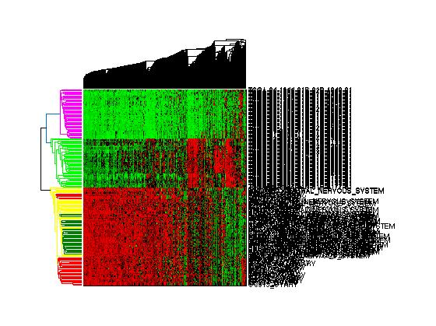
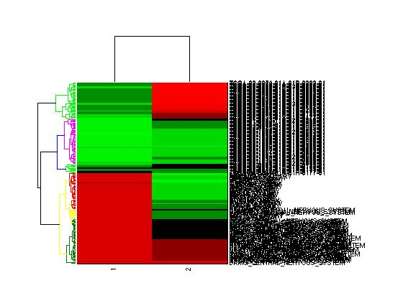
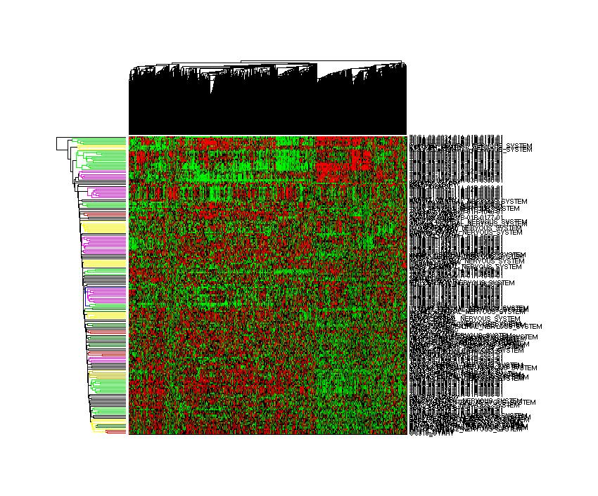
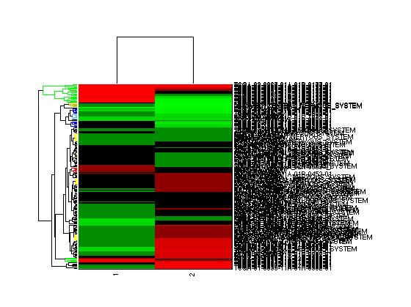
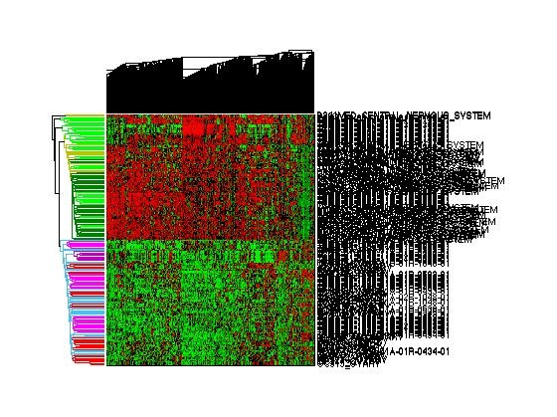
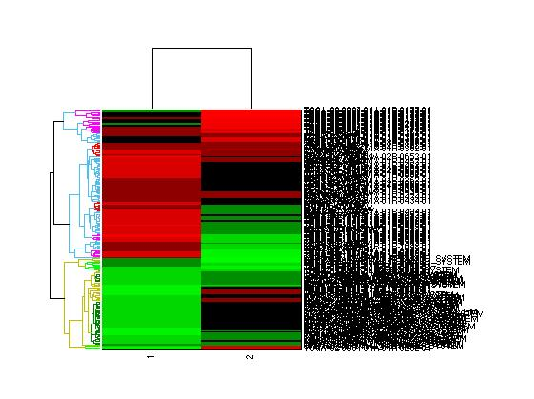
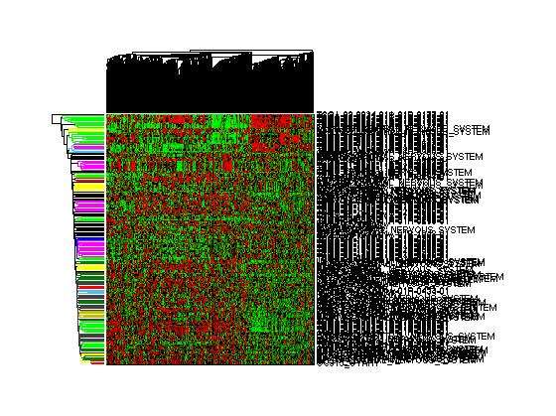
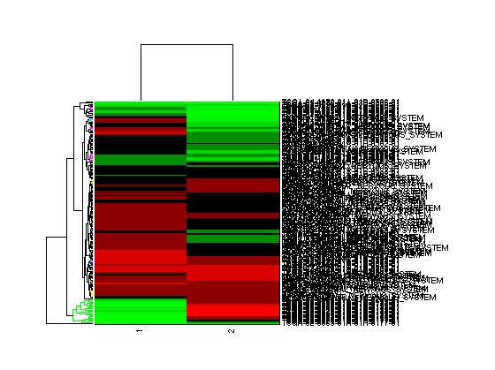
No PCA
PCA
Raw Data
Quantile
Pair Quantile
Z-Score
Notes:
ERKIN/TAYLOR
Do PCA
If norm do it along cancer types
1)Legend – and explain exactly what this is showing
Graph before giving an example of how this could look
2) Raw data separated by source, not tumor type
3) Biases for tumor type if performed on tumor types (eg. Pair quantile) more random with quantile and z-score (all 4 or individually performed respectively)
4) PC2 for raw data splits based on source PC2 for Pair Quantile splits based on cancer type. Kind of an internal control

Slide 15
PCA Scatters
Notes:
ERKIN

Slide 16
Confusion Matrix
Notes:
LIU

Slide 17
Summary of Findings
Gitter Note:
Finally, as you note in your report, as major challenge will be performing a summarizing meta-analysis to interpret the many clustering results. It will be difficult to interpret your results if they are presented as a series of clustering outputs without any further summarization. Try to arrive at a concise conclusion based on your data - i.e. these cell lines are good models of these tumor samples or cell line/tumor similarity is determined by step X in the pipeline as opposed to an inherent biological feature - and present the results in a way that builds toward that conclusion.
Notes:
ERKIN

Slide 18
Discussion

Slide 19
Implications
Notes:
TAYLOR

Slide 20
Challenges
Heatmap generation can be slow and cumbersome
Data in “rawest” form is difficult to handle
Downloading data
Different chips: CCLE v2
Notes:
LIU

Slide 21
Future Work
Normalization on pan cancer
Notes:
ERKIN

Slide 22
References
[1] Barretina, Jordi, et al. "The Cancer Cell Line Encyclopedia enables predictive modelling of anticancer drug sensitivity." Nature 483.7391 (2012): 603-607.
[2] Domcke, Silvia, et al. "Evaluating cell lines as tumour models by comparison of genomic profiles." Nature communications 4 (2013).
[3] Leek, Jeffrey T., et al. "The sva package for removing batch effects and other unwanted variation in high-throughput experiments." Bioinformatics 28.6 (2012): 882-883.
[4] Cancer Genome Atlas Research Network. "Integrated genomic analyses of ovarian carcinoma." Nature 474.7353 (2011): 609-615.

