Slide 1
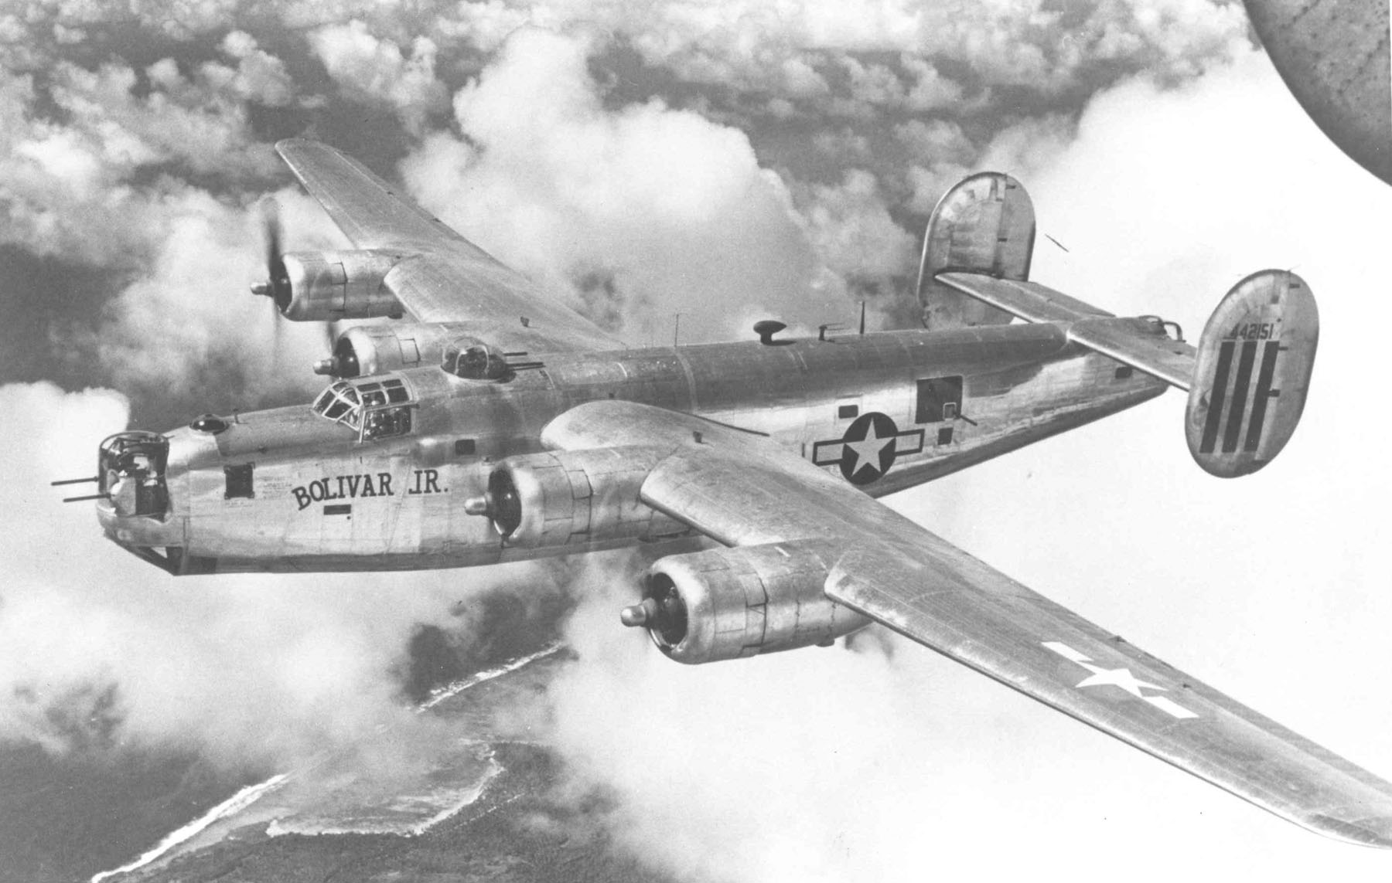
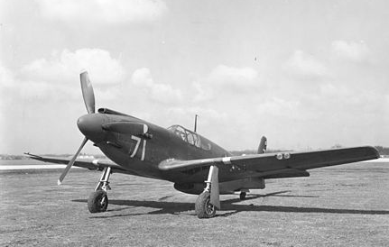
Consolidated B-24M-20-CO „Liberator“
North American A-36A

