Slide 1
Testing and Verification of RESTful Web Services
Ege Can Özer
Notes:
My job is to maintain and improve a testing software at work
My motivation is to learn other means of techniques regarding software testing
For this seminar I have picked the topic of Testing and Verification of RESTful W.S.

Slide 2
Outline
Background
Test-the-rest: An approach to testing RESTful web services[4]
Connectedness testing of RESTful w.s. [6]
Model-based testing of RESTful w.s. using UML protocol state machines[7]
REST service testing based on inferred XML schemas[8]
RESTful API automated test case generation[9]
Summary
Conclusion
Notes:
Here is the outline of the presentation
In both of my peer review the lack of background information addressed, So I will talk about it that
What is REST
Some Testing methods
My seminar is similar to review paper but I have only covered 5 papers. Explain these
I will summarize in a big table, comparing them briefly
I will conclude with the findings

Slide 3
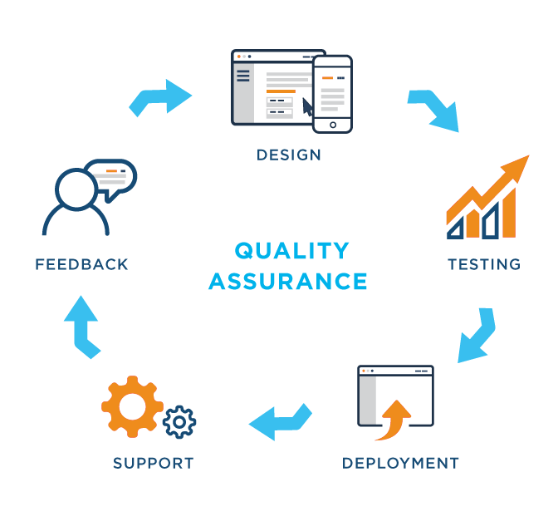
Testing is important!
Bugs are nature of software development
Testing helps to find defects
Ensures,
Quality of the product
Effective performance
But,
Time consuming
Testing challenges varies
Notes:
Testing is the part of the quality assurance of the software development
But it is time consuming

Slide 4

Testing Levels
Canfora and Di Penta 2006 [2]
Functional testing:
Non-functional testing:
Regression testing
Integration testing
Notes:
They categorize testing levels
Also testing perspective (integrator, developer etc) but no need to go deeper

Slide 5

Functional testing
Testing software’s FEATURE
Unit testing
Sanity
Localization
Interoperability
And so on …
Notes:
You will see this term in somewhere, so this is the explanation

Slide 6

Non-functional testing
Testing software’s PROPERTY
Load testing
Performance
Security
Volume
Stress
And so on...

Slide 7

Regression testing
Wikipedia definition:
Regression testing is a type of software testing which verifies that software which was previously developed and tested still performs the same way after it was changed or interfaced with other software
Regression
“When you fix one bug, you introduce several newer bugs.”

Slide 8

Integration testing
Wikipedia definition:
Integration testing is the phase in software testing in which individual software modules are combined and tested as a group

Slide 9
What is REST?
Representational State Transfer
Not a protocol, but an architectural guideline
Stateless
URIs
GET /products
GET /products?k=v
POST /products
GET /products/{id}/price
DELETE /products/{id}
GET PUT POST DELETE
JSON XML HTML JPG …
Notes:
Stateless: server does not store any state about the client session on the server side
The client session is stored on the client.
The server is stateless means that every server can service any client at any time
SOAP (originally Simple Object Access Protocol)

Slide 10
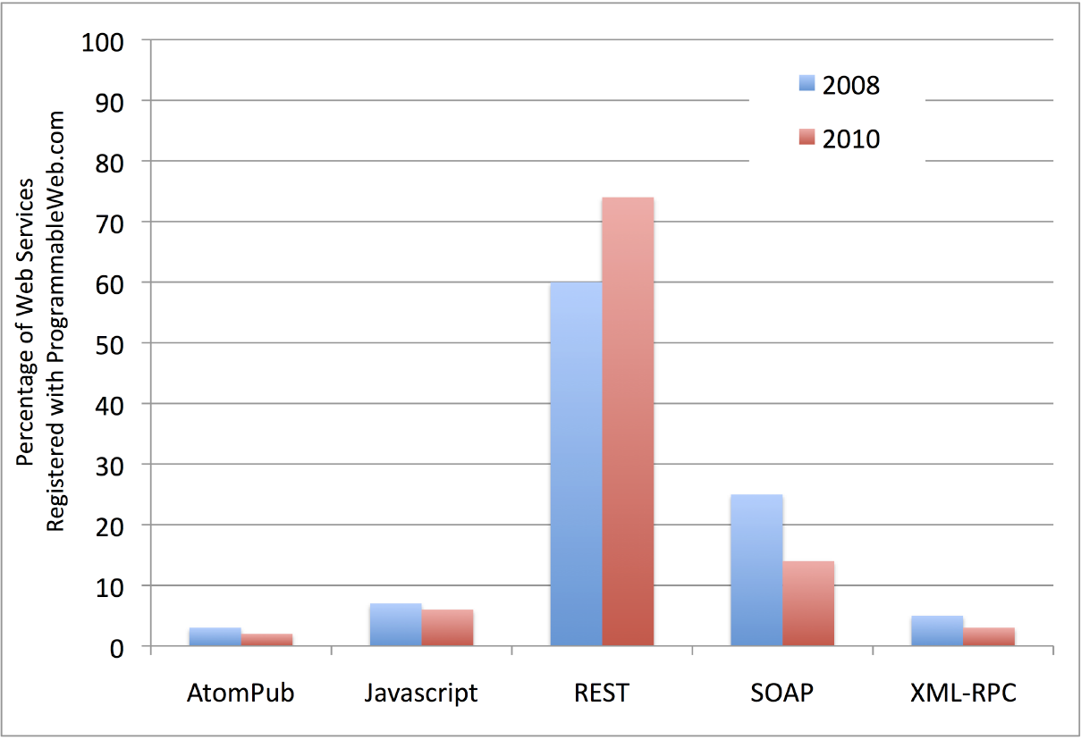
Why REST
Easy to implement
Scalability
Lightweight
Good performance
Popularity
Popularity of webservices registered to Programmableweb [1]
Notes:
REST is used exponentially more

Slide 11


Test-the-REST [4]
First testing system proposed for RESTful w.s. by Chakrabarti and Kumar 2009 [4].
They developed a testing framework capable of
Functional/non-functional testing
Automatic test case generation
Extensible architecture by external plugins
Main contribution on test specification language that has many capabilities e.g. reusable, composable test cases.
Nowadays, many alternatives exist
Notes:
TTR = Testing framework
Considering this paper is 2009, the very basic principle of testing is as shown in the graph

Slide 12
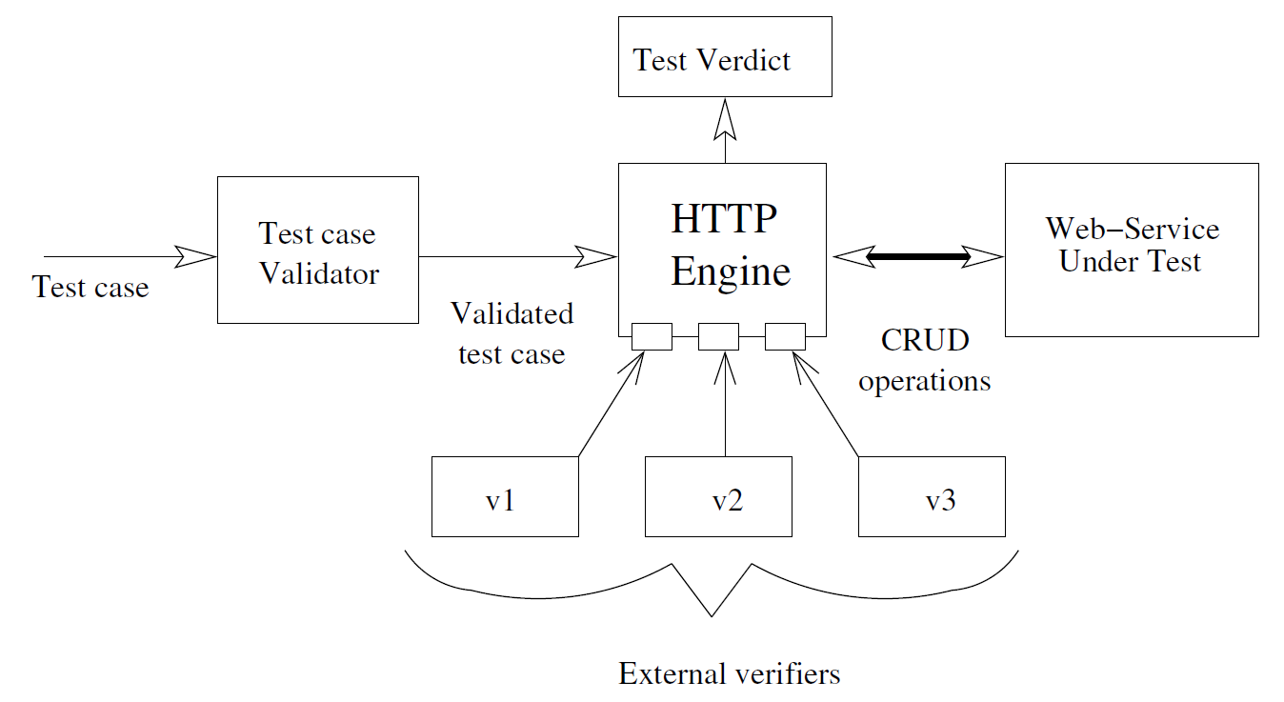
Test-the-REST [4]
General architecture of TTR, Chakrabarti and Kumar 2009 [4]
Notes:
Test case goes through the Sanity check in test case validator
HTTP responses are validated with external verifiers e.g. XML validator plugin

Slide 13
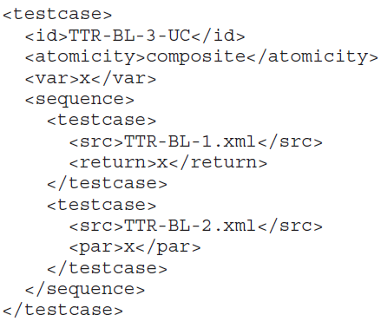
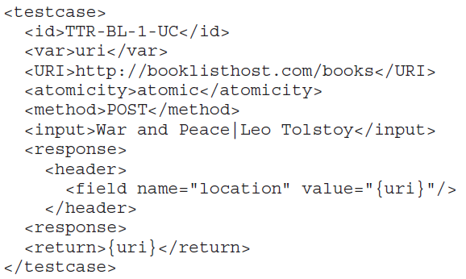
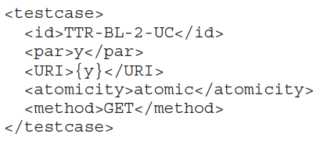
Test-the-REST [4] – Use case testing of Book-List service
Create a book
Read a book
Create then read the book
Notes:
Test case specification language,
WADL: Web application development language. Markup language

Slide 14
Test-the-REST [4] - Results
Tested in an in-house web service (book reservation)
200-300 test cases defined
Test execution takes 5 minutes
Weekly 5-10 test cases failed (It works!)
Exhaustive test case generation performed
42,067 test cases generated and 38,016 are failed
Only use case testing performed
Inadequate quantitave data, they say it just works and useful

Slide 15
Connectedness testing [6]
REST is all about resources – URIs
Presence of connectedness has practical implications
How to ensure every resource is reachable from the base resource
Chakrabarti and Rodriquez 2010 [6] propose an algorithm to test connectedness of RESTful w.s
A web service is connected,
if there is one-to-one mapping
between
referenced URI list and
visited URI list
Notes:
URI=resources should be reachable
Testing specific feature of web service = connectedness

Slide 16
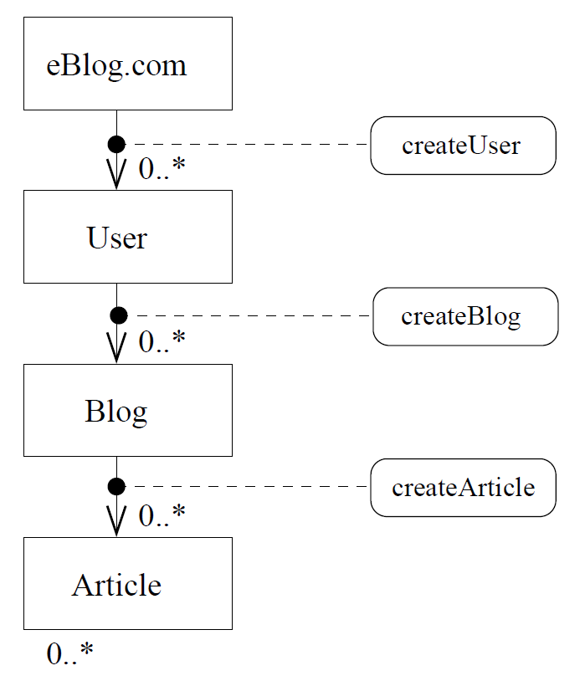
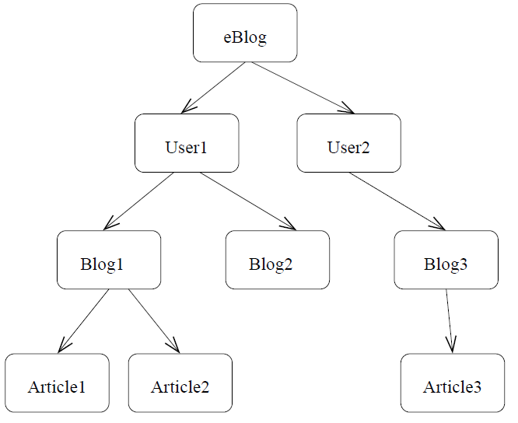
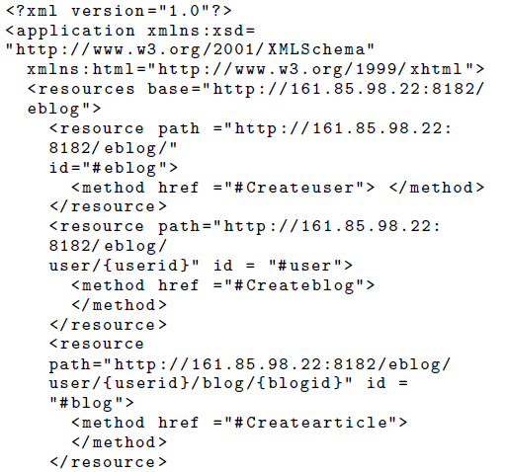
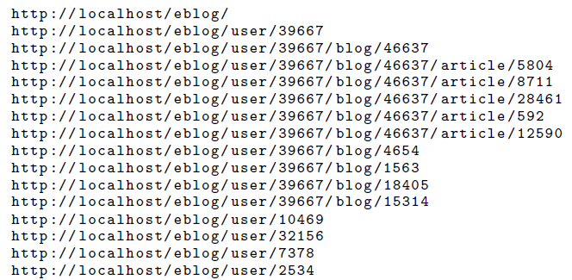
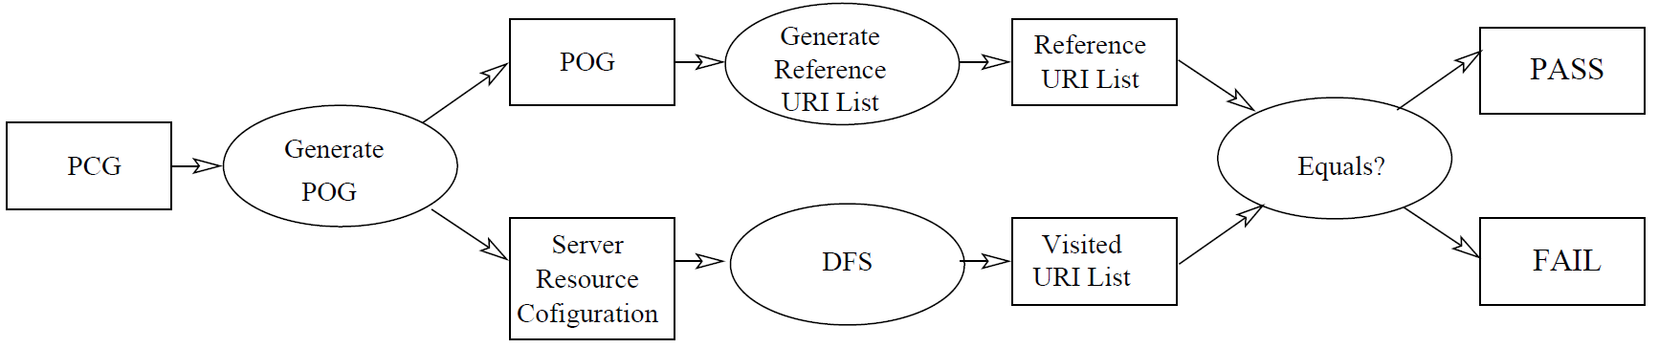
Connectedness testing [6] - Algorithm
Analyze the PCG and generate an appropriate server-side resource scenario and a POST object graph (POG).
Generate reference URI list from the POG.
Generate visited URI list by doing a DFS on the webservice (GET request on base URI -> extract URIs on the response -> recurse).
Compare “Reference URI” and “Visited URI”.

Slide 17
Connectedness testing [6] - Result
Experiments conducted in in-house prototype called eblog.
The approach can detect whether if a web service is connected or not.
Not so detailed experiment conducted
No performance measurements, comparison etc.
There are a few alternatives: Xenu, LinkTiger, Audisto
Seems immature compared to existing alternatives
Not production ready!
Notes:
Again not so good evaluation

Slide 18
MBT using UML protocol state machine [7]
Pinheiro et al. employs a model-based testing approach
Developer models a specific behaviour of the system (e.g using graphs/UML) and tests it.
System generates test cases automatically for state and transition coverage criteria
Complicated to implement
There is no experimental evaluation
Some alternatives: GraphWalker, SpecExplorer, NModel
Notes:
Different testing method = Model-based testing

Slide 19
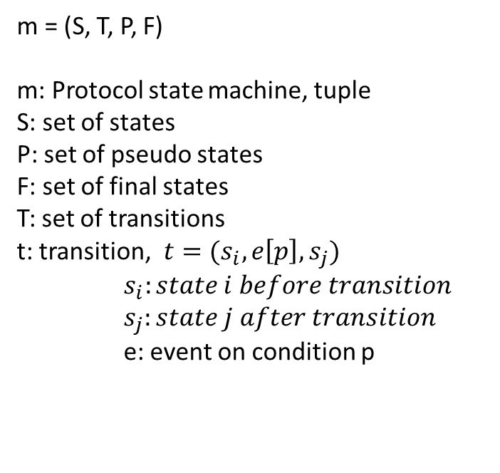
m = (S, T, P, F)
m: Protocol state machine, tuple
S: set of states
P: set of pseudo states
F: set of final states
T: set of transitions
t: transition,$t=(s_{i}, e\left[p\right], s_{j})$ $s_{i}:state i before transition$
$s_{j}:state j after transition$
e: event on condition p
Figure 1 illustrates a protocol state machine model for a RESTful service that manages a hotel room booking [7]
Notes:
Protocol state machine defined as this, explain the meanings
Initial1,2 etc are pseude states

Slide 20
Notes:
XMI: XML Metadata Interchange

Slide 21
REST service testing based on inferred XML schemas[8]
Navas et al. [8] propose a black-box automatic error detection system for RESTful w.s. based on statistical information.
Method tests w.s. without knowing its full specification
The core component is ”inferencer”
Input: XML Documents -> generate the corresponding XSD (XML Schema Def.)
New research direction for Machine-learning algorithms
Clustering, supervised learning and so on
First decent experimental evaluation until now (1/4 papers)
Google places API (real world), 1 in-house web service

Slide 22
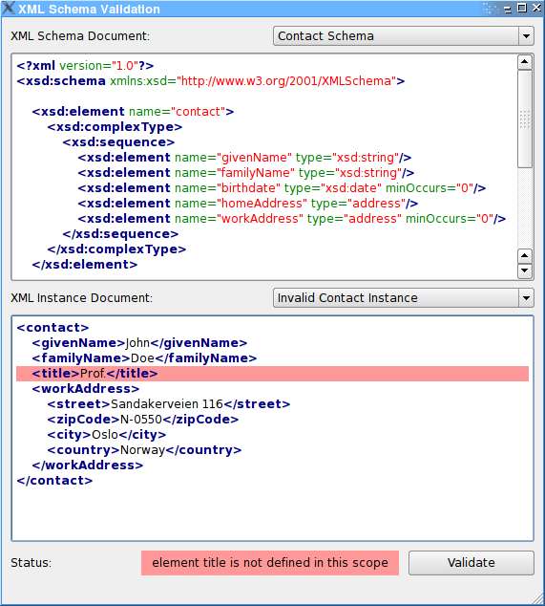
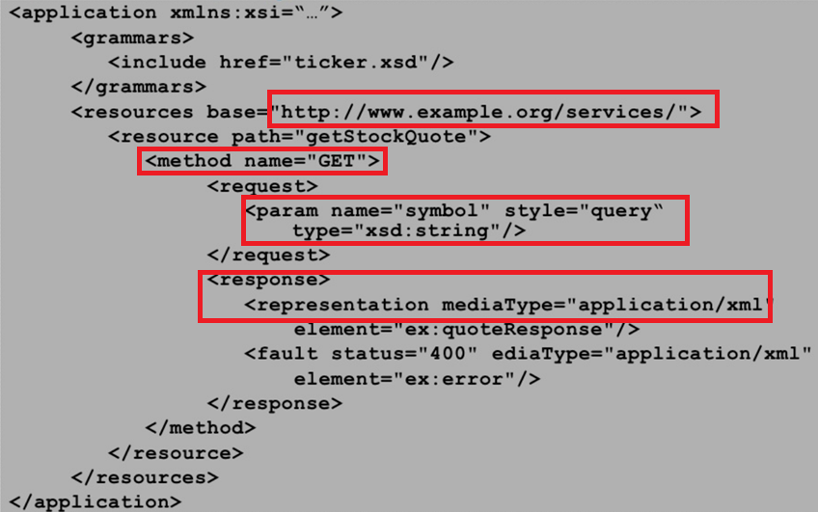
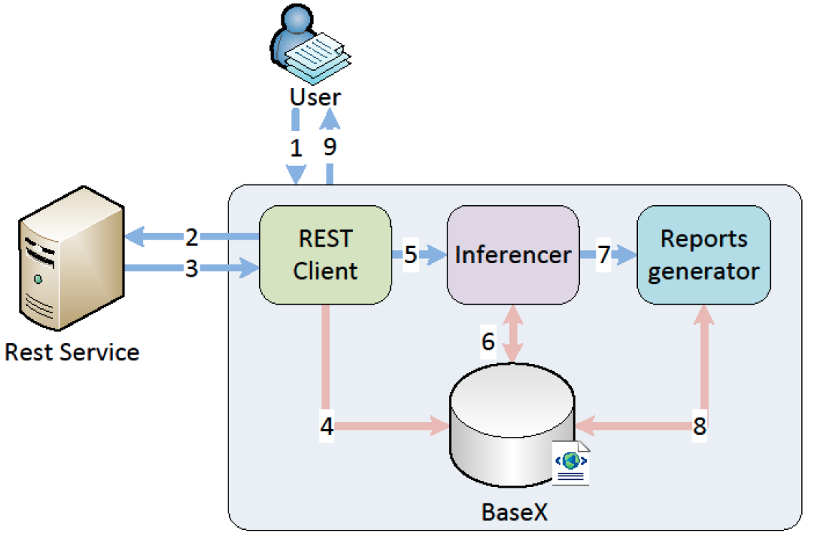
Input: set of test documents of test URL, HTTP method, parameters etc.
REST client reads the data and generates requests
Service makes an XML document for each response
Stores the XML documents in database
Inferencer module generates XSD from XML documents and collect statistics
Report generator checks for anomalies
Syntactic level: Traverse XSD and check the counts of elements
Semantic level: Check variance, mode, max/min of each element per file (probability distribution.)
Notes:
XSD (XML Schema Definition)
Input is a dataset made up of a test URL and HTTP method for the tested service, and a set of parameters to adjust the request. The larger this dataset, the better the quality of the anomaly detection and inferred XSD will be.
XSD’s purpose is to validate the structure of another xml document.

Slide 23
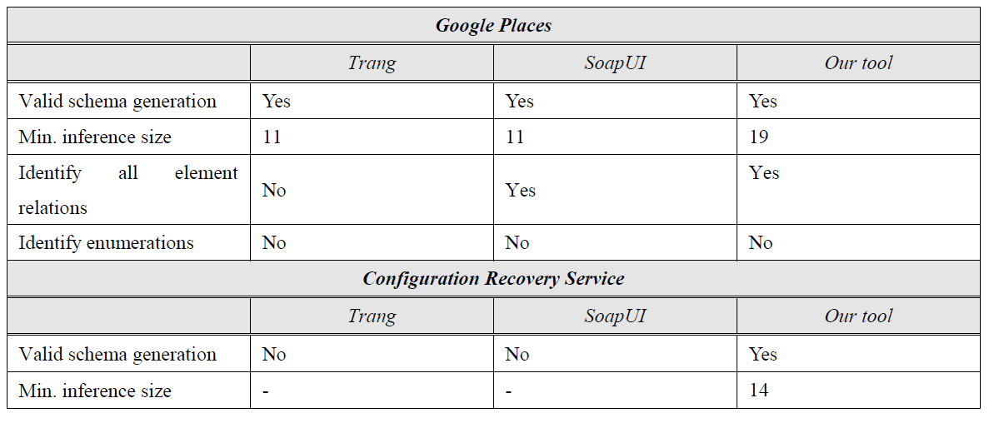
REST service testing based on inferred XML schemas[8]
Inferencer results
Surpasses existing tools
Anomaly detection result (only in 2nd w.s.)
Detects outliers by 56.25% precision rate (9/16).
Notes:
XSD (XML Schema Definition)

Slide 24
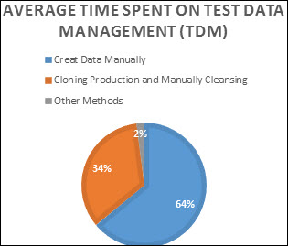
RESTful API automated test case generation[9]
Creating test case data is trivial and tedious job
64% of time spent to create test data (IBM 2016)
RQ1: How is it possible to generate test cases
automatically for RESTful web services?
RQ2: How to create feasible test suites?
Andrea Arcuri [9] presents a method to generate test cases for RESTful w.s. automatically using Evolutionary algorithm (anoth.
White-box testing
Tool can find bugs in the system and provide coverage
Average time spent on TDM: http://www.softwaretestinghelp.com/tips-to-design-test-data-before-executing-your-test-cases/

Slide 25
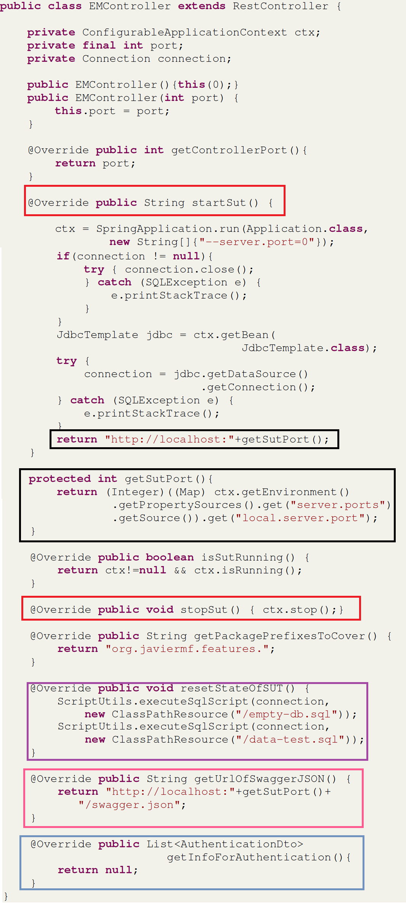
Step 1: Configuration of the system under test (SUT)
- The tool itself is a library
SUT starter/stopper
SUT location related configs: address, port
SUT needs reset for database operations
Swagger configuration
Authentication

Slide 26

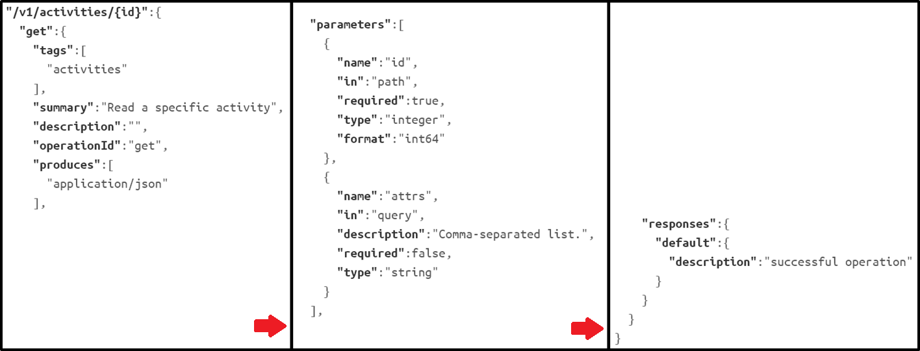
Step 2: Test case generation:
Step 2.1 Definition of the test case
Once we have configured the system, it can generate documentation using Swagger.
Extracted JSON definition of GET operation on /v1/activities/id,
its parameters, and the response defined in [9]
Notes:
evolve test suites, we use the Whole Test Suite. A
GA individual will be a set of test cases, randomly initialized. The fitness of a test suite is
the aggregated fitness of all of its test cases. The crossover
operator will mix test cases from two parent sets when new
offspring are generated. The mutation operator will do small
modifications on each test case, like increasing or decreasing
a numeric variable by 1.

Slide 27
Step 2: Test case generation:
Step 2.2 Validation of a test case
Validation using HTTP return codes (1XX, 2XX, 3XX, 4XX, 5XX)
(Assumption) Any 5XX return code is a bug
For example:
Wrong user input returns 403 (unauthorized) response code = not a bug in the server
Any problem in the logic would throw 5XX (e.g. 500 internal server error)
Does not hold if resource retrieval is proceed without a check (raises an exception). Returns 500, but it should be 404 (Not found)
Notes:
evolve test suites, we use the Whole Test Suite. A
GA individual will be a set of test cases, randomly initialized. The fitness of a test suite is
the aggregated fitness of all of its test cases. The crossover
operator will mix test cases from two parent sets when new
offspring are generated. The mutation operator will do small
modifications on each test case, like increasing or decreasing
a numeric variable by 1.

Slide 28
Step 2: Test case generation:
Step 2.3 Generation of the test cases
Software testing as an optimization problem:
Maximize the code coverage and fault detection of the generated test suites.
Once a fitness function is defined, evolutionary algorithm can explore the search space
Algorithm (briefly):
Evolve test suites using Whole Test Suite
Genetic Algorithm individual is set of test cases, randomly initialized.
Crossover operator mixes test cases from two parent sets (new generation)
Mutation operator makes small modifications on each test case (e.g +/- numbers by 1)
The evolution ends when
Optimal individual is evolved
Or has run out of search space
Notes:
evolve test suites, we use the Whole Test Suite. A
GA individual will be a set of test cases, randomly initialized. The fitness of a test suite is
the aggregated fitness of all of its test cases. The crossover
operator will mix test cases from two parent sets when new
offspring are generated. The mutation operator will do small
modifications on each test case, like increasing or decreasing
a numeric variable by 1.

Slide 29
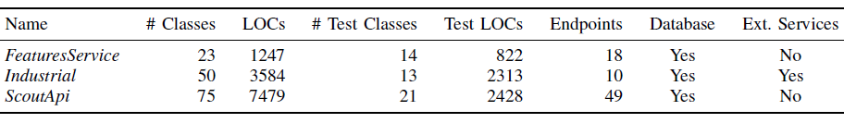
RESTful API automated test case generation[9]
Three open source w.s. chosen for experimental evaluation of the method [9]
Notes:
ENDPOINTS: THE NUMBER OF EXPOSED RESOURCES AND HTTP METHODS
APPLICABLE ON THEM

Slide 30
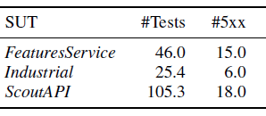
RESTful API automated test case generation[9]
Number of test cases generated and bugs found in total [9]
Notes:
ENDPOINTS: THE NUMBER OF EXPOSED RESOURCES AND HTTP METHODS
APPLICABLE ON THEM

Slide 31
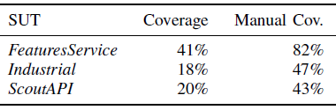
RESTful API automated test case generation[9]
Statement coverage results for the generated tests compared to the
ones obtained by the already existing, manually written tests [9]
Notes:
Automated coverage result is less than manual
Mutation takes place only in one direction
Not feasible for continuous testing

Slide 32
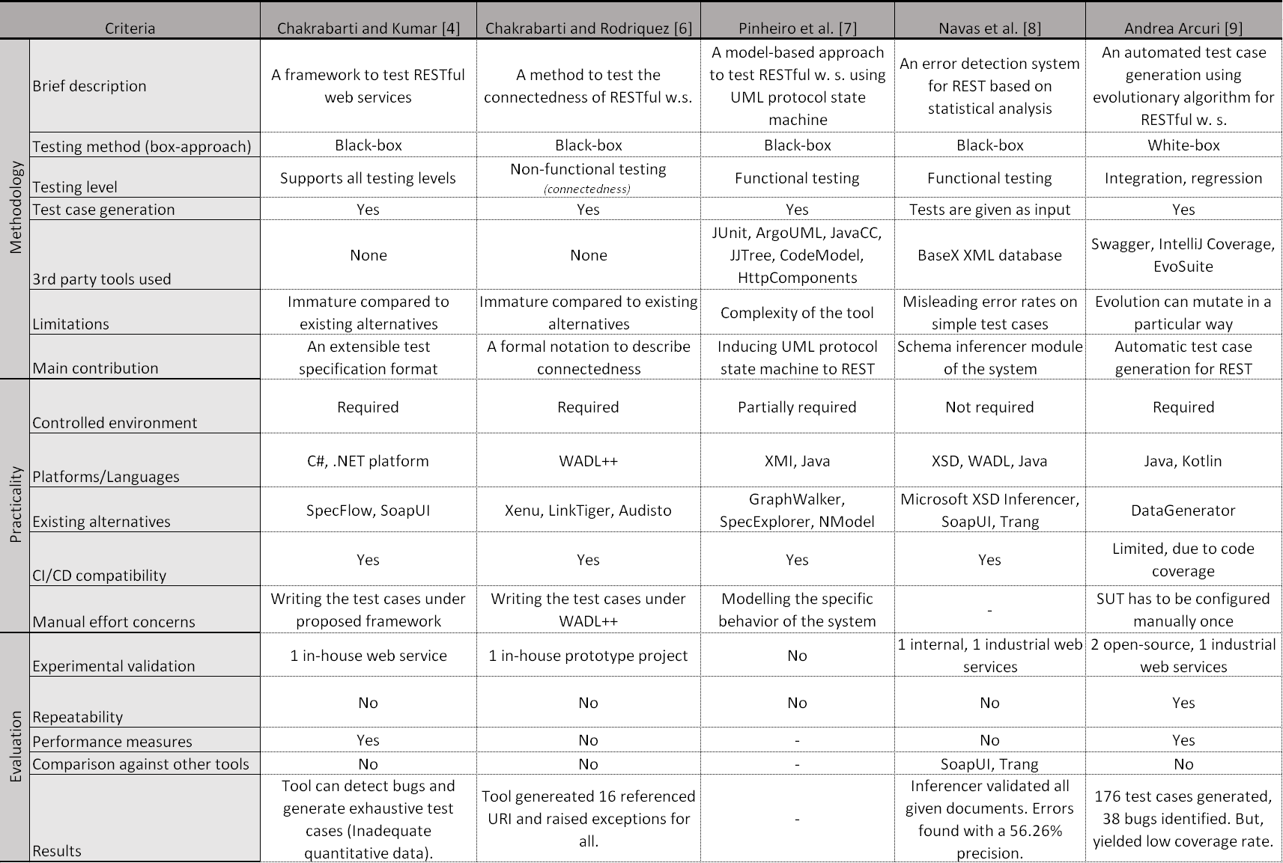

Slide 33
Lack of evaluation in SOA testing
Types of case studies used in experiments by Bozkurt et al. 2008 [5]
Notes:
Total of 177 papers

Slide 34
Conclusion
There is no one size-fits ALL solution
Most of the evaluation of the testing systems are lacking
More standard way is needed!
Common test bed services as a benchmark
Performance measurements
Open source it!
Do not re-invent the wheel, try to use open source applications and build on top of it e.g. SOAPUI
Machine learning gets in use, which will lead to new research directions
Notes:
How presentation will benefit audience: Adult learners are more interested in a subject if they know how or why it is important to them.
Presenter’s level of expertise in the subject: Briefly state your credentials in this area, or explain why participants should listen to you.

Slide 35
Thank you for listening!
Questions?
Notes:
How presentation will benefit audience: Adult learners are more interested in a subject if they know how or why it is important to them.
Presenter’s level of expertise in the subject: Briefly state your credentials in this area, or explain why participants should listen to you.

Slide 36
References
[1] ProgrammableWeb, Programmableweb is an information and news source about the web as a programmable platform, 2005.
[2] G. Canfora and M. Di Penta, Service-oriented architectures testing: A survey, Software Engineering, pp. 78105, 2009.
[3] M. Bozkurt, M. Harman, and Y. Hassoun, Testing and verification in service-oriented architecture: a survey, Software Testing, Verification and Reliability, vol. 23, no. 4, pp. 261313, 2013.
[4] S. K. Chakrabarti and P. Kumar, Test-the-rest: An approach to testing restful web-services, in Future Computing, Service Computation, Cognitive, Adaptive, Content, Patterns, 2009. COMPUTATIONWORLD'09. Computation World: , pp. 302308, IEEE, 2009.
[5] G. Canfora and M. Di Penta, Testing services and service-centric systems: Challenges and opportunities, IT Professional, vol. 8, no. 2, pp. 1017, 2006.
[6] S. K. Chakrabarti and R. Rodriquez, Connectedness testing of restful webservices, in Proceedings of the 3rd India software engineering conference, pp. 143152, ACM, 2010.
[7] P. V. P. Pinheiro, A. T. Endo, and A. Simao, Model-based testing of restful web services using uml protocol state machines, in Brazilian Workshop on Systematic and Automated Software Testing, 2013.
[8] A. Navas, P. Capelastegui, F. Huertas, P. Alonso-Rodriguez, and J. C. Dueñas, Rest service testing based on inferred xml schemas, Network Protocols and Algorithms, vol. 6, no. 2, pp. 621, 2014.
Notes:
How presentation will benefit audience: Adult learners are more interested in a subject if they know how or why it is important to them.
Presenter’s level of expertise in the subject: Briefly state your credentials in this area, or explain why participants should listen to you.

Slide 37
References
[9] A. Arcuri, Restful api automated test case generation, in Software Quality, Reliability and Security (QRS), 2017 IEEE International Conference on, pp. 9 20, IEEE, 2017.
[10] WebInject, Webinject is a free tool for automated testing of web applications and web services, 2004.
[11] G. Fraser and A. Arcuri, Whole test suite generation, IEEE Transactions on Software Engineering, vol. 39, no. 2, pp. 276291, 2013.
[12] SmartBear, The complete api test automation framework for soap, rest and more, 2005.
Notes:
How presentation will benefit audience: Adult learners are more interested in a subject if they know how or why it is important to them.
Presenter’s level of expertise in the subject: Briefly state your credentials in this area, or explain why participants should listen to you.

