Slide 1
Testing and Verification of RESTful Web Services
Ege Can Özer
Notes:
My job is to maintain and improve a testing software at work
My motivation is to learn other means of techniques regarding software testing
For this seminar I have picked the topic of Testing and Verification of RESTful W.S.

Slide 2
Outline
Background
Test-the-rest: An approach to testing RESTful web services[4]
Connectedness testing of RESTful w.s. [6]
Model-based testing of RESTful w.s. using UML protocol state machines[7]
REST service testing based on inferred XML schemas[8]
RESTful API automated test case generation[9]
Summary
Conclusion
Notes:
Here is the outline of the presentation
In both of my peer review the lack of background information addressed, So I will talk about it that
What is REST
Some Testing methods
My seminar is similar to review paper but I have only covered 5 papers. Explain these
I will summarize in a big table, comparing them briefly
I will conclude with the findings

Slide 3
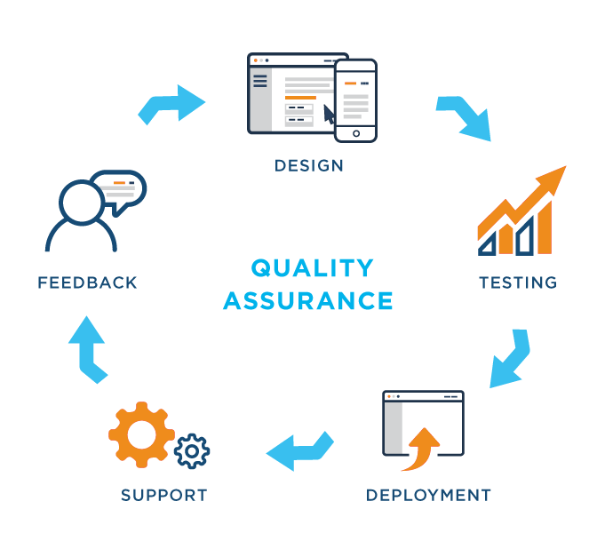
Testing is important!
Bugs are nature of software development
Testing helps to find defects
Ensures,
Quality of the product
Effective performance
But,
Time consuming
Testing challenges varies

Slide 4

Testing Levels
Canfora and Di Penta 2006
Functional testing:
Non-functional testing:
Regression testing
Integration testing

Slide 5

Functional testing
Testing software’s FEATURE
Unit testing
Sanity
Localization
Interoperability
And so on …

Slide 6

Non-functional testing
Testing software’s PROPERTY
Load testing
Performance
Security
Volume
Stress
And so on...

Slide 7

Regression testing
Wikipedia definition:
Regression testing is a type of software testing which verifies that software which was previously developed and tested still performs the same way after it was changed or interfaced with other software
Regression
“When you fix one bug, you introduce several newer bugs.”

Slide 8

Integration testing
Wikipedia definition:
Integration testing is the phase in software testing in which individual software modules are combined and tested as a group

Slide 9
What is REST?
Representational State Transfer
Not a protocol, but an architectural guideline
Stateless
URIs
GET /products
GET /products?k=v
POST /products
GET /products/{id}/price
DELETE /products/{id}
GET PUT POST DELETE
JSON XML HTML JPG …
Notes:
Stateless:
By stateless it means that the server does not store any state about the client session on the server side. The client session is stored on the client. The server isstateless means that every server can service any client at any time, there is no session affinity or sticky sessions.

Slide 10
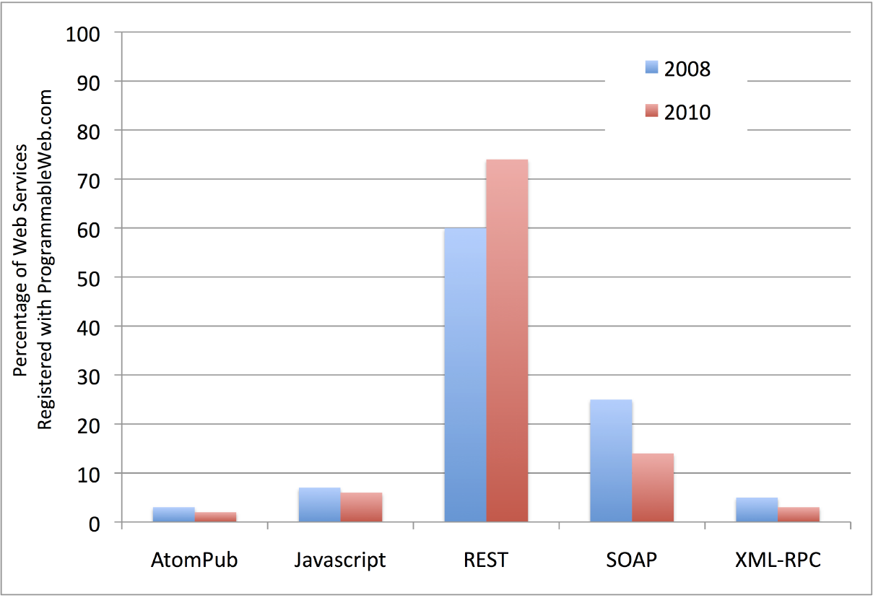
Why REST
Easy to implement
Scalability
Lightweight
B
Popularity

Slide 11
Testing challenges in REST
Distributedness
Headless
Lack of transparency
Loose-coupling
Lack of reliability of WWW as a common communication framework
3rd party w.s. and applications makes testing more complicated

Slide 12


Test-the-REST [4]
First testing system for RESTful w.s. by Chakrabarti and Kumar 2009 [4].
They developed a testing framework capable of
Functional/non-functional testing
Automatic test case generation
Extensible architecture by external plugins
Main contribution on test specification language that has many capabilities e.g. reusable, composable test cases.
Nowadays, many alternatives exist

Slide 13
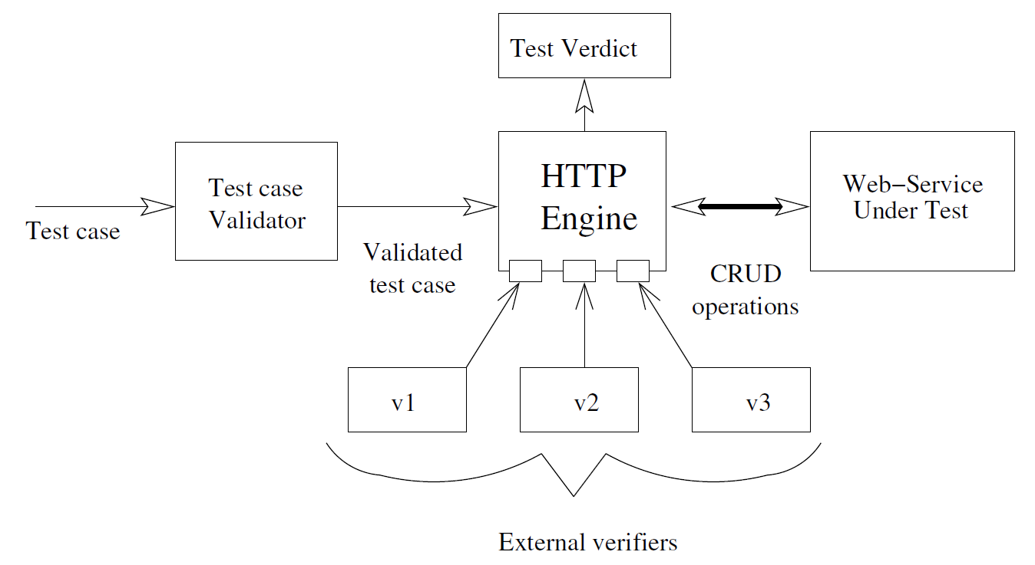
Test-the-REST [4]
General architecture of TTR, Chakrabarti and Kumar 2009 [4]
Notes:
Considering this paper is 2009, the very basic principle of testing is as shown in the graph
Test case goes through the Sanity check in test case validator
HTTP responses are validated with external verifiers e.g. XML validator plugin

Slide 14
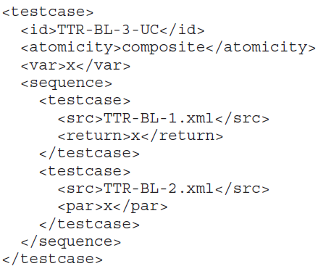
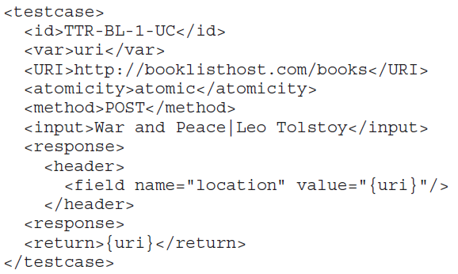
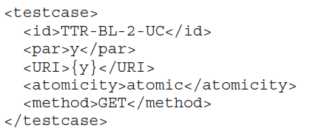
Test-the-REST [4] – Use case testing of Book-List service
Create a book
Read a book
Create then read the book
Notes:
Inspired WebInject’s Test case specification language,
WADL: Web application development language. Markup language

Slide 15
Test-the-REST [4] - Results
Tested in in-house web service
200-300 test cases defined
Test execution takes 5 minutes
Weekly 5-10 test cases failed (It works!)
Exhaustive test case generation performed
42,067 test cases generated and 38,016 are failed
Only use case testing performed
Inadequate quantitave data, they say it just works and useful

Slide 16
Connectedness testing [6]
REST is all about resources – URIs
How to ensure every resource is reachable from the base resource
Presence of connectedness has practical implications
Chakrabarti and Rodriquez 2010 [6] propose an algorithm to test connectedness of RESTful w.s
A web service is connected,
if there is one-to-one mapping
between
referenced URI list and
visited URI list
Notes:
In the context of RESTful web-services, connectedness refers to the property wherein every resource in the web-service is reachable from the base resource by successive HTTP GET requests. Presence (or absence) of connectedness has practical implications and hence is an important property of RESTful web-services.

Slide 17
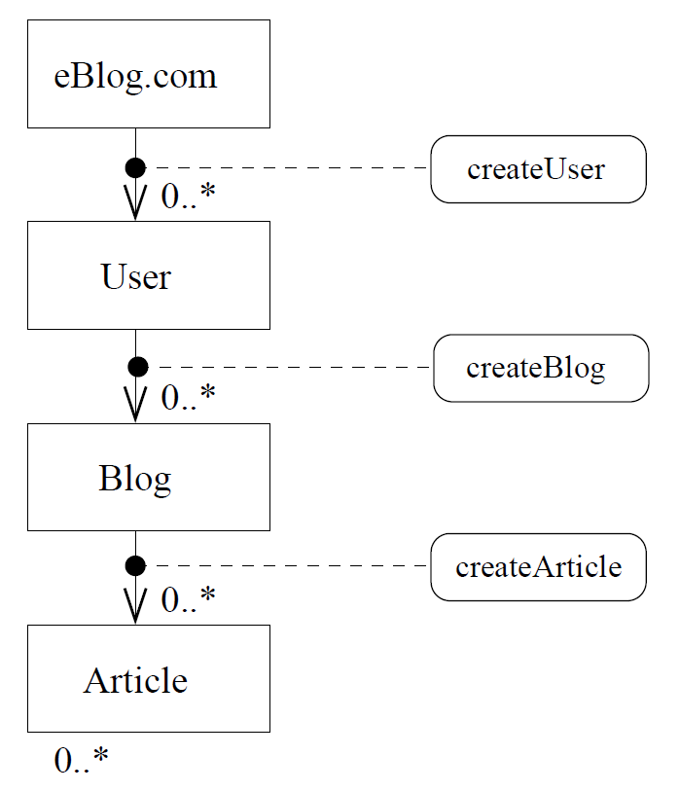
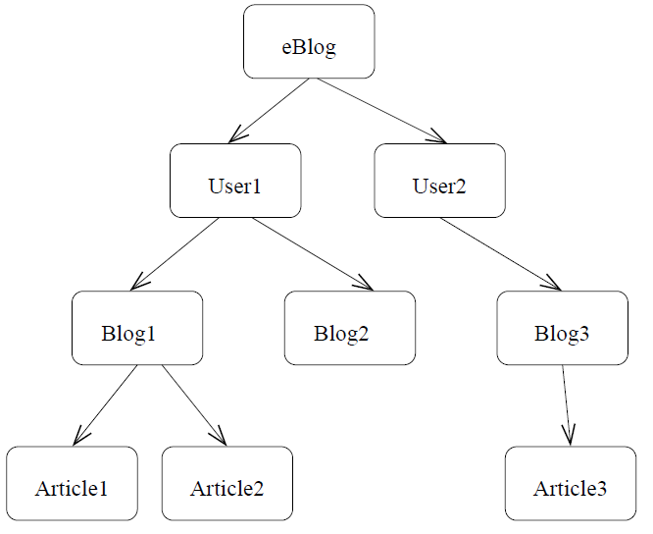
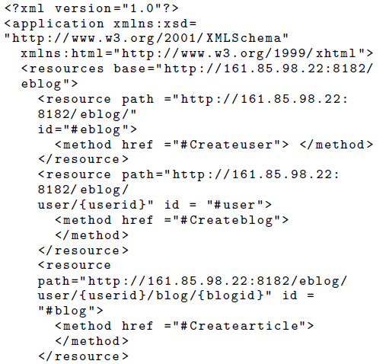
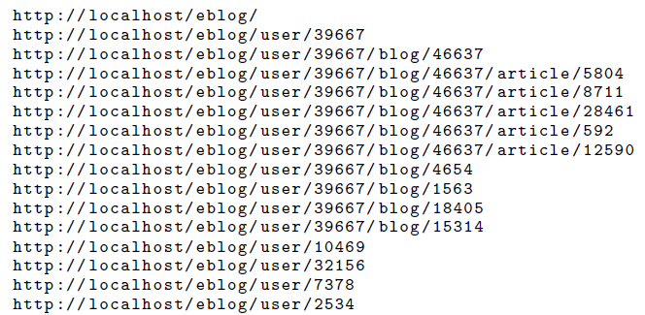
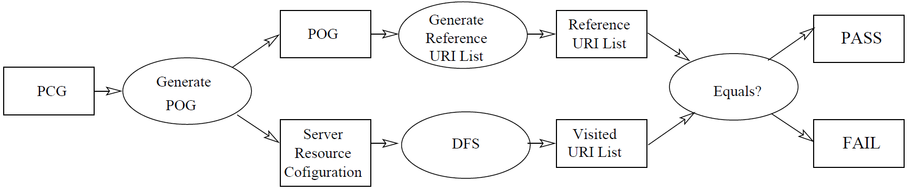
Connectedness testing [6] - Algorithm
Analyze the PCG and generate an appropriate server-side resource scenario and a POST object graph (POG).
Generate reference URI list from the POG.
Generate visited URI list by doing a DFS on the webservice (GET request on base URI -> extract URIs on the response -> recurse).
Compare “Reference URI” and “Visited URI”.

Slide 18
Connectedness testing [6] - Result
Experiments conducted in in-house prototype called eblog.
The approach can detect whether if a web service is connected or not.
Not so detailed experiment conducted
No performance measurements, comparison etc.
There are a few alternatives: Xenu, LinkTiger, Audisto
Seems immature compared to existing alternatives
Not production ready!

Slide 19
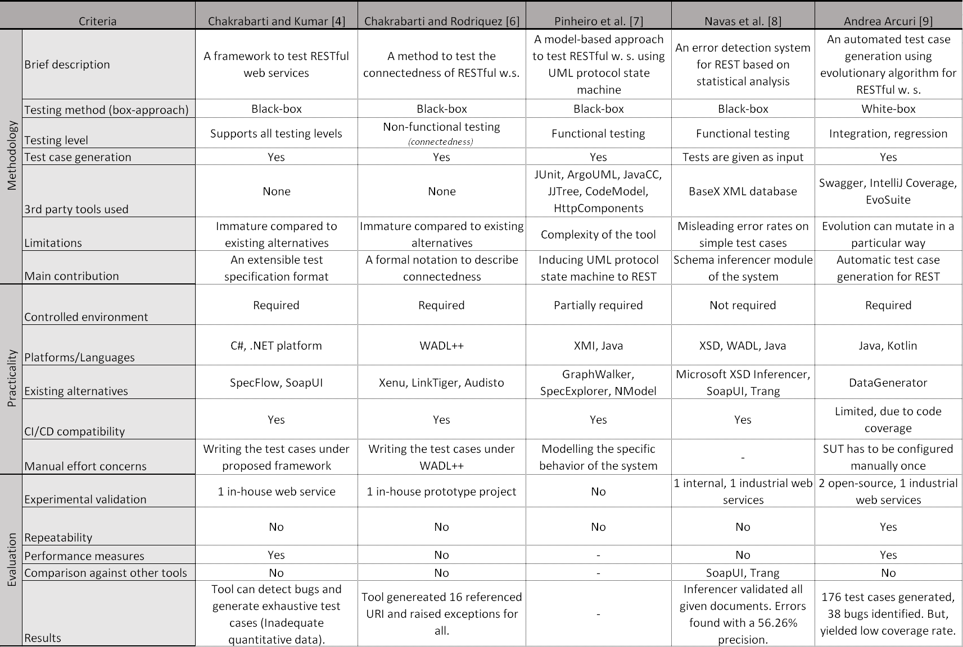

Slide 20
Lack of evaluation in SOA testing
Bozkurt et al. 2008 [5]
Notes:
Total of 177 papers

Slide 21
Conclusion
There is no one size-fits ALL solution
Most of the evaluation of the testing systems are lacking
More standard way is needed!
Common test bed services as a benchmark
Performance measurements
Open source it!
Do not re-invent the wheel, try to use open source applications and build on top of it e.g. SOAPUI
Machine learning gets in use, which will lead to new research directions
Notes:
How presentation will benefit audience: Adult learners are more interested in a subject if they know how or why it is important to them.
Presenter’s level of expertise in the subject: Briefly state your credentials in this area, or explain why participants should listen to you.

Slide 22
Thank you for listening!
Questions?
Notes:
How presentation will benefit audience: Adult learners are more interested in a subject if they know how or why it is important to them.
Presenter’s level of expertise in the subject: Briefly state your credentials in this area, or explain why participants should listen to you.

Slide 23
References
[1]
[2]
[3]
[4]
[5]
[6]
[7]
[8]
[9]
[10]
Notes:
How presentation will benefit audience: Adult learners are more interested in a subject if they know how or why it is important to them.
Presenter’s level of expertise in the subject: Briefly state your credentials in this area, or explain why participants should listen to you.

