Slide 1
A Bundle Storage Implementation
Brian Tomko

Slide 2
Read Operations
For a given specified set of available destination node IDs, find (from these IDs) the bundle that has the highest priority (00 = bulk, 01 = normal, 10 = expedited) with the lowest “absolute expiration time”. A higher priority bundle will always be chosen over a “lower priority bundle that is about to expire”.
Read bundle metadata, part of the bundle, or all of the bundle.
After reading, optionally mark the bundle on the disk for deletion (mark it over-writeable).
Optionally restore from disk in event of program restart.

Slide 3
Write Operations
For a given bundle, instantly reserve the necessary amount of 4KB segments required to store the bundle using the “Segment Allocator”.
When the user of the storage is ready, write all or part of the bundle to disk.
When the bundle is completely written to disk, update the internal “Bundle Bookkeeping” data structures so that the bundle can be ready to read.

Slide 4
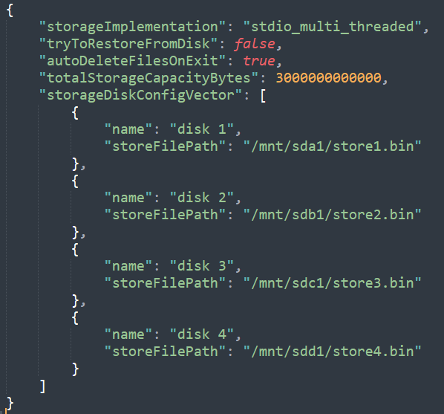
Config File Example (3TB split across 4 drives)

Slide 5
Architecture (implementation=stdio_multi_threaded)
SSD 0
“data_0.bin”
Stores segments:
(SegID % n) == 0
SSD 1
“data_1.bin”
Stores segments:
(SegID % n) == 1
SSD n-1
“data_n-1.bin”
Stores segments:
(SegID % n) == (n-1)
…
Thread I/O function calls:
fopen
fread
fwrite
fseek
Windows: _fseeki64_nolock
POSIX: fseeko64
Each SSD requires any filesystem that is approximately the same size.
Minimum of 1 SSD is required.
…
Thread 0
Thread 1
Thread n-1
…
Circular Buffers,
Condition Variable
Circular Buffers,
Condition Variable
Circular Buffers,
Condition Variable
Storage Controller Thread/API

Slide 6
Architecture (implementation=asio_single_threaded) Asynchronous I/O (Overlapped I/O)
I/O function calls Windows:
boost::asio::windows::random_access_handle
boost::asio::async_write_at
boost::asio::async_read_at
CreateFile (FILE_FLAG_OVERLAPPED)
I/O function calls Linux:
boost::asio::posix::stream_descriptor
boost::asio::async_write
boost::asio::async_read
lseek64
open
SSD 0
“data_0.bin”
Stores segments:
(SegID % n) == 0
SSD 1
“data_1.bin”
Stores segments:
(SegID % n) == 1
SSD n-1
“data_n-1.bin”
Stores segments:
(SegID % n) == (n-1)
…
boost::asio::io_service + 1 thread for boost::asio::io_service::run
…
Circular Buffers,
Callback Function,
Condition Variable
Circular Buffers,
Callback Function,
Condition Variable
Circular Buffers,
Callback Function,
Condition Variable
Storage Controller API

Slide 7
3TB benchmark across Four 1-TB SSDs, even mix of 4KB, 8KB, 2MB, 4MB, & 40MB bundles
Fill up ~3TB storage (write speed = 10.9 GBits/sec)
Read ~1.5TB storage (read speed = 6.33 GBits/sec)
Fill up ~1.5TB storage (write speed = 7.55 GBits/sec)
Read ~1.5TB storage (read speed = 6.31 GBits/sec)

Slide 8
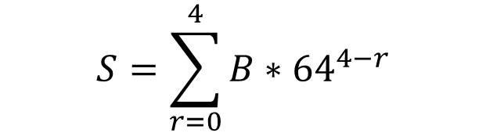
5 Row Segment Allocator Example
Assembly instruction optimization
x86: BSF — Bit Scan Forward
ARM: CLZ (Count Leading Zeros) and RBIT (Reverse bits)
Row 0: uint64_t[1]
Root Row 0 (64 bits)
10001...1111011000
Row 1: uint64_t[64^1]
Bit 3 of Row 0 (64 bits)
1001000...000
Bit 0 of Row 0 (64 bits)
000...00000000 (completely full)
1 denotes space free
0 denotes space allocated
5 rows => 64^5 = 1,073,741,824 4KB segments (4.3TB) using 137MB ram (big O 5 allocation time)
Row 2: uint64_t[64^2]
Bit 60 of Row 1 (64 bits)
1001000...01000000
Row 3: uint64_t[64^3]
Bit 6 of Row 2 (64 bits)
1001000...1010000
To find the first free segment “S”,
where “B” is the least significant 1 bit,
And “r” is the row index
$$S=\sum_{r=0}^{4}{B∗{64}^{4−r}}$$
Row 4: uint64_t[64^4]
Bit 1 of Row 3 (64 bits)
1001000...1000010

Slide 9
Bundle Bookkeeping (example)
Destination Link Map
[1,2,5,6,…21]
Priority Vector
[0,1,2]
Priority Vector
[0,1,2]
Absolute Expiration Time Map
[12311, 12222,…]
Absolute Expiration Time Map
[12345, 13355,…]
Here is a set of bundles with the same destination link ID, the same priority, and the same absolute expiration time
Chain Info Vector
[Bundle Chain 1, Bundle Chain 2,…]
Chain Info
{Bundle Size bytes, Segment Id chain Vec}
32-bit Segment Id’s Chain Vec
[4KB Seg1 (22), 4KB Seg2 (18), …]

Slide 10
4096-Byte Segment on Disk
Bundle Size Bytes (64-bit little endian)
A “Next Segment ID” of UINT32_MAX denotes the last segment of the bundle.
A bundle is deleted from disk by writing UINT64_MAX to bundleSizeBytes of first logical segment.
Only the first segment of a bundle has a bundle size value that is not UINT64_MAX.
Assigned Custody ID present/duplicated for every segment
These rules enable restoring/rebuilding the “Segment Allocator Data Structure” and the “Bundle Bookkeeping Data Structures” from disk after reboot or power loss, which is currently implemented in the code.
Next Segment ID (32-bit little endian)
Bundle Data (4084 bytes)
Assigned Custody Id(64-bit little endian)

