Slide 1
SIL Technical Overview

Slide 2
SIL Overview
cFS External Code Interface (ECI) integrates existing/autogenerated code as a cFS application via a set of generic wrapper code and an interface definition
See https://github.com/nasa/ECI
The Simulink Interface Layer (SIL) extends the Simulink code generation pipeline to produce an ECI-compatible interface definition for the code generated from a Simulink model

Slide 3
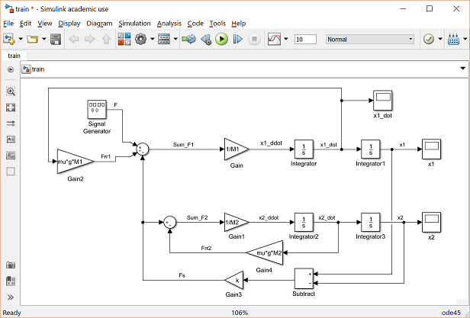

SIL and Code Generation
The SIL extends the Simulink code generation process via a custom TLC file (csl_ert.tlc) to generate an interface definition (eci_interface.h) which is compiled with the ECI to produce a cFS app
<mdl_name>.c
<mdl_name>.h
eci_interface.h
<mdl_name>.o
cFS Application
Simulink Code Generation
App Compilation
Simulink Model
cfs_ert.tlc
eci_app.c
eci_app.h
SIL Customization
ECI Wrapper Code
Notes:
The code generation produces a eci_interface.h file specific to that Simulink application
Each Simulink application is compiled with the SIL code to create a cFS application.

Slide 4
ECI App Interfaces

Slide 5
ECI Features
ECI provides following features to external code:
Execution Management
Message I/O
Table Management
cFS Event Messaging
Status Reporting
cFS Time

Slide 6
ECI Execution Management
ECI supports a step function and optional initialization and termination functions
Init
Called on app startup (optional)
Step
Called each cycle upon receipt of TICK message
Usually from scheduler, can be from other cFS apps
Executes algorithms
Term
Called on app shutdown (optional)

Slide 7
ECI Input Messages
ECI handles interface with cFS software bus
Subscribes to defined message ID’s
Wakes up on tick message to perform processing
Receives telemetry messages and forwards to Simulink application for processing
Receives and queue’s command messages:
Executes ECI commands
Forwards other commands to Simulink application for execution
Maintains counters on all messages received, per APID
Maintains command rejection and execution counters

Slide 8
ECI Output Messages
ECI handles interface with cFS software bus
Registers defined output message ID’s
Telemeters status flags
Issues HK messages on receipt of HK request
Outputs telemetry messages from Simulink application
Fills headers of outgoing messages
Allows for asynchronous/periodic messaging

Slide 9
ECI Table Management
ECI applications may have multiple tables:
Zero or one state tables
Arbitrary number of parameter tables
State Tables:
Holds internal state information for app
Dump-only (written to a file using the cFE Table Services interface)
Parameter Tables:
Holds tunable parameters for app
May be loaded or dumped from a file using the cFE Table Services interface
Default tables are automatically loaded at initialization

Slide 10
ECI Event Messaging
ECI issues event messages via cFE Event Services
User-defined type, mask, and message
Issued when indicated by external code (via flag)

Slide 11
ECI Status Reporting
ECI collects, monitors, and telemeters status flags
Telemeters flags as bitfield
Maintains a set of latch flags to indicate if flag has tripped
Useful for loss of telemetry/telemetry downsampling
Latch enablable/clearable via command

Slide 12
ECI Time Retrieval
ECI gets cFS time (from Time Services) at time of app execution

Slide 13
SIL Interface Definitions

Slide 14
SIL Interfaces
SIL maps the following Simulink constructs to ECI app interfaces:
See integration guide for implementation steps
Simulink construct | Maps to | ECI Interface
Autogenerated initialization, execution, and termination functions | -> | cFS app lifecycle
Inport/Outport blocks and Simulink.Signal object | -> | messages received/sent via the cFE Software Bus
Simulink.Parameter objects | -> | parameters tables managed via cFE Table Services
Logical signals within model connected to event block | -> | status flags output for health/status checking by other cFS apps
Logical signals within model connected to status flag block | -> | trigger events via cFE Event Services
Signal output from cFS Time block | -> | current cFS time to model at time of execution

Slide 15
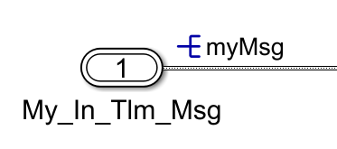
SIL Input Message Definition
Assignment of cfsPackage.Signal object designates root level inport as input message
Un-designated inports are ignored by SIL/ECI
ECI copies message (including header) from cFS Software bus into that inport for autocode to operate on
Notes:
Undesignated inputs are ignored and allow for simulation-only/analysis inputs/outputs

Slide 16
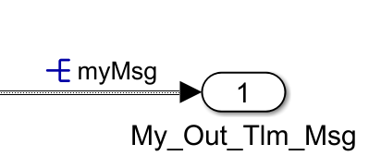
SIL Output Message Definition
Similar to input message definition…
Assignment of cfsPackage.Signal object designates root level outport as output message
Un-designated outports are ignored by SIL/ECI
ECI copies message from Simulink application, fills CCSDS header, and issues message onto cFS software bus

Slide 17

SIL Conditional Messaging
Block designates output message as conditional
Only sends message when flag input evaluates to true
Used for controlling rate of output generation (asynchronous/periodic messaging)

Slide 18
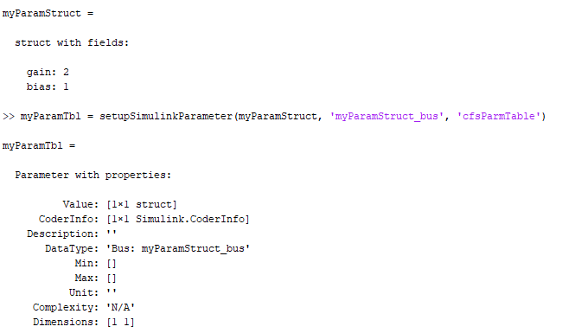
Table Definition
cfsPackage.Parameter objects wrap Matlab structure variable which is used throughout Simulink model
Each Parameter object corresponds to a separate table
Parameters organized by grouping into structures
Undesignated structures are ignored by SIL/ECI, hardcoded during code generation
Notes:
Ignored parameters allows tuning parameters in simulation-only if needed

Slide 19
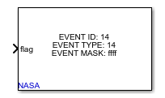
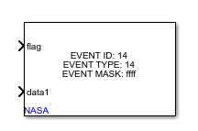
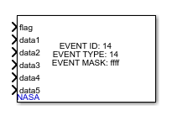
cFS Event Messaging
Simulink Library provides blocks which send cFS event message
Message is sent by ECI when ‘flag’ input signal evaluates to ‘true’
Block allows sending 0 to 5 pieces of supporting data with message
Supporting data is a value of a variable that is printed into the event message text

Slide 20
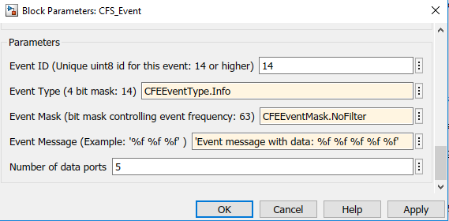
cFS Event Definition
Block supports user-defined message information:
Event ID: Unique ID for each event
Event Type: Indicates severity
Event Mask: Controls rate event is sent
Event Message: standard fprintf syntax that prints out the data fed into event.

Slide 21

Status Reporting
Simulink Library provides block to report status flags
Evaluates ‘flag’ signal to either true or false and telemeters as a bitfield

Slide 22

cFS Time
Block outputs current cFS time for use by algorithms

Slide 23
Under the hood…
Simulink Code Generation Background

Slide 24
Overview
Simulink is a graphical programming language which uses blocks as the basic structure of the code
Blocks correspond to an algorithm which operates on the input signals to produce the output signals
In order to run the model, code is converted to a standard textual language, compiled, and run
Need a process to convert blocks to snippets of code
TLC

Slide 25
TLC
Target Language Compiler (TLC) files control the expression of a model in another language
Can have multiple TLC’s to express model in multiple languages
C is most common, also Fortran, C++
TLC’s are hierarchical, like models:
Higher level system TLC’s control architecture/organization of code
Call lower-level block TLC’s which emit algorithms/operations
More info: https://www.mathworks.com/help/rtw/tlc/what-is-the-target-language-compiler.html

Slide 26
SIL
SIL extends code generation pipeline via TLC file which generates the ECI interface header file
Inherits from Embedded Real Time TLC to produce rest of code
SIL’s TLC file identifies which portions of the model contains ECI interfaces to generate correct description of interfaces
SIL uses special data types/blocks/model structures to identify interfaces

Slide 27
Message Input/Output
cfsPackage.Signal is a thin wrapper around Simulink.Signal object
Simulink.Signal objects are a built-in datatype used to associate metadata with a signal and control code generation behavior
TLC API’s make it easy to identify cfsPackage.Signal objects
These objects are associated with a signal by the developer
TLC finds inport/outport block connected to signal, gets pointer to associated data structure, echo's pointer into eci_interface.h during code generation
cfsPackage.Signal implemented two custom storage classes
cfsTlmMessage – Designates as telemetry message
cfsCmdMessage – Designates as command message
Notes:
Custom storage classes affect ECI handling of headers

Slide 28
Message Input – Generated Code
ECI expects all info about input messages in a SL_MsgRcv data structure in eci_interface.h
One entry per input message, contains:
Message identifier
Pointer to message
Size of message
See ECI documentation for full description
ECI wrapper code copies messages from cFS Software Bus into pointer to buffer
See eci_msg_manage() within ECI source code
Buffer is defined in interface header, passed to model step function
static const SL_Msg_t SL_MsgRcv[] = { {
MYINMSGTYPE_MYINMSG_MID, &myApp_U_myInMsg,
sizeof(myInMsgType_t), NULL, NULL },
…
}
static myInMsgType_t myApp_U_myInMsg;
…
#define MODEL_FCN_STEP myApp_step(PC_M, & myApp_U_myInMsg);

Slide 29
ECI Command Message Queuing
One command executed per cycle – may receive more than one per cycle
ECI maintains FIFO ring buffer and passes commands to code each cycle
ECI will reject commands which exceed buffer capacity and issue event message
New Message
High Water
Mark Check
Pointer to end
of queue (qtl)
Queued Message 5
Buffer managed by advancing qhd pointers and qtl pointers (providing for pointer wrap) to keep track of active locations in the queue. Queue count tracks number fill level.
Queued Message 4
Queued Message 3
Queue
Count
Queued Message 2
Pointer to start
of queue(qhd)
Queued Message 1
Active Message
Read Message Buffer
Queue

Slide 30
Message Output – Generated Code
ECI expects all info about input messages in a SL_MsgSnd data structure in eci_interface.h
Contains:
Message identifier
Pointer to message
Size of message
See ECI documentation for full description
ECI wrapper code copies messages from pointer, adds header, sends on cFS Software Bus
See eci_send_msg() within ECI source code
Buffer is defined in interface header, passed to model step function
static const SL_Msg_t SL_MsgSnd[] = { {
MYOUTMSGTYPE_MYOUTMSG_MID, &myApp_Y_myOutMsg,
sizeof(myOutMsgType_t), NULL,
&myApp_B.GeneratePCFSOutputs.sendFlag }
…
}
static myOutMsgType_t myApp_Y_myOutMsg;
…
#define MODEL_FCN_STEP myApp _step(PC_M, & myApp_Y_myOutMsg);

Slide 31
Event Specification - Simulink
cfs_Event_Block is implemented as an sfunction
Parameterized with event ID, type, mask, message
Inputs for flag and data items
Sfunction stores these values in its Dwork
TLC API’s are used to get pointers to Dwork in generated code and emit event definition into interface header
ECI used those pointers to issue events with correct metadata if needed

Slide 32
Event Output – Generated Code
ECI expects all info about events in a SL_Events data structure in eci_interface.h
See ECI documentation for full description
ECI wrapper code checks flag and issues event if evaluates to true
See event_signal() within ECI source code
static const SL_Evs_t SL_Events[] = {
{ EVENT_message0_ID,
&myApp_B.CFEEvents.EVENT_message0_id,
&myApp_B.CFEEvents.EVENT_message0_type,
&myApp_B.CFEEvents.EVENT_message0_mask,
&myApp_B.CFEEvents.EVENT_message0_flag,
&myApp_B.CFEEvents.EVENT_message0_string[0],
"<S89>", 0, 0, 0, 0, 0 },
…
}

Slide 33
Status Flag Specification - Simulink
cfs_Status_Flag is implemented as an sfunction
Parameterized with flag ID
Inputs for flag
Sfunction stores these values in its Dwork
TLC API’s are used to get pointers to Dwork in generated code and emit status flag definition into interface header
ECI used those pointers to get status flags, echo them in telemetry, and maintain latch state for each

Slide 34
Status Flag – Generated Code
Flags are defined in table in eci_interface.h
ECI wrapper code processes flags each cycle
See fdc_signal() in ECI source code
static const SL_Fdc_t SL_Flag[] = {
{ &myApp_B.FDC_message0_id,
&myApp_B.FDC_message0_flag },
…
}

