Slide 1
Rapid Uncertainty Propagation for High-Fidelity Prognostics Using SROMPy and Python James Warner¹, Patrick Leser¹, Jacob Hochhalter² 1. NASA Langley Research Center (LaRC) 2. University of Utah, formerly NASA LaRC 10th Annual Conference of the Prognostics and Health Management Society Philadelphia, PA September 25th, 2018

Slide 2
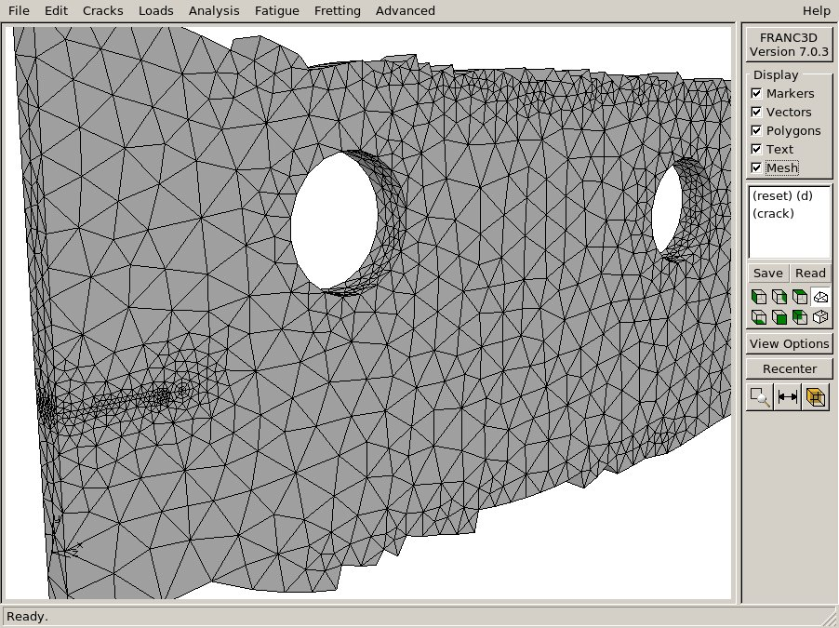
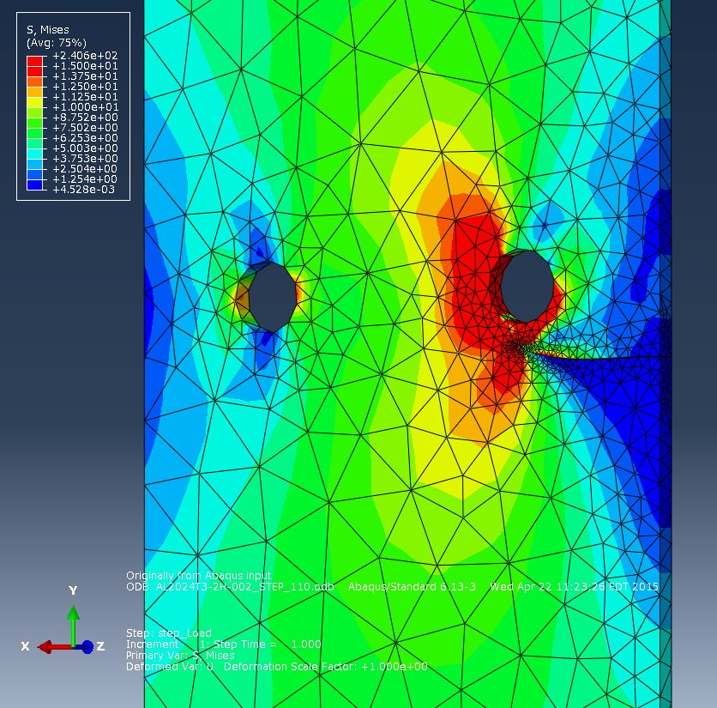
Motivation
Model-Based Prognostics
Uncertainty propagation
End of Life
High-fidelity simulations
Failure
Load
Damage Size
SHM
Time
Sensor Noise
Propagating uncertainty through high-fidelity models presents a significant computational challenge
Notes:
Show wing/component/SHM. Once we have diagnoses from SHM, want to simulate damage evolution in time [mean line]. Argue we need two characteristics for general and reliable prognostics. 1) UQ [animate uncertainties, uncertainty cone]. Then individual curves / end of life. 2) High fidelity models. [Animate red curve, simulation pics].

Slide 3
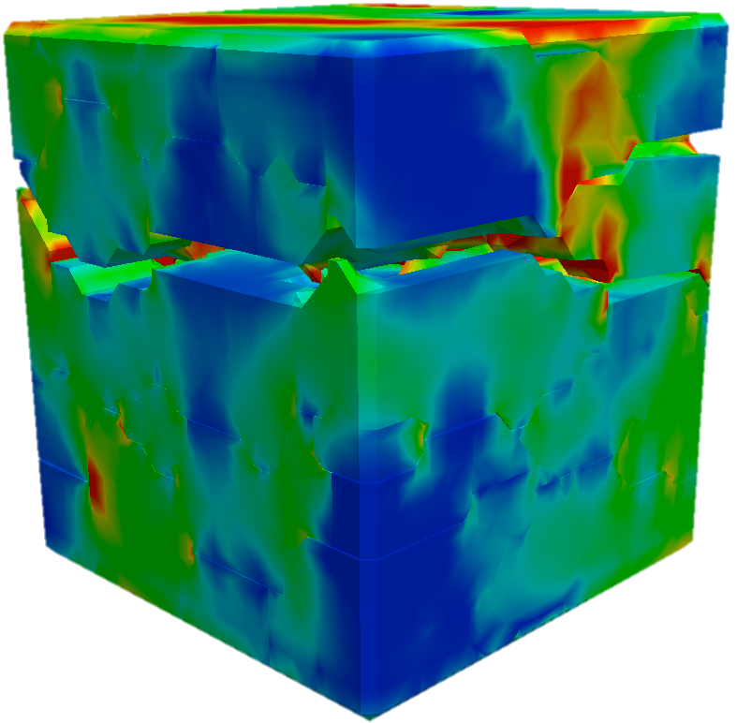
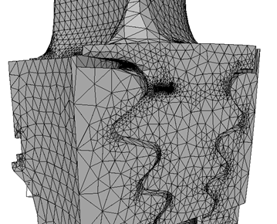
Uncertainty Propagation
Goal: given the probability distribution of the inputs , compute
Input Parameters
High-Fidelity Model
Outputs
Traditional Approach: Monte Carlo simulation (MCS)
1) Generate input parameter samples
N = 10³-10⁶
2) Compute output samples
3) Use sample-based estimators
Introduce model notation
Two methods to speed up -> speed up single model evaluation, or fewer total model evaluations
Examples of each – focusing on the latter here …
Notes:
Talk abstractly for a slide… (reference prognosis ex / variable meaning)

Slide 4

Uncertainty Propagation
Goal: given the probability distribution of the inputs , compute
Input Parameters
High-Fidelity Model
Outputs
Approaches for accelerating uncertainty propagation
1) Speed up a single model evaluation (e.g., surrogate modeling)
2) Reduce the total number of model evaluations
Notes:
Talk abstractly for a slide… (reference prognosis ex / variable meaning)

Slide 5
Rapid High-Fidelity Prognostics
A practical approach for accelerating uncertainty propagation for high-fidelity prognostics using stochastic reduced order models (SROMs)* and the Python package, SROMPy, is presented
Highlights:
First application of SROMs in the PHM field
First open-source implementation of the method – SROMPy
Orders of magnitude computational speedup for probabilistic, non-planar fatigue crack growth
Probabilistic, high-fidelity prognostics requires relatively little coding effort using SROMPy and Python
All source code and input data required to reproduce the results in this study are available online
*M. D. Grigoriu, Applied Mathematical Modeling. 2009.

Slide 6
Stochastic Reduced Order Models (SROMs)
SROMs can be viewed as a smart Monte Carlo simulation (MCS) method
MCS – thousands or millions of random, equally-likely samples
Model
SROMs – a small number of manually selected/weighted samples
Preprocessing Optimization
Model
Efficient - Speedup (when is expensive); easy to parallelize
Practical - Non-intrusive; get optimal solution for your resources
Accurate - Good agreement with MCS; proven asymptotic convergence
Notes:
Only have resources for 5 simulations? Get the best solution for those 5 runs. Have 12 processors, make SROM with size 10 and run models in parallel.

Slide 7
Forming a SROM
Preprocessing Optimization
Conceptually:
Select SROM parameters (samples & probabilities) such that the statistical error between the SROM and target random variable is minimized
Mathematically:
With SROMPy:
Distribution errors
Moment errors
#Define SROM and determine optimal parameters
srom = SROM(size=10)
srom.optimize(target_random_variable)

Slide 8
Ex: Forming a SROM with SROMPy
from target import NormalRandomVariable
from srom import SROM
from postprocess import Postprocessor
#Initialize Normal random variable
normal = NormalRandomVariable(mean=3, std_dev=1.5)
#Initialize SROM and optimize to match the target:
srom = SROM(size=10, dim=1)
srom.optimize(normal)
#Compare SROM and Normal CDFs:
pp = Postprocessor(srom, normal)
pp.compare_CDFs()
Cumulate distribution function (CDF) comparison: SROM vs. normal random variable

Slide 9
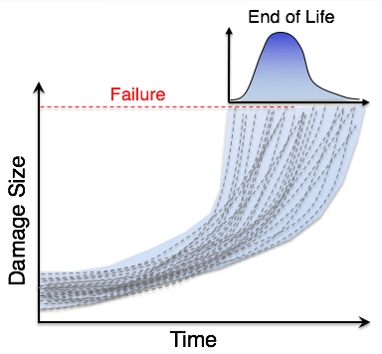
Probabilistic Prognostics with SROMs
Goal:
Generate a probabilistic end of life (EOL) estimate for a structural component under fatigue loading
Use SROMs to estimate EOL with significantly fewer simulations than MCS
Model:
Fatigue crack growth with Paris’ Law:
Iterate until failure occurs:
Uncertain parameters:
Driving forces
Fracture mechanics
Crack starting location
Finite Element Method
Quantity of interest:
Updated mesh
( : crack starting location)

Slide 10

Example: Non-Planar Crack Growth
Experimental Setup
EOL predictions using SROMs were generated and compared to MCS to assess accuracy and speedup
Fixed
Uncertainty in the input parameters, , was estimated beforehand using a MCMC-based calibration procedure
Ø 6.35 mm
A reference solution for the CDF of the EOL was generated using MCS with 5000 samples. SROM solutions were generated for sizes: m = 5, 10, and 20
254 mm
50.8 mm
Material:
AA2024-T3
2.04 mm thick
Displaced
Input Parameter Histograms
Fatigue loading
Applied Stress (MPa)
43.10
4.31
Time
Goal: accurately predict remaining useful life (RUL) at fixed times (cycles) preceding failure
Approach:
Diagnose damage in the component over the course of the test
Use diagnoses to update model and systematically reduce uncertainty in the RUL predictions

Slide 11
Results: SROMs Vs. Monte Carlo
Probabilistic end of life (EOL) predictions using SROMs vs. MCS
Piecewise-constant approximations
Piecewise-linear approximations*
SROM solution times:
SROM solution times:
Serial Times
m = 5: 2.8 hours
m = 10: 5.5 hours
m = 20: 11.0 hours
m = 5: 11.0 hours
m = 10: 22.0 hours
m = 20: 44.0 hours
125X Speedup
MCS solution time: ~115 days (5000 samples)
One crack growth simulation: ~30 minutes
Time to form a SROM: < 10 seconds
*M. Grigoriu, Journal of Computational Physics, 2012

Slide 12
Complete SROM Code
import numpy
from postprocess import Postprocessor
from srom import SROM, SROMSurrogate
from target import SampleRV
#Define target random vector from samples
samplesfile = "input_samples_MC.txt"
MCsamples = numpy.genfromtxt(samplesfile)
target = SampleRV(MCsamples)
#Define SROM and determine optimal parameters
srom_size = 20
input_srom = SROM(size=srom_size, dim=3)
input_srom.optimize(target)
#Run the model for each input SROM sample:
srom_eols = numpy.zeros(srom_size)
(srom_samples, srom_probs) = input_srom.get_params()
for i, sample in enumerate(srom_samples):
srom_eols[i] = model.evaluate(sample)
#Generate SROM surrogate for the EOL
eol_srom = SROMSurrogate(input_srom, srom_eols)
#Make random variable with MC EOL solution
mc_eol_file = "eol_samples_MC.txt"
MC_eols = numpy.genfromtxt(mc_eol_file)
eol_mc = SampleRV(MC_eols)
#Compare final EOL solutions SROM vs MC:
pp = Postprocessor(eol_srom, eol_mc)
pp.compare_CDFs(variablenames=["EOL"])
1) Define random input
parameters
2) Optimize for the
input SROM
3) Evaluate the model
4) Create SROM for
the output
5) Compare SROM and
reference solutions

Slide 13
Summary
Stochastic reduced order models (SROMs) are a practical uncertainty propagation method for efficient high-fidelity prognostics
With the open-source Python package, SROMPy, the SROM approach is straightforward to leverage, requiring relatively few lines of code
The potential for orders of magnitude speedup was demonstrated for probabilistic, non-planar crack growth simulation with excellent agreement with respect to Monte Carlo simulation (MCS)
Combining SROMs with surrogate modeling and high performance computing could enable real-time prognostics
The source code provided with this study provides a starting point for follow on investigations for prognostics using SROMPy

Slide 14
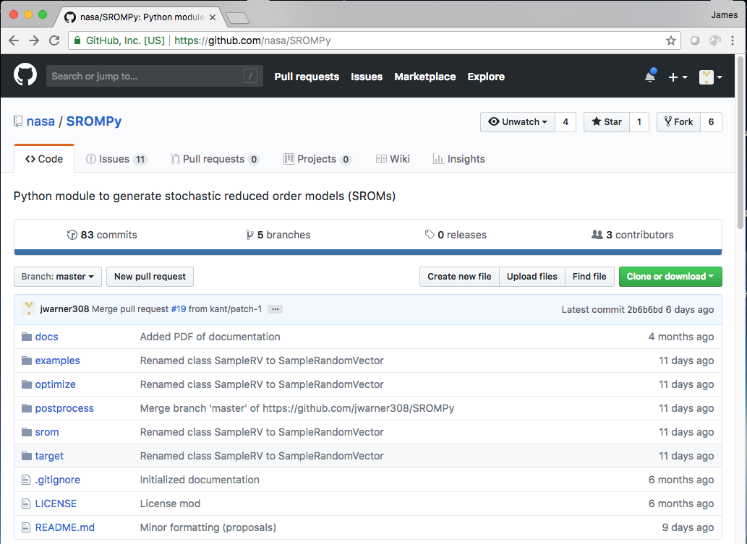
Acknowledgement: Luke Morrill, Georgia Tech, SROMPy Software Developer
Email: james.e.warner@nasa.gov
Access SROMPy: https://github.com/nasa/SROMPy/
Code & data for paper: https://github.com/nasa/SROMPy/examples/phm18

