Slide 2

What’s New in NetBeans IDE 7.3
Notes:
In this presentation, you’ll be focusing on new features in NetBeans IDE, while also providing a context for those of your audience who are not familiar with NetBeans IDE.

Slide 3
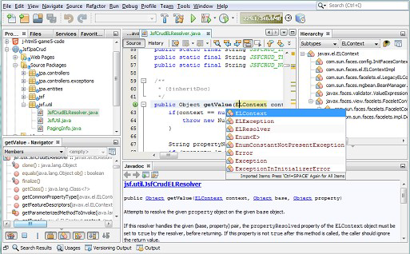
What is NetBeans IDE?
A Comprehensive & Modular IDE
Ready to use out of the box
Support for latest Java specifications & standards
Other platforms too (HTML5, PHP, C/C++)
Intuitive workflow
Debugger, Profiler, Refactoring, etc.
Binaries and ZIPs for Mac OS, Linux, and Windows
Simply download and run on any operating system!
Notes:
Here you’re giving a high level overview of NetBeans IDE. It’s two key features are that
It has everything needed for getting started with Java development, out of the box. (Unlike Eclipse.)
It is free. (Unlike IntelliJ IDEA.)
Talk on each of the bullets, just sharing your own knowledge on these points.
The main focus of this presentation is the new HTML5 support, though point out that Java development continues to be the main focus of the IDE.
Many developers don’t know that NetBeans is not only available via installers, but also as a ZIP file.

Slide 4
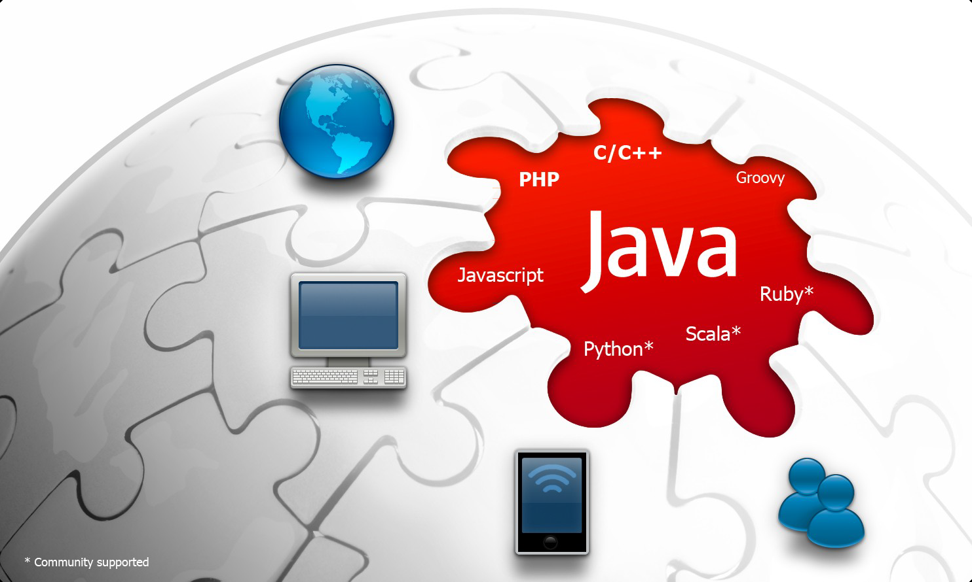
What is NetBeans IDE?
A Comprehensive & Modular IDE
NEW! HTML5 Support
Notes:
Java, PHP, and C/C++ are the main language platforms supported by the IDE, now with the addition of HTML5.
Groovy is also supported and some attention has been given to it in the past few releases,
See blogs.oracle.com/netbeansgroovy
But the IDE is pluggable and provides many editor APIs, making it possible for Python, Scala, Ruby, and other languages to be supported.

Slide 5
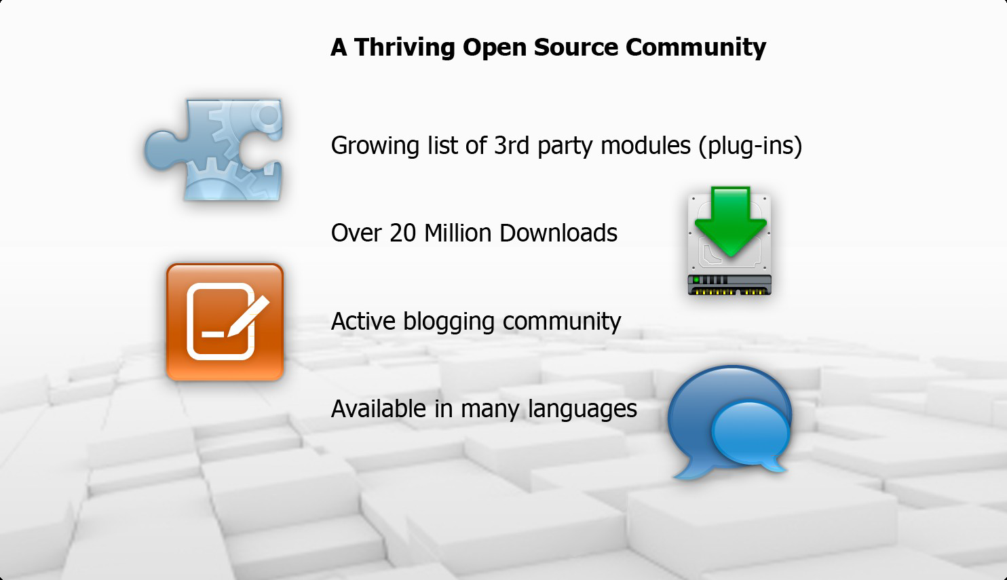
What is NetBeans IDE?
A Comprehensive & Modular IDE
Notes:
NetBeans is an IDE, an application framework, and a large international community.
In 2011, NetBeans attained the 1,000,000 active user status, and it continues to grow.

Slide 6

Why Use NetBeans IDE?
Increase Developer Productivity
Works out of the box
Freely available
Open source
Support for Java standards & other popular platforms, such as HTML5
Deeply integrated Maven support
Extensible Java desktop framework
Powerful, award winning GUI Builder
Profiling and debugging tools
Customizable and extensible
Notes:
Again, mention the “out of the box” and “free” aspects a lot.
Java EE and Maven – there’s no better IDE for these technologies than NetBeans IDE.
There’s also a large community working on creating plugins (i.e., the ‘customizable and extensible’ item above).

Slide 7
Focus Areas of NetBeans IDE 7.3
The Smarter and Faster Way to Code
HTML5 rich client-side web and mobile development
Java Editor enhancements
Miscellaneous Enhancements
Java EE
JavaFX
Maven
Groovy
PHP
C/C++

Slide 8
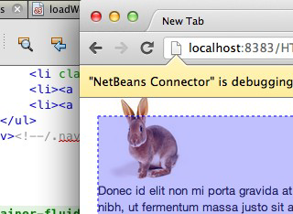
HTML5 Rich Client Development
The Smarter and Faster Way to Code
Accelerated HTML5 Development
Live Web Preview and Responsive Web Design
Rewritten JavaScript Editor on Nashorn
JavaScript Debugger
CSS3 Editor, Style Editor, and Rule Editor
Backbone.js Client Generation from Existing RESTful Web Service Project

Slide 9
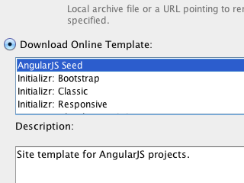
Accelerated HTML5 Development
The Smarter and Faster Way to Code
Create applications from popular templates
Open existing HTML5 applications
Open applications from ZIP file
Use popular tutorial samples
New JavaScript Library Manager

Slide 10
Live Preview & Responsive Design
The Smarter and Faster Way to Code
Deep integration with WebKit API
Integration with embedded browser
Instant feedback from page design
Select in browser, see related code in IDE, and reverse… without needing to save
Multiple form factors, e.g., desktop or mobile, in browser

Slide 11
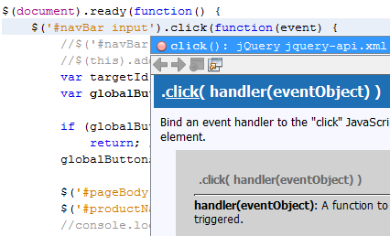
JavaScript Editor on Nashorn
The Smarter and Faster Way to Code
Early build of Nashorn used for parsing
Syntax coloring, code completion, pattern recognition, jQuery, and JSON
JavaScript refactoring
Many customization settings in Options window

Slide 12
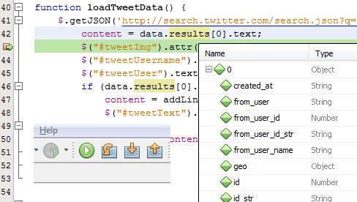
JavaScript Debugger
The Smarter and Faster Way to Code
HTML5 applications are automatically in debug mode
Set breakpoints in JavaScript file, on Line, DOM, Event, or XMLHTTPRequest
Refresh the browser and immediately you can step through code
Use Debugger windows to monitor watches, threads, and breakpoints

Slide 13
CSS3 Editors
The Smarter and Faster Way to Code
Inspect and edit CSS from CSS Styles window
Inspect styles applied to HTML elements in Navigator window
Change in CSS Editor is immediately reflected in the browser

Slide 14
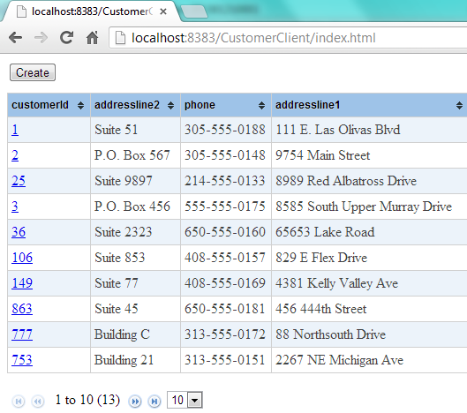
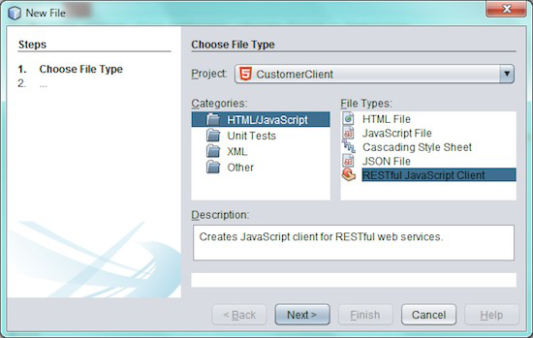
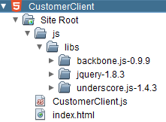
Backbone.js Client Generation
The Smarter and Faster Way to Code
Create or open an HTML5 application
Generate a Backbone.js frontend from RESTful web services
JavaScript file with HTML file is generated and can immediately be opened in the browser
Expose a database in an HTML5 application within 5 minutes

Slide 15





Community Feedback
The Smarter and Faster Way to Code

Slide 16
Be More Productive When Coding
Improved Java Editor
Java Editor is main feature of NetBeans IDE
Developed in close co-operation with Java SE Team
First editor to support Java technologies, e.g., Java, Java EE, JavaFX
“javac” is our parser, all language features are always in sync with Java

Slide 17
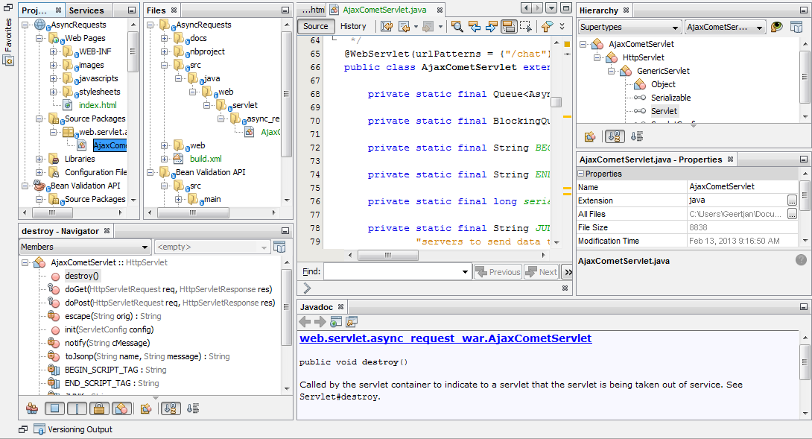
Improved Java Editor
Enhanced Code Navigation
Rewritten Hierarchy window for supertypes and subtypes
New Breadcrumb Toolbar beneath editor
New Brace Matching Bar above editor

Slide 18
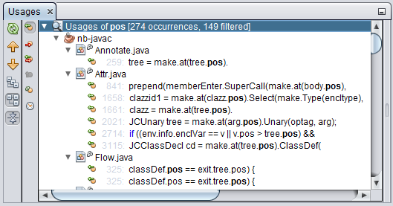
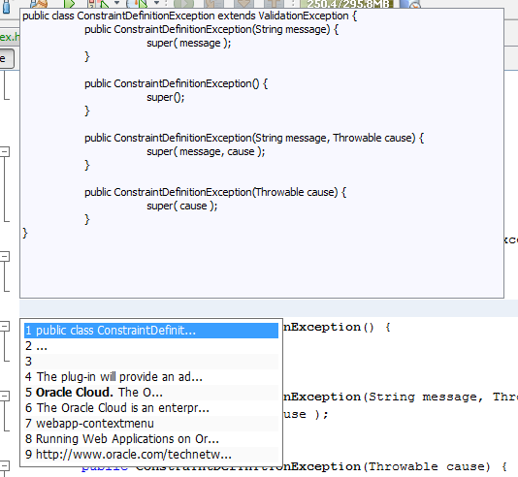
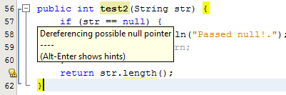
Improved Java Editor
Enhanced Tools
Access to clipboard
Specify “save actions” to be performed when files are saved
New hints and refactorings, e.g., identify potential NullPointerExceptions
Find Usages filters

Slide 19
New Features & Enhancements
The Smarter and Faster Way to Code
Java EE
JavaFX
Maven
Groovy
Profiler
PHP
C/C++

Slide 20
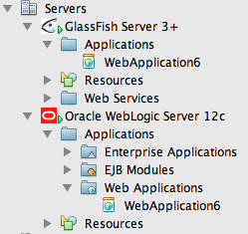
Support in NetBeans for Java EE
Out of the Box Java EE Support
Developed in close co-operation with GlassFish and WebLogic teams
Best in breed GlassFish integration, strong support for WebLogic and other servers
First day support for standards, e.g., Java EE 6
Ready to use out of the box

Slide 21
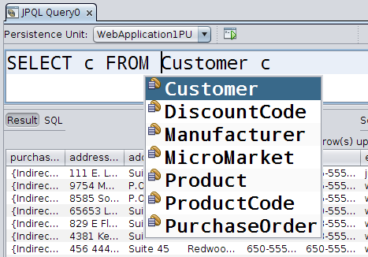
New in Java EE
Out of the Box Java EE Support
JPQL Query Tester
From RESTful Web Services to JavaScript without coding
Groovy integration

Slide 22
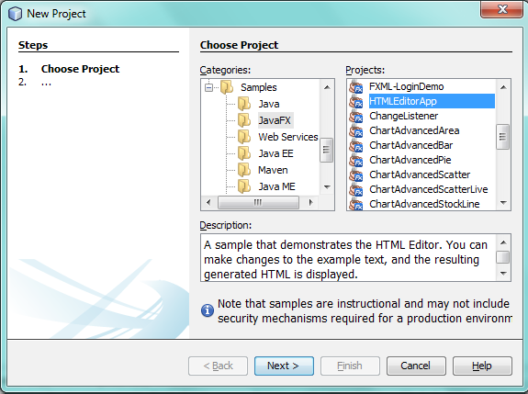
Support in NetBeans for JavaFX
Out of the Box JavaFX Support
First IDE to provide JavaFX tools
Developed in close co-operation with the JavaFX team
Supports create, edit, compile, deploy cycle
Integrated with Scene Builder
Library of ready to use samples out of the box

Slide 23
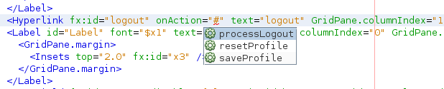
New in JavaFX
Out of the Box JavaFX Support
Code completion for FXML Source Editor
Generate controllers or update existing controllers
Partial validation with error hints
JavaScript event handler syntax colors and code completion

Slide 24
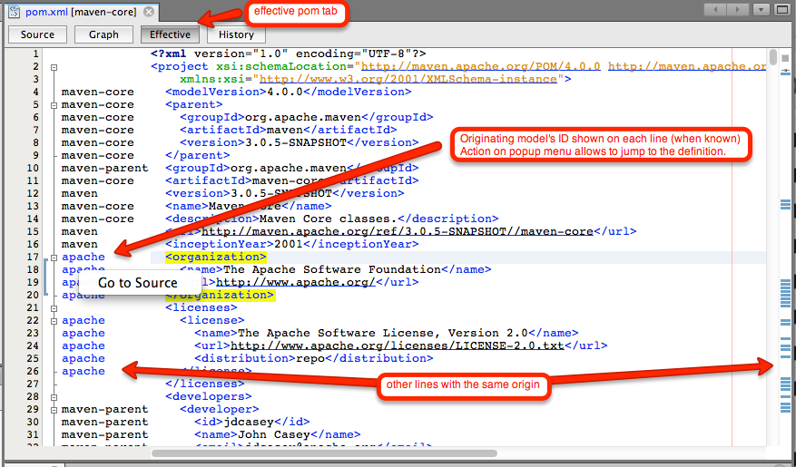
New in Maven
Out of the Box Maven Support
Less memory needed for Maven projects
Effective POM tab shows origin of elements
Code Generator for POM files to generate license headers

Slide 25
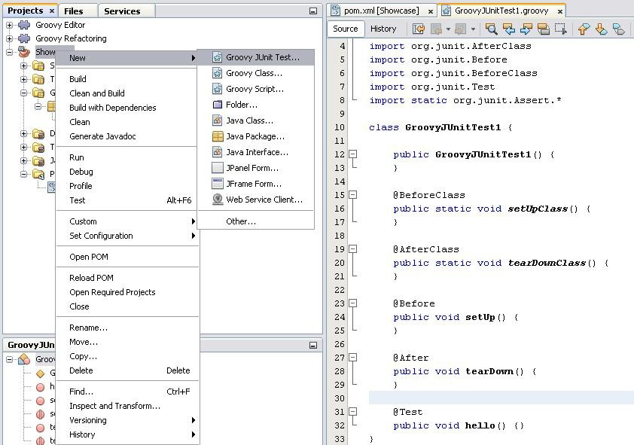
New in Groovy
Out of the Box Groovy Support
Groovy 2.0.5
Integration with Java EE
Groovy JUnit
Find Usages
Rename Refactoring

Slide 26
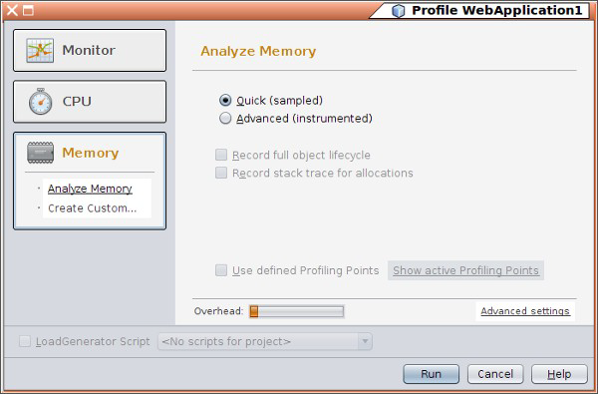
New in the NetBeans Profiler
Out of the Box Java Profiler Support
Simplified memory profiling
Memory profiler provides sampled histograms of live objects
CPU snapshots can be compared, just like memory snapshots

Slide 27
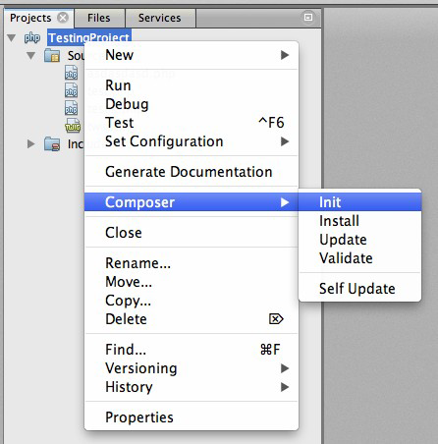
New in PHP
Out of the Box PHP Support
Composer integration
Detect and resolve memory problems
Enhancements for
Smarty
Twig

Slide 28
New in C/C++
Out of the Box C/C++ Support
Memory usage improvements. Requires 2x less memory for big projects.
Parser. Speed and scalability improvements.
Relocatable Index. Project index may be kept with the project metadata and used when project is moved.
VCS Ready Projects. Major improvements in how projects are stored.
Breakpoint Groupings. Per file, per project, per type.

Slide 29
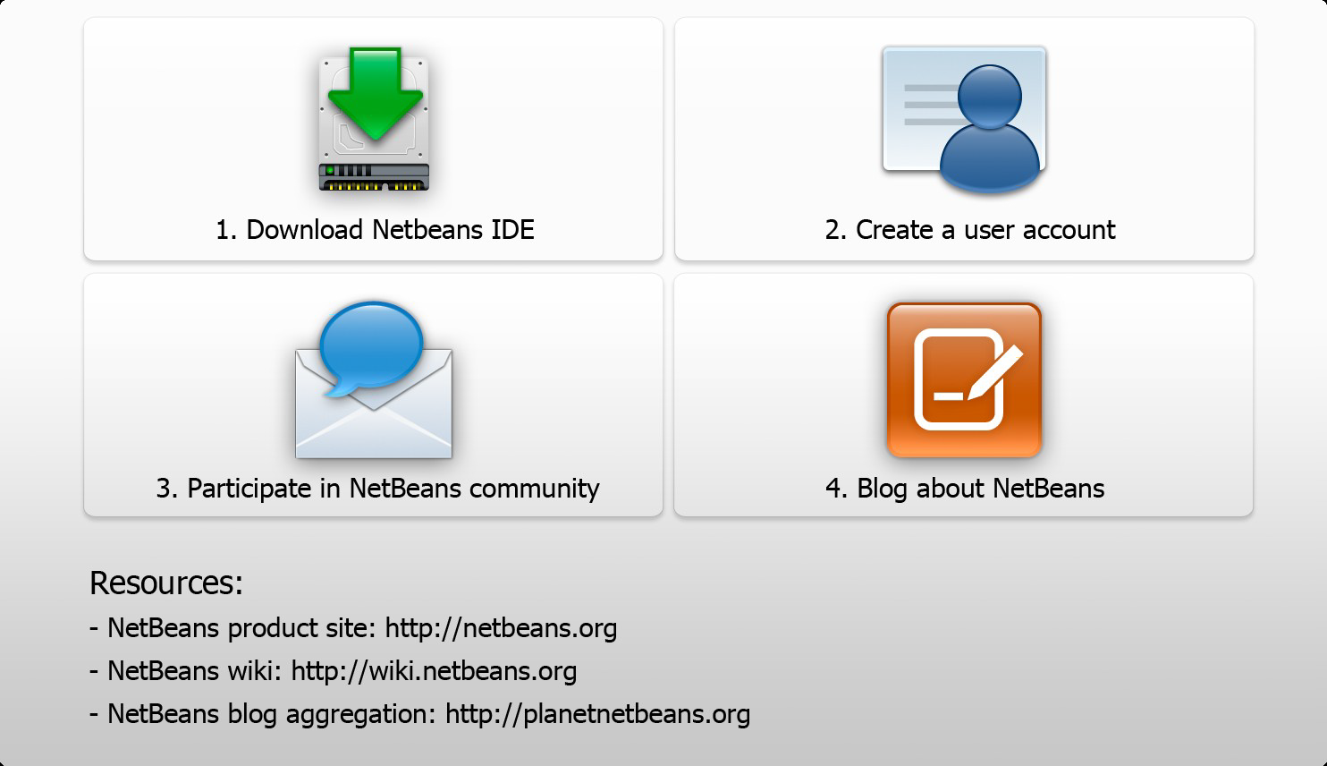
Next Steps

Slide 30


Oracle Technology Network
For Java Developers
Resources for You
Technical Content on oracle.com/technetwork/java
Java Magazine (100K subscribers)
Java Developer Newsletter (700K subscribers)
Free Developer Days events.oracle.com
Project space on java.net (7K+ projects)
@java, Facebook/IloveJava
Path to Recognition
Content by You!
Send links to blogs, videos, and proposals for articles to otnfeedback_us@oracle.com

