Slide 1
Developer Workflow

Slide 2
What is Agile?
Agile is a process formed in response to the “waterfall process.” In the waterfall process, developers would receive clear requirements up front, be left alone to work for X months, then be expected to deliver the final product to users.
Agile centers around user feedback and quick, responsive iterations.
Many engineering teams in tech companies use the Agile process to organize and drive development.
Example: making a wedding cake vs. baking cookies
Notes:
In waterfall, requirements are clear and defined upfront. Minimal back-and-forth between stakeholders (the ones funding and/or asking for the product) and devs.
In software development, waterfall doesn’t work very well since there’s no planned intake of user feedback

Slide 3
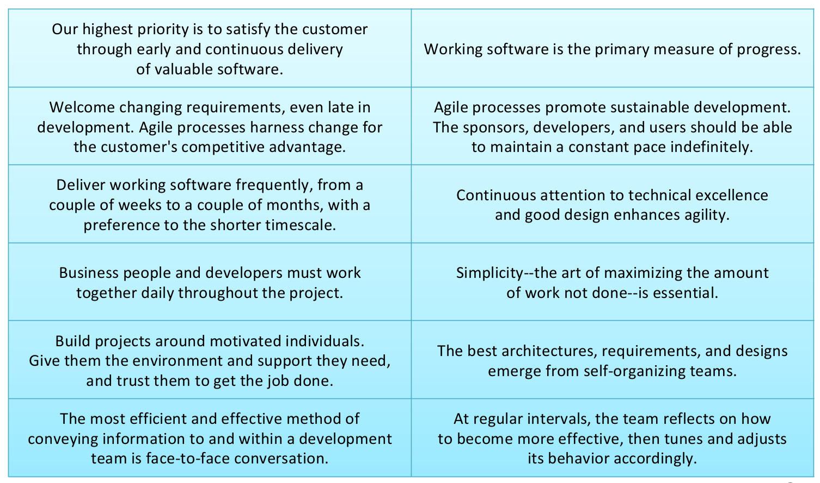
12 Agile principles
Source: www.agilemanifesto.org
Notes:
Don’t bother memorizing these principles, as long as you understand the gist. To be clear, no one actually follows Agile 100% anyway.

Slide 4
What is Scrum?
Scrum is an organizational model that follows Agile principles.
User story: a feature request that fills in “I as a <Role> want <Feature> so that <Value>”
Epic: a large feature request that will take more than a single sprint to complete
Acceptance criteria: a list of requirements for the feature
Product backlog: a prioritized list of feature requests
Product owner: the person who prioritizes the product backlog, is either the stakeholder or works closely with the stakeholder
Story points: a number to designate the complexity of a user story
Sprint: a 2-4 week chunk of dev time where certain user stories are “promised.” Begins with sprint planning and ends with sprint demos.
Sprint backlog: the user stories in the current sprint
Daily scrum meeting (aka “stand-up”): a meeting where each person on the dev team describes what they worked on yesterday, what they will work on today, and any blockers
Notes:
Scrum organizes how the different teams (stakeholders and dev) work together
A user story must be a deliverable, aka success is clearly defined and can be demonstrated; definition of done
Example user story: I as a homeowner want a pool so that I can swim when it’s really hot out

Slide 5
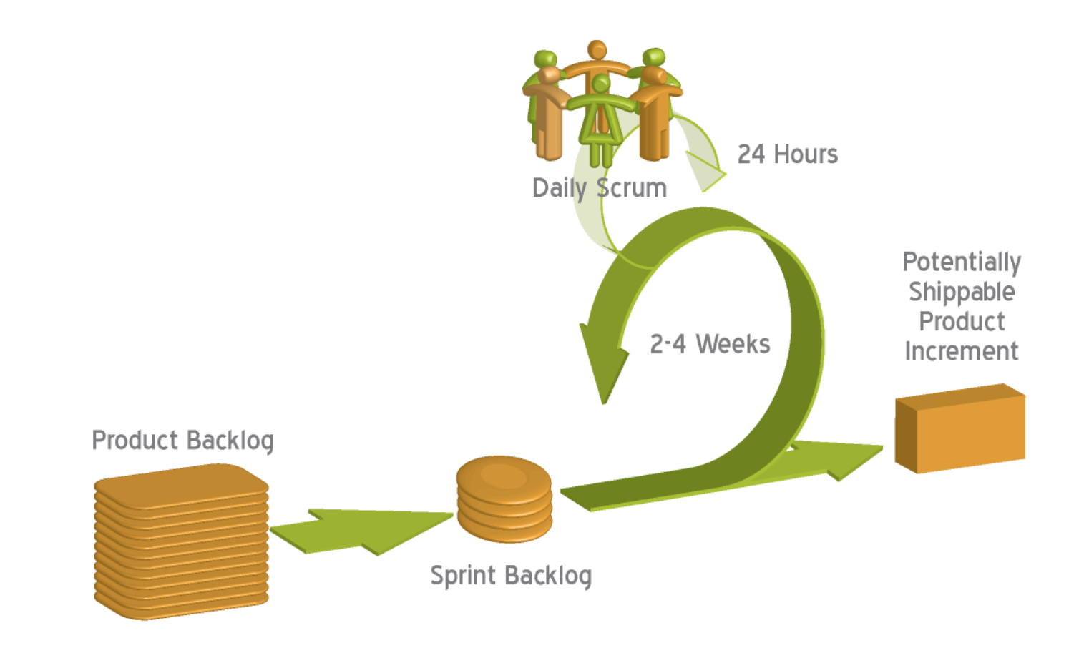

Slide 6
That’s it for Agile!
Any questions?

Slide 7
Software development process
So as an engineer, you take on a user story during the sprint. What does your actual software development process look like?

Slide 8
From JIRA ticket to Production
Choose a user story (aka “ticket”) in JIRA to work on
Develop the feature locally
Write unit tests if applicable, and make sure both the new and existing tests all pass
Create a Review Board (RB) request so that others can peer review your code
Update the RB as necessary based on feedback
Once your code receives a “Ship It!” you can check in the code
The code builds (either automatically or manually triggered)
Code is deployed to staging (either automatically or manually triggered)
Test on staging, make sure it works correctly
Code is deployed to prod (either automatically or manually triggered)
Notes:
Unit tests are code written to test code. Confusing right? It helps so that you don’t have to manually test everything to make sure you didn’t break anything after writing new code. There a few types of tests, unit tests is the most basic one because it tests the smallest unit of code.
Code building: code is compiled, dependencies are pulled in, bundled into a deployable unit
Staging and prod are two code environments (local is yet another code environment). Staging is supposed to be as similar to prod as possible, to allow for testing on a environment that’s not user-specific such as the local dev environment.

Slide 9
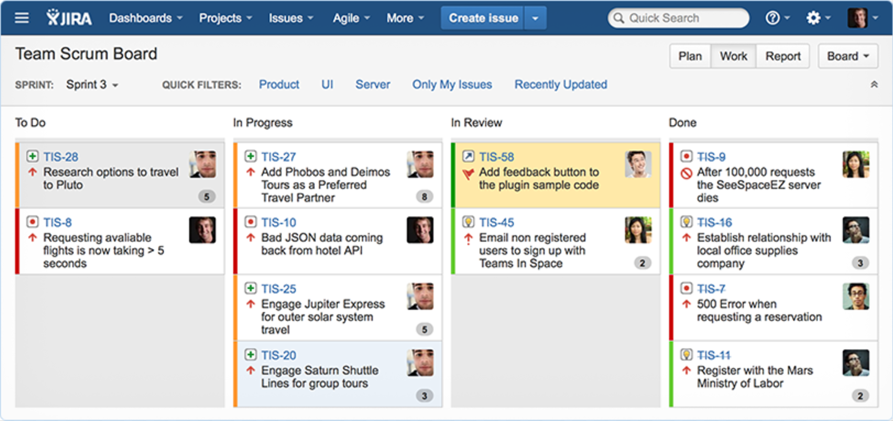
Notes:
Image from: https://tctechcrunch2011.files.wordpress.com/2014/07/feattour_new_hero_614x378-jira-pt-hero.png?w=614
This is what a sprint in JIRA generally looks like.
Each column is called a “swimlane,” and is used to denote what stage of development the ticket is in. Swimlanes can be customized to a team’s need.
Tickets have a ticket number (e.g., TIS-28), a short description (e.g., “Research options to travel to Pluto”), story points, and maybe an epic label. Tickets can also be Bugs (red dot icon) or User Stories (lightbulb icon). Here is where we already diverge from Agile; not all tickets are defined as User Stories.
You can open up a ticket to see the longer description and other info, such as comments. Very useful for capturing requirements and work done.

Slide 10
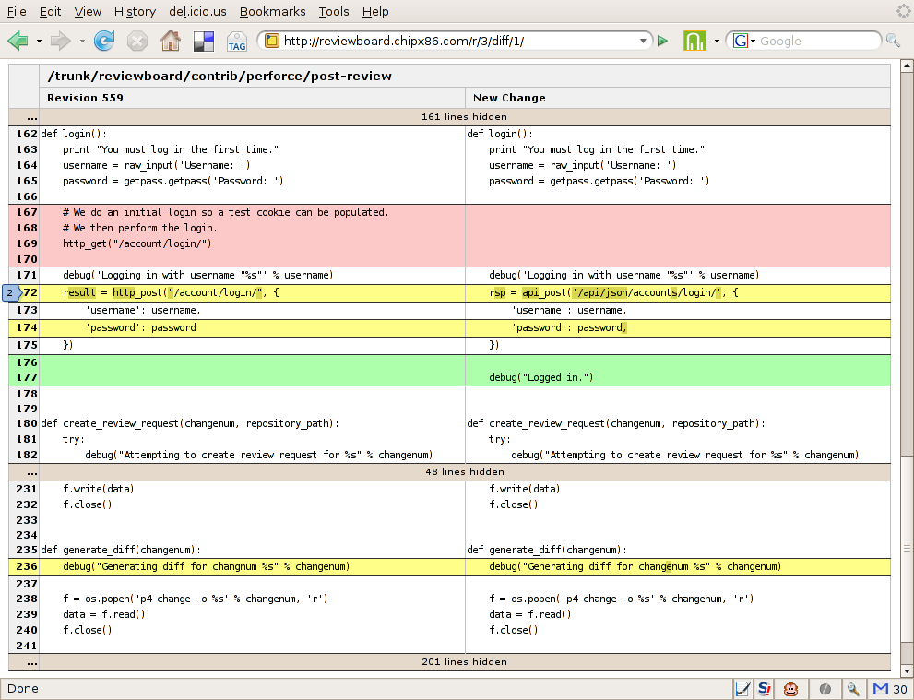
Notes:
Image from: http://osiris.chipx86.com/images/blog/20070517/diffviewer.png
This is what a Review Board request looks like.
You see the code changes organized by file, and you see two panes, a left and right pane.
The left pane shows what the code was like previously. The right pane shows what the code was changed to as part of this RB request.
Color coding is also used to signify the type of change done. Green means new code was added; yellow means line of code was modified; red means code was deleted.
You can click on the line numbers to leave a comment for that line, or select multiple lines to leave a comment for a particular chunk of code.

Slide 11
That’s it for the software developer workflow!
Any questions?

