Slide 1
Natural Language Processor
Question Answerer
Knowledge Base
Domain Classifier
Intent Classifier
Entity Recognizer
Role Classifier
Entity Resolver
Language Parser
Dialogue Manager
Application Manager
Gateway
Natural Language Processor
Question Answerer
Knowledge Base
Domain Classifier
Intent Classifier
Entity Recognizer
Role Classifier
Entity Resolver
Language Parser
Dialogue Manager
Application Manager

Slide 2
Hello
Hello, Pat. I can help you find store hours for your local Kwik-E-Mart. How can I help?
When does the store on Elm Street close today?
The 23 Elm Street Kwik-E-Mart opens at 7am and closes at 9pm today.
Where is the nearest Kwik-E-Mart?
Your nearest Kwik-E-Mart is located at Pine and Market.
When does that store open tomorrow?
The Pine and Market Kwik-E-Mart opens at 6am and closes at 10pm tomorrow.
Goodbye
Have a nice day.

Slide 3
Close the door
Sure, which room?
Bedroom
Close the door
Sure, which room?
Hello!

Slide 4
Hello
Hello, John. Some nearby popular restaurants you can order delivery from are Palmyra, Boulevard Cafe and Sallys.
I would like a grilled chicken sandwich with sourdough from Sams.
Sure, I got the Grilled Chicken Sandwich on sourdough bread from Sam's Sandwiches & Coffee for a total price of $5.95. Would you like to place the order?
Sure!
Great, your order from Sam’s Sandwiches & Coffee will be delivered in 15-30 minutes.
Thank you
Have a nice day.
Notes:
0.31, 0.43, 0.55, 0.72

Slide 5
Hello
What are some good places that have garlic naan?
Hello, John. Some nearby popular restaurants you can order delivery from are Palmyra, Boulevard Cafe and Sallys.
I found Garlic Naan at Punjab Kabab House, Little India and Urban Curry. Which one would you like to order form?
I would like a grilled chicken sandwich with sourdough from Sams.
How about Little India?
Sure, I got the Grilled Chicken Sandwich on sourdough bread from Sam's Sandwiches & Coffee for a total price of $5.95. Would you like to place the order?
Great, what can I get you from Little India?
I want Saag Paneer with Peas Pulav, cucumber raita and one garlic naan.
Sure!
Ok, I got the Saag Paneer with a side of Peas Pulav and Raita and a Garlic Naan from Little India for a total price of $14.75. Would you like to place the order?
Great, your order from Sam’s Sandwiches & Coffee will be delivered in 15-30 minutes.
Thank you
Could you also add a mango lassi to my order?
Have a nice day.
Sure, I’ve added a Mango Lassi to your order from Little India. The total price is now $17.75. Would you like to place the order?
Yes
Great, your order from Little India will be delivered in 30-45 minutes.
Notes:
0.31, 0.43, 0.55, 0.72

Slide 6
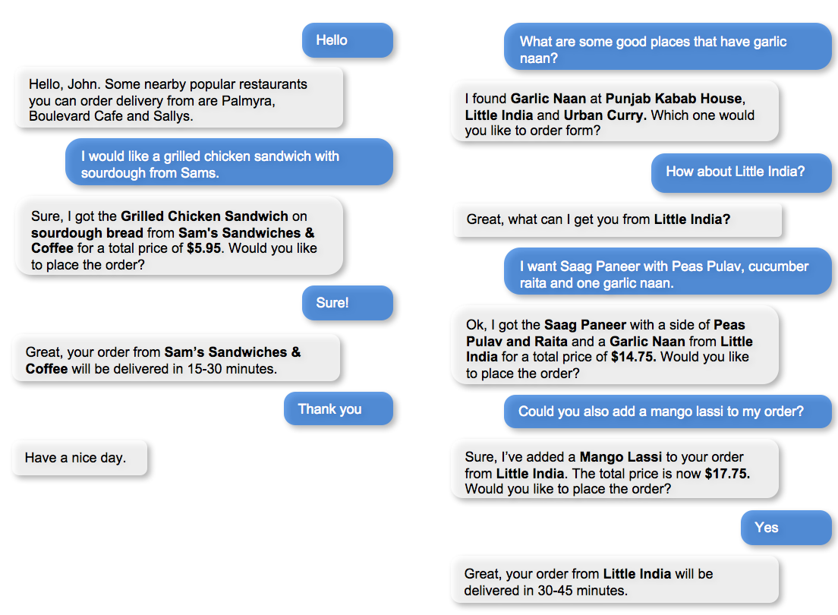
Notes:
0.31, 0.43, 0.55, 0.72

Slide 7
Hello
do you have romantic movies?
Hi.
Ok. Here are some romance movies:
Talk to me to browse movies and TV shows.
Beauty and the Beast
Twilight
…
Find Tom Hanks movies
Show me the ones with Tom Hanks
Ok. Here are some movies with Tom Hanks:
Done. Here are some romance movies with Tom Hanks:
Forest Gump
Inferno
…
Forest Gump
Big
…
Thank you
Released in 2011
See you later.
Done. Here are some romance movies with Tom Hanks released in 2011:
Larry Crowne
Thank you
See you later.
Notes:
0.31, 0.43, 0.55, 0.72

Slide 8
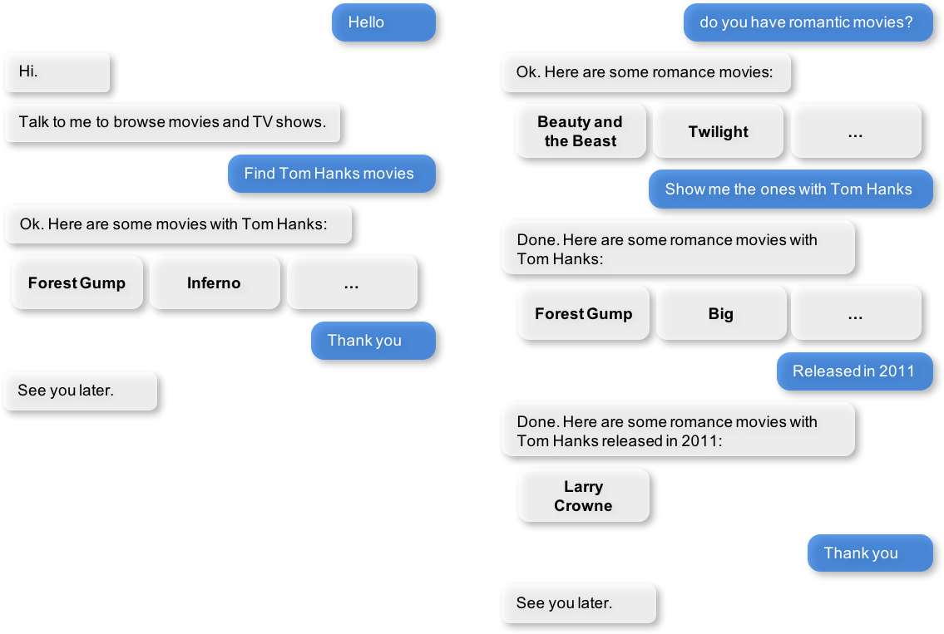

Slide 9
MY APP
DOMAIN CLASSIFIER:
'Will it rain tomorrow?' → DOMAIN: weather
'Play my jazz playlist.' → DOMAIN: music
...
DOMAIN 1
DOMAIN 2
DOMAIN 3
INTENT CLASSIFIERS:
'Wake me up at 7am.' → INTENT: set-alarm
'Who sings Thriller?' → INTENT: get-artist
...
INTENT 1
INTENT 2
INTENT 3
ENTITY RECOGNIZERS:
'Book a flight to Miami.' → ENTITY: Miami
'Films with Tom Hanks.' → ENTITY: Tom Hanks
...
ENTITY 1
ENTITY 2
ENTITY 3
ROLE CLASSIFIERS:
'Schedule a meeting → '10am' ROLE: start
from 10am to noon.' → 'noon' ROLE: end
...
ROLE 1
ROLE 2
ROLE 3

Slide 10
my_app
DOMAINS:
store_info
INTENTS:
greet
get_store_hours
find_nearest_store
exit
help
ENTITIES:
store_name
date

Slide 11
APP:
food_ordering
DOMAINS:
ordering
INTENTS:
greet
build_order
place_order
start_over
exit
help
unsupported
ENTITIES:
restaurant
cuisine
category
dish
option
sys_number

Slide 12
APP:
video_discovery
DOMAINS:
video_content
unrelated
INTENTS:
greet
help
start_over
exit
browse
unsupported
general
compliment
insult
ENTITIES:
cast
country
director
genre
sort
title
type

Slide 13
APP:
home_assistant
DOMAINS:
greeting
smart_home
weather
time_and_dates
unknown
INTENTS:
greet
check_thermostat
check_weather
change_alarm
unknown
exit
close_door
check_alarm
lock_door
set_alarm
open_door
start_timer
set_thermostat
stop_timer
specify_location
turn_appliance_on
turn_appliance_off
turn_lights_off
turn_lights_on
turn_off_thermostat
turn_on_thermostat
turn_up_thermostat
unlock_door
Notes:
From Minh 07-27-17

Slide 14
Hello
→
DOMAIN:
store_info
INTENT:
greet
When does the store on Elm Street close today?
→
DOMAIN:
store_info
INTENT:
get_store_hours
ENTITIES:
Elm Street |store_name
today|sys_time
Where is the nearest Kwik-E-Mart?
→
DOMAIN:
store_info
INTENT:
find_nearest_store
When does that store open tomorrow?
→
DOMAIN:
store_info
INTENT:
get_store_hours
ENTITIES:
tomorrow|sys_time
Goodbye
→
DOMAIN:
store_info
INTENT:
exit

Slide 15
Send a text to Pat
1
DIALOGUE STATE:
prompt_for_message_body
REPLY: What message would you like to send?
2
See you at 8pm
3
DIALOGUE STATE:
prompt_for_confirmation
REPLY: Got it. Ready to send?
4
Yes
5
DIALOGUE STATE:
verify_message_sent
REPLY: Your message has been sent.

Slide 16
Send a text to Pat
1
DIALOGUE STATE:
prompt_for_message_body
REPLY: What message would you like to send?
See you at 8pm
2
3
5
DIALOGUE STATE:
prompt_for_confirmation
Scratch that. Send a text to Sue instead
4
REPLY: Got it. Ready to send?
6
7
DIALOGUE STATE:
verify_message_sent
Meet you at Enzo's
REPLY: Your message has been sent.
8
Hold on a second. How do I get to Enzo's restaurant?
DIALOGUE STATE:
show_directions
9
REPLY: Here are directions to {location}.

Slide 17
DIALOGUE STATE:
welcome
Hello
1
REPLY: Hello, {name}. I can help you find store hours for your local Kwik-E-Mart. How can I help?
When does the store on Elm Street close today?
2
3
DIALOGUE STATE:
send_store_hours
REPLY: The {store_name} Kwik-E-Mart opens at {open_time} and closes at {close_time} {date} .
Where is the nearest Kwik-E-Mart?
4
5
7
DIALOGUE STATE:
send_nearest_store
When does that store open tomorrow?
6
REPLY: Your nearest Kwik-E-Mart is located at {store_name}.
8
Goodbye
9
DIALOGUE STATE:
say_goodbye
REPLY: Have a nice day.

Slide 18
Order one large squishee and a dozen donuts from the Elm Street Kwik-E-Mart
one
large
squishee
a dozen
donuts
Elm Street
QUANTITY
SIZE
PRODUCT
QUANTITY
PRODUCT
STORE_NAME
Language Parser
Parse Tree
PRODUCT: squishee
PRODUCT: donuts
STORE_NAME: Elm Street
QUANTITY: one
QUANTITY: a dozen
SIZE: large

Slide 19
Query
Order one large squishee and a dozen donuts from the Elm Street Kwik-E-Mart
Natural Language Processor
Domain
Entities
Ordering
PRODUCT: squishee
PRODUCT: donuts
STORE_NAME: Elm Street
Intent
QUANTITY: one
QUANTITY: a dozen
Build Order
SIZE: large

Slide 20
INPUT
“Order one large squishee and a dozen donuts from the Elm Street Kwik-E-Mart”
OUTPUT
DOMAIN
RESOLVED ENTITY GROUPS
ORDERING
PRODUCT: SIGNATURE SQUISHEE
PRODUCT: GLAZED DONUT
STORE: 23 ELM STREET
INTENT
QUANTITY: 1
QUANTITY: 12
BUILD ORDER
SIZE: LARGE
Notes:
Parser function: Relations, Entity Groups
Quantity 1, Size: Large → Squishee
Separate order of donuts
Requested store
All info to fulfill request, e.g. POS system

Slide 21
INPUT
“I’d like to order a pepperoni pizza with extra cheese, a calzone and two diet coke.”
ENTITY GROUPS
DISH: PEPPERONI PIZZA
DISH: CALZONE
DISH: COKE
CANDIDATE
PARSE 1
OPTION: EXTRA CHEESE
QUANTITY: TWO
ENTITY GROUPS
CANDIDATE
PARSE 2
DISH: PEPPERONI PIZZA
DISH: CALZONE
DISH: COKE
OPTION: EXTRA CHEESE
QUANTITY: TWO
ENTITY GROUPS
CANDIDATE
PARSE 3
DISH: PEPPERONI PIZZA
DISH: CALZONE
DISH: DIET COKE
OPTION: EXTRA CHEESE
QUANTITY: TWO
Notes:
Parser function: Relations, Entity Groups
Quantity 1, Size: Large → Squishee
Separate order of donuts
Requested store
All info to fulfill request, e.g. POS system

Slide 22
Hola
Hello
Bienvenido al sistema de evaluación de salud. Mediante unas sencillas preguntas, puedo ayudarte a determinar tu riesgo a padecer prediabetes. ¿Desea conocer su riesgo de padecer prediabetes?
Welcome to the health assessment system. Using a few simple questions, I can help you determine your risk for prediabetes. Do you want to know your risk for prediabetes?
Quiero conocer mi riesgo de tener prediabetes
I would like to know my risk for prediabetes
¿Cuál es su edad?
How old are you?
45 años
45 years old
¿Es de género masculino o femenino?
Are you male or female?
Soy hombre
I am a man
¿Tiene algún familiar inmediato que haya sido diagnosticado con diabetes? Estos incluyen padre, madre, hermano o hermana.
Do you have an immediate family member who has been diagnosed with diabetes? These include father, mother, brother or sister
My papá
My dad

Slide 23
APP:
screening_app
DOMAINS
greetings
prediabetes_screening
INTENTS
greet
exit
answer_age
answer_yes
answer_yes_gestational
answer_yes_hbp
answer_height
answer_weight
answer_gender
answer_no
answer_yes_family
answer_yes_active
ENTITIES
sys_number
gender
sys_number
unit

