Slide 1
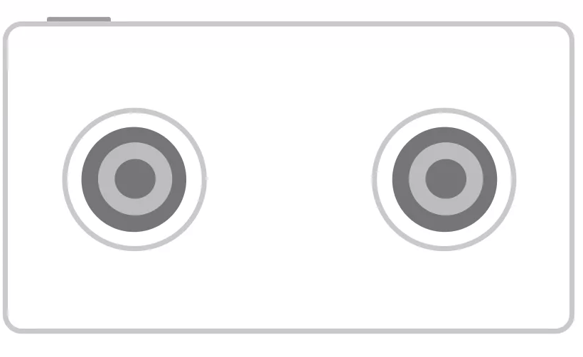
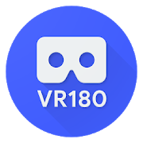


VR180 Overview
VR180 Media
Hardware
Platform (OS)
Camera App
VR180 camera
Open formats (video, photo)
Supported by Google Apps

Slide 2
Hardware
130°x100° - 180°x180°
15+ resolved pixels per degree
Fixed focus at hyperfocal distance
6-axis IMU aligned with camera for VR stabilization
Interpupillary distance apart (64mm)
Synchronized frame exposure

Slide 3
Platform / OS
L
Left camera
L
R
Virtual camera
R
Right camera
IMU
QCS605 used for Google’s reference implementation
Virtual stereo camera through Android Camera2 API
Full capability for frame exposure control
Real timestamps for synchronizing with IMU data.

Slide 4
Google’s Open-source Camera App
Hardware
Platform
Open-source camera app:
Sensor fusion;
Photo/video formats;
RTMP live streaming;
Integration with the VR180 companion app;
Simple customization API for new cameras.
Android API
Stereo camera
IMU
Audio
Hardware/platform calibration & VR metadata
WIFI/BT camera API
VR180 companion app

Slide 5
Calibration & Validation
Every device should be factory-calibrated to produce accurate VR180 media
Calibration toolkit is provided for producing necessary VR metadata
Validation toolkit is also provided for verifying the output VR180 media
More instructions can be found in the released toolkits.
Camera App in calibration capture mode
Capture in calibration boxes
Calibration datasets
Run calibration toolkit
IMU/camera time offset
Time-offset calibration
Camera App ready for regular capture mode
Lens parameters & metadata
Lens calibration

