Slide 1
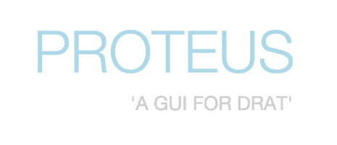
Daler Asrorov
Steven Francus
Jun Suh Lee
Emily (Zhi Fei) Liu

Slide 2

What is RAT?
Release Audit Tool
An Apache open source project
Audits, especially for licenses, for software projects are a critical part of software asset management/release
Open source products require dependencies with less-restrictive licenses, notably the Apache License
Enterprise code-bases require less-restrictive licenses too, or they can be sued or charged for improper usage

Slide 3

So… what is DRAT?
RAT takes an extremely long time to analyze large repositories of code.
It can hang indefinitely on large codebases.
DRAT—Distributed RAT—is able to do so much faster
Crawl
Index
Map
Reduce
Notes:
“crawls” a directory, recursively finding all files and feeding them to OODT’s File Manager.
uses Apache Tika to parse the files found during crawl, and pull out relevant metadata like the file’s mime-type and content and indexes them in Apache Solr.
performs the map step of map-reduction in DRAT, segmenting the code-base by mime-type (so each RAT instance only works on a segment of the code-base)
takes the logs generated from each RAT Instance and aggregates them to form a CSV file containing a breakdown of all license types found in the repo.

Slide 4
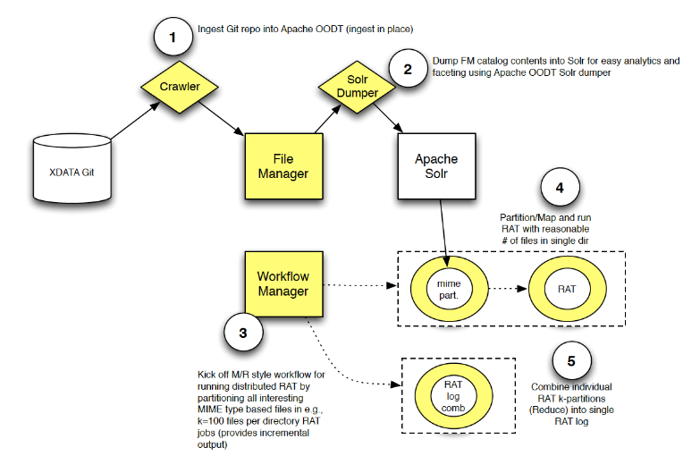
DRAT Workflow

Slide 5
Why an audit tool?
Massive increase in open source projects hosted in public repositories across multiple domains.
Existence of more than 60 licenses, such as MIT license, Berkley Software Distribution (BSD), General Public License (GPL), the Apache License version 2 (ALv2).
Misunderstandings and oversights can lead to costly legal issues.
An audit tool can be used to remedy this problem through automated scans of entire projects.
More accurate and quicker than human eyes alone!

Slide 6
What is Proteus?
DRAT runs in the command line Proteus provides a GUI
for interacting and monitoring DRAT
Runs as a website/web app when Apache OODT is launched
Allows the end user to upload a ZIP file or specify a directory path to run DRAT on
Analytics like 20 recent files scanned (during crawl),
the repo’s MIME type breakdown (during index), the # of RAT Instances running, and the breakdown of license types in the repo (during map/reduce)
Additionally exposes a REST API (from Proteus’s mid-tier) that other services can build from

Slide 7
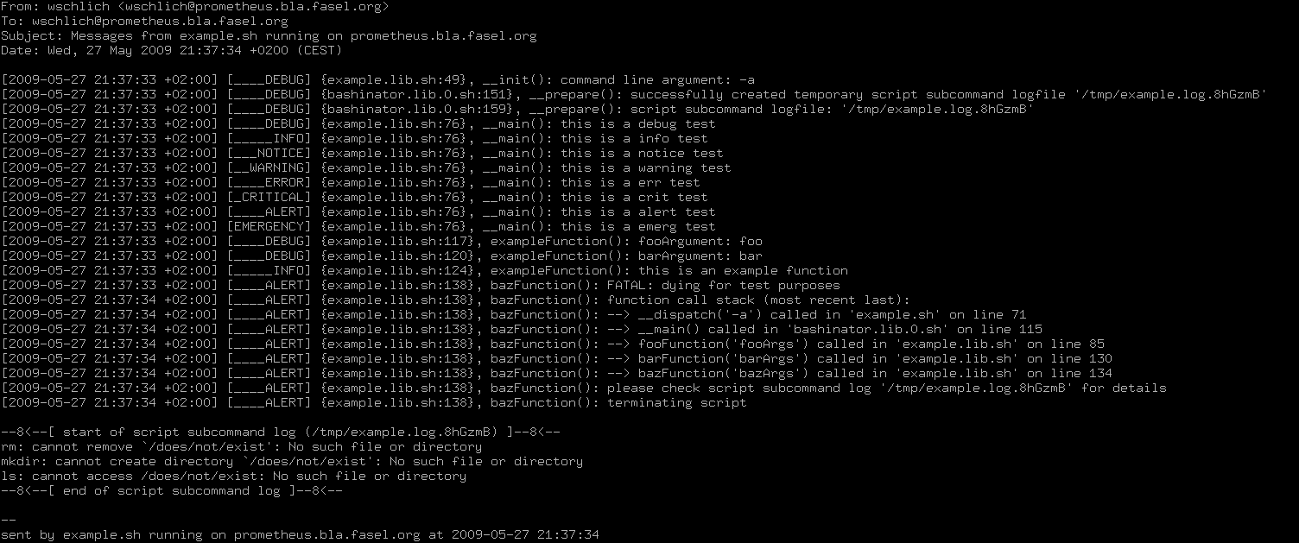
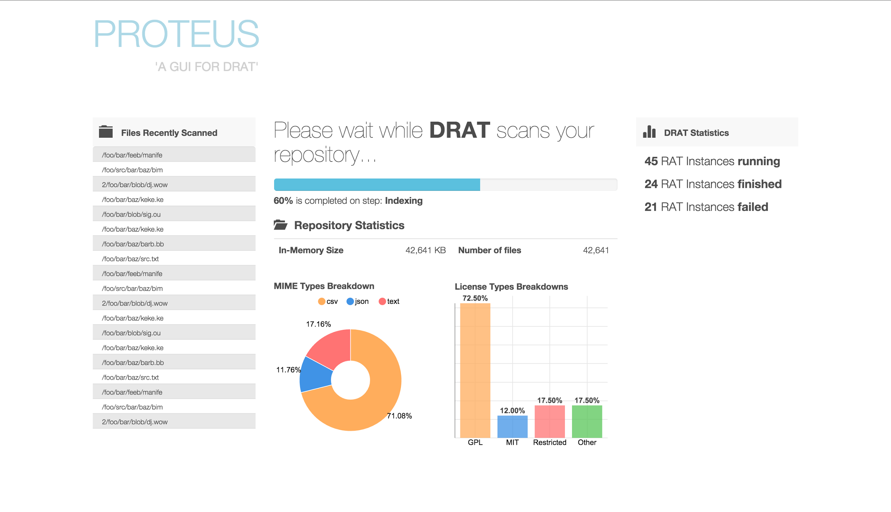
What impact does Proteus have?
Proteus will allow less technically-minded people to run DRAT easily
This can help get it more widely adopted
Exposes a new REST API for DRAT (like showing DRAT’s status) allowing new tools to be built in the future
Sleek Web 2.0 gives DRAT some more street cred in the open source community.

Slide 8
TACC Wrangler system
Ongoing experiment to move DRAT to a new architecture TACC (Texas Advanced Computing Center) Wrangler system which is designed for large scale data transfer, analytics, and sharing and provides flexible support for a wide range of software stacks and workflows.
Scanning entire Apache Subversion repository (200+ software projects, >2M source code revisions as of July 2014).
Proteus is supporting both the experiments through its large scale code analysis from REST APIs.
Provides an easy to read/understand GUI interface.

Slide 9
Issues around Proteus?
Proteus is an addition to an existing open source project, and has a great community of supporters who will continue building it
Since it is an Apache project, we only used dependencies with very permissive licenses
Apache License gave us the most flexibility
Unlike other projects, security wasn’t a huge concern since it is meant to be run locally
Code quality was important since everyone can see our code (Github) and future contributors would thank us
Documentation, documentation, documentation!

Slide 10
Development
What worked
Dividing it into a midtier, backend, and front-end helped modularize the code and split work efficiently
Two week sprints helped us keep track of goals and manage our time effectively
Awesome feedback/enthusiasm from our stakeholder
What didn’t
Initially, communication was difficult and our team wasn’t great at Github
Time spent learning the tools before starting is valuable!
Working on a requirements document served less purpose than the time it took
Better spent on coding!

Slide 11
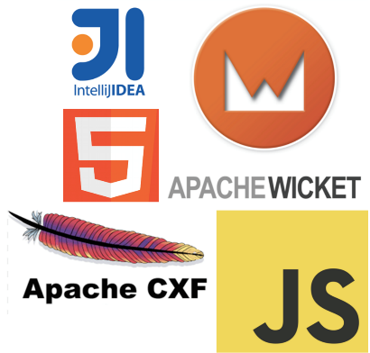

Stack
On the front-end, we used Angular.js (for organization and DOM manipulation) with d3.js (for graphing) and Bootstrap (for CSS)
On the midtier, we used Apache Wicket as our application server (and Tomcat 7), as well as the Apache CXF Client API to serve JAX-RS requests to OODT endpoints

Slide 12

Outside Topics (aka things != school)
Using open source tools,
especially Apache (OODT, DRAT,
Solr – to name a few)
Learning Angular.js + d3.js on
the front-end
Creating the designs for the
front-end in Sketch (UI/UX design)
Building a REST API
Using Git + Github (not just for code storage, but opening issues/merging as well)

Slide 13
Class topics used
To determine the state DRAT is currently in, a lock-like structure is used on the backend along with a thread monitor [CSCI 201]
Multi-threading is extensively used for interaction with DRAT, which uses the Java Process API
Java… lots of Java. Both the drink and the programming language. [CSCI 201]
The midtier is divided into services to a service-oriented architecture (HealthMonitor, RecentProducts,
LicenseTypeBreakdown, MimeTypeBreakdown), and
the DratWrapper is a singleton (one Drat instance a time)
[CSCI 201/310]

Slide 14

Questions

