Slide 1
DIN and Performance Forecasting

Slide 2
Deep Interest Network(DIN)

Slide 3


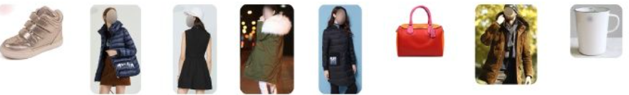
User’s behavior history vs current behavior
known
unknown
Attention
intensity
User behavior history
past
current
User characters：female + behavior history
Current behavior

Slide 4
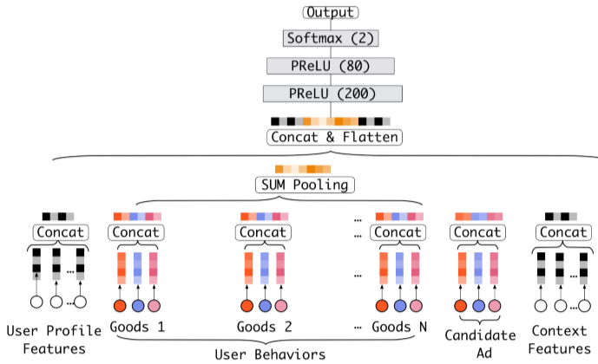
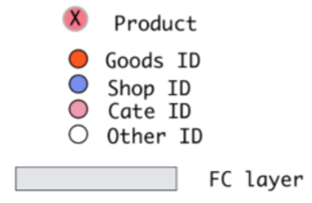

Baseline model
Embedding & MLP model

Slide 5
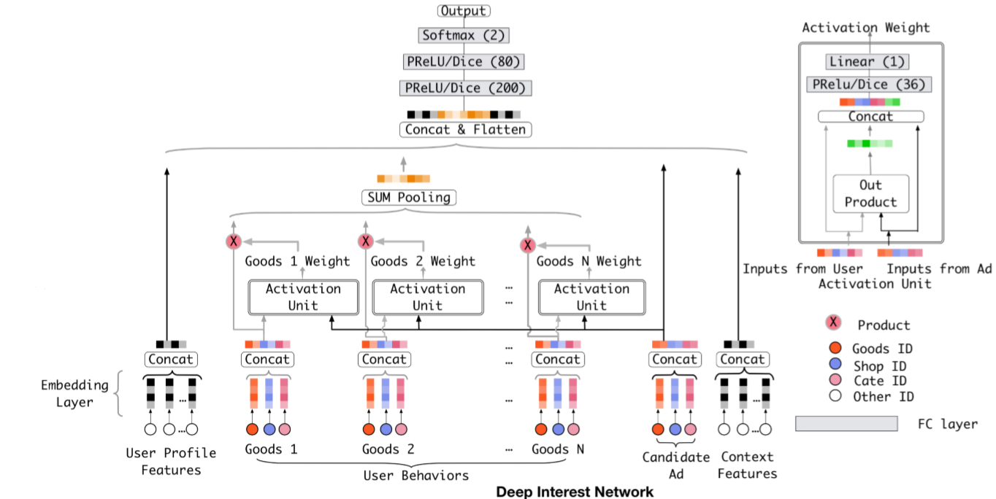
Deep Interest Network (DIN) Model
Major concepts:
User attribute: gender, age, …
Ads attribute: goods_id, shop_id, cate_id, …
User behavior: visited {goods_id, shop_id, cate_id, …}
Context: pid (slot_id), time, …
Major components:
Embedding layer
Attention network (activation unit)
SUM pooling
MLP
2 fully connected layers
softmax

Slide 6
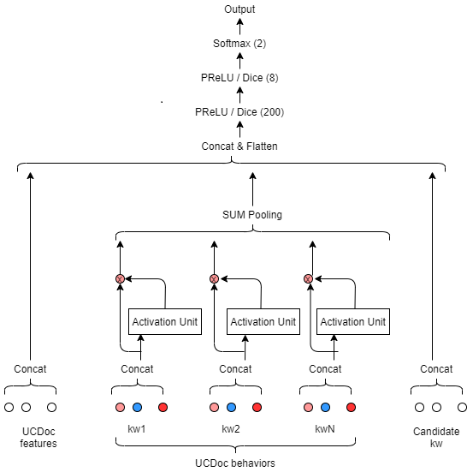
GDIN (Uckey based DIN) Model

Slide 7
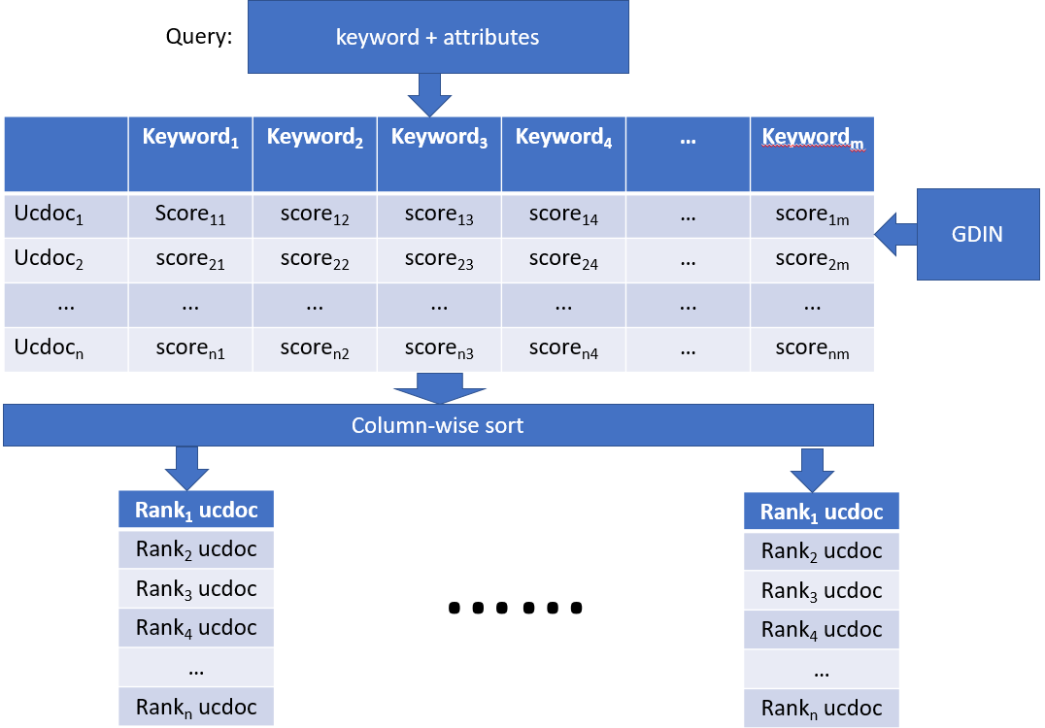
GDIN (Uckey based DIN) Model Output

Slide 8
Performance Forecasting

Slide 9
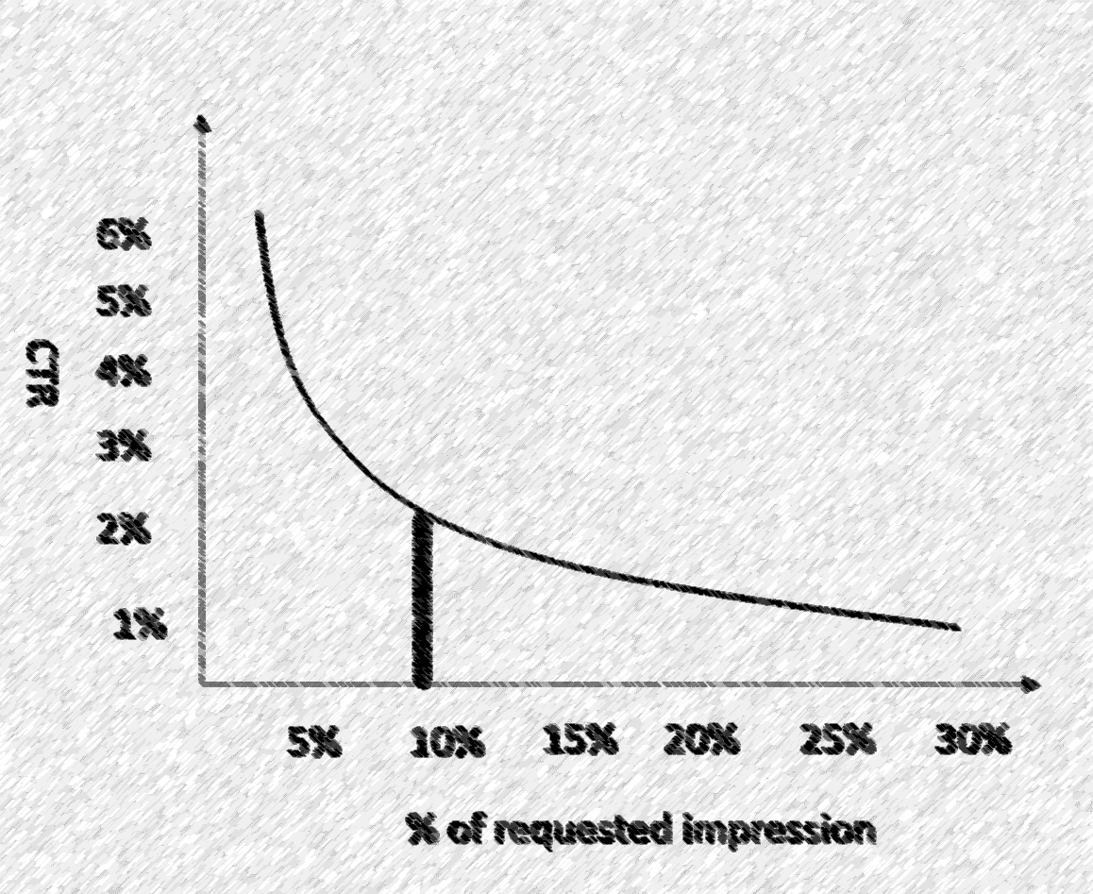
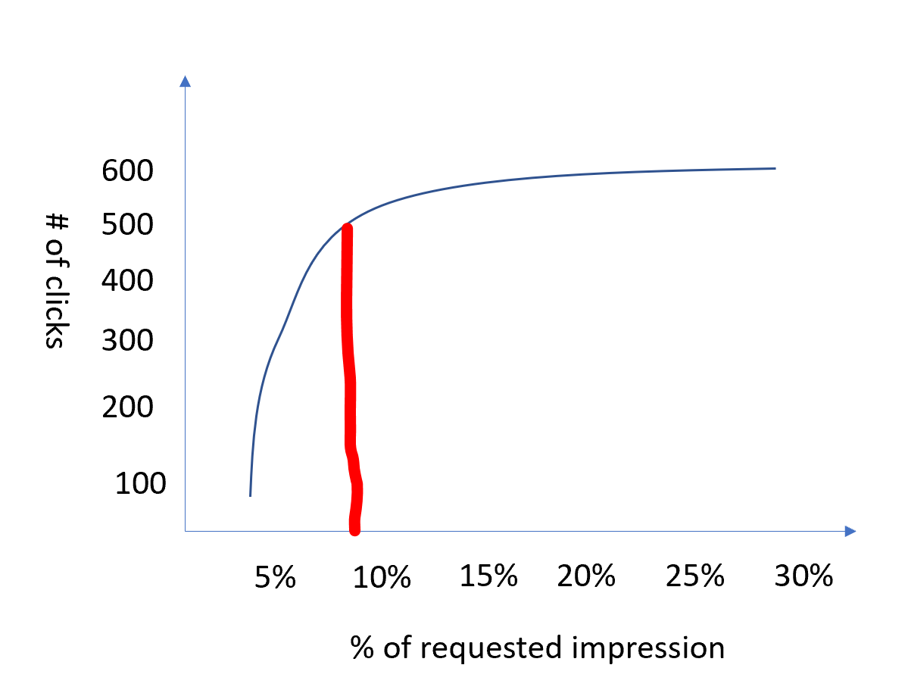
Performance Forecasting based on GDIN
Advertiser selects some high-level search query criteria such as
Geo regions
Gender
Age groups
Number of impressions or clicks or CTR threshold
PF recommends the best inventories in the system.
Advertiser books the returned inventories.

Slide 10
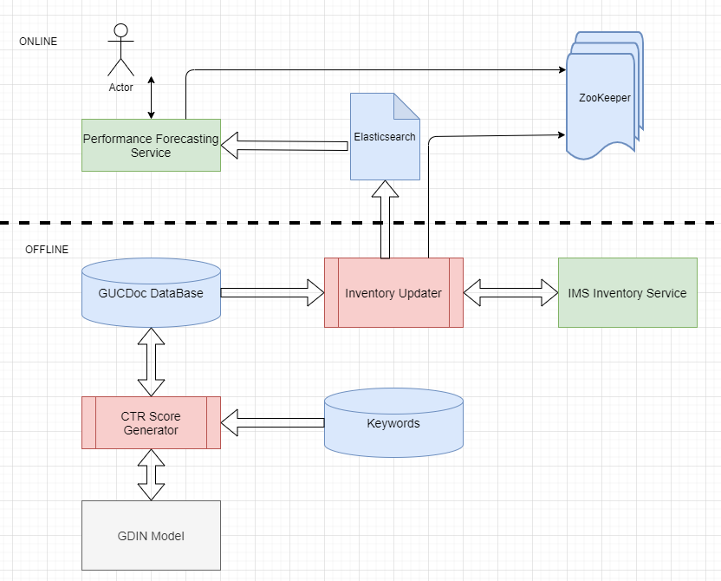
Performance Forecasting Architecture

Slide 11
Thank you

