Slide 1
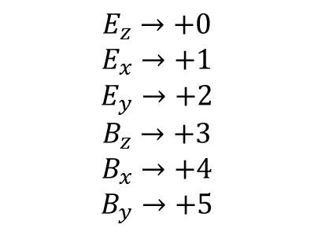








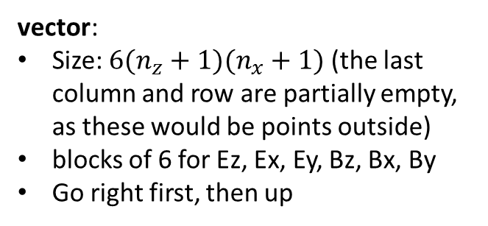
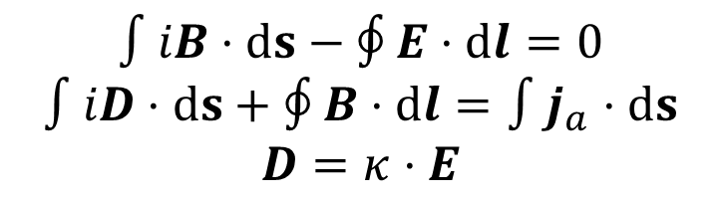
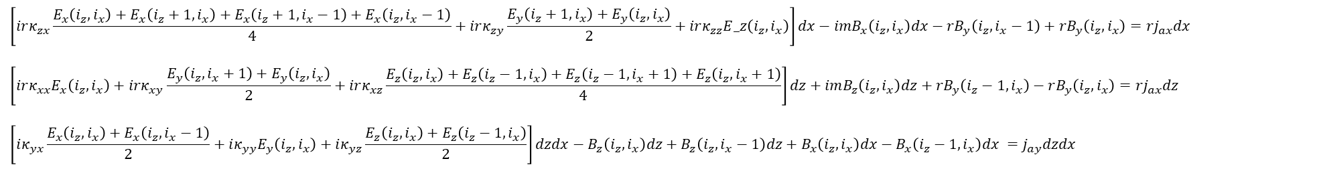
$$n_{x}$$
4
vector:
Size: $6(n_{z}+1)(n_{x}+1)$ (the last column and row are partially empty, as these would be points outside)
blocks of 6 for Ez, Ex, Ey, Bz, Bx, By
Go right first, then up
$$E_{z}→+0$$
$$E_{x}→+1$$
$$E_{y}→+2$$
$$B_{z}→+3$$
$$B_{x}→+4$$
$$B_{y}→+5$$
3
2
(second index)
$$x$$
$$E_{x},B_{z}$$
$$B_{y}$$
1
$$E_{y}$$
$$E_{z},B_{x}$$
$$∫iB⋅ds−∮E⋅dl=0$$
$$∫iD⋅ds+∮B⋅dl=∫j_{a}⋅ds$$
$$D=κ⋅E$$
0
1
2
3
4
0
$$z$$
$$n_{z}$$
(first index)
$$irB_{z}\left(i_{z},i_{x}\right)dx+imE_{x}\left(i_{z},i_{x}\right)dx−rE_{y}\left(i_{z},i_{x}+1\right)+rE_{y}\left(i_{z},i_{x}\right)=0$$
$$irB_{x}\left(i_{z},i_{x}\right)dz−imE_{z}\left(i_{z},i_{x}\right)dz+rE_{y}\left(i_{z}+1,i_{x}\right)−rE_{y}\left(i_{z},i_{x}\right)=0$$
$$iB_{y}\left(i_{z},i_{x}\right)dzdx−E_{z}\left(i_{z},i_{x}\right)dz−E_{x}\left(i_{z}+1,i_{x}\right)dx+E_{z}\left(i_{z},i_{x}+1\right)dz+E_{x}\left(i_{z},i_{x}\right)dx=0$$
$$\left[irκ_{zx}\frac{E_{x}\left(i_{z},i_{x}\right)+E_{x}\left(i_{z}+1,i_{x}\right)+E_{x}\left(i_{z}+1,i_{x}−1\right)+E_{x}\left(i_{z},i_{x}−1\right)}{4}+irκ_{zy}\frac{E_{y}\left(i_{z}+1,i_{x}\right)+E_{y}\left(i_{z},i_{x}\right)}{2}+irκ_{zz}E_z\left(i_{z},i_{x}\right)\right]dx−imB_{x}\left(i_{z},i_{x}\right)dx−rB_{y}\left(i_{z},i_{x}−1\right)+rB_{y}\left(i_{z},i_{x}\right)=rj_{ax}dx$$
$$\left[irκ_{xx}E_{x}\left(i_{z},i_{x}\right)+irκ_{xy}\frac{E_{y}\left(i_{z},i_{x}+1\right)+E_{y}\left(i_{z},i_{x}\right)}{2}+irκ_{xz}\frac{E_{z}\left(i_{z},i_{x}\right)+E_{z}\left(i_{z}−1,i_{x}\right)+E_{z}\left(i_{z}−1,i_{x}+1\right)+E_{z}\left(i_{z},i_{x}+1\right)}{4}\right]dz+imB_{z}\left(i_{z},i_{x}\right)dz+rB_{y}\left(i_{z}−1,i_{x}\right)−rB_{y}\left(i_{z},i_{x}\right)=rj_{ax}dz$$
$$\left[iκ_{yx}\frac{E_{x}\left(i_{z},i_{x}\right)+E_{x}\left(i_{z},i_{x}−1\right)}{2}+iκ_{yy}E_{y}\left(i_{z},i_{x}\right)+iκ_{yz}\frac{E_{z}\left(i_{z},i_{x}\right)+E_{z}\left(i_{z}−1,i_{x}\right)}{2}\right]dzdx−B_{z}\left(i_{z},i_{x}\right)dz+B_{z}\left(i_{z},i_{x}−1\right)dz+B_{x}\left(i_{z},i_{x}\right)dx−B_{x}\left(i_{z}−1,i_{x}\right)dx =j_{ay}dzdx$$

Slide 2
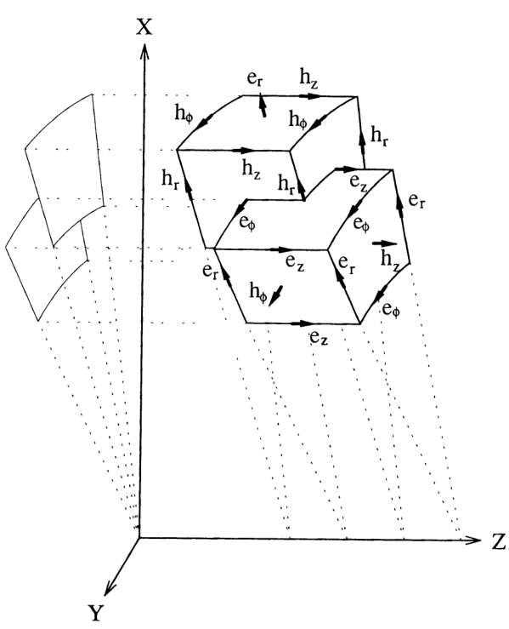
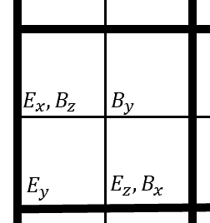
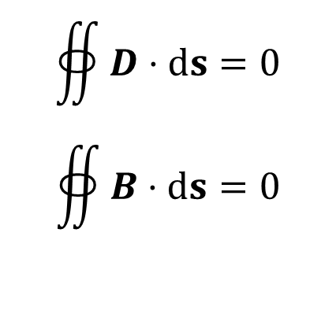

It is not the same positioning! (it is equivalent)
$$∯{D⋅ds}=0$$
$$∯{B⋅ds}=0$$
Additional divergence equations:
$$(i_{z}, i_{x})$$
${r^{ix} [D_{z}\left(i_{z}−1,i_{x}\right)−D}_{z}\left(i_{z},i_{x}\right)]dx+\left[{r^{ix−0.5}D}_{x}\left(i_{z}, i_{x}−1\right)−{r^{ix+0.5}D}_{x}\left(i_{z}, i_{x}\right)\right]dz−{imD}_{y}dxdz =0$
$r^{ix+0.5}[B_{z}\left(i_{z},i_{x}\right)−B_{z}\left(i_{z}+1,i_{x}\right)]dx+$ $\left[{r^{ix}B}_{x}\left(i_{z}, i_{x}\right)−{r^{ix+1}B}_{x}\left(i_{z}, i_{x}+1\right)\right]dz−{imB}_{y}dxdz=0$
$$D_{x}\left(i_{z},i_{x}\right)=κ_{xx}E_{x}\left(i_{z},i_{x}\right)+κ_{xy}\frac{E_{y}\left(i_{z},i_{x}+1\right)+E_{y}\left(i_{z},i_{x}\right)}{2}+κ_{xz}\frac{E_{z}\left(i_{z},i_{x}\right)+E_{z}\left(i_{z}−1,i_{x}\right)+E_{z}\left(i_{z}−1,i_{x}+1\right)+E_{z}\left(i_{z},i_{x}+1\right)}{4}$$
$$D_{z}\left(i_{z},i_{x}\right)= κ_{zx}\frac{E_{x}\left(i_{z},i_{x}\right)+E_{x}\left(i_{z}+1,i_{x}\right)+E_{x}\left(i_{z}+1,i_{x}−1\right)+E_{x}\left(i_{z},i_{x}−1\right)}{4}+κ_{zy}\frac{E_{y}\left(i_{z}+1,i_{x}\right)+E_{y}\left(i_{z},i_{x}\right)}{2}+κ_{zz}E_{z}\left(i_{z},i_{x}\right)$$

Slide 3
