Slide 1
https: Certificate Not Trusted
Stanislav Židek szidek@redhat.com
Quality Engineering - BaseOS Security

Slide 2
Motivation
Level? - beginner
Why? - problems with https
What? - understand what is happening
How? - get your hands dirty in CLI!

Slide 3
Theory
public key cryptography
  "hey, everybody, this is my public key!"
  vs. "let's meet in the docks to exchange private keys"
certificate
  "whose public key is that?"
  attested by certification authority (CA)
public key infrastructure
  "should I trust this key?"

Slide 4
Theory - continued
root CA
  intermediate CA (0-N)
    server certificate

Slide 5
Practice
trusted certificate authorities preinstalled
  system or browser
situation is complicated
let's get our hands dirty

Slide 6
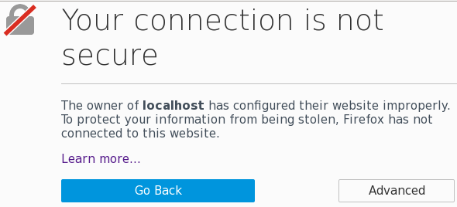
Situation - Bad Domain

Slide 7
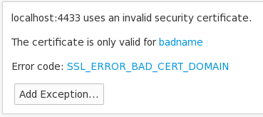
Situation - Bad Domain

Slide 8
Get Certificate
openssl s_client
-connect <host>:<port>
-showcerts
-servername <name>

Slide 9
Get Certificate
CONNECTED(00000003)
...
Certificate chain
0 s:/CN=badname
i:/CN=DevConf2017CA
-----BEGIN CERTIFICATE-----
MIIDMzCCAhugAwIBAgIBBjANBgkq
b25mMjAxN0NBMCIYDzIwMTcwMTI4
KcW/3vlbfdH/DrYGzR0SqWEiDa/l
Cmj3+oSBUulpdHF3K2CVvPEadihm
hrH47JuVyQ==
-----END CERTIFICATE-----
...

Slide 10
View Certificate
openssl x509
-noout -text
-in <filename> (or stdin)

Slide 11
View Certificate
Certificate:
Data:
...
Issuer: CN=DevConf2017CA
Validity
Not Before: Jan 28 12:29:18 2017 GMT
Not After : Jan 28 12:29:18 2018 GMT
Subject: CN=badname
...

Slide 12
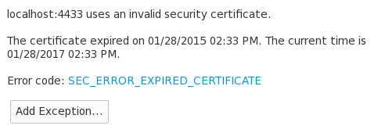
Situation - Expired

Slide 13
Get and View Certificate
Certificate:
Data:
...
Issuer: CN=DevConf2017CA
Validity
Not Before: Jan 28 13:33:26 2014 GMT
Not After : Jan 28 13:33:26 2015 GMT

Slide 14
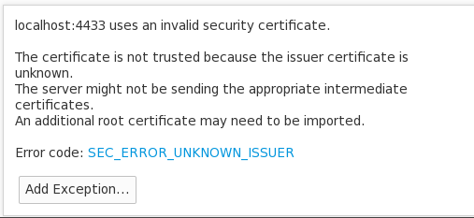
Situation - Unknown Issuer

Slide 15
Get Certificate
Certificate chain
0 s:/CN=localhost
i:/CN=localhost
-----BEGIN CERTIFICATE-----
MIIDJDCCAgygAwIBAgIBATANBgkqhki
bGhvc3QwIhgPMjAxNzAxMjAwOTI5MDd
3lAGP4leYcH3HEecJVNGTDMcVrtSOCp
4NMQM+eb1Cl6Vskeq2zf+eJug==
-----END CERTIFICATE-----
...
Verify return code: 21 (unable to verify the first certificate)

Slide 16
Get Certificate - alternative
Certificate chain
0 s:/CN=localhost
i:/CN=UnknownCA
-----BEGIN CERTIFICATE-----
-----END CERTIFICATE-----
1 s:/CN=UnknownCA
i:/CN=UnknownCA
-----BEGIN CERTIFICATE-----
-----END CERTIFICATE-----
Verify return code: 19 (self signed certificate in certificate chain)

Slide 17
Verify Certificate
openssl verify
-CAfile <rootca>
<cert>
cert.pem: OK

Slide 18
Verify Certificate - alternative
cert.pem: CN = localhost
error 20 at 0 depth lookup:
unable to get local issuer certificate

Slide 19
Get Certificate - alternative
Certificate chain
0 s:/CN=localhost
i:/CN=IntermediateCA
-----BEGIN CERTIFICATE-----
-----END CERTIFICATE-----
1 s:/CN=TrustedCA
i:/CN=TrustedCA
-----BEGIN CERTIFICATE-----
-----END CERTIFICATE-----

Slide 20
Verify Certificate Chain
openssl verify
-CAfile <rootca>
-untrusted <inter>
<cert>
cert.pem: OK

Slide 21
Conclusion
we covered some typical problems
reality is much more complicated
  very complex system (X.509)
  many other possible problems
    extensions
    certificate revocation
    ...
come talk to me if you are interested
  possible project on certificate verification

Slide 22






THANK YOU
plus.google.com/+RedHat
facebook.com/redhatinc
linkedin.com/company/red-hat
twitter.com/RedHatNews
youtube.com/user/RedHatVideos

