Slide 1

Intro to Serverless
DEBRECEN UI COMMUNITY PRESENTS
Attila Gyöngyösi

Slide 2


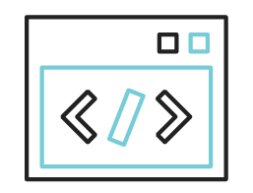
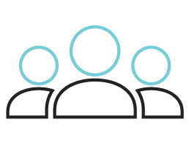
Agenda
The Problem
The Solution
The Code
The Questions

Slide 3
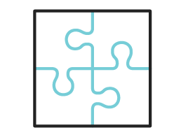

The Problem
Managing an application on a cloud infrastructure provider involves multiple moving parts & services
Containers
Databases
Domain names
Load balancing
Logging & monitoring
Permissions
What have you
Migration to another cloud platform is difficult
You have to move all your assets and services and set up everything in a different environment with different rules.

Slide 4
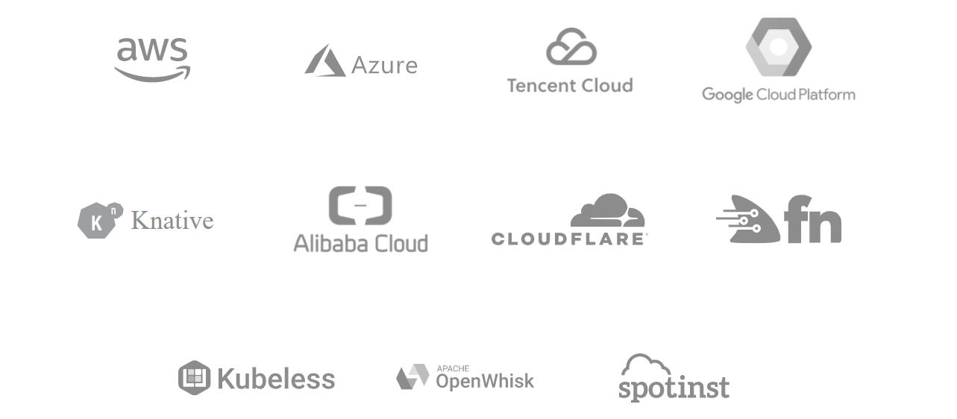
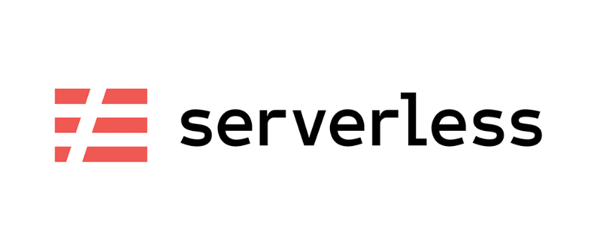
The Solution
The solution is the serverless framework
Provides application lifecycle management on cloud platforms
Supports developing, deploying, monitoring & troubleshooting complex apps
Supports Amazon Web Services, Microsoft Azure & Google Cloud Platform & couple more
Provides code scaffolding and out-of-the-box solutions with Components
Includes a hosted dashboard
https://www.serverless.com/

Slide 5
The code

Slide 6
Questions?!

Slide 7
Links
https://www.serverless.com/
Tutorials: https://www.serverless.com/blog/category/guides-and-tutorials/
Serverless Components: https://www.serverless.com/blog/what-are-serverless-components-how-use
Code & Slides: https://github.com/epam-debrecen-ui-community/tech-corner-1-serverless-intro
https://www.npmjs.com/package/serverless-http
https://github.com/dherault/serverless-offline
Debrecen UI Community on Community-Z: https://community-z.com/communities/epam-debrecen-ui-community

