Slide 1

The semantic-release Toolset
DEBRECEN UI COMMUNITY PRESENTS
Attila Gyöngyösi

Slide 2


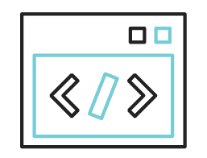

Agenda
The Problem
The Solution
The Code
The Questions

Slide 3
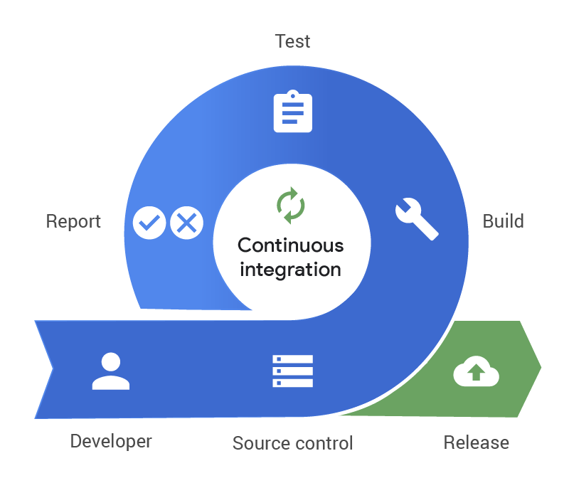
The Problem
How do you enforce semantic versioning for a software library or customer application?
How do you automate version bump semantically?
How do you generate automatic changelogs to publish with your library release?
How do you educate your development team to do commits right?

Slide 4
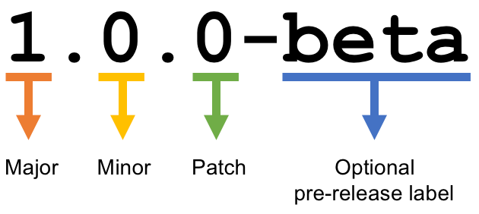
The Problem
Building blocks of a semantic version number
MAJOR breaking changes to the public API
MINOR backwards-compatible changes, new features
PATCH bugfixes, minor housekeeping

Slide 5

The Solution
The solution is
Fully automated version management and package publishing toolset
Makes your team adhere to the Semantic Versioning Specification - https://semver.org/
Which also means formalized commit messages - https://www.conventionalcommits.org/en/v1.0.0/
Ready to be integrated into your choice of CI/CD pipeline
Extensible with plugins
https://semantic-release.gitbook.io/semantic-release/

Slide 6
The code

Slide 7
Questions?!

Slide 8
Links
https://semantic-release.gitbook.io/semantic-release/
Tutorials: https://semantic-release.gitbook.io/semantic-release/support/resources
Frequently Asked Questions: https://semantic-release.gitbook.io/semantic-release/support/faq
Code & Slides: https://github.com/epam-debrecen-ui-community/tech-corner-3-semrel
Debrecen UI Community on Community-Z: https://community-z.com/communities/epam-debrecen-ui-community

