Slide 1
Spring MVC
Norbert Guta
CONFIDENTIAL | © 2020 EPAM Systems, Inc.

Slide 2

Norbert Guta
Software Engineer at EPAM
Current Project Role: Developer
Primary Skill: Java Backend Development
Mostly working with Spring-based (micro)services and CLI components
REST and SOAP API-s
Working with Semantic Web (RDF, SKOS) and XML related technologies
Contact
norbert_guta@epam.com

Slide 3

Agenda
1
Standalone Server vs. Embedded Servlets
2
MVC Architectural Pattern
3
Spring MVC

Slide 4
Standalone Server vs. embedded servlets

Slide 5

Standalone Server vs. Embedded Servlets - Client-Server Architecture

Slide 6
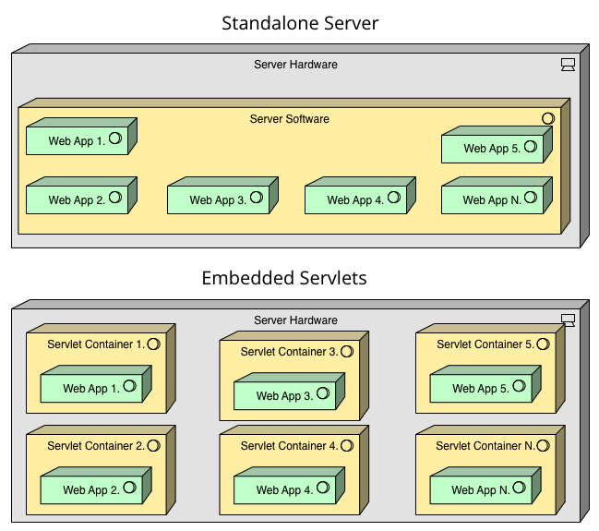
Standalone Server vs. Embedded Servlets
Isolation
Easy to setup, configure
Direct Access
Scalable

Slide 7
MVC Architectural Pattern

Slide 8
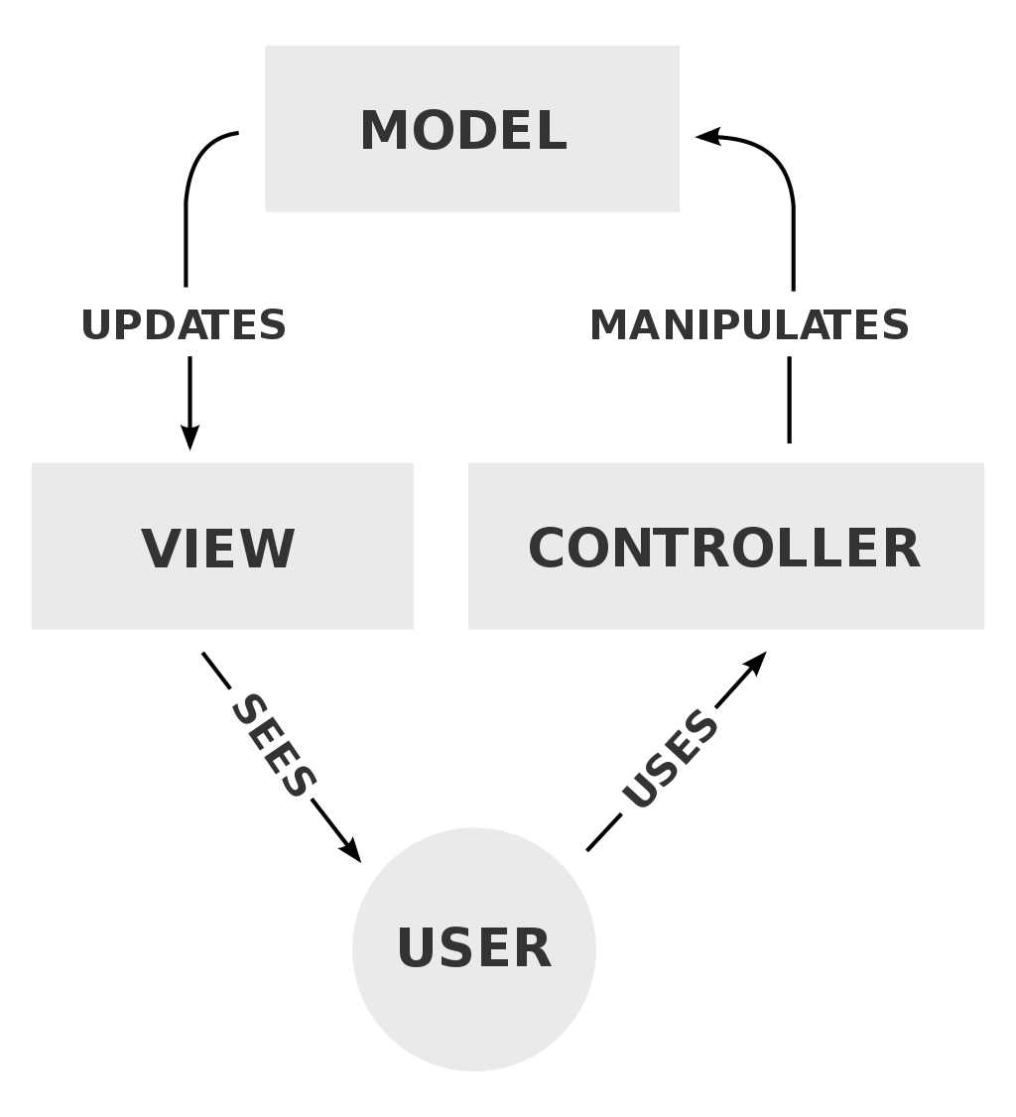
MVC Architectural Pattern
Model
View
Controller

Slide 9
Spring MVC

Slide 10
Spring MVC - What is Spring MVC?
An MVC framework that supports development of MVC pattern based web applications.
Request driven
Makes it possible to implement cleaner frontend code.
Fully integrated with the Spring IoC container.
Allows using all features that Spring provides.

Slide 11
Spring MVC - What is Spring MVC?
Pluggable
Can be integrated with other MVC implementations (e.g. JSF, Struts)
Supports multiple layout engines (e.g. Tiles, SiteMesh)
Supports multiple templating engines (e.g. Thymeleaf, Freemaker, Velocity)
Designed around the Java Servlet technology
Implements the FrontController pattern using the DispatcherServlet.

Slide 12
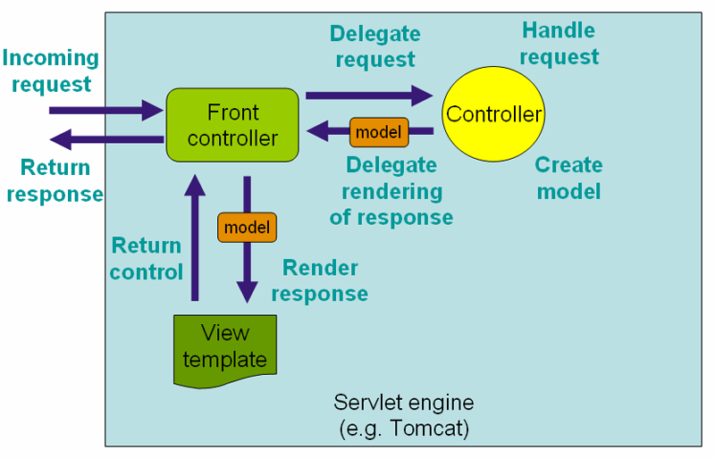
Spring MVC – Request handling Flow

Slide 13
Spring MVC - What does a controller do?
It will accept incoming web requests, so it gives an entry point to the application.
Interprets user input.
Based on the input, returns data for the view.

Slide 14
Spring MVC - How to implement a controller?
Mark a class with the @Controller annotation.
Implement handler methods in the controller.
@Controller public class OwnerController { @RequestMapping(value = "/owners/new", method = RequestMethod.GET) public String initCreationForm(Map<String, Object> model) { Owner owner = new Owner(); model.put("owner", owner); return "ownerView"; }
}

Slide 15
Spring MVC - Defining handler methods
Mark a method in the Controller with @RequestMapping annotation.
The return value specifies the view to be rendered and can contain data for the view as well.
Data can be added to the view in multiple ways:
You can use the ModelAndView object or the @ModelAttribute annotation.

Slide 16
Spring MVC - Narrowing request mapping
Why do we need narrowing?
Usually, request mappings need to be narrowed down, otherwise they would be too generic.
Too generic mappings might match multiple requests that need to be handled differently.
Spring provides several criteria that can be used for narrowing.

Slide 17
Spring MVC - Narrowing request mapping
Narrowing based on media types
Request mappings can take consumable media types as parameter.
Request will be matched if the Content-Type request header matches the specified media type.
Request mapping can take producible media types as parameter.
Request will be matched if the Accept request header matches the specified media type.
@RequestMapping(value = "/test", consumes = MediaType.APPLICATION_JSON_VALUE)
@RequestMapping(value = "/test", produces = {MediaType.APPLICATION_JSON_VALUE, MediaType.APPLICATION_JSON_UTF8_VALUE})

Slide 18
Spring MVC - Narrowing request mapping
Narrowing based on request parameters
You can match if a request parameter
can be found,
cannot be found,
has a specific value.
@RequestMapping(params = {"rows", "page", "sort"})
@RequestMapping(params = {"!rows", "!page"})
@RequestMapping(params = "somename=somevalue")

Slide 19
Spring MVC - Narrowing request mapping
Narrowing based on request method
You can narrow down the list of handled requests by request method.
For example you can create a RequestMapping, that only matches GET requests.
@RequestMapping(value = "/owners/find", method = RequestMethod.GET)

Slide 20
Spring MVC - Narrowing request mapping
Narrowing based on header values
Similar to request parameter based narrowing, the only difference is, that this is for headers.
@RequestMapping(value="/fetch", headers={"content-type=text/plain", "id=100"})

Slide 21
Spring MVC - Handler method parameters
Handler methods can have very flexible signature.
Different method arguments are supported.
Method arguments can be used in arbitrary order.
Spring automatically populates supported method parameters.

Slide 22
Spring MVC - Servlet API Request / Response / Session objects
The Servlet API’s Request / Response / Session objects are automatically populated.
@RequestMapping(value = "/owners", method = RequestMethod.GET) public String processCreationForm(HttpServletRequest httpServletRequest, HttpServletResponse httpServletResponse, HttpSession httpSession) {

Slide 23
Spring MVC - Request parameters
Parameters from the request can be populated automatically.
The request parameter’s name is either specified or the method parameter’s name is used.
Parameters can be marked as required.
public String show(@RequestParam(value = "filter", required = false) String filter, @RequestParam(value = "order") String order, @RequestParam(value = "maxResults") int maxResults) {

Slide 24
Spring MVC - The Model
A model object can also be passed in as a method argument.
You can use one of the following:
org.springframework.ui.Model
org.springframework.web.servlet.ModelAndView
On ModelAndView you can also set view related properties.
@RequestMapping(value = "/show", method = RequestMethod.GET) public String show(ModelAndView modelAndView) {

Slide 25
Spring MVC - Handler method return types
Handler methods can have very flexible signature.
Different return types are supported.
View name can be resolved in various ways based on the return types.

Slide 26
Spring MVC - String return type
The string return type is interpreted as the logical view name.
A view name resolver can be used to create the actual path to the view.
@RequestMapping(value = "/owners/new", method = RequestMethod.POST) public String processCreationForm(@Valid Owner owner, BindingResult result) { if (result.hasErrors()) { return "owners/createOrUpdateOwnerForm"; } else { this.clinicService.saveOwner(owner); return "redirect:/owners/" + owner.getId(); } }

Slide 27
Spring MVC - Model return type
Model can contain data for the view.
In case of a Model return type, a view name cannot be specified in the returned object.
A RequestToViewNameTranslator is used to resolve the view name from the request.
@RequestMapping(value="/customers") public Model show(Model model) { model.addAttribute("customers", getCustomers()); return model; }

Slide 28
Spring MVC - ModelAndView return type
ModelAndView can contain data for the view and also the name of the view.
A view name resolver can be used to create the actual path to the view.
@RequestMapping(value="/customers") public ModelAndView show(ModelAndView modelAndView) { modelAndView.setViewName("customerList"); modelAndView.addObject("customers", getCustomers()); return modelAndView; }

Slide 29
Spring MVC - The redirect prefix
If the redirect prefix is used, the request will be redirected to the given path.
A RedirectView instance can be used in case of ModelAndView.
public ModelAndView show(ModelAndView modelAndView) { modelAndView.setViewName("redirect:customerList"); return modelAndView; }
modelAndView.setView(new RedirectView("customerList"));

Slide 30
Spring MVC - The forward prefix
If the forward prefix is used, the request will be forwarded to the given path.
@RequestMapping(value="/customers") public ModelAndView show(ModelAndView modelAndView) { modelAndView.setViewName("forward:customerList"); return modelAndView; }

Slide 31
Spring MVC - Additional return types
Return any object in combination with the @ResponseBody annotation.
HttpMessageConverters will convert the returned object (e.g. to JSON).
@ResponseStatus annotation can be used to set the response code.
Return a ResponseEntity
Represents the complete HTTP response, anything can be controlled.

Slide 32
Spring MVC - More on returning JSON
To enable returning JSON from Spring controllers:
Specify <mvc:annotation-driven> (or @EnableWebMVC) in the config.
Add jackson-databind dependency.
Add @ResponseBody annotation to the controller method.
Use the .json URL suffix or specify in @RequestMapping that the method should produce JSON.
@RequestMapping(value = "/vets.json")
@RequestMapping(value = "/vets.jso", produces = MediaType.APPLICATION_JSON_VALUE)

Slide 33
demo

